Slide 1
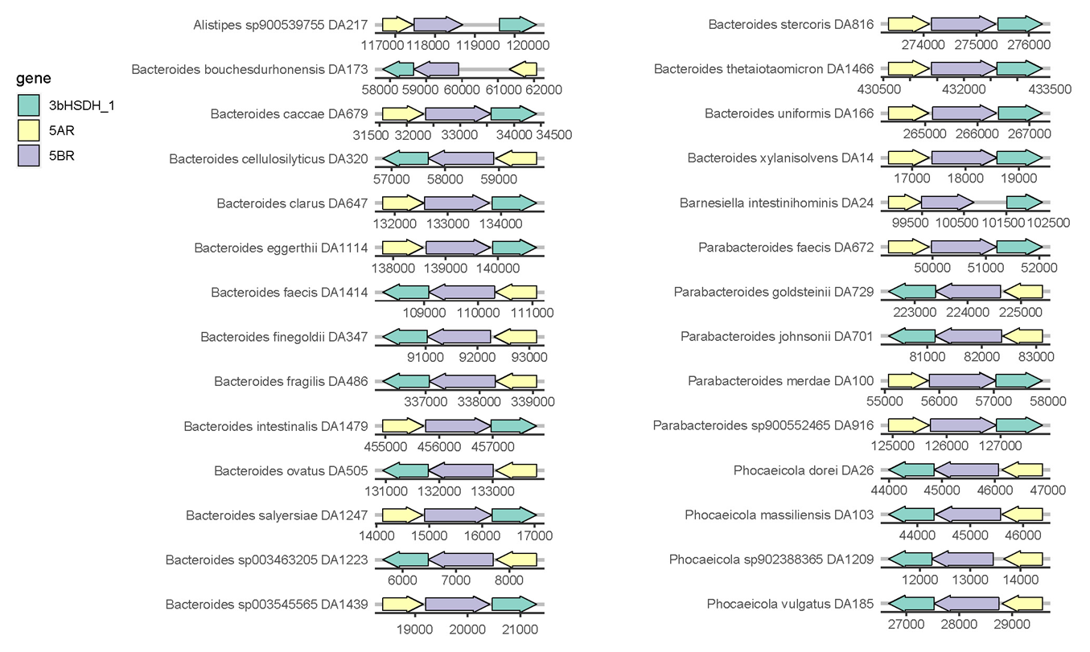
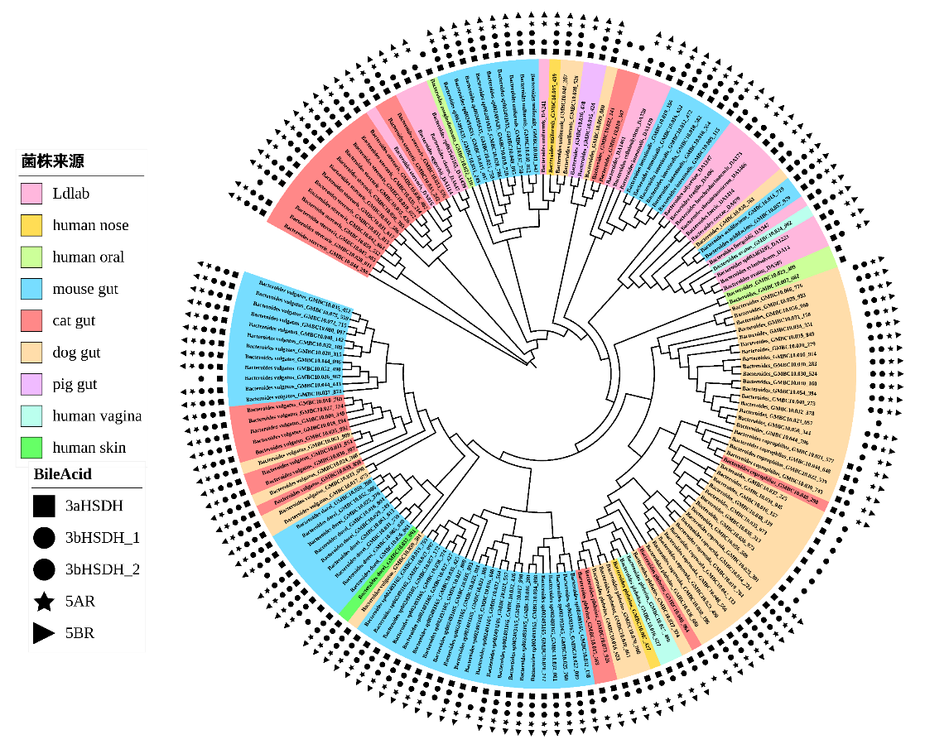
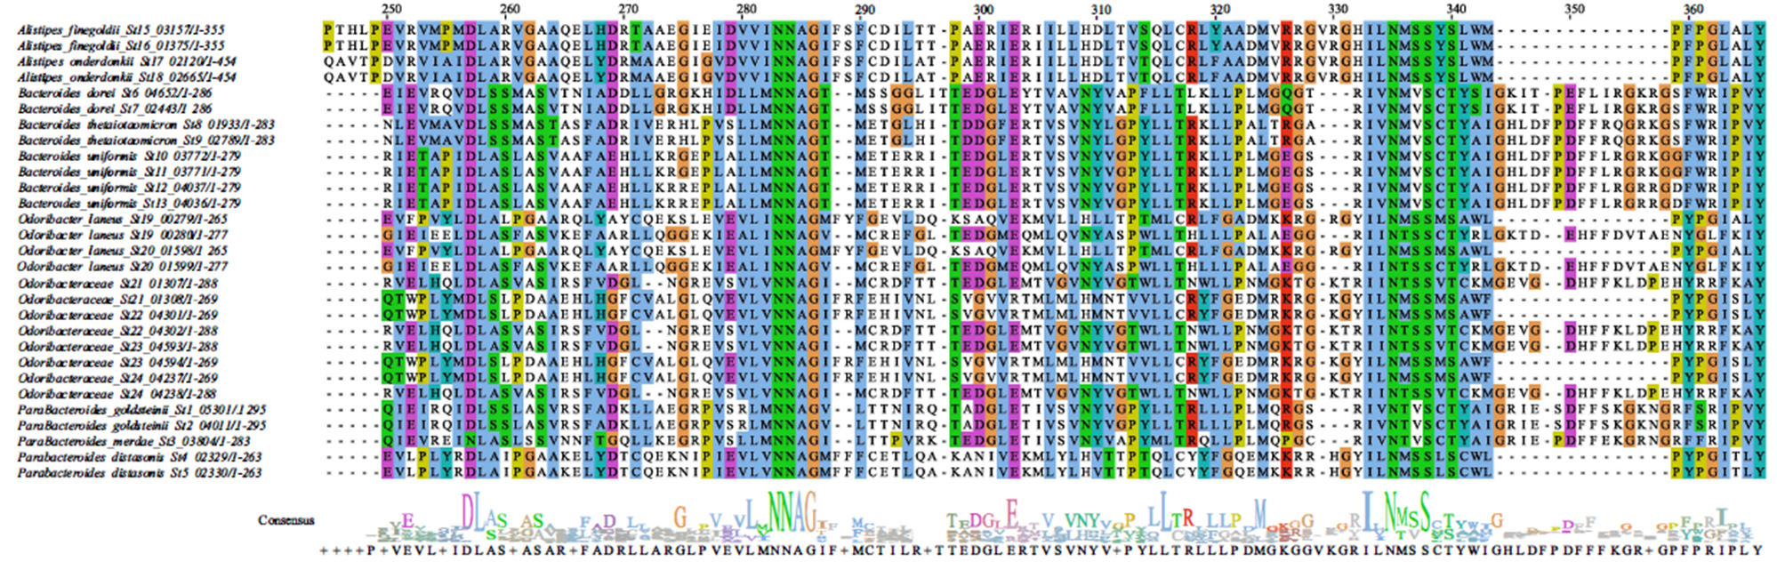
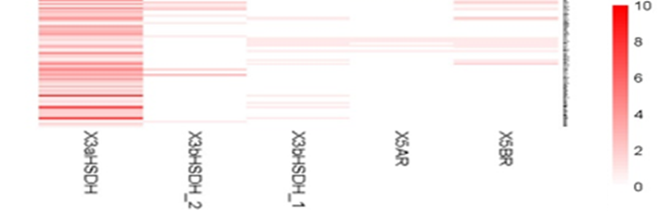
Targeted functional gene sets
Targeted functional gene sets – BileAcid, SCFA, bacteriophage lysin……
diamond blasp, Phylophlan, iTol, gggene, Jalview, pheatmap
Gene cluster
Tree with functional genes
multiple sequence
alignment
Gene abundance
Notes:
CVtree: oligopeptide content, i.e., frequency of amino acid Kstrings in their complete proteomes；Whole Proteome Prokaryote Phylogeny Without Sequence Alignment: A K-String Composition Approach | SpringerLink
diamond blasp(蛋白同源比对), Phylophlan（基因组进化树）, iTol（进化树美化）, gggene（基因簇可视化）, Jalview（多序列比对及可视化）, pheatmap（热图）

