Slide 1
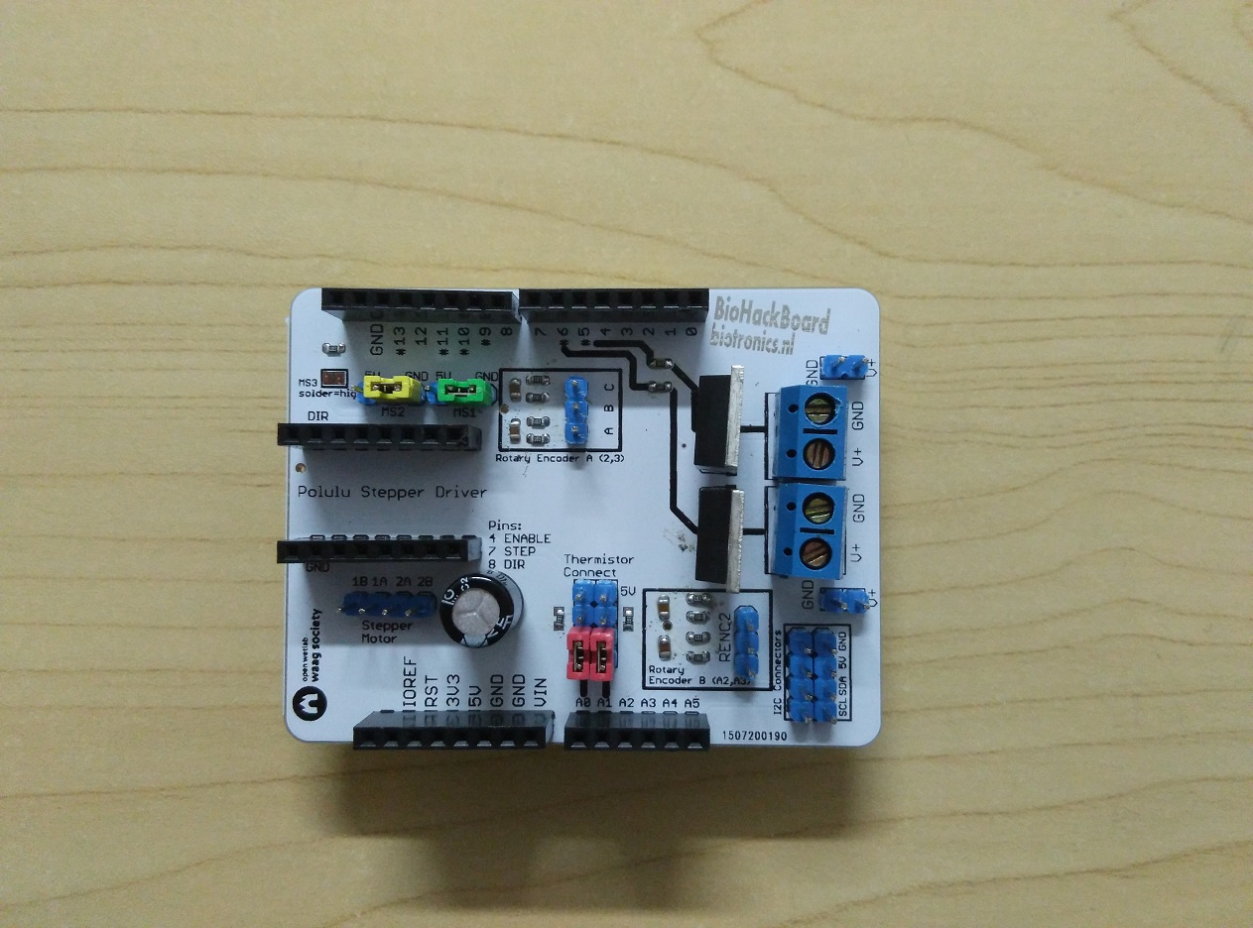
MS1, MS2 and MS3 control the resolution
of the stepper motor driver
Connect a rotary encoder
(Terminal A, GND, Terminal B)
MOSFET switch (pin 5)
100V 8A
Arduino pins for controlling the stepper driver
MOSFET switch (pin 6)
100V 8A
Two rows of I2C connections.
Usable for I2C LCD panel
2 thermistor connections with
voltage divider using a 10k ohm resistor.
Remove the jumpers to use the pins for something else
Stepper motor connection

