Slide 1
Retrieval 2/2
BDK10-6 | Information Retrieval
William Hersh, MD | Department of Medical Informatics & Clinical Epidemiology
Oregon Health & Science University

Slide 2
Natural language retrieval
User enters natural language words without Boolean operators
Output usually ranked based on number of words common to query and content items (non-Web) or number of links to items (Web)
This is implicitly an OR, although some systems (e.g., Web search engines) apply an AND
Usually used in conjunction with weighted indexing
(Salton, 1991)

Slide 3
Natural language retrieval approach
User enters free-text query
If indexing applied stop list or stemming, must be applied to query words as well
Content items scored based on weight of words common to query and content item
Sums TF*IDF weights for all words that occur in both query and content item
Content items may be “normalized” to account for length
List sorted and presented to user

Slide 4
This approach allows other features
Relevance feedback
Allows system to “find me more documents like these ones”
After user designates relevant content items (documents), query modified
New words from relevant content items added
Query words not in relevant content items downweighted
Used in PubMed Related Articles feature
Query expansion
Relevance feedback without designation of relevant content items, i.e., top-ranking content items assumed to be relevant

Slide 5
Web searching
The visible Web
The invisible or deep Web
Searching on the Web, e.g., bibliographic databases, textbooks, etc.
Searching the Web, e.g., Google,
Yahoo, Health Finder, etc.

Slide 6
Searching the Web
Web search engines tend to use natural language search, although most allow some Boolean operators, usually
+ before word indicates word must occur (AND), e.g., +congestive
- before word indicates word must not occur (NOT), e.g., -congestive
Most Web search engines use implicit AND between search terms

Slide 7
Web searching – dominated by the “big three”
Search Engine | Searches per month | Share
Google | 10.4B | 63.6%
Microsoft Bing | 3.7B | 22.8%
Yahoo! | 1.9B | 11.6%
Ask | 0.2B | 1.3%
AOL | 0.1B | 0.8%
Data from comScore (March, 2015)
Only change over last few years is Microsoft steady growth over Yahoo! as second-highest search engine

Slide 8
Google has other features
Ad words – matching search terms to advertising but clearly demarcating from regular search results
Image – images on pages retrieved by query
Scholar – searching of scientific papers (on Web)
Maps and satellite photos
News – latest news
(Beel, 2010)

Slide 9
Why does Google work so well?
Page Rank algorithm ranks pages based on number of links to them
Even though it has had to be “schooled” over the years
Default AND between search terms also helps due to large size of Web
This approach works well for Web pages but not necessarily for other types of content
Google has many other nifty features, including API for programmers
(Brin, 1998), (Lohr, 2011), (Dornfest, 2006)

Slide 10
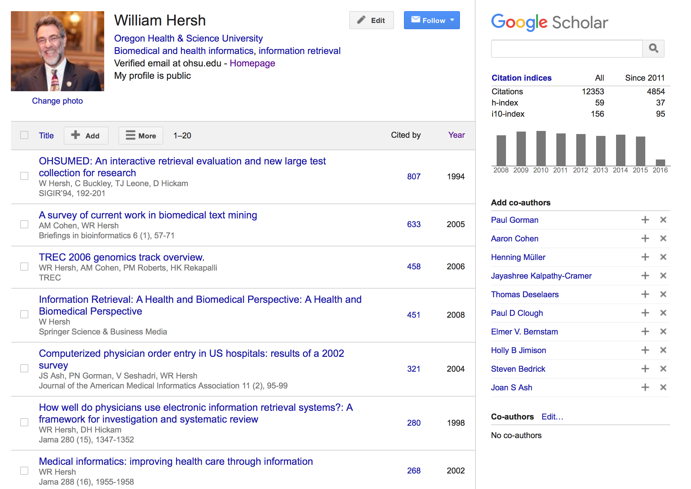
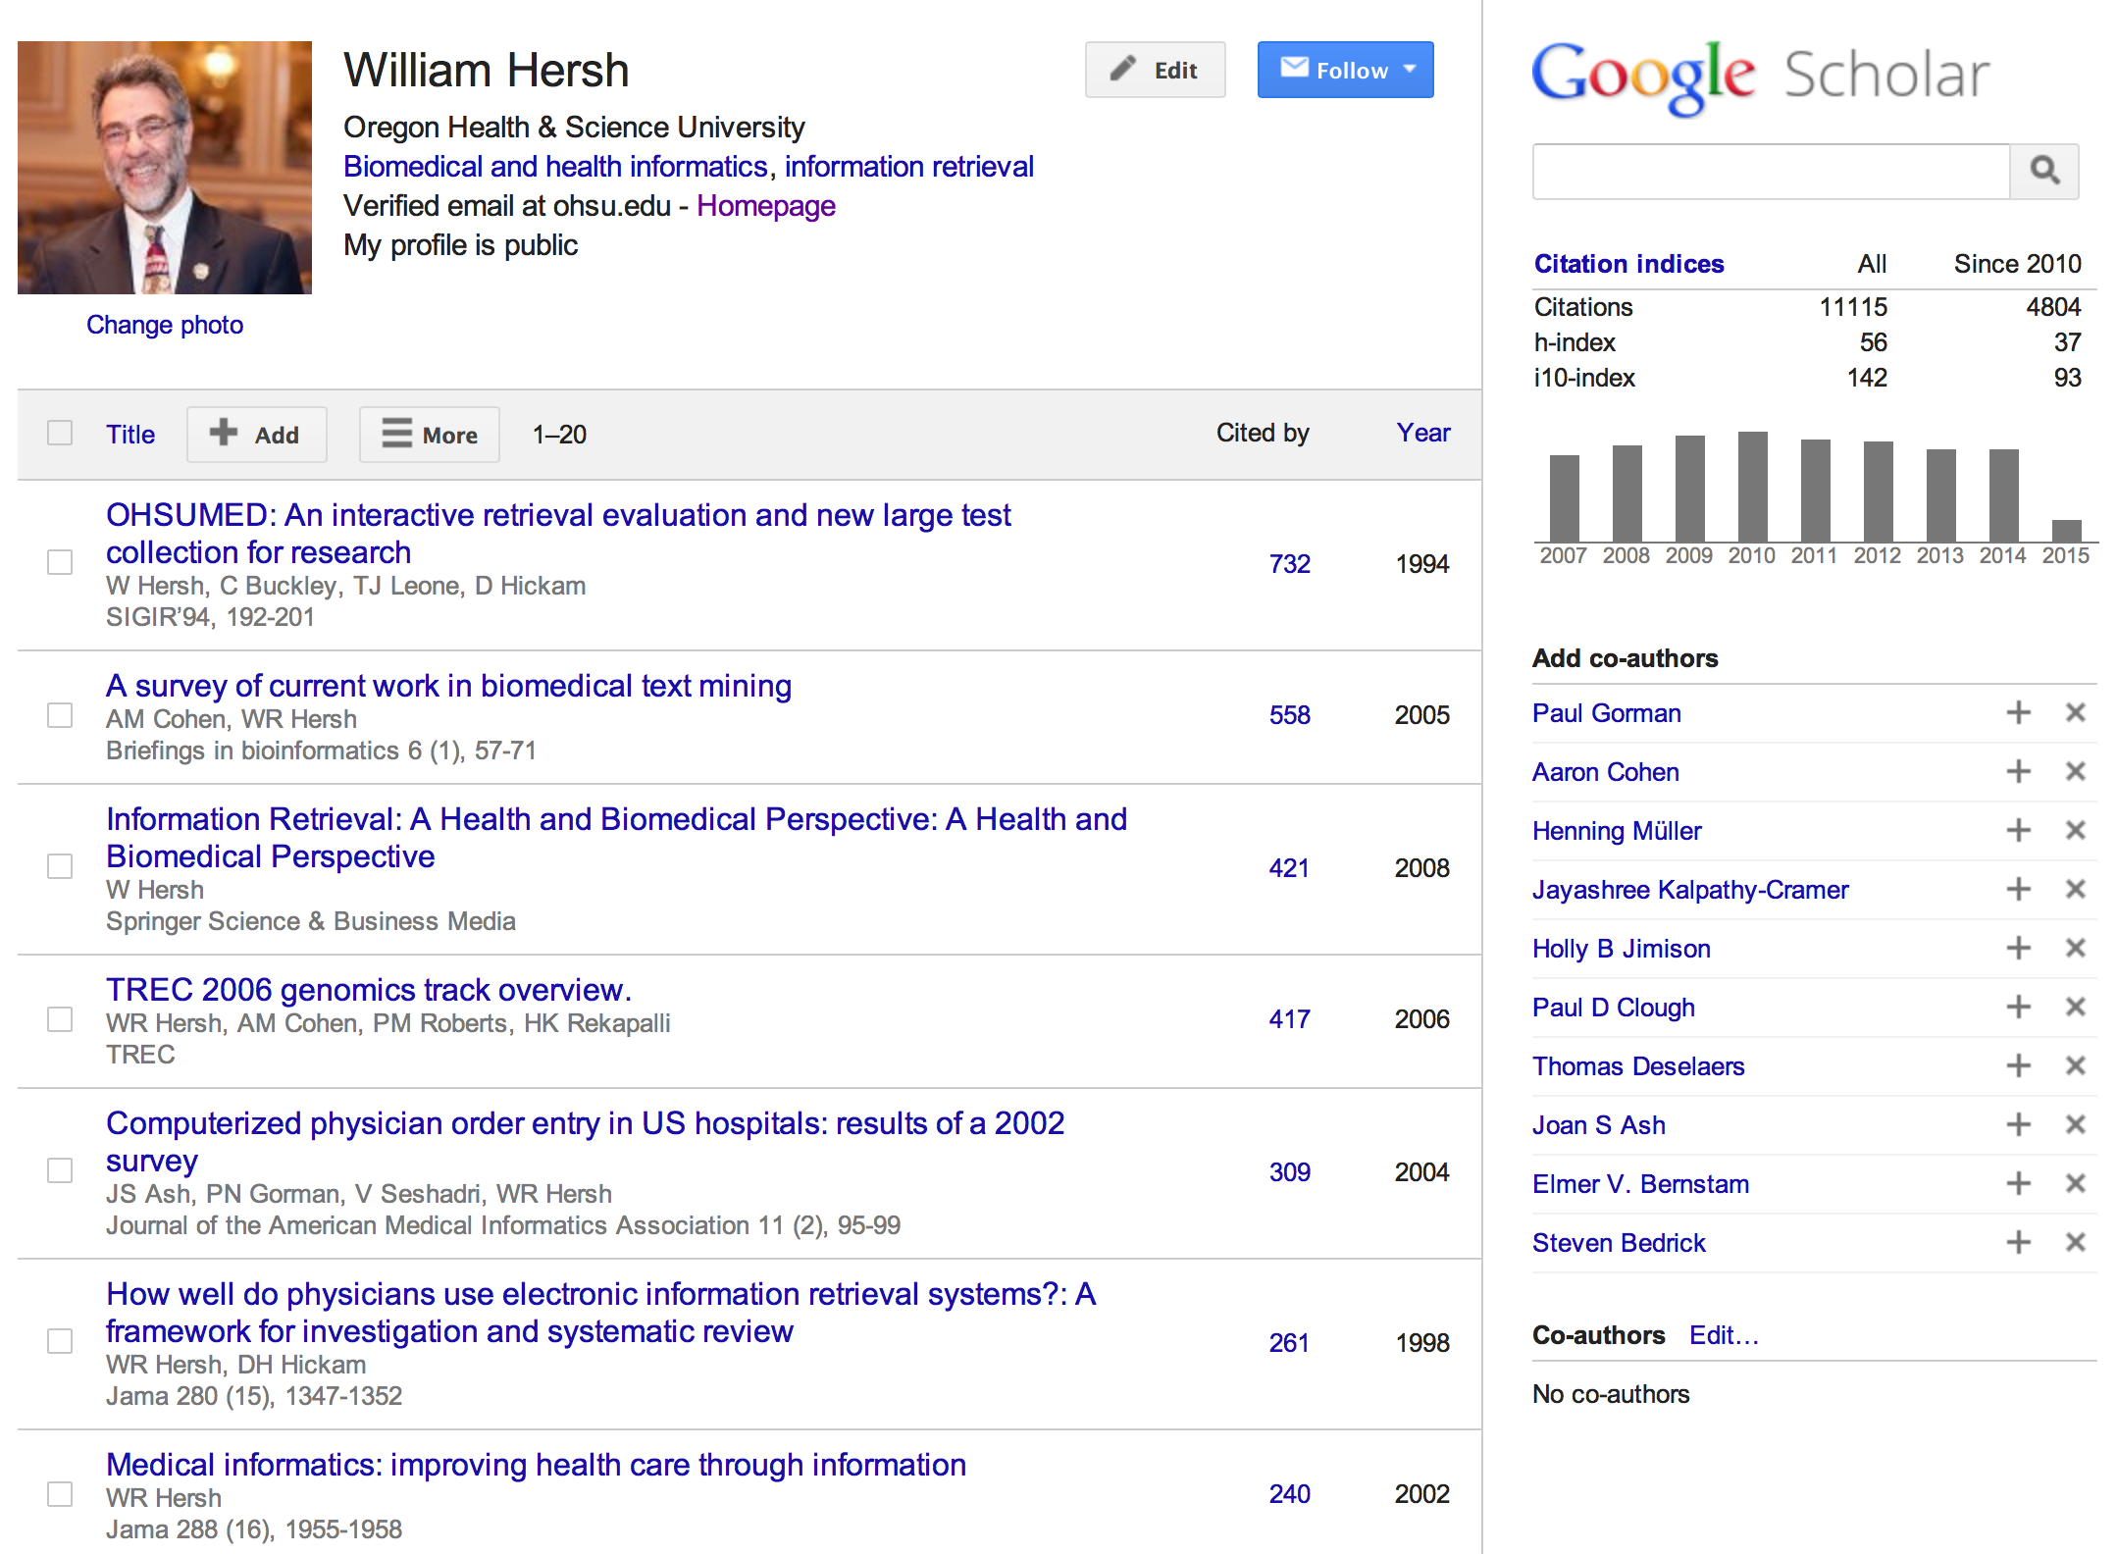
Another feature of Google Scholar allows researchers to create profiles

Slide 11
Retrieval on smartphones and other mobile devices
Very popular in clinical settings, with many applications, both proprietary and free, e.g.,
NLM Pubmed4Hh
NLM BabelMeSH
Publishers such as Unbound Medicine
Portability and instant-on features appealing
iOS and Android also allow voice searching
But small form factor may not be amenable to more complex searching and viewing of large documents, images, etc.

Slide 12
Infobuttons: direct linkage of patient-based information to knowledge
Contexts in EHR or PHR (e.g., specific diagnoses, test results, etc.) lead to generic queries that can be passed to on-line resources
The wide variety of content accessible from the Web facilitates this linkage
Leading researcher in this area has been Cimino (1996), who has developed Infobutton Manager to manage context and communications between applications
Now an HL7 standard and a requirement for EHR certification in Stage 2 rules for meaningful use
(Cimino, 2006), (Del Fiol, 2012)

Slide 13
Retrieval of other “objects”
Image retrieval
As with indexing, can use semantic or visual queries
Semantic (textual) queries usually used to find images of structures, processes, diseases, etc.; e.g.,
Goldminer
Yottalook
Open-I
Visual queries usually used for finding similar images, e.g., “find me more like this”
Annotated content
Searching over metadata fields, e.g.,
learning objects
Data sets
(Müller, 2010; Kalpathy-Cramer, 2015), (Grauman, 2010), (Hersh, 2006)

Slide 14
Thank you
Please download the resource list with useful links from the “Resources” tab in the upper right of the player.
This course was made possible under a grant from the NIH (# 1R25GM114820-01)

