Slide 1
Proof of concept:
Natural language filtering of U.S. VAERS data
Mike Rightmire
Candidate
Lab Informatics Data Scientist Agilent, Waldbronn

Slide 2
Introduction
The U.S. VAERS (Vaccine Adverse Event Reporting System) was established in 1990, under the management of the U.S. Centers for Disease Control and Prevention (CDC) and the U.S. Food and Drug Administration (FDA) to collect and analyze vaccine adverse event data with the hopes of identifying unpredicted and unforeseen side effects once the vaccines are available to the community.
Currently there are more than 397,000 VAERS reports for 2021, with 31,000+ of these classified as serious adverse events in need of investigation. With limited resources, triaging for investigation becomes a challenging task for both government and private researchers.
This project is a proof-of-concept intended to allow for the discovery and filtering of individual adverse event reports based on specified criteria.
https://vaers.hhs.gov/about.html

Slide 3
Table of Content (ToC)
Introduction
Overview
The data
Challenges
Solutions
Success criteria
The Pipeline
Methods
How many deaths reported involved confirmed Sars-CoV-2 infections?
Feature examples
Training and testing
Iterations and properties
Remedial training
Results: Hits versus false positives
Conclusions
Summary
References

Slide 4
Overview The data
Both mandatory and voluntary reports of adverse events (AEs) may be submitted by anyone.
Consumers can freely report an adverse event to VAERS.
Healthcare professionals are required to report certain adverse events.
Vaccine manufacturers are required to report all adverse events that come to their attention.
Much of the critical VAERS data is reported in free-form text fields.
Only serious AEs are validated or investigated.
VAERS data is available to the public via their website, https://vaers.hhs.gov/data.html
https://vaers.hhs.gov/about.html
ToC
Notes:
VAERS data is an open database, available for anyone to submit data, and anyone to investigate the data.
Consumers are invited to submit data voluntarily, whereas medical professionals and vaccine manufacturers are required to report certain AEs. Serious AEs are defined as (https://vaers.hhs.gov/faq.html)...
Death;
A life-threatening AE;
Inpatient hospitalization or prolongation of existing hospitalization;
A persistent or significant incapacity or substantial disruption of the ability to conduct normal life functions;
A congenital anomaly/birth defect;
An important medical event that based on appropriate medical judgement may jeopardize the individual and may require medical or surgical intervention to prevent one of the outcomes listed above.
- Of particular concern regarding this project is the fact that doctors must report any death occurring within a specific timeframe from a vaccination. 60 days is generally required by most facilities.

Slide 5
Overview Challenges
Much of the critical VAERS data exists only as unconstrained text fields.
This text includes reports from both medical professionals, and laypeople – making syntax and vernacular unpredictable.
The quality of the descriptions vary greatly, ranging from a single word to long, detailed patient histories.
Average word count: 77
Minimum word count: 1
Maximum word count: 2996
Misspellings, entry errors, idioms, and grammatical issues are commonplace.
ToC
Notes:
The challenge in this project is that the data of import are free-form test fields. Language, syntax, and common idioms are found frequently, as are misspellings, incorrect punctuation, and grammatical errors.

Slide 6
Overview Solutions
A supervised Natural Language Processing (NLP) pipeline using Python NLTK, and SKLearn.
TF-IDF logistic regression.
Adjustable parameters for iteration, percent cutoff, and majority selection.
Success criteria
Manual annotation of the data for training is <10% of data set.
Fewer than 5% false positives.
https://vaers.hhs.gov/about.html
ToC
Notes:
To overcome this, Python natural language processing is used with supervised training on the dataset itself. Term frequency-inverse document frequency (TF-IDF) logistic regression was selected over Word2vec logistic regression or Naive Bayes (tf-idf) by trial and error earlier in the project, as it produced better results.
With TF-IDF the value of a word increases proportionally to count in the document, but inversely proportional to the frequency of the word in the corpus.

Slide 7
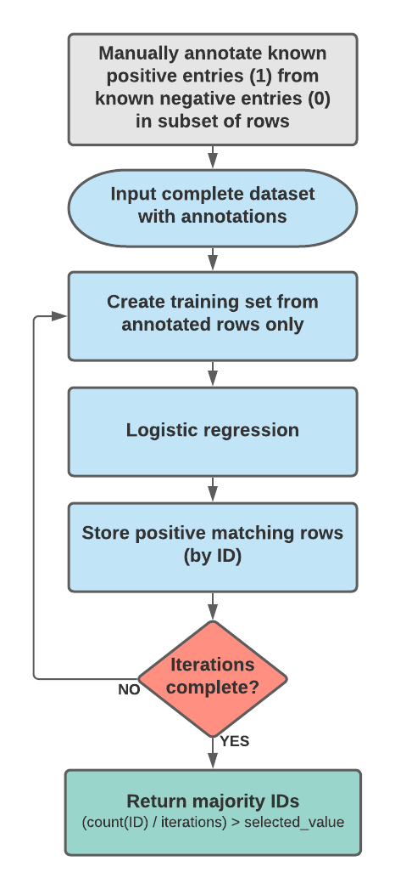
Pipeline General flow
Annotate the training set.
Train based on the annotated rows.
Logistic regression on the complete dataset.
Capture the output of each training/test session.
Reiterate.
Run an election on all stored results, capturing only those which pass majority (default: 50%.)
ToC
Notes:
- Training data was added to the target columns (SYMPTOM_TEXT_TARGET or LAB_DATA_TARGET) manually, using Excel. A „1“ (positive) or „0“ (negative) was assigned exclusively based on the data of the commensurate column, even if the other column clarified the Covid state.

Slide 8
Pipeline General flow
Annotate the training set.
Train based on the annotated rows.
Logistic regression on the complete dataset.
Capture the output of each training/test session.
Reiterate.
Run an election on all stored results, capturing only those which pass majority (default: 50%.)
ToC
Notes:
- The CSV file was loaded via Pandas, and passed into the training and testing functions.

Slide 9
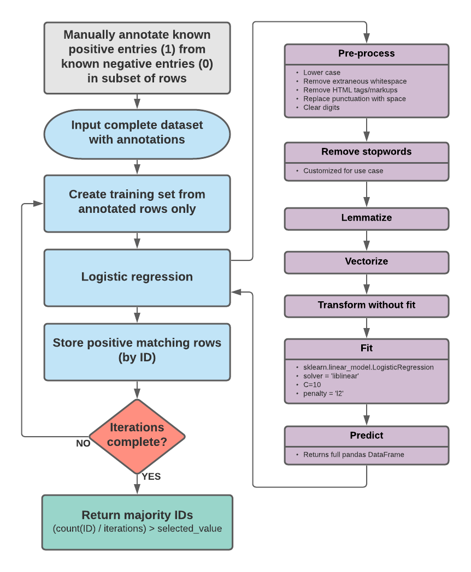
Pipeline General flow
Annotate the training set.
Train based on the annotated rows.
Logistic regression on the complete dataset.
Capture the output of each training/test session.
Reiterate.
Run an election on all stored results, capturing only those which pass majority (default: 50%.)
ToC
Notes:
- A relatively classic NLP regression is performed to build the model.
- The model is then run against the entire dataset.

Slide 10
Pipeline General flow
Annotate the training set.
Train based on the annotated rows.
Logistic regression on the complete dataset.
Capture the output of each training/test session.
Reiterate.
Run an election on all stored results, capturing only those which pass majority (default: 50%.)
ToC
Notes:
- To save memory, only the ID column data is captured. This data is used later in the process to pull the appropriate data rows from the original Pandas DataFrame.

Slide 11
Pipeline General flow
Annotate the training set.
Train based on the annotated rows.
Logistic regression on the complete dataset.
Capture the output of each training/test session.
Reiterate.
Run an election on all stored results, capturing only those which pass majority (default: 50%.)
ToC
Notes:
- One option for improving searches was to include an iterative component. The Ids from each iteration are captured separately.

Slide 12
Pipeline General flow
Annotate the training set.
Train based on the annotated rows.
Logistic regression on the complete dataset.
Capture the output of each training/test session.
Reiterate.
Run an election on all stored results, capturing only those which pass majority (default: 50%.)
ToC
Notes:
Once all iterations are complete, the entire set of captured data (a list of IDs from each iteration) then goes through an election process. A simple majority election is used to include only those IDs which were captured in a majority of iterations. The majority limit can be set by parameters (default = 0.5 or a greater than 50% majority.)

Slide 13
Methods How many deaths reported involved confirmed Sars-CoV-2 infections?
The complete 2021 VAERS data was downloaded on the first week of July.
Data was filtered to include only feature "DIED" == "Y"
The columns "SYMPTOM_TEXT" and "LAB_DATA “ were selected as features.
The columns "SYMPTOM_TEXT_TARGET" and "LAB_DATA_TARGET" were added and annotated with a 1 (Positive) or a 0 (Negative) to indicate the commensurate column was Covid(+) or Covid(-)/Unknown.
The feature columns were annotated individually, without referencing the other column for confirmation. I.e. If the column was unclear, the training was marked as “0” based on the unclear column alone.
ToC
Notes:
- The question asked was, “How many deaths reported involved confirmed Sars-CoV-2 infections?”
- The criteria for selecting the positive training values was any patient who had a positive test within 30 days prior to the vaccination, or anytime after being vaccinated, or if the text annotated that the patient had a covid diagnosis, covid symptoms, or died of a covid related symptom.
- Information that the patient had covid may appear in one or both columns, so each column was processed separately without consideration to the data in the other column.

Slide 14
Methods How many deaths reported involved confirmed Sars-CoV-2 infections?
Examples
Positive (1) | Negative (0)
After vaccination, patient tested positive for COVID-19. Patient was very ill and had numerous chronic health issues prior to vaccination. Facility had a number of patients who had already tested positive for COVID-19. Vaccination continued in an effort to prevent this patient from contracting the virus or to mitigate his risk. This was unsuccessful and patient died. | Feb 8 states she had a cold. Feb 9 added stomach ache and nausea. Feb 9 visited urgent care facility for exam and Covid-19 test. Rapid test results were negative. Appeared tired but fine. Told to go home and rest. Feb 10 at 9:00 am found dead on the floor in pool of blood and aspirated. Excessive blood in toilet, pooled on floor and hallway rug.
Vaccine 12/30/2020 Screening PCR done 12/31/2020 Symptoms 1/1/2021 COVID test result came back positive 1/2/2021 Deceased 1/4/2021 | Patient death within 60 days of receiving the COVID vaccine series
Patient had been diagnosed with COVID-19 on Dec. 11th, 2020. Symptoms were thought to have started on 12/5/2020. Received Moderna vaccine on 12/23. Unexpected death on 1/8/2021. Resuscitation attempts unsuccessful | Spoke to RN at ER. Resident had fever of 102.9 upon arrival to the ER. He coded on the way back from his CT scan. He was diagnosed with right sided pnuemonia, respiratory failure and sepsis. Resident just passed away in ER and was not even admitted. Family was there with him
Patient developed Covid pneumonia dx 1/15/21, patient expired | respitory colase
+ COVID 19 | COVID 19
ToC
Notes:
Determinations should be independent for each column. I .e. If the LAB_DATA column cannot conclusively identify the positive/negative status, it should be marked negative even if the SYMPTOM_TEXT column clearly indicates positive.

Slide 15
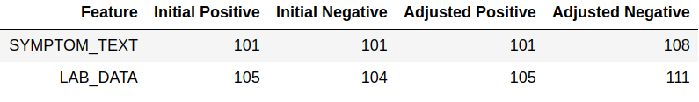
Training and testing How many reported deaths involved confirmed Sars-CoV-2 infections?
Training and test were run against the selected columns individually and together, using both the “10 iterations with election” and “best of 10” methods.
The majority parameter for the elections was set to > 0.5 (simple majority.)
The percent cutoff (perc_cutoff) parameter was at 80 (80% confidence in datapoint.)
Re-training (training adjustment) used to mark commonly misidentified phrases.
“Patient was hospitalized x 3 and died within 60 days of receiving a COVID vaccine series”
“Patient death within 60 days of receiving the COVID vaccine series”
“Sars PCR 2/2/21” (versus “Pos Sars PCR 2/2/21.”)
“COVID 19” (versus “COVID 19 positive.”)
Patient death within 60 days of receiving the COVID vaccine series
ToC
Notes:
- Training and testing was done with...
Each individual column separately.
Both columns together.
10 iterations amalgamated.
„Best of“ 10 individual (non-iterative) runs.
Majority parameter = 0.5
Percent cutoff = 80%
- After the first series of runs, adjustments were made to the selectoin of training rows, due to very common false positives arising. For example, phrases coming from a single clinical source regularly used the formats...
“Patient was hospitalized x 3 and died within 60 days of receiving a COVID vaccine series”
“Patient death within 60 days of receiving the COVID vaccine series”
... which made up 75 out of 89 false positives from the SYMPTOM_TEXT column .
Similarly, a distinction needed to be made between „COVID 19“ and „COVID 19 pos“ or „COVID 19 (+)“
- 6 and 7 additional rows were annotated as negative (0) for the LAB_DATA and SYMPTOM_TEXT columns, respectively.

Slide 16
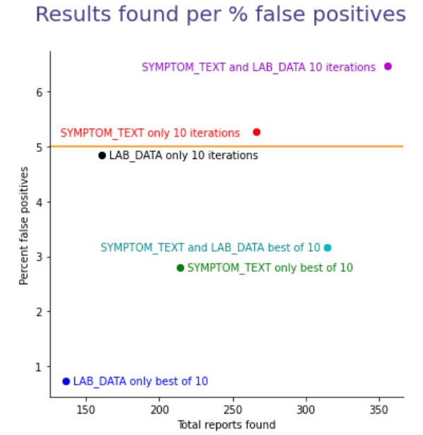
Training and testing How many reported deaths involved confirmed Sars-CoV-2 infections?
LAB_DATA (only) iterations vs. best of:
8/161 vs. 1/136
18.38% more hits.
575.78% greater false positives rate.
SYMPTOM_TEXT (only) iterations vs. best of:
14/266 vs. 6/214
24.3% more hits.
87.72% greater false positives rate.
SYMPTOM_TEXT and LAB_DATA iterations vs. best of:
23/356 vs. 10/315
13.02% more hits.
103.51% greater false positives rate.
ToC
Notes:
- Here we‘re looking at the results of each run, with the number of reports found on X, and the percent of false positives on Y.
We see that the „best out of 10“ consstently produces a lower error rate than 10 iterations.
Presumably since easily identified rows are found in all or most of the runs, while borderline data have 10 opportunites to be erroneously collected.
I.e. The bad data piles up. While the good data is unchanged.
We also see that both columns consistently outperform either individual column, when balancing the number of hits versus error percent.

Slide 17
Conclusions How many reported deaths involved confirmed Sars-CoV-2 infections?
Best overall score, SYMPTOM_TEXT and LAB_DATA best of 10.
LAB_DATA (only) provided the most accurate search, likely due to information density.
SYMPTOM_TEXT combined with LAB_DATA provided better results than either column alone.
Different methods (iteration vs. best-of) still contain value for differing use cases. I.e. Early to late filtering.
ToC
Notes:
A few conclusions can be drawn at this point...
- The best overall filter was both columns, in a best of 10 search. It provides the highest hit count, within the less than 5% false positive success condition.
LAB_DATA has the best accuracy, possibly because the data is less conversational and more technical (more informaiton packed into fewer words coming from a smaller corpus. I.e. medical terms and drug test data.)
While „Both columns best of 10“ is the ideal, all methods provide potential for different use cases.
For example, the high hit/high error rate would be acceptable for early filtering, since the goal is to remove as much data as possible to find the most concerning cases.
Reducing the error rate by using only the LAB_DATA column becomes useful after the majority of immediate concern SAE investigations are complete, to go back and pick up the borderline data.

Slide 18
Summary
A pipeline was implemented using natural language scoring on two open text features of the VAERS data.
Supervised training to answer a specific question required the manual selection of ~8% of entire data set.
Training was implemented in two rounds: an initial training, and a remedial training to remove commonly misidentified phrases.
Each feature was scored independently, and results tabulated based on each individual feature, as well as for the features’ combined efforts.
The model successfully identified the expected volume of data points, within the established margins of error.
ToC

Slide 19
References…
Title
Jupyter Notebook
Data set annotated for supervised learning
VAERS User Guide/Legend for data set
Download current VAERS data
NLP Tutorial for Text Classification in Python
ToC

Slide 20
THANK YOU
ToC

