Slide 1
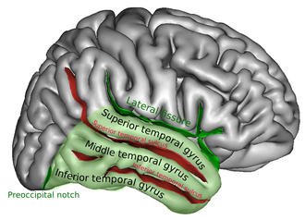
Sample Info
Filter criteria: nFeature_RNA > 200 & nFeature_RNA < 5000 & percent.mt < 5
Patient Cell #
ad02 1003
ad04 4012
ad12 6036
ad16 5504
ad17 4947
ad30 8124
hc03 5101
hc07 8338
hc14 4664
hc19 7135
hc35 817
hc37 9844
postmortem frozen human brain tissues of middle temporal gyrus
AD HC
29626 35899
https://www.ncbi.nlm.nih.gov/geo/query/acc.cgi?acc=GSE188545

Slide 2
Decreased number of astrocytes and increase number of microglia

Slide 3
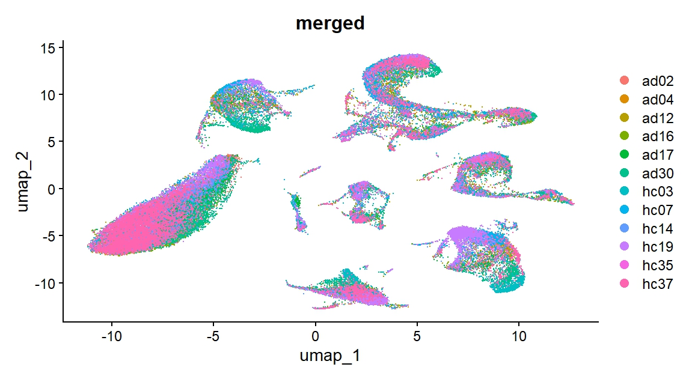
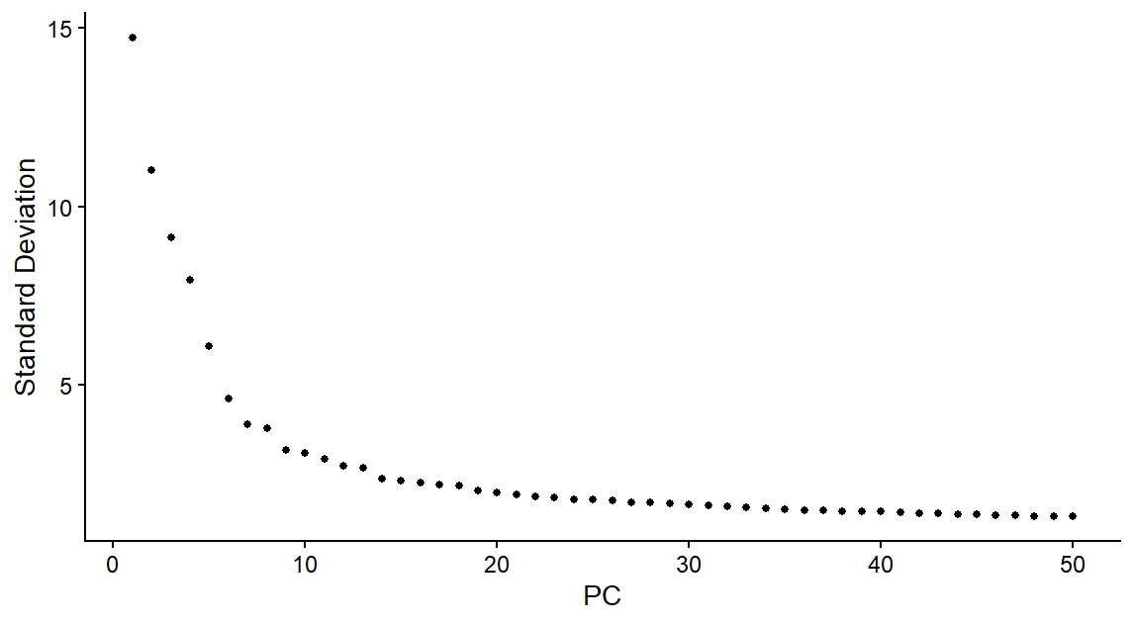
PCA plot is used to pick up #of PC used for following analysis/umap
Merged umap/sample is used to check potential batch effects. If each cluster contains every samples, there should be little batch effects. This data show little batch effects among samples.

Slide 4
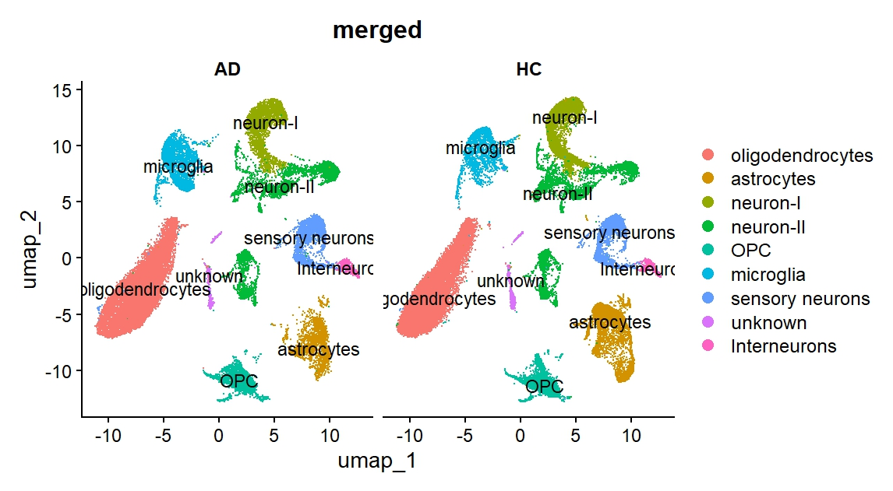
UMAP with annotations based on marker genes

Slide 5
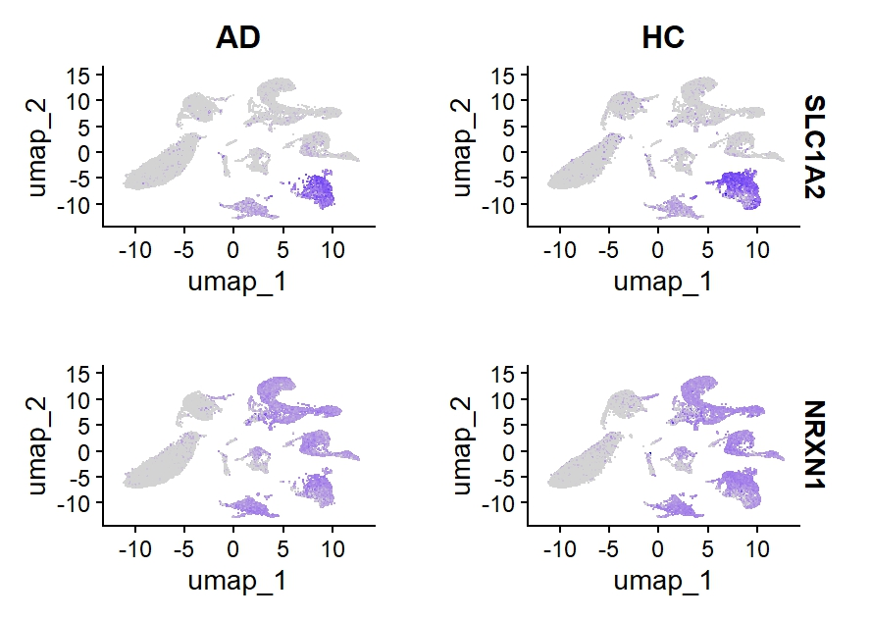
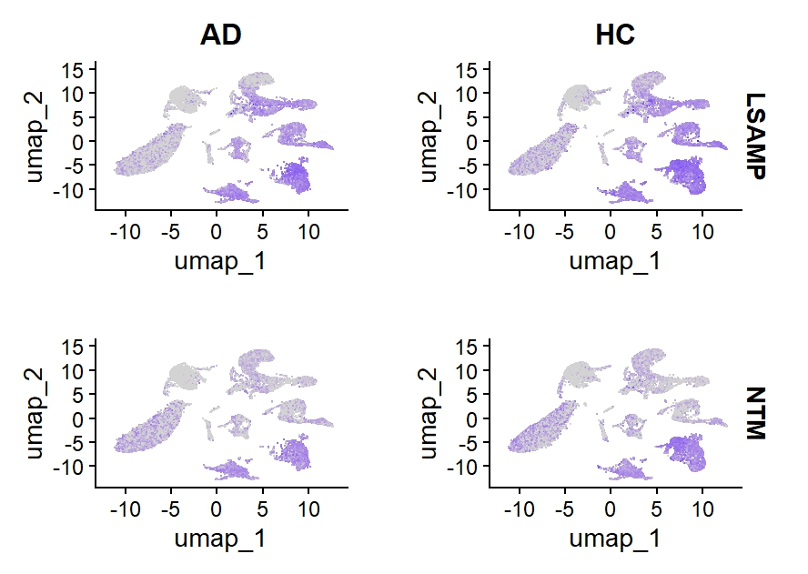
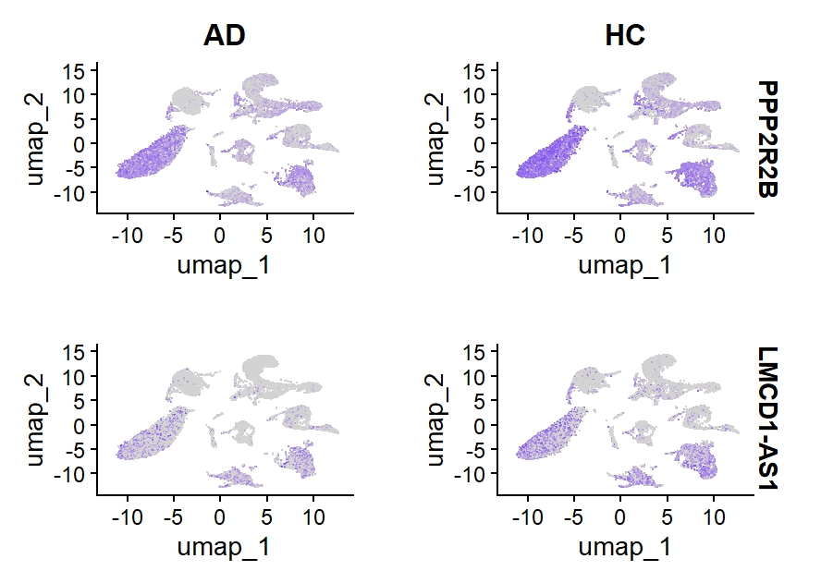
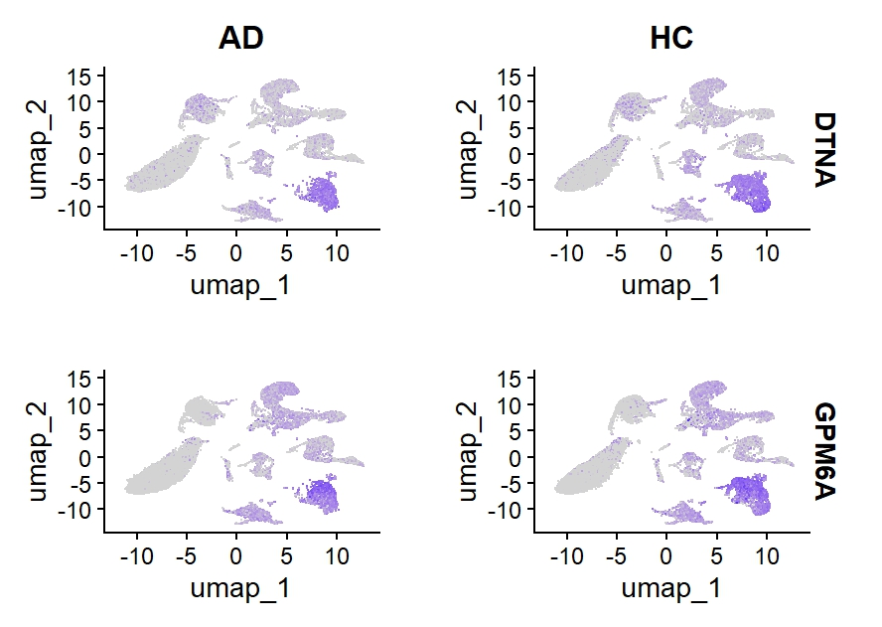
Example Genes decreased in AD

Slide 6
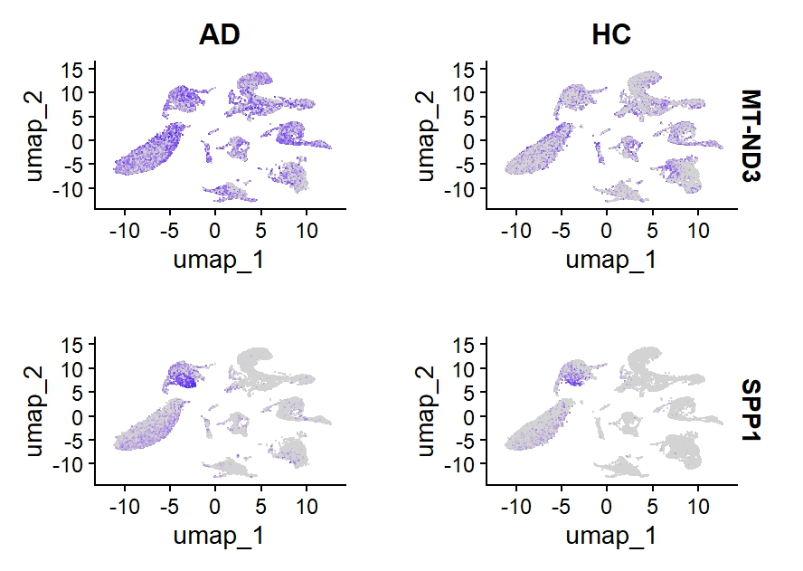
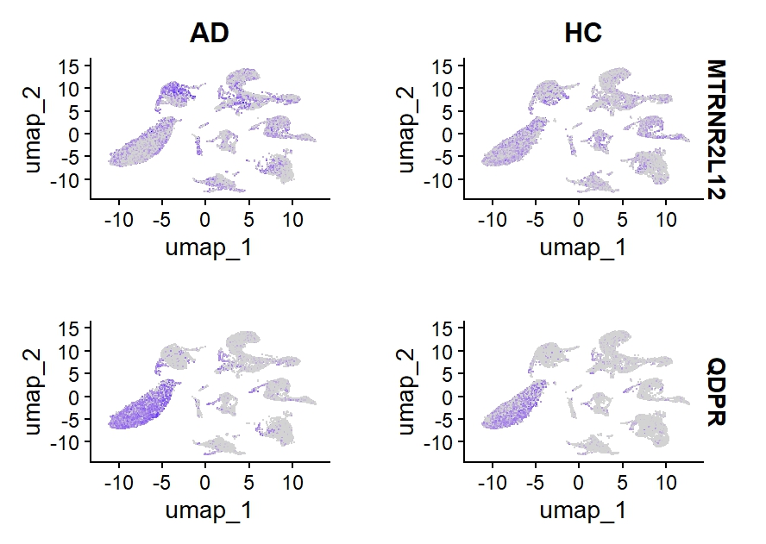
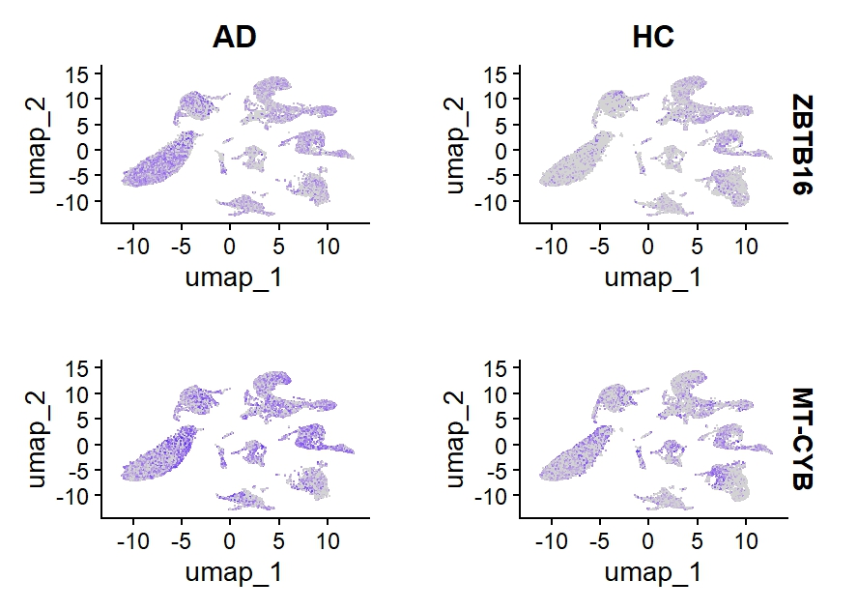
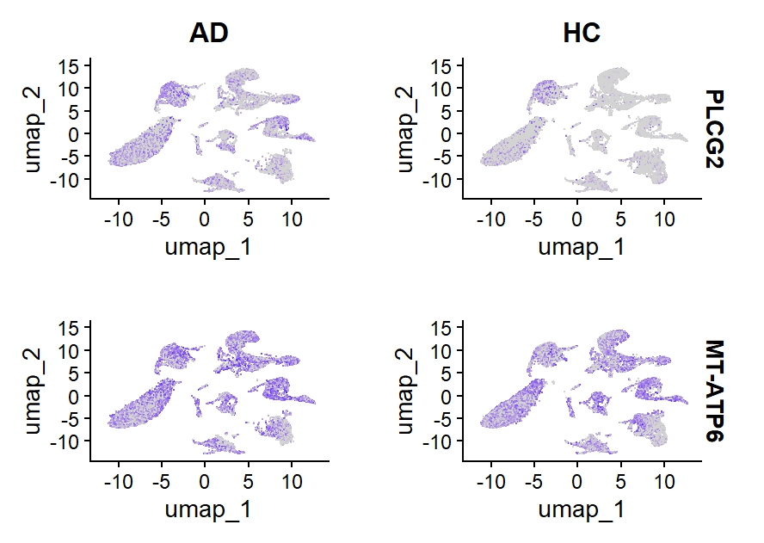
Example Genes increased in AD

Slide 7
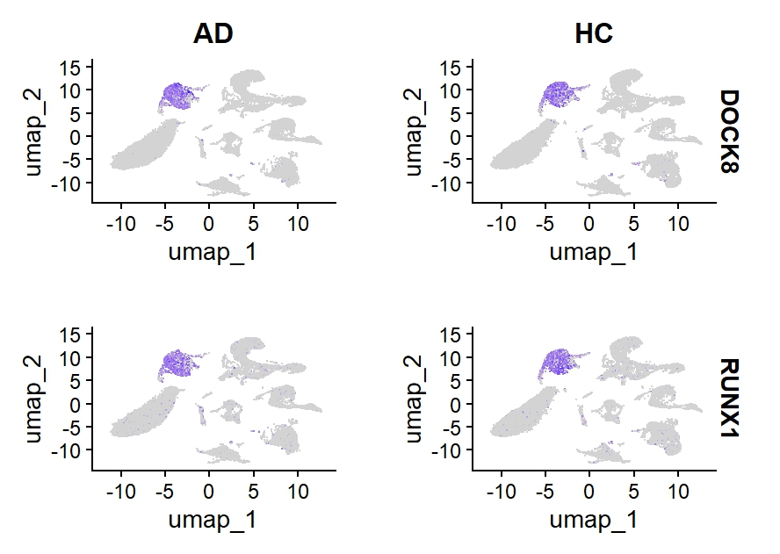
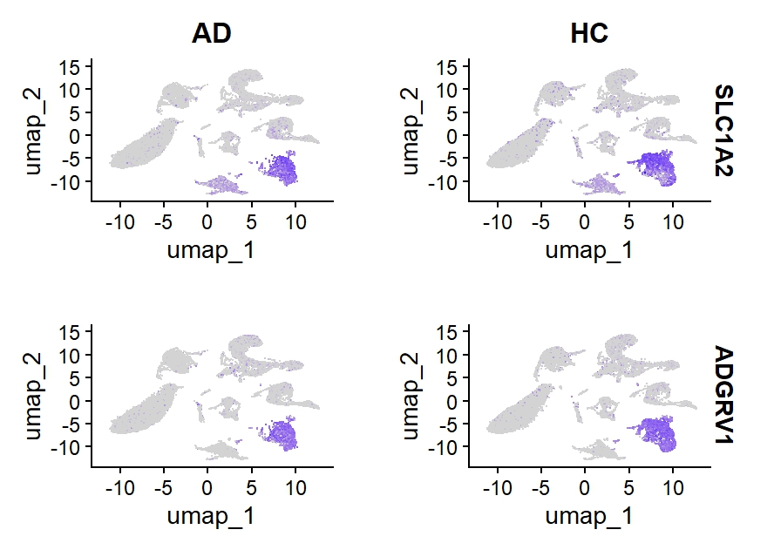
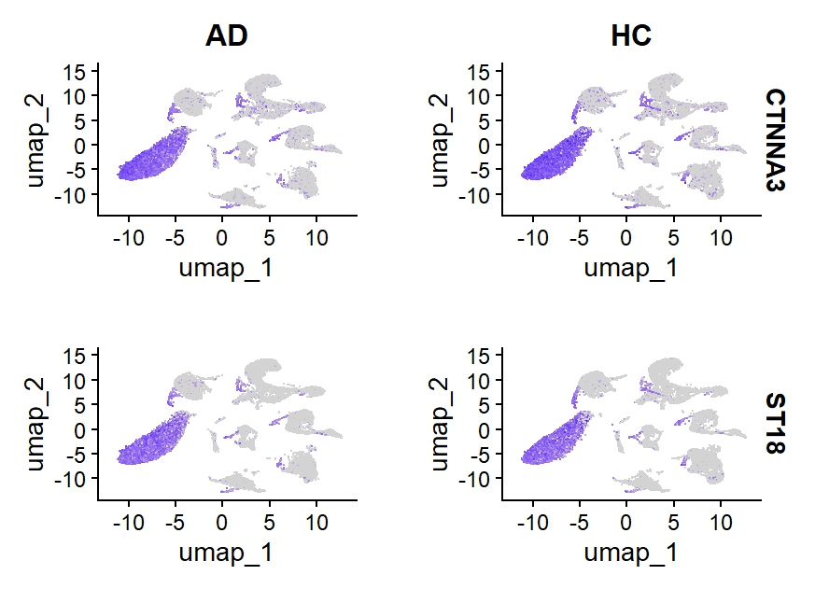
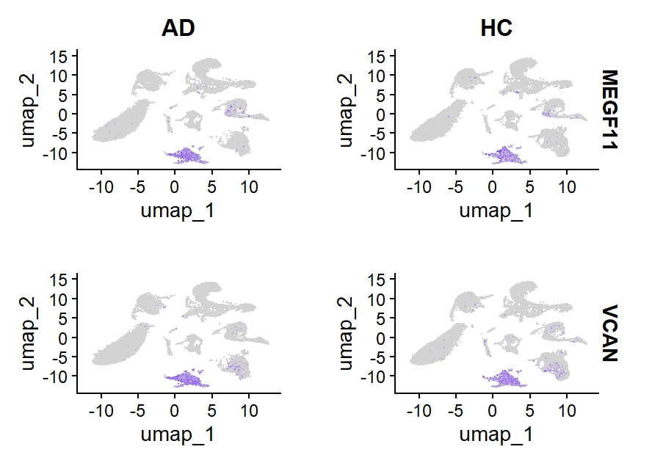
Cell markers
Microglia
Astrocytes
Oligodendrocyte
OPC

Slide 8
Itgam, Cx3cr1, and Csf1r for microglia; Slc1a3, Gfap, and Clu for astrocytes; Syp for neurons; and Plp1 for oligodendrocytes;

