Slide 1
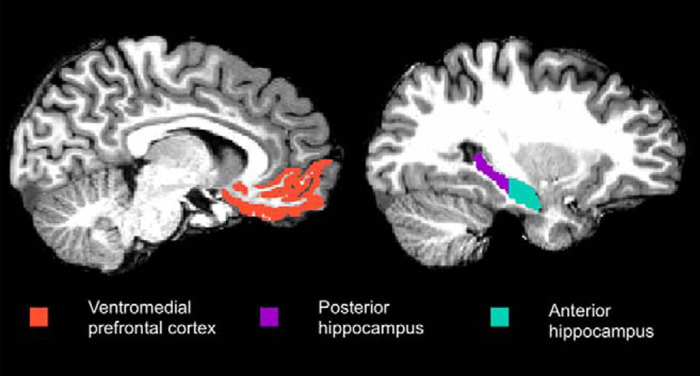
Sample Info and data source
postmortem frozen human brain tissues anterior hippocampal cortex (HIPP)
Filter criteria: nFeature_RNA > 200 & nFeature_RNA < 5000 & percent.mt < 5
patient | cell #
ad_a1 | 5391
ad_a3 | 3367
hc_a2 | 4148
hc_a4 | 8265
https://www.ncbi.nlm.nih.gov/geo/query/acc.cgi?acc=GSE175814

Slide 2
Decreased number of astrocytes and increase number of microglia

Slide 3
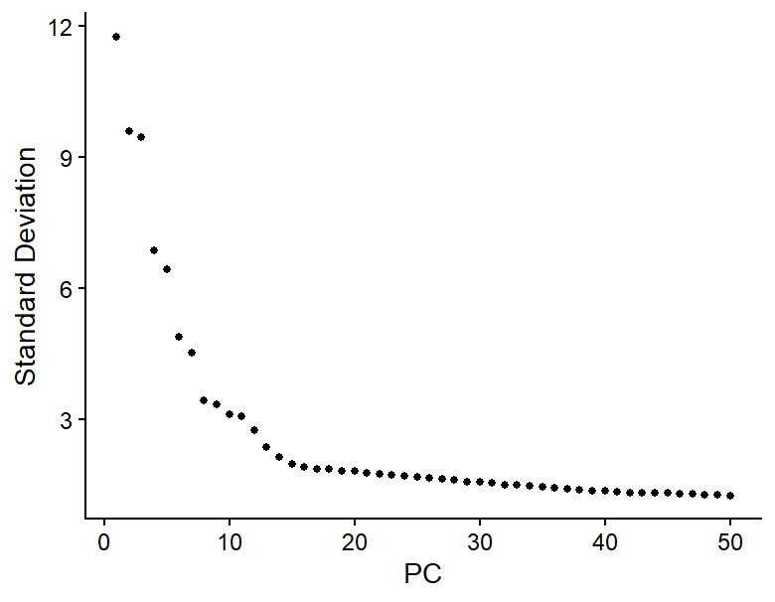
PCA plot is used to pick up #of PC used for following analysis/umap

Slide 4
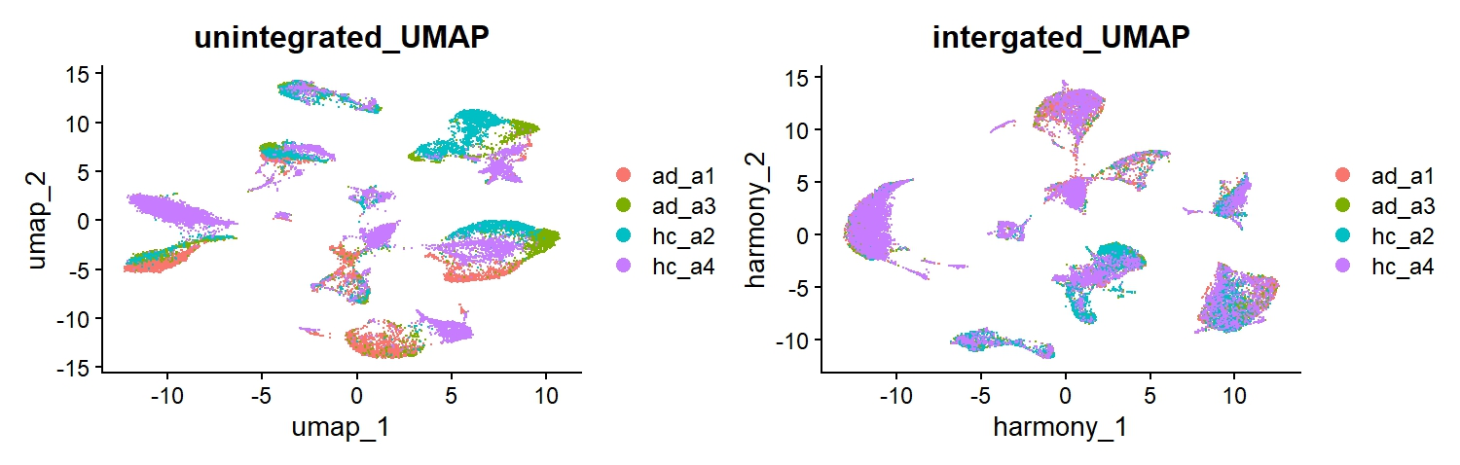
Merged umap/sample is used to check potential batch effects. Some clusters only contain cells from one sample, indicating batch effects. Using integration method harmony, eliminate batch effects.

Slide 5
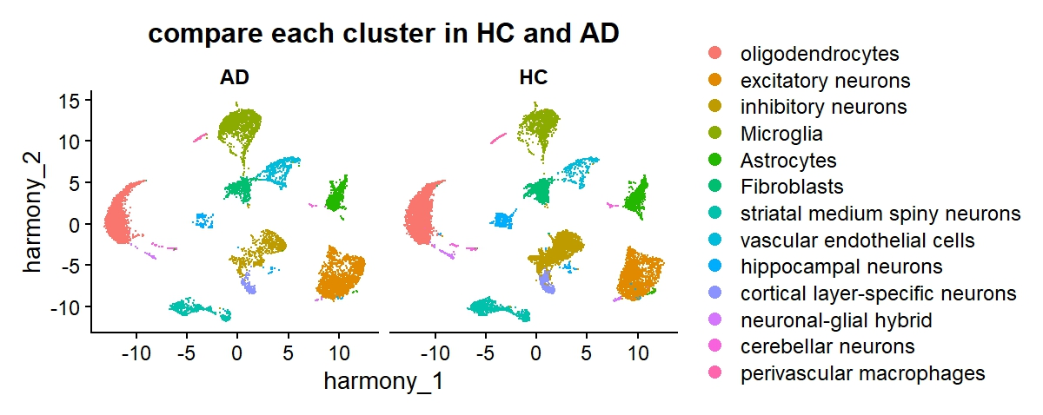
UMAP with annotations based on marker genes

Slide 6
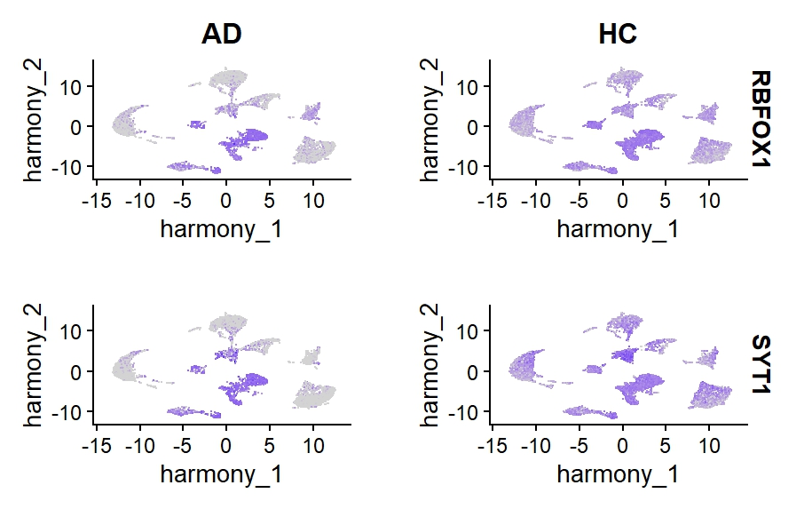
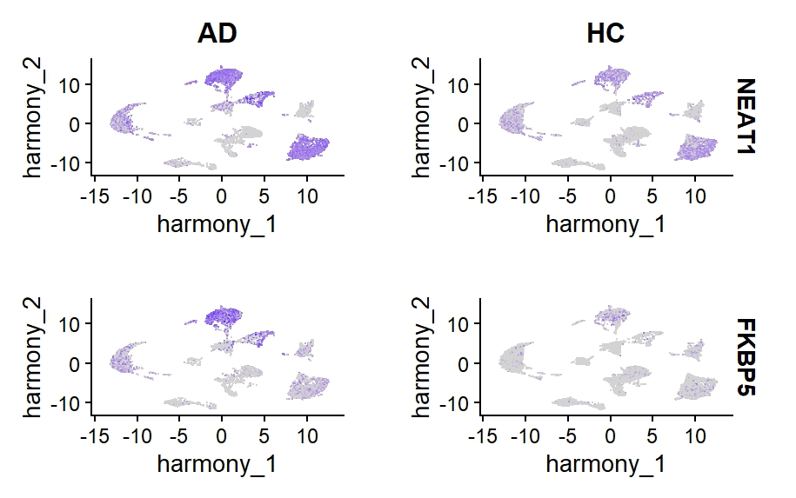
Example Genes decreased in AD
Example Genes increased in AD

Slide 7
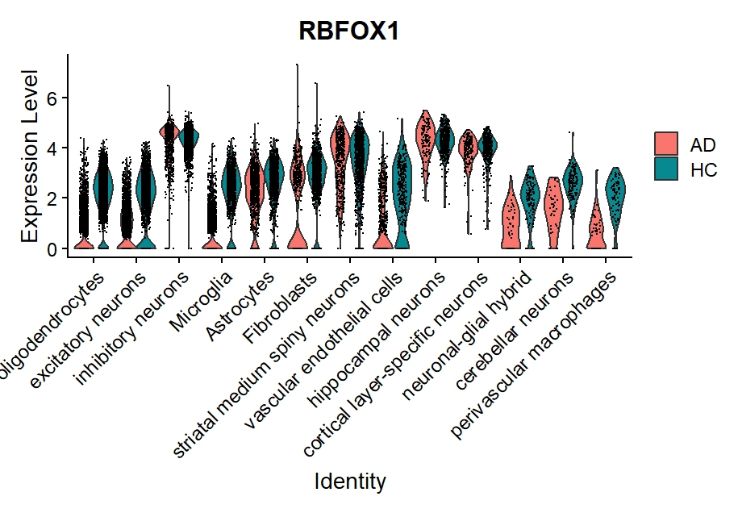
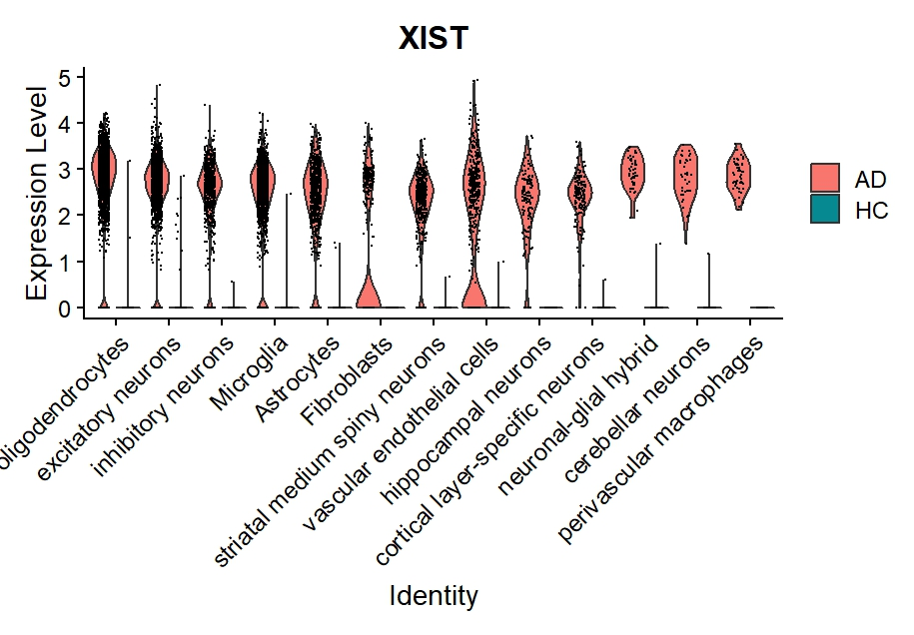
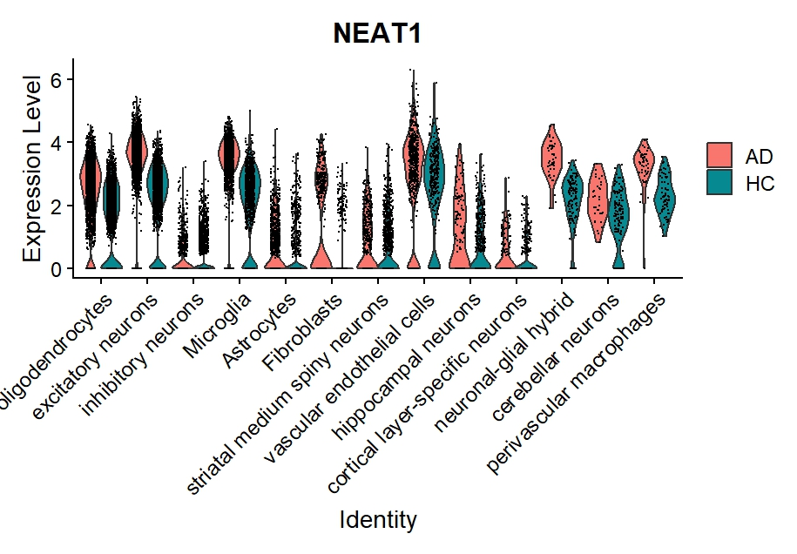
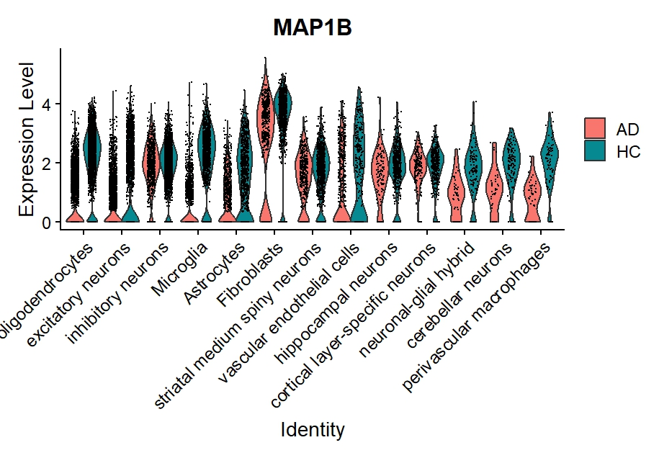
Vlnplot of DE genes between HC and AD

Slide 8
Takeaways:
There are increased microglia and decreased astrocytes numbers in AD samples comparing HC samples.
Always check batch effects and integrate samples if possible.
No perfect clusters, try to match cluster markers and annotated properly.
Novel identified DE genes need to be validated and compare to traditional marker genes.

