Slide 1
948 nominated target genes were obtained from:
https://agora.adknowledgeportal.org/genes/nominated-targets
Then the expression status of the nominated targets were checked in the scRNA seq dataset
https://www.ncbi.nlm.nih.gov/geo/query/acc.cgi?acc=GSE175814
Containing 2 AD and 2 HC postmortem frozen human brain tissues anterior hippocampal cortex (HIPP)
Genes increased and decreased in AD were clustered and highlight for further comparison and study

Slide 2
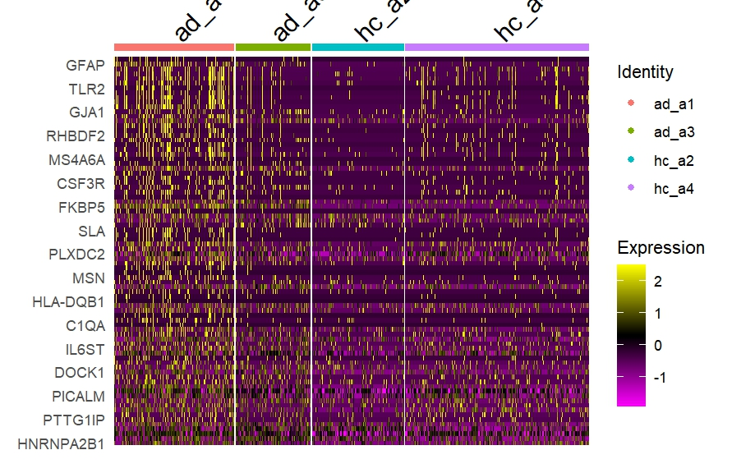
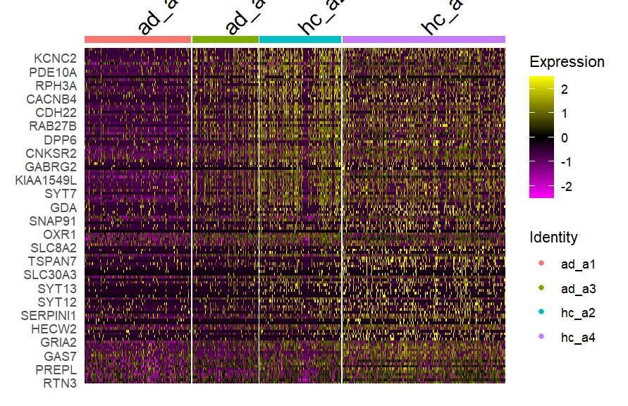

Slide 3
