Slide 1
948 nominated target genes were obtained from:
https://agora.adknowledgeportal.org/genes/nominated-targets
Then the expression status of the nominated targets were checked in the scRNA seq dataset
https://www.ncbi.nlm.nih.gov/geo/query/acc.cgi?acc=GSE188545
Containing 6 AD and 6 HC postmortem frozen human brain tissues of middle temporal gyrus
Genes increased and decreased in AD were clustered and highlight for further comparison and study

Slide 2
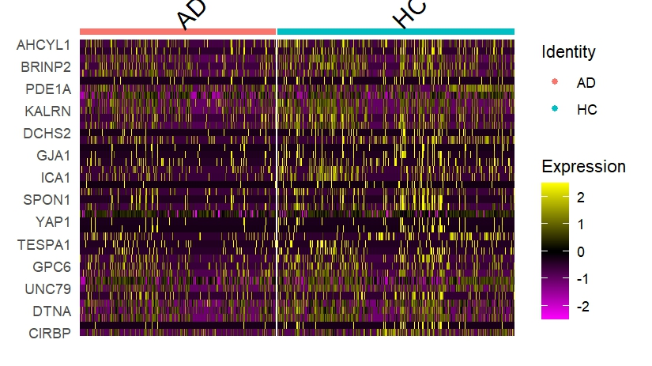
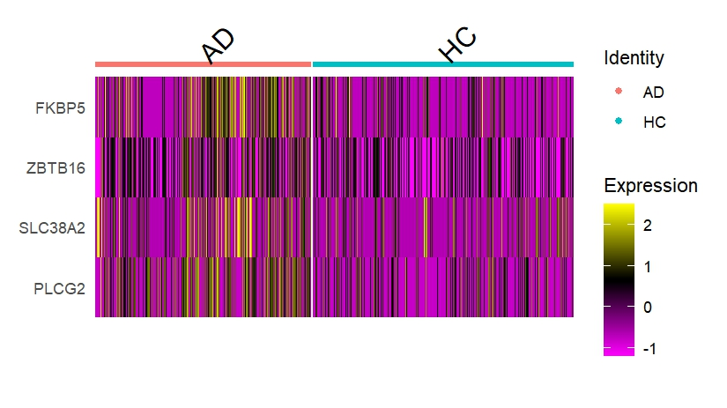
Cluster 3
Cluster 4

Slide 3
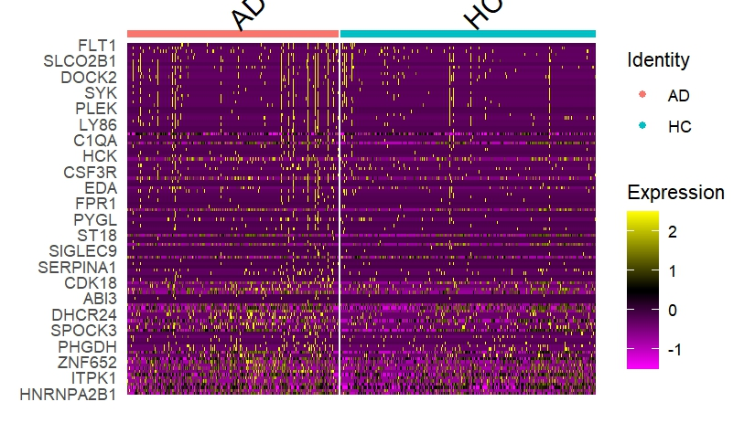
Cluster 2

