Slide 1


Initiation to Statistics in Proteomics Analysis BePa Winter School 2026 - UMONS
Philippe Grosjean Numerical Ecology & STATforU, UMONS philippe.grosjean@umons.ac.be https://web.umons.ac.be/statforu/

Slide 2



Presentation & STATforU
Bioengineer / marine biologist
Data Scientist
Teacher (data science & statistics)
R software developer Manage STATforU with Kathy Huet
Consultancy in statistics at UMONS
See https://web.umons.ac.be/statforu/

Slide 3
Why Statistics Matter in Proteomics
Proteomics generates massive datasets requiring rigorous statistical frameworks to extract biological meaning.
~10K
Proteins per sample
95%
Modern mass spectrometry identifies thousands of proteins across multiple samples
Biological variability and technical noise create uncertainty in measurements
Noise Reduction
Statistical methods distinguish true biological signals from random variation
1
Proper analysis prevents false discoveries and missed findings
Reliable Conclusion

Slide 4

What is Probability?
Probability quantifies uncertainty as a number between 0 and 1 representing the likelihood of an event.
P(Event) = Favorable Outcomes / Total Outcomes
0 ≤ P ≤ 1
Classical
Based on theoretical models (e.g., fair coin: P(Heads) = 0.5)
Frequentist
Long-run frequency of events in repeated experiments
The Axiom of Probability
In Proteomics
Probability that a protein is truly differentially expressed given observed data

Slide 5
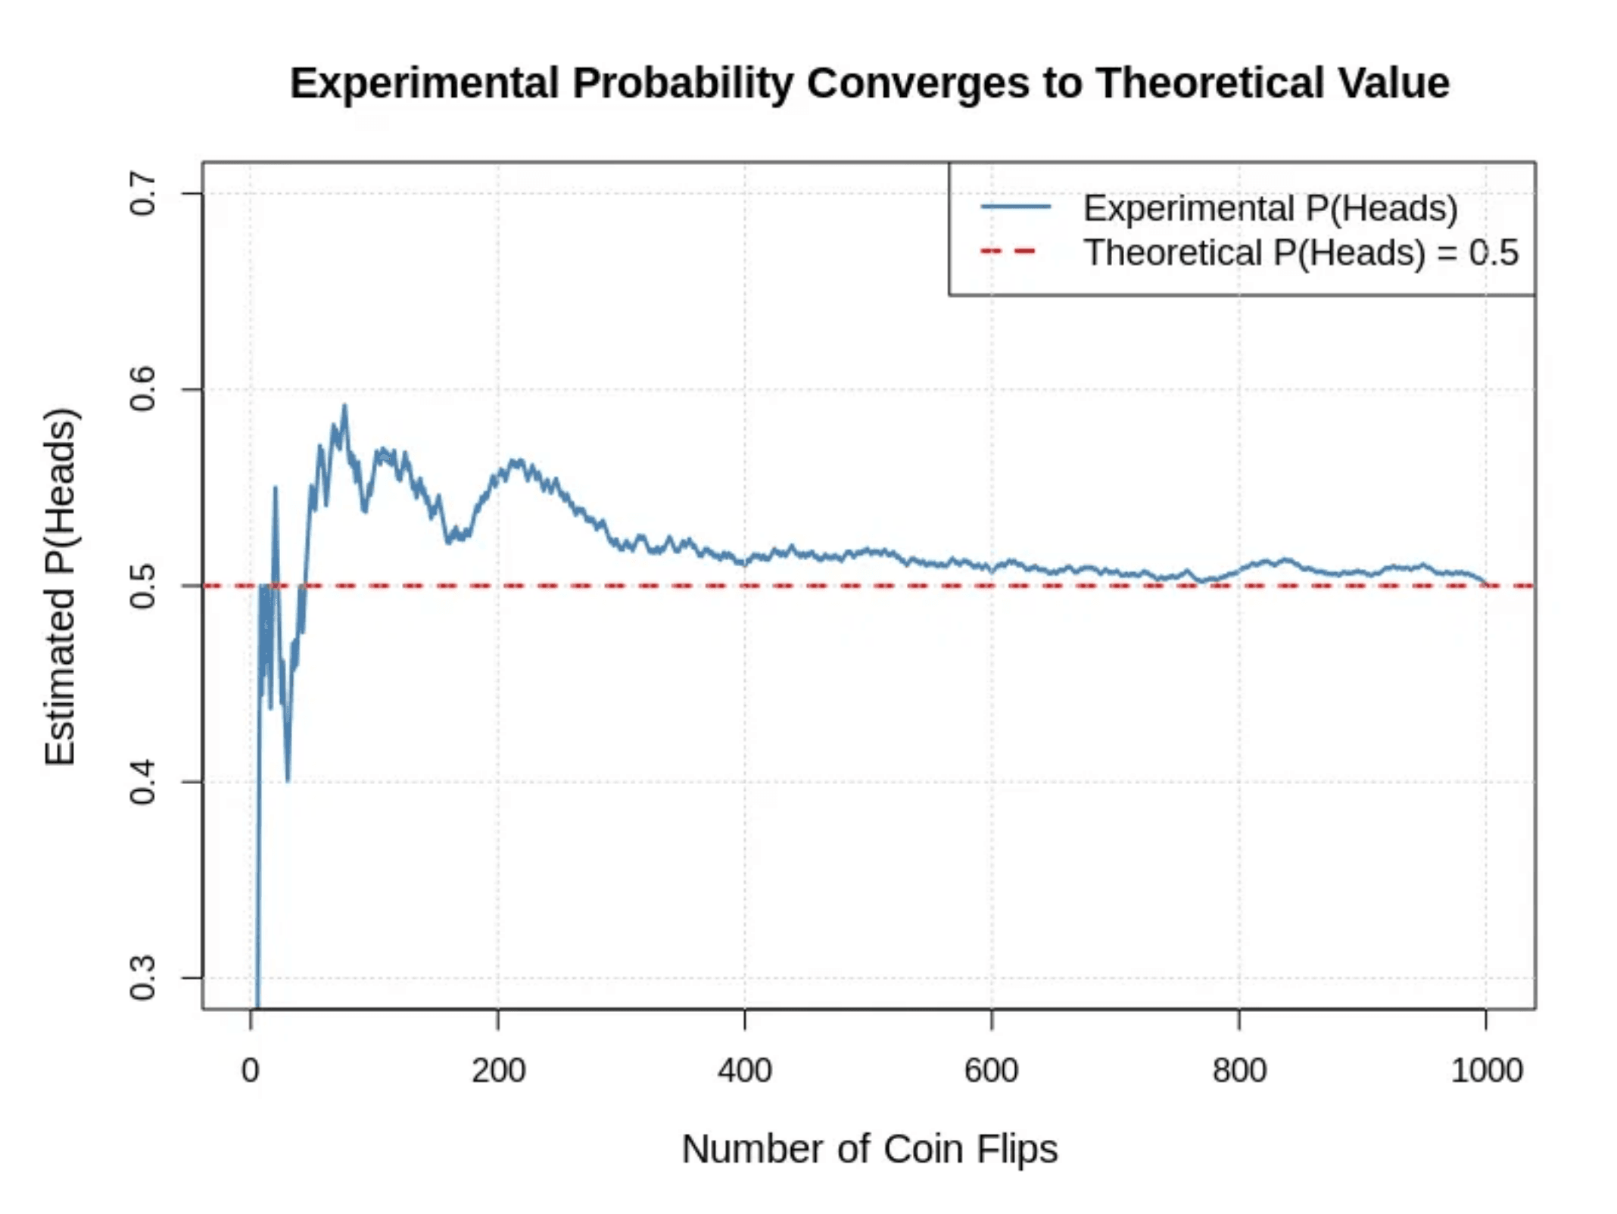
Measuring Probability Experimentally
Experimental Formula
P(E) ≈ n(E) / n(Total)
Law of Large Numbers
As sample size increases, experimental
probability converges to the theoretical
probability.
Example
Flip a coin 100 times, observe 53 heads →
P(Heads) ≈ 0.53.
In Proteomics
Estimate detection probability by
counting occurrences across technical
replicates. Larger sample sizes yield more
reliable estimates.
Simulation of 1000 coin flips showing convergence to P = 0.5

Slide 6

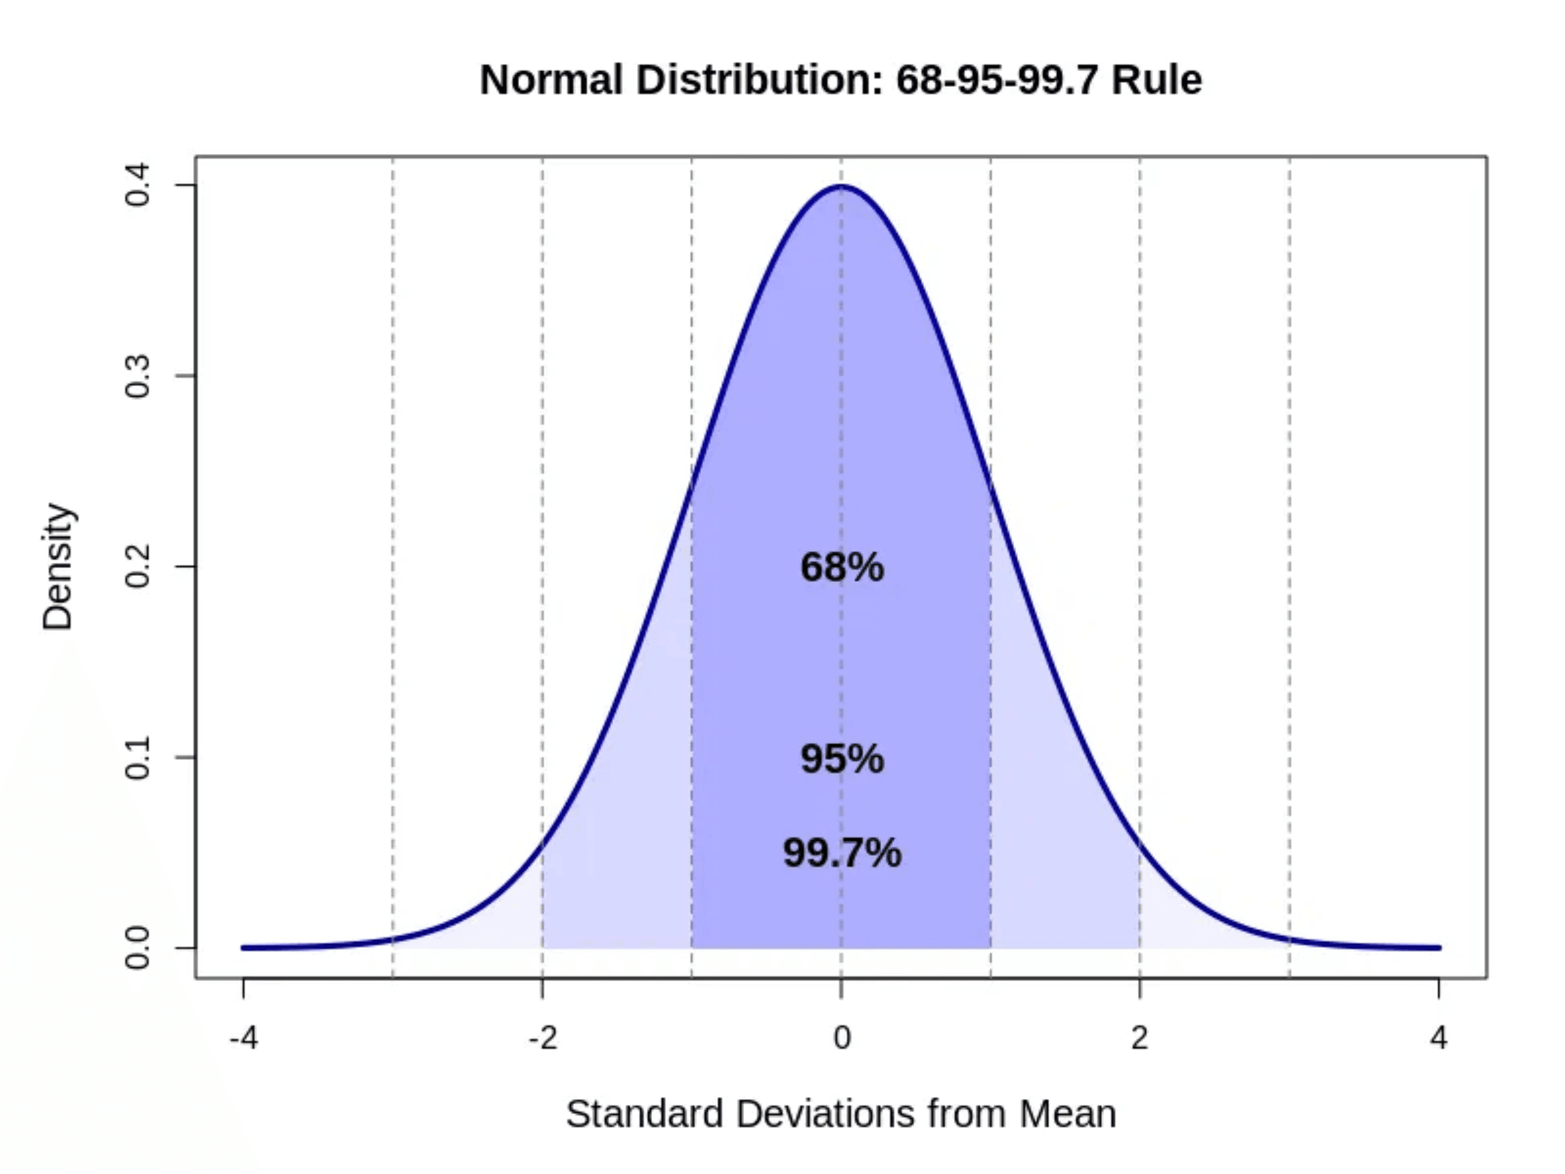
The Normal Distribution
The foundation for statistical testing, characterized by Mean (μ) and Standard Deviation (σ).
68-95-99.7 Rule:
Data falls within 1σ, 2σ, and 3σ respectively.
Many biological measurements, including protein abundance, approximate this distribution (or the log of the measurements).
Essential for modeling noise and calculating probabilities in proteomics.
Central Limit Theorem
Sample means follow a normal distribution regardless of the underlying data distribution, enabling robust statistical inference.

Slide 7

Statistical Hypothesis Testing Framework
H₀
01
Collect data and calculate a test statistic that measures evidence against H₀.
Null Hypothesis
02
Compare the statistic to a known distribution (e.g., Normal, t-distribution).
The default assumption of no effect or no difference. Example: Protein abundance is equal between conditions.
03
If evidence is strong enough (p < α), reject H₀ in favor of H₁.
Key Principle
We never "prove" H₁ is true, we only reject or fail to reject H₀.
H₁
Alternative Hypothesis
The effect we want to detect. Example: Protein abundance differs between conditions.

Slide 8

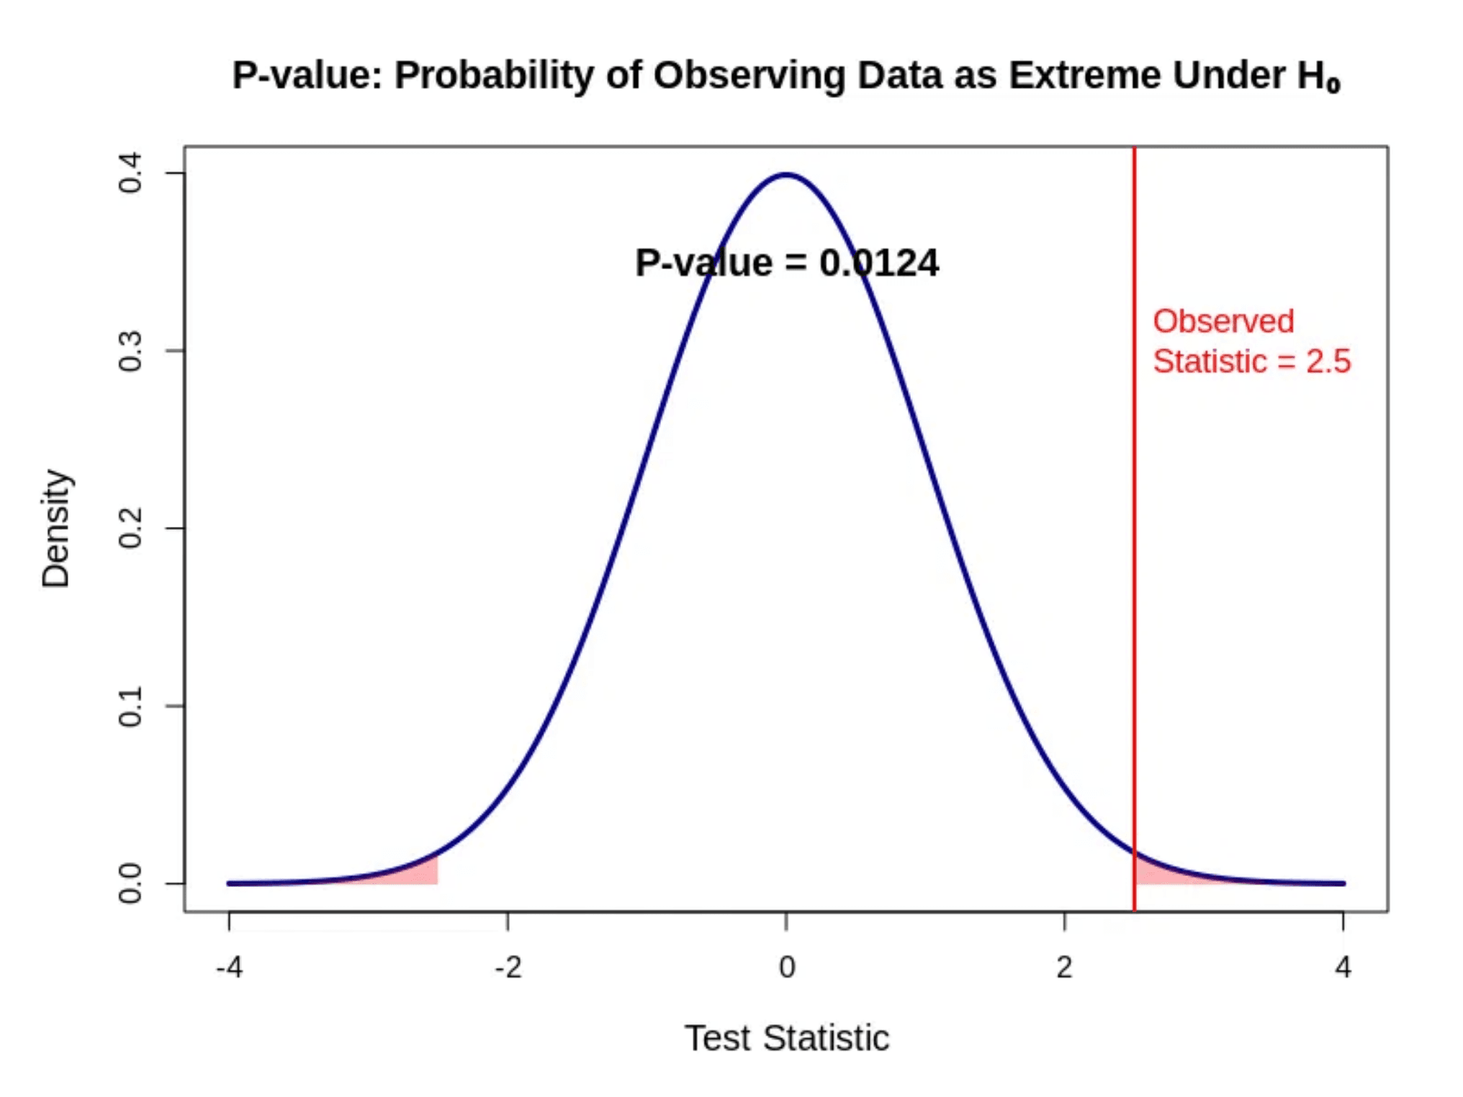
Understanding P-values
P-value = P(Data | H₀)
The probability of observing data as extreme or more extreme than what was observed, assuming the null hypothesis is true.
Common Misconception
It is NOT the probability that the null hypothesis is true.
Threshold:
p < 0.05 (5% significance level) is standard.
Decision:
Small p-value suggests data is unlikely under H₀ → Reject H₀.
Example:
p = 0.03 means there is a 3% chance of seeing this difference by random noise alone.
Visualizing the p-value as the tail area under the null distribution curve.

Slide 9

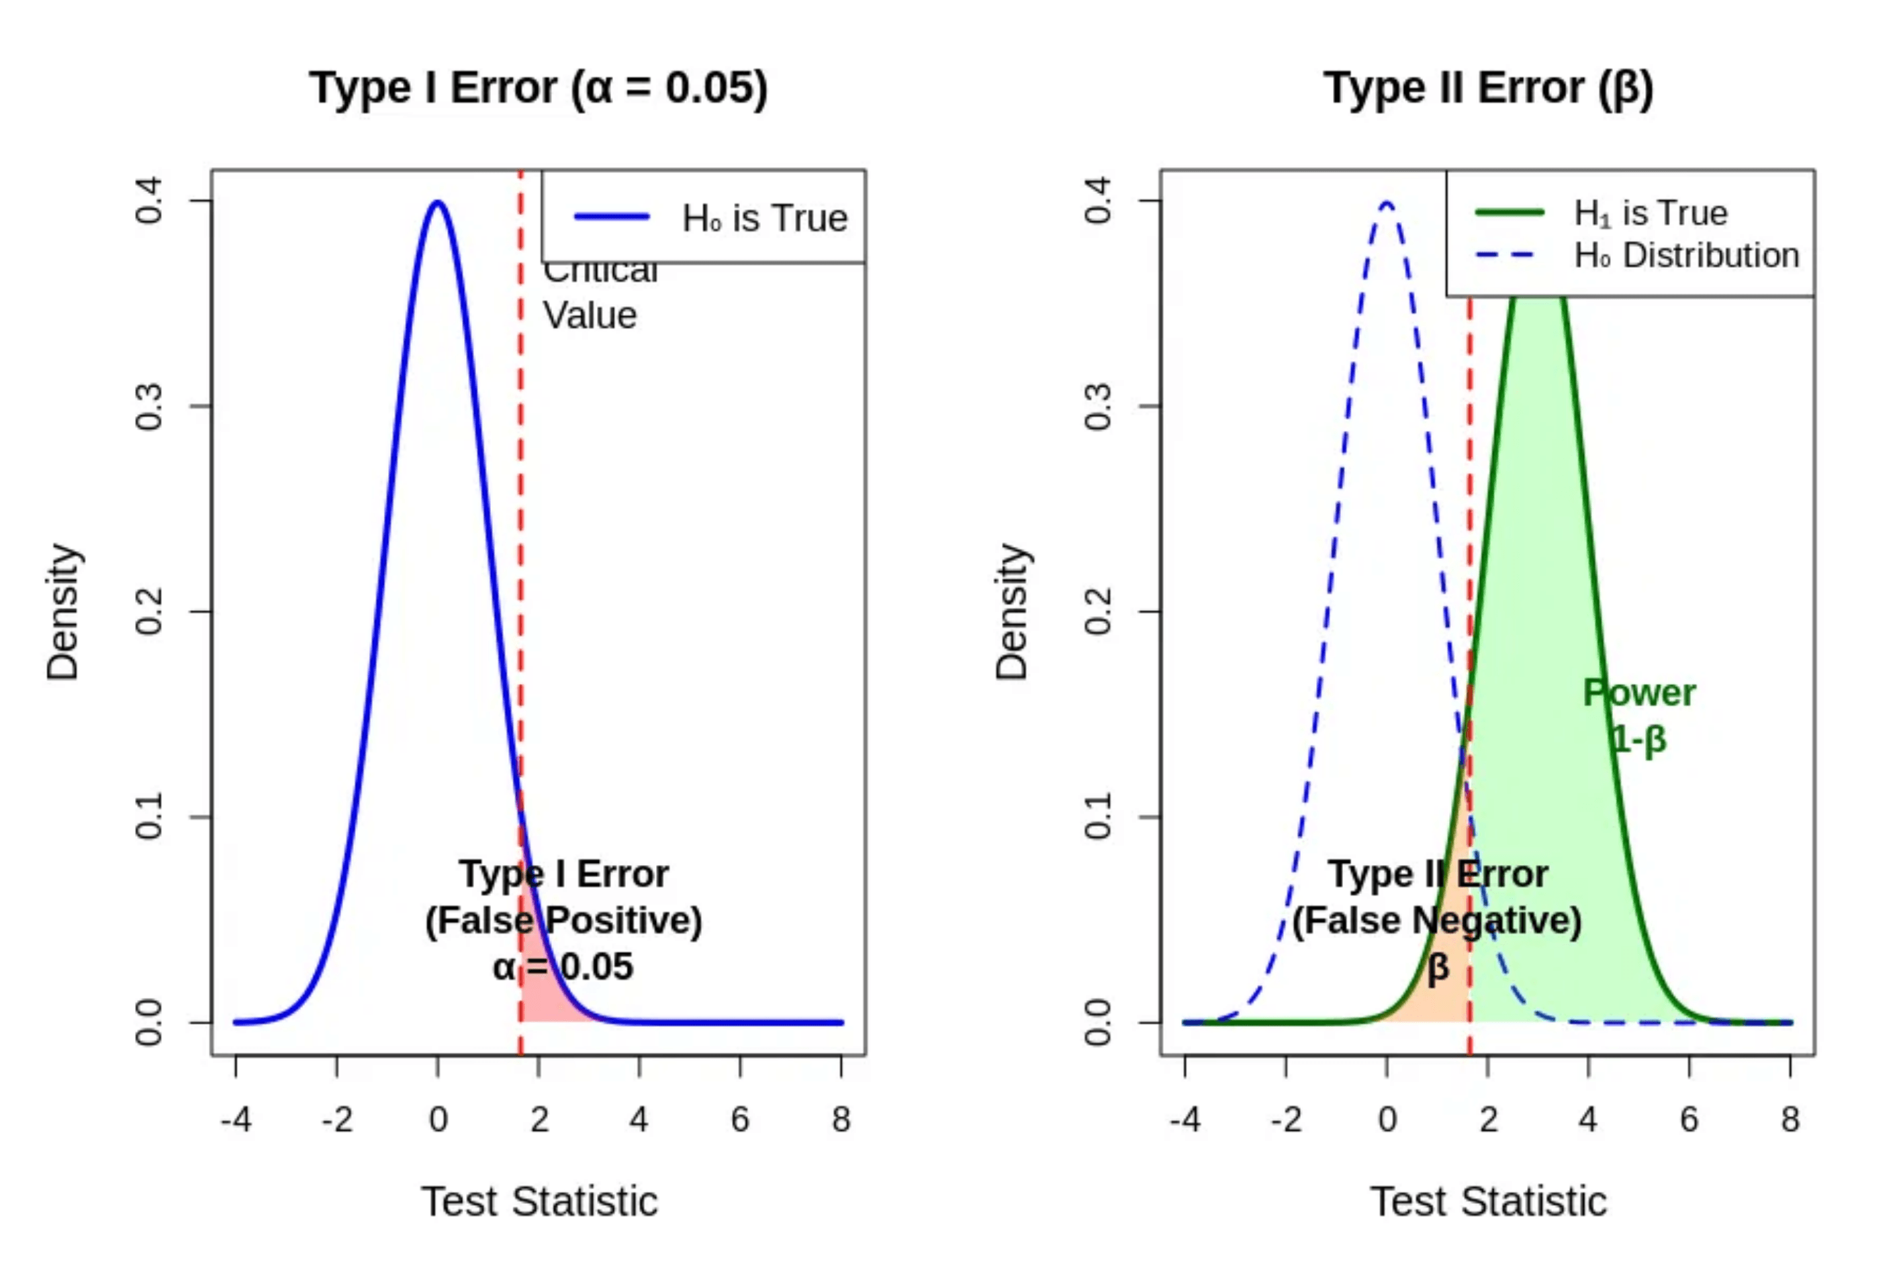
Type I and Type II Errors
Type I Error (α)
False Positive
Rejecting H₀ when it is actually true.
"Claiming a protein is differentially expressed when it's not."
Type II Error (β)
False Negative
Failing to reject H₀ when H₁ is true.
"Missing a truly differentially expressed protein."
The Trade-off
Reducing Type I errors (stricter α) inevitably increases Type II errors (lower power).
Visualizing the overlap between Null (H₀) and Alternative (H₁) distributions

Slide 10

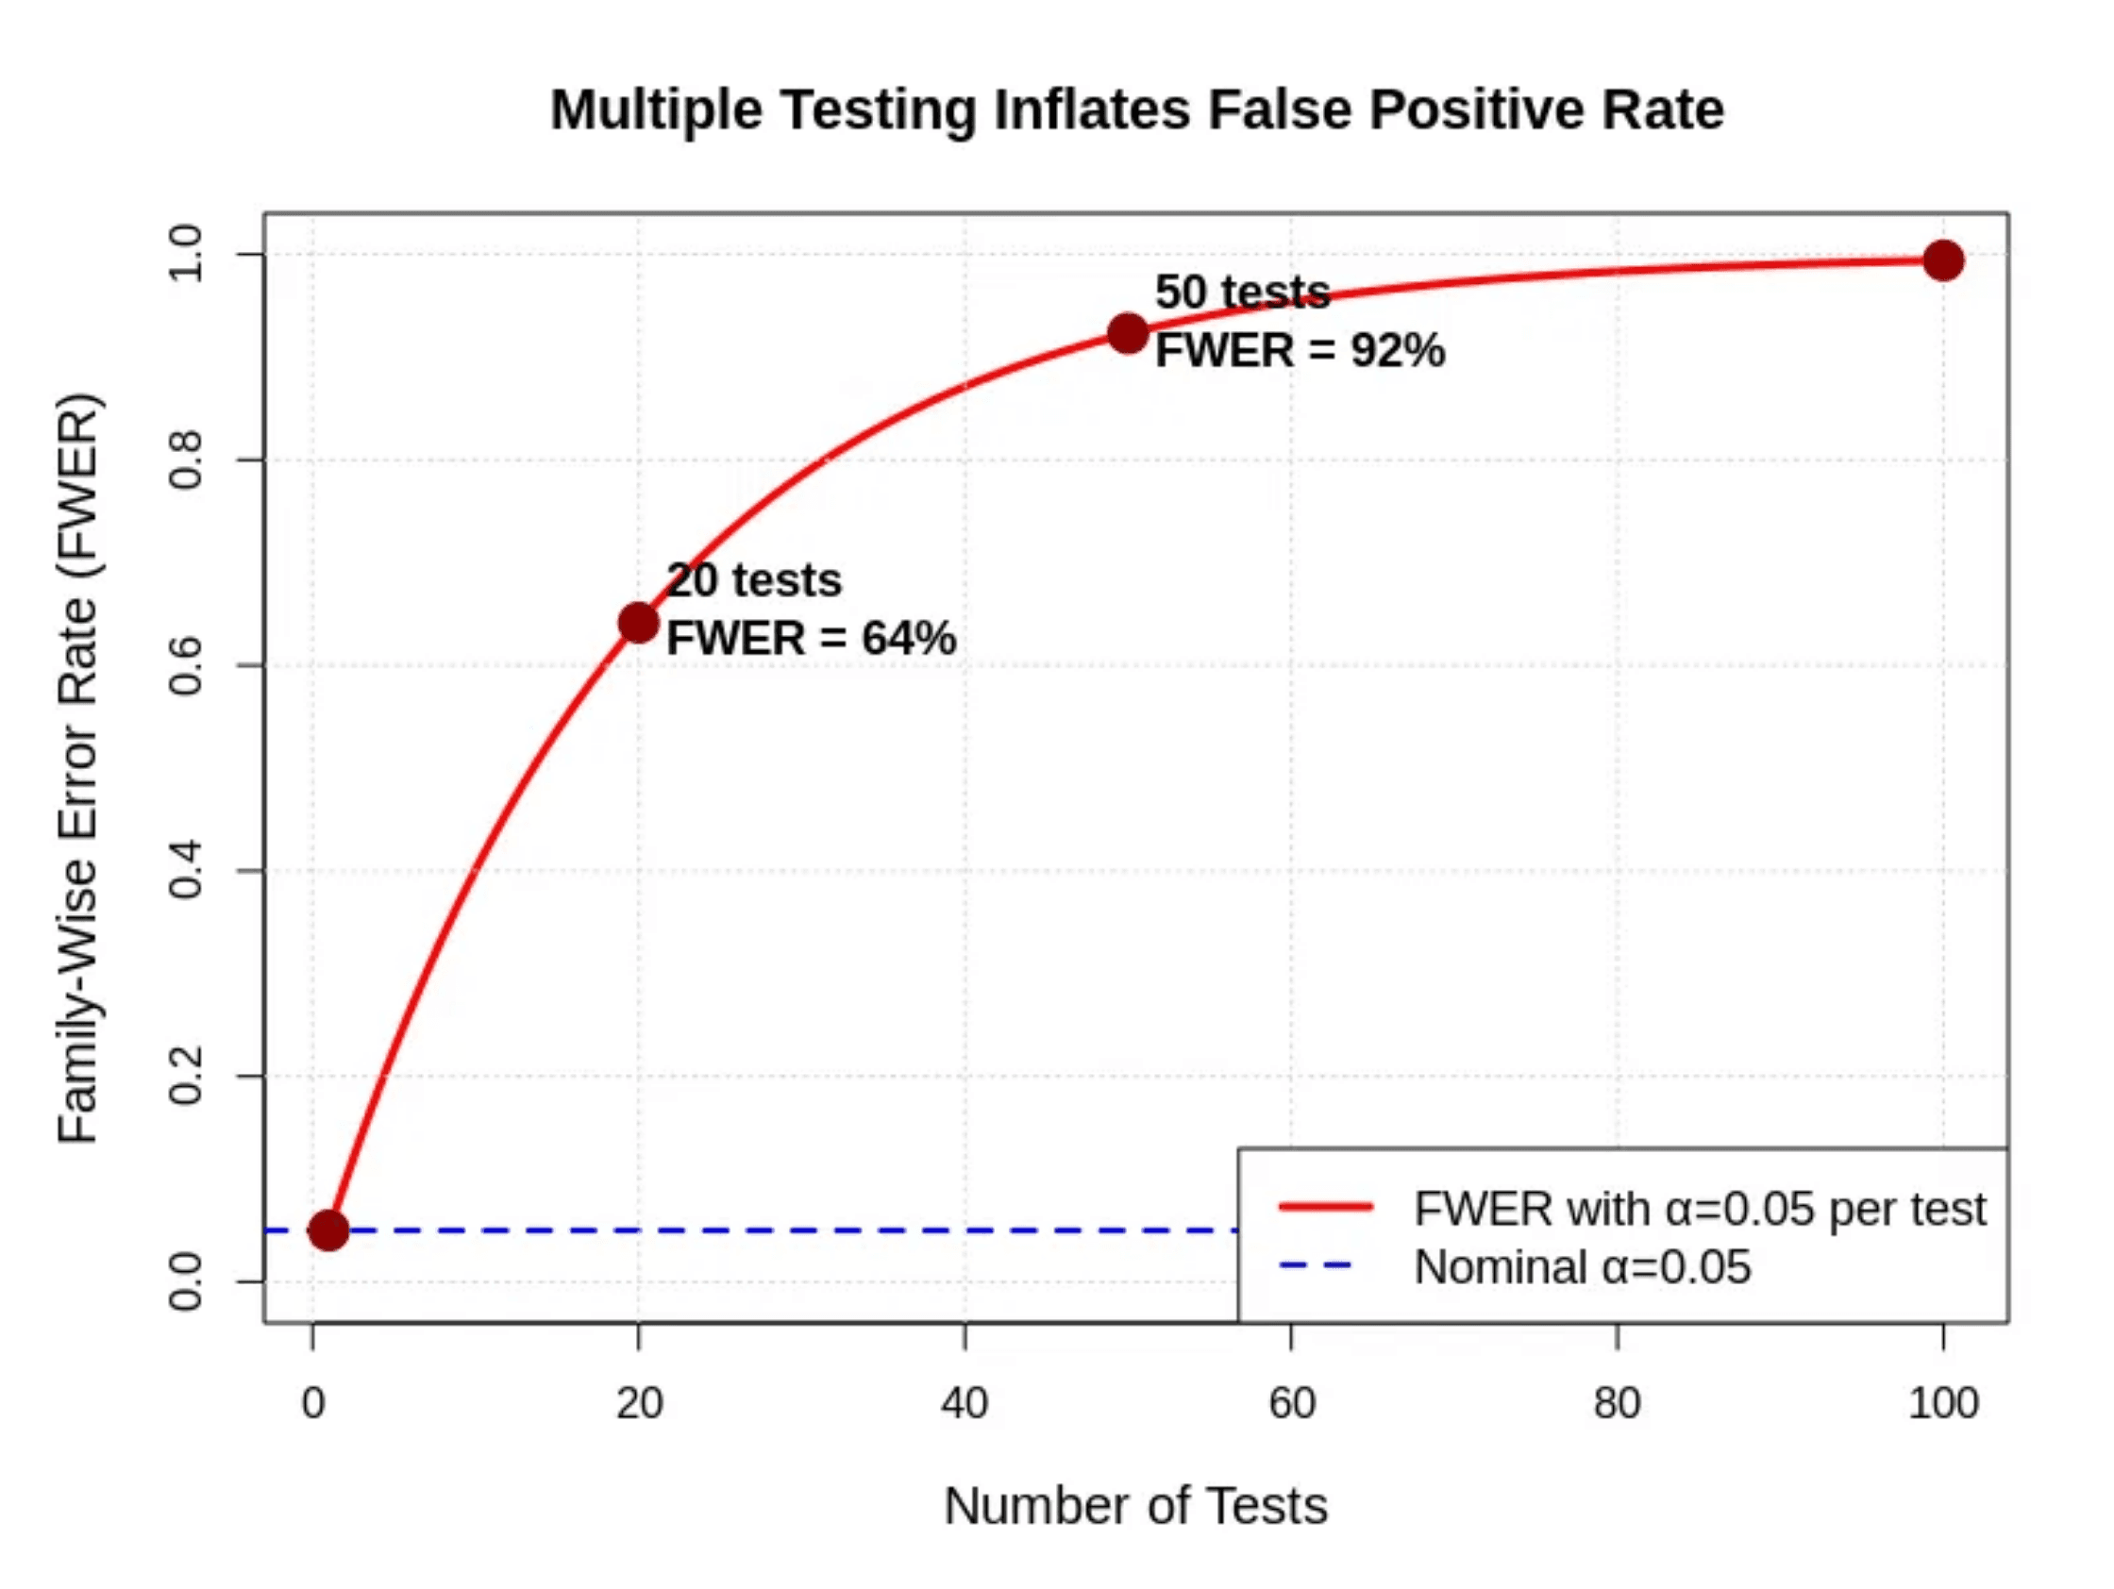
The Multiple Testing Problem
Testing thousands of proteins simultaneously inflates false positive rates dramatically without correction.
The Numbers Game
10,000 Proteins × 0.05 (α) = 500 False Positives
Family-Wise Error Rate (FWER)
The probability of making at least one Type I error. Without correction, FWER approaches 100% as the number of tests increases.
Even with just 20 tests, the probability of at least one false positive exceeds 60%.

Slide 11

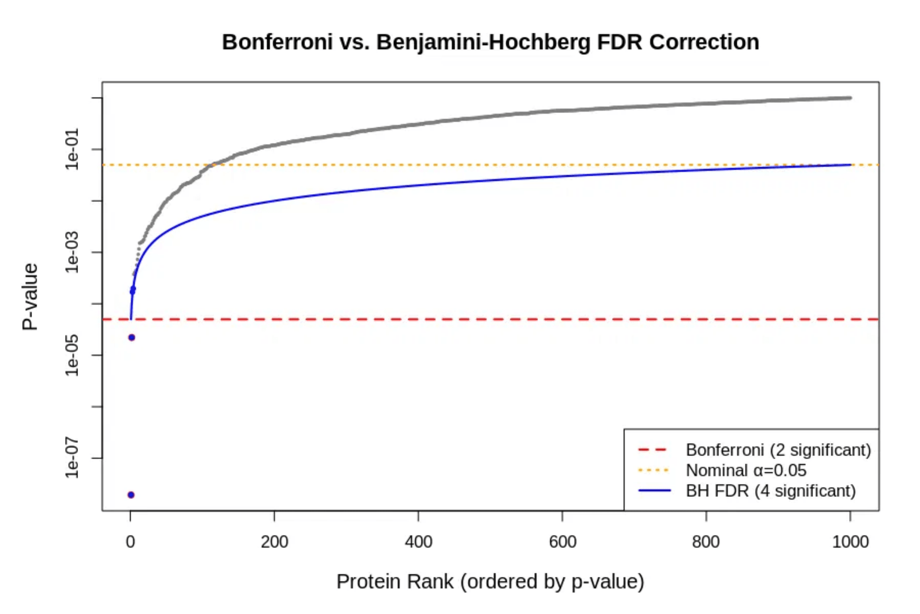
Bonferroni Correction
The Method
α_adj = α / n
Example: 10,000 proteins, α = 0.05 Threshold = 0.000005
Advantage
Simple to implement and strictly guarantees Family-Wise Error Rate (FWER) ≤ α.
Disadvantage
Extremely conservative. Drastically reduces statistical power and increases Type II errors (missed discoveries).
Comparison showing the strict Bonferroni threshold (red dashed line) vs the more adaptive FDR threshold.

Slide 12

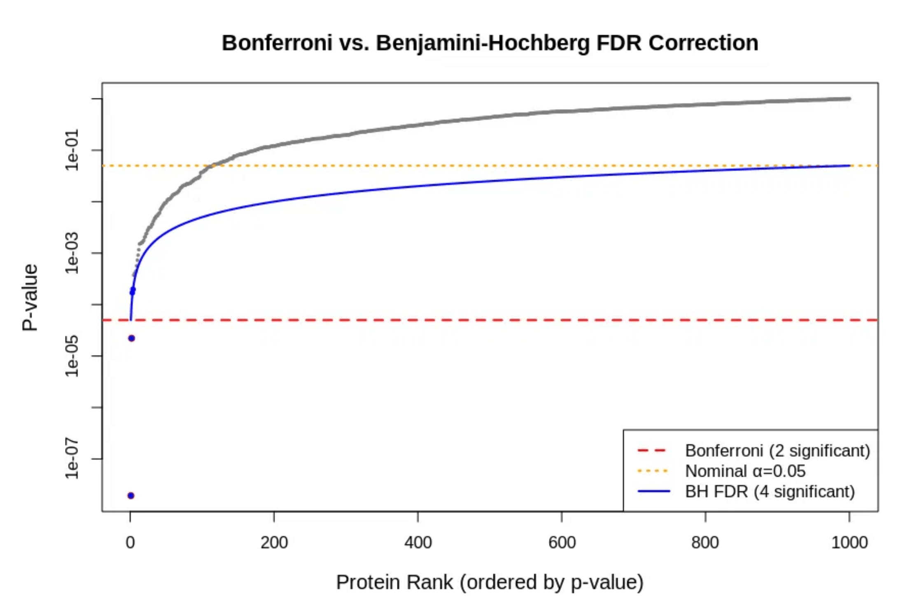
False Discovery Rate (FDR)
Definition
The expected proportion of false positives among all rejected hypotheses (discoveries).
Benjamini-Hochberg (BH) Procedure
A step-up procedure that controls FDR. It is less conservative than Bonferroni, offering higher statistical power.
Proteomics Standard
FDR < 0.05 implies we accept that 5% of our "significant" proteins may be noise in exchange for finding more true biological signals.
FDR (Blue) adapts the threshold to allow more discoveries than Bonferroni (Red).

Slide 13

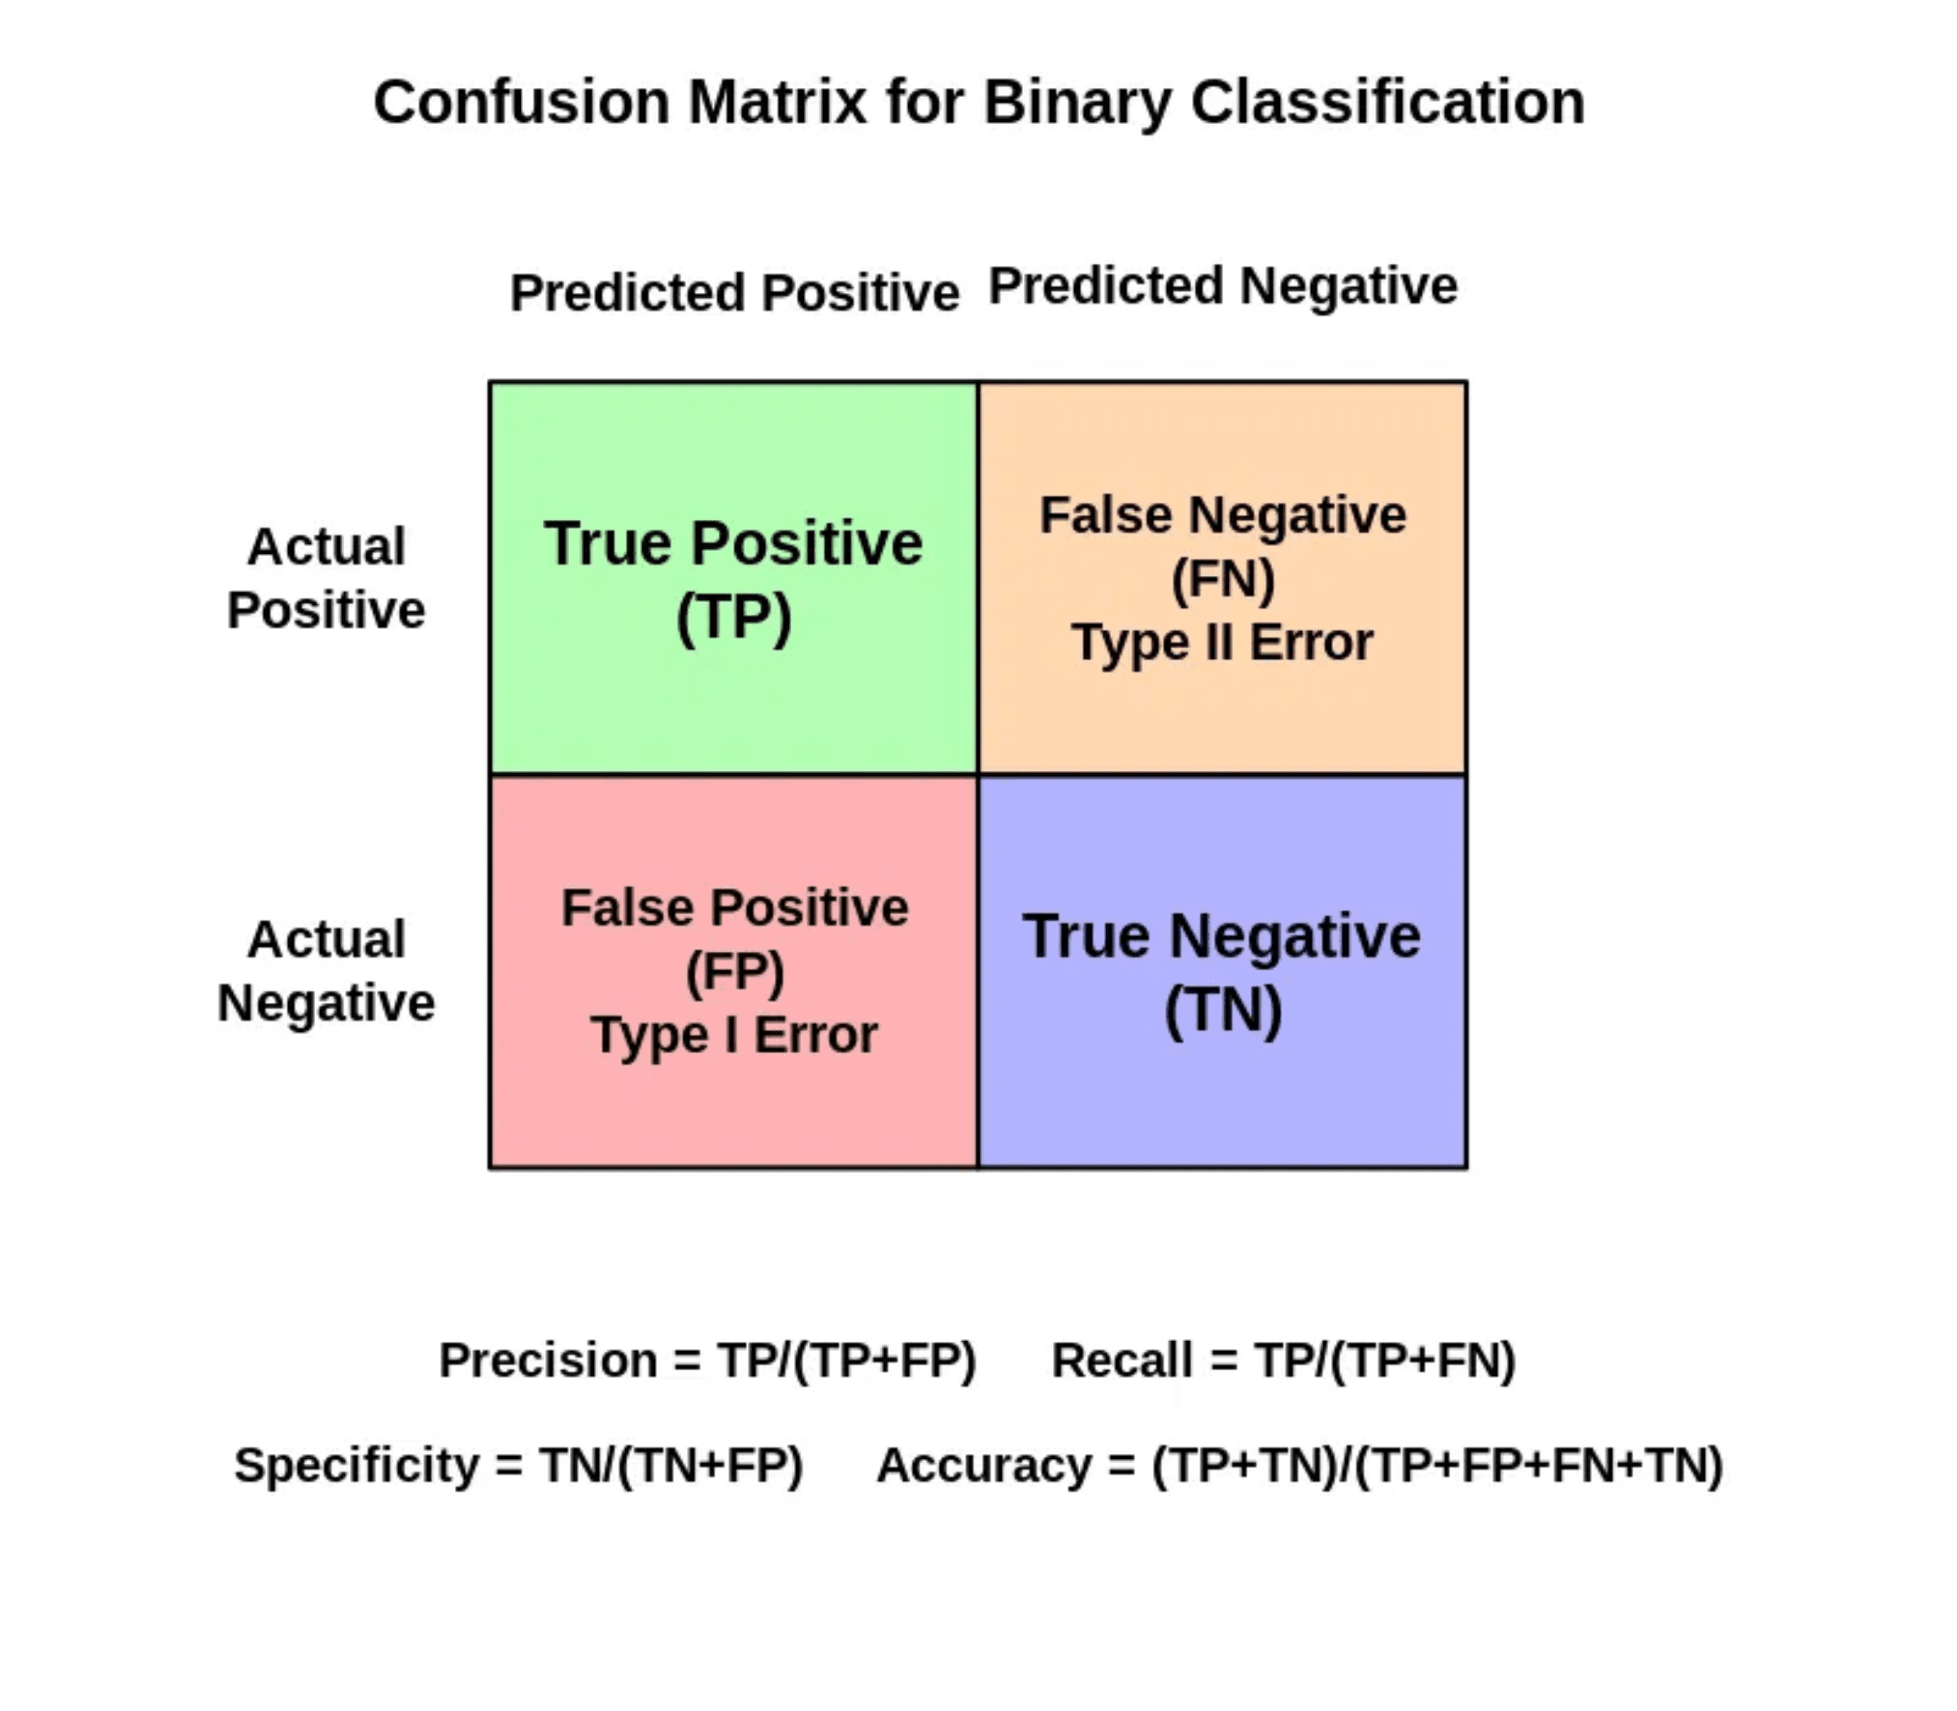
Confusion Matrix in Classification
Precision (PPV)
TP / (TP + FP)
Proportion of predicted positives that are actually correct.
Recall (Sensitivity)
TP / (TP + FN)
Proportion of actual positives correctly identified.
Specificity
TN / (TN + FP)
Proportion of actual negatives correctly identified.
Trade-off: Increasing recall often decreases precision.

Slide 14

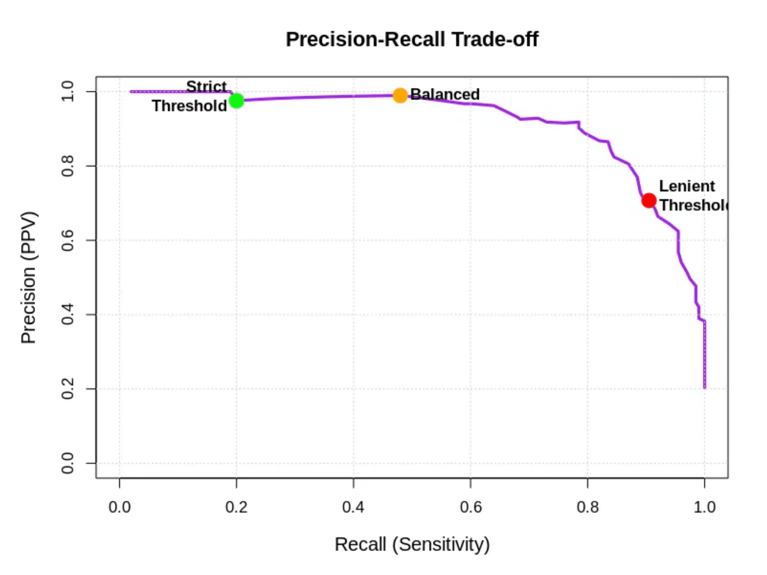
Precision-Recall Trade-off
Strict Threshold
High Precision, Low Recall. Few false positives, but many missed discoveries (False Negatives).
Lenient Threshold
Low Precision, High Recall. Captures most true signals, but includes many false positives.
Strategic Application
Discovery Phase:
Favor Recall (Lenient) to cast a wide net.
Validation Phase:
Favor Precision (Strict) to ensure reliability.
The inverse relationship between Precision (PPV) and Recall (Sensitivity)

Slide 15

Bayes' Theorem Fundamentals
Target here is a protein that is over- or under-expressed
P(target|positive)
Posterior / Positive Predictive Value (PPV)
Probability of Hypothesis given Data (The Goal).
P(target|positive) =
P(positive|target)
Likelihood / sensitivity of the target detection
Probability of Data given Hypothesis (The Evidence).
P(positive|target) P(target)
P(target)
Prior / prevalence = fraction of protein whose expression change
P(positive)
Initial belief about Hypothesis before seeing data.
P(positive)
Marginal / fraction of proteins change detected (correct or not)
Total probability of observing the Data.
The Logic of Inference
Core Concept
Bayes' theorem provides a mathematical way to update our prior beliefs with new experimental evidence.

Slide 16

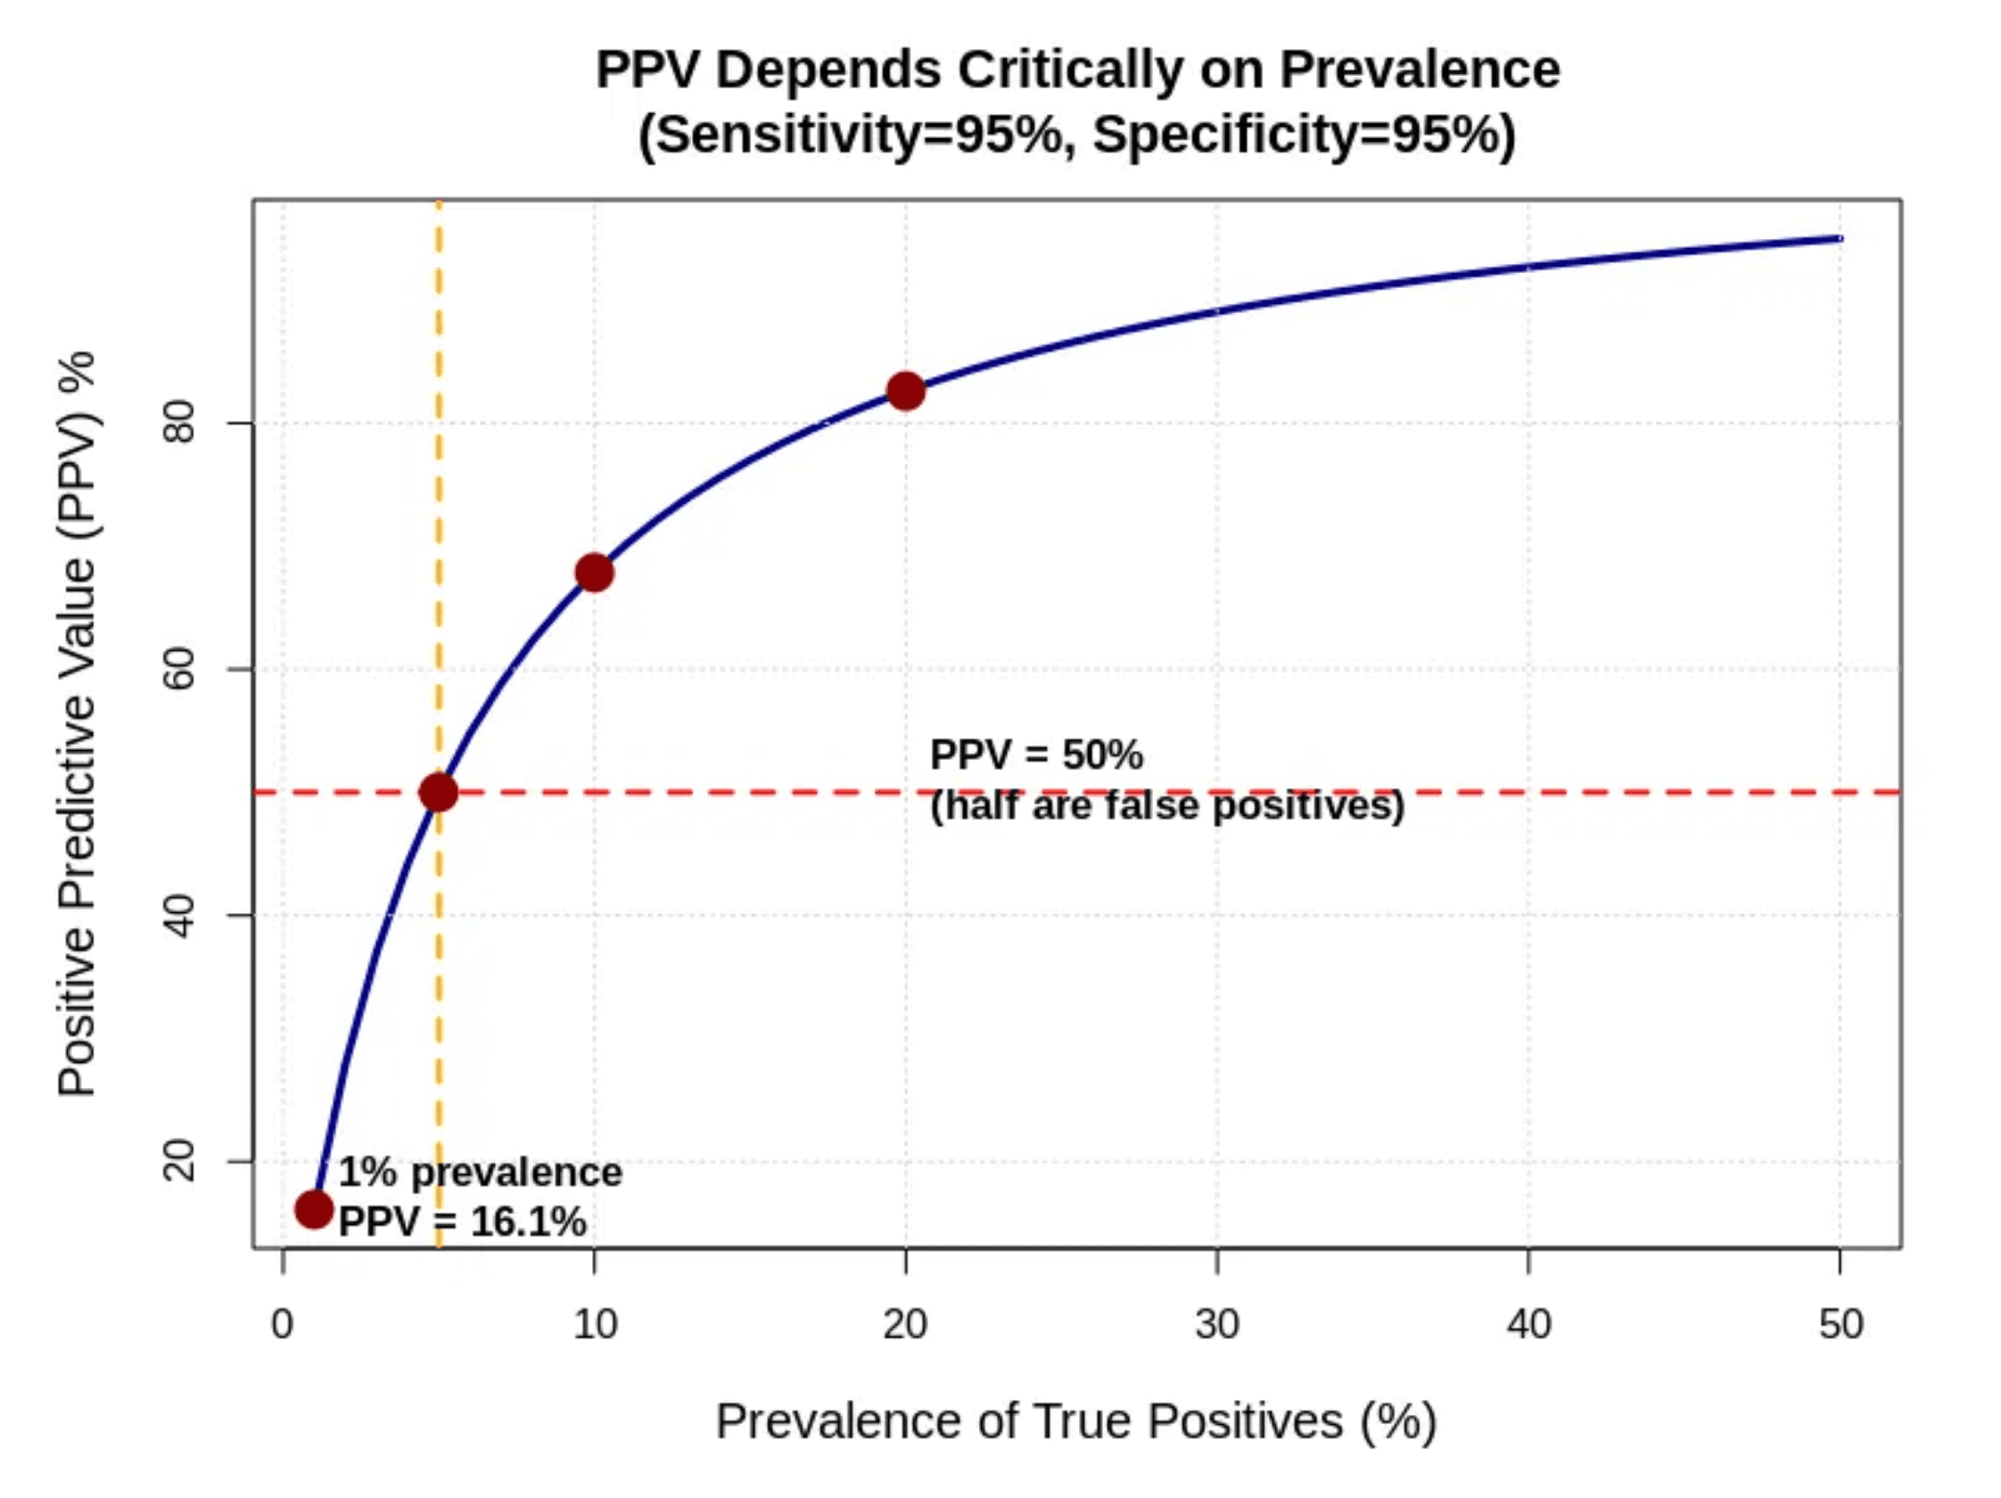
Bayes' Theorem and False Positives
Low prevalence of true positives dramatically increases false positive rates, even with accurate tests.
The 1% Prevalence Problem
Sensitivity: 95%
Specificity: 95%
Prevalence: 1%
16%
Positive Predictive Value (PPV)
84% False Positives!
"In proteomics, if only 1% of proteins are truly changing, standard p-value thresholds will flood your results with noise. You need stricter controls (low FDR)."
As prevalence drops (x-axis), the reliability of a positive result (y-axis) plummets.

Slide 17

Differential Expression Analysis in Proteomics
01. Quantify
Common Statistical Tests
Measure protein abundance.
t-test:
2-group comparison.
ANOVA:
>2 groups.
02. Normalize
limma:
Linear models for complex designs.
Remove technical bias.
Key Assumptions
03. Statistical Testing
Data ~ normal (often log-transformed).
Compute p-values per protein.
Independent samples.
Comparable group variances.
04. Correction
Adjust p-values (FDR).
The Goal
List proteins with significant fold changes and adjusted p-values to identify candidates.

Slide 18

Practical Example - Data Preparation in R
# Load required libraries
library(limma)
library(DEqMS)
# 1. Load Data (Expression Matrix)
# Rows = Proteins, Columns = Samples
data <-read.csv("protein_abundance.csv", row.names=1)
# 2. Quality Control & Filtering
# Keep proteins with valid data in at least 3 samples
valid_rows <-rowSums(!is.na(data)) >=3
filtered_data <- data[valid_rows, ]
# 3. Normalization (Quantile)
# Corrects for technical variation between samples
norm_data <-normalizeQuantiles(as.matrix(filtered_data))
# 4. Log Transformation
log_data <-log2(norm_data +1)
Essential Packages
limma
Linear Models
DEqMS
Variance Modeling
ggplot2
Visualization
Data Structure
Expression Matrix: Rows = Proteins Columns = Samples (Replicates)
Workflow
1. Import Data 2. Filter Missing Values 3. Normalize (Quantile/Median) 4. Log Transformation

Slide 19

Practical Example - Statistical Testing in R
The limma Package
Originally designed for microarrays, limma (Linear Models for Microarray Data) is the gold standard for proteomics differential expression.
# Fit linear model and contrasts, then apply eBayes
Fit <- lmFit(expression_data, design) contrast_matrix <- makeContrasts(TreatmentVsControl=Treatment-Control, levels=design) fit2 <- contrasts.fit(fit, contrast_matrix) fit2 <- eBayes(fit2) results <- topTable(fit2, number=Inf)
Empirical Bayes Moderation
Borrows information across all proteins to stabilize variance estimates. Critical for small-sample proteomics (n = 3 to 6).
Why it works
lmFit()
eBayes()
Prevents proteins with artificially low variance from appearing significant by chance.
Fits a linear model for each protein.
Computes moderated t-statistics and p-values.

Slide 20
Practical Example - Multiple Testing Correction in R
The p.adjust() Function
R's built-in function to adjust raw p-values using various methods. For proteomics, "BH" (Benjamini-Hochberg) is the standard for FDR control.
# 1. Extract raw p-values from results
raw_pvalues <- results$P.Value
# 2. Apply Benjamini-Hochberg (FDR) correction
results$adj.P.Val <- p.adjust(raw_pvalues, method = "BH") # 3. Filter for significant discoveries (FDR < 0.05)
significant_proteins <- subset(results, adj.P.Val < 0.05) # 4. Check how many proteins passed
print(nrow(significant_proteins))
The Reality Check
Protein A
p = 0.01 → adj.p = 0.15
Protein B
p = 0.0001 → adj.p = 0.03
Protein A is no longer significant after correction!

Slide 21

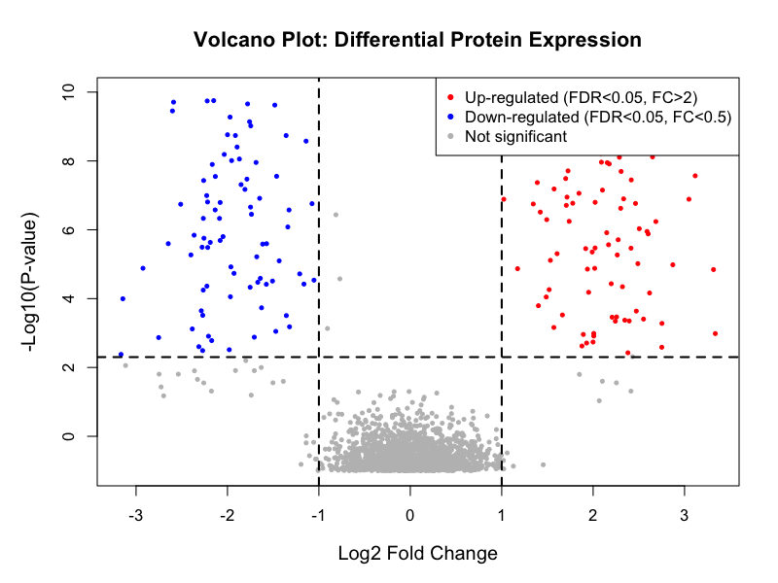
Practical Example - Results Visualization in R
Generating a Volcano Plot
library(ggplot2) # Create Volcano Plot
ggplot(results, aes(x = logFC, y = -log10(adj.P.Val))) +
geom_point(aes(color = Significant)) +
theme_minimal() +
labs( title = ”Volcano Plot: Differential Protein Expression", x = "Log2 Fold Change", y = "-Log10(P-value)" ) +
geom_hline(yintercept = -log10(0.05), linetype = "dashed") +
geom_vline(xintercept = c(-1, 1), linetype = "dashed")
X-Axis (Log2 Fold Change)
Y-Axis (-Log10 P-value)
Magnitude of change. Positive = Upregulated, Negative = Downregulated.
Statistical significance. Higher points are more significant.

Slide 22

Summary and Best Practices
01
Power in Numbers
Biological replicates are essential. n = 3 is the absolute minimum; n ≥ 5 is recommended for robust statistics.
Core Philosophy
02
Choose the Right Test
"Statistics is a filter to remove noise, not a machine that generates truth."
Use limma or similar moderated tests for small sample sizes to stabilize variance estimates.
03
Correct for Multiple Testing
Always apply FDR correction (Benjamini-Hochberg). A raw p-value < 0.05 is rarely sufficient in proteomics.
04
Validate Findings
Use statistical tools to prioritize candidates, but let biological understanding guide your final conclusions.
Statistical significance ≠ Biological relevance. Validate key hits with orthogonal methods (e.g., repetition, Western Blot, biological validation).

Slide 23
Resources and Further Learning
Essential Reading
Software & Tools
Proteomics with Open Source Software
FDR & Benjamini-Hochberg
Platform
Proteomics Analysis with R
A Tutorial on False Discovery Control
Bioconductor
Using R for Proteomics Data Analysis (nov. 2025)
https://www.stat.cmu.edu/~genovese/talks/hannover1-04.pdf
Open-source software project for high-throughput genomic/proteomic data https://www.bioconductor.org
https://www.bioconductor.org/packages/release/data/experiment/vignettes/RforProteomics/inst/doc/RforProteomics.html
R Package
Controlling the False Discovery Rate: A Practical and Powerful Approach to Multiple Testing (1995)
limma
R for Mass Spectrometry (2026)
Linear models for microarrays and omics data https://www.bioconductor.org/packages/release/bioc/html/limma.html
https://www.rformassspectrometry.org
https://rss.onlinelibrary.wiley.com/doi/10.1111/j.2517-6161.1995.tb02031.x
This Presentation & Associated R Scripts
Proteomics Analysis with Python
https://filedn.com/lzGVgfOGxb6mHFQcRn9ueUb/bepa2026/bepa2026_stats.pdf
Pyteomics
https://filedn.com/lzGVgfOGxb6mHFQcRn9ueUb/bepa2026/generate_visualizations.R
https://pyteomics.readthedocs.io/en/latest/
https://filedn.com/lzGVgfOGxb6mHFQcRn9ueUb/bepa2026/r_code_examples.R

