Slide 1
Use demo data
Yes
No
npx_data1
Outlier detection
npx data file sample manifest
olink_qc_plot
olink_pca_plot
olink_umap_plot
Yes
Filter data
No
Filter sample(s) and/ or Assay(s)
Filtering not done
Statistical analysis
Parametric statistics
Non-parametric statistics
Outcome with 2 levels
Outcome with > 2 levels
Outcome with 2 levels
Outcome with > 2 levels
olink_ttest
olink_anova
olink_lmer
olink_wilcox
olink_one_non_parametric
olink_ordinalRegression
Post-hoc test
Post-hoc test
olink_anova_posthoc
olink_lmer_posthoc
olink_one_non_parametric_posthoc
olink_ordinalRegrssion_posthoc
Pathway enrichment
Gene Set Enrichment Analysis (GSEA)
Over-Representation Analysis (ORA)

Slide 2
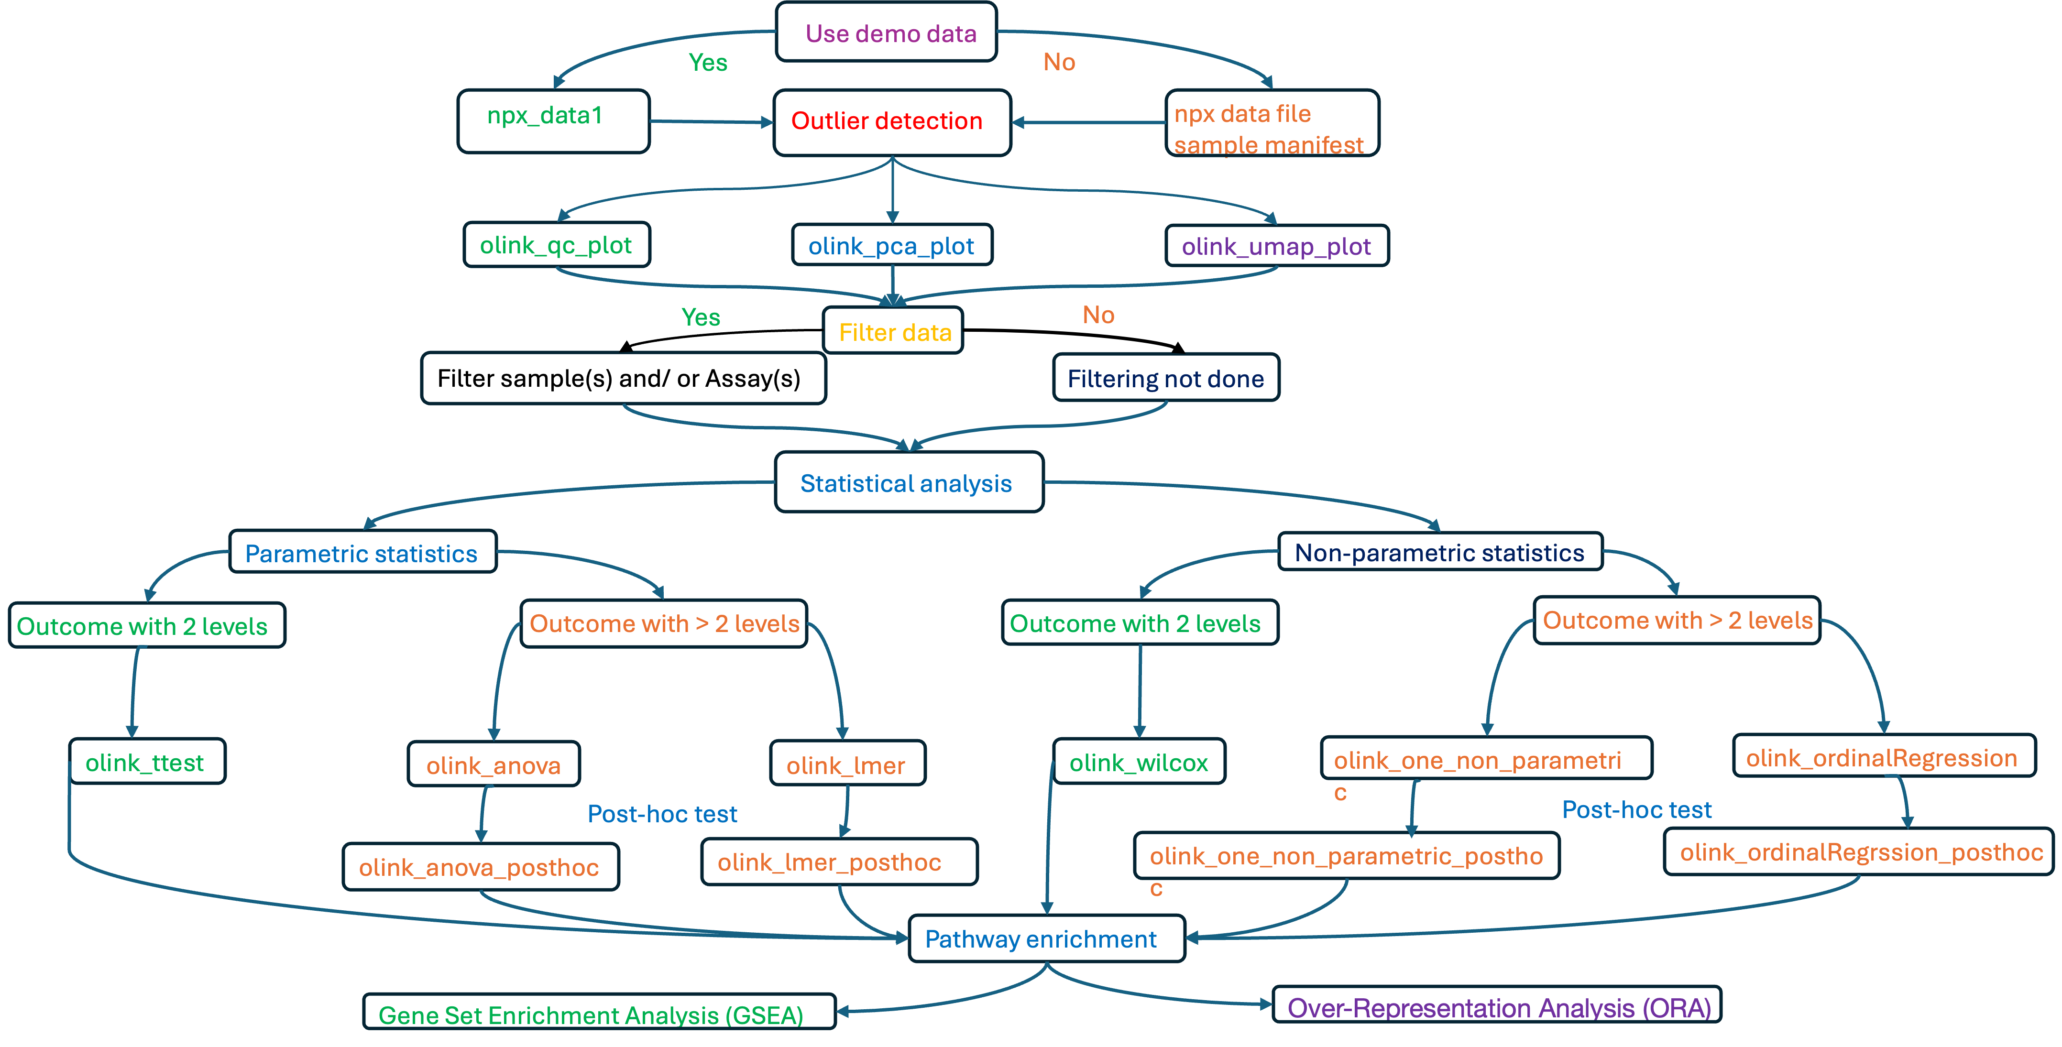
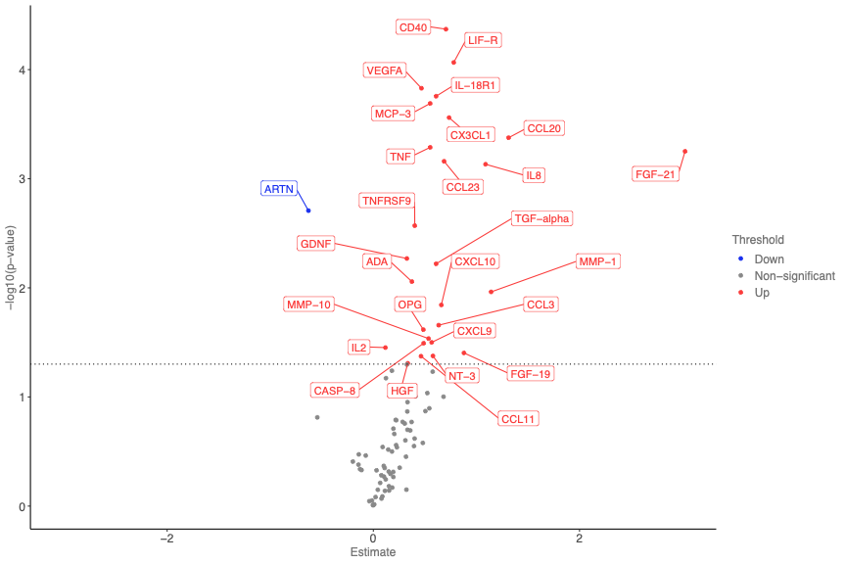
A.
B.

Slide 3
Use demo data
Yes
No
npx_data1
Outlier detection
npx data file sample manifest
olink_qc_plot
olink_pca_plot
olink_umap_plot
Yes
Filter data
No
Filter sample(s) and/ or Assay(s)
Filtering not done
Statistical analysis
Parametric statistics
Non-parametric statistics
Outcome with 2 levels
Outcome with > 2 levels
Outcome with 2 levels
Outcome with > 2 levels
olink_ttest
olink_anova
olink_lmer
olink_wilcox
olink_one_non_parametric
olink_ordinalRegression
Post-hoc test
Post-hoc test
olink_anova_posthoc
olink_lmer_posthoc
olink_one_non_parametric_posthoc
olink_ordinalRegrssion_posthoc
Pathway enrichment
Gene Set Enrichment Analysis (GSEA)
Over-Representation Analysis (ORA)

