Slide 1


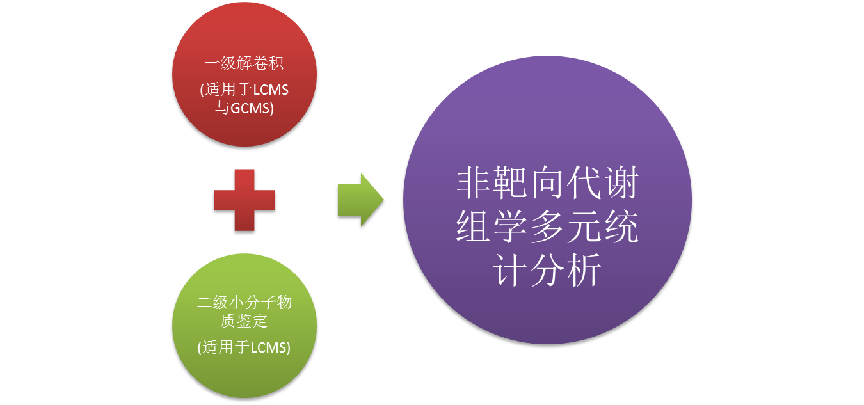


BioDeep Metabolism Workflow

