Slide 1
Robust inference of biological Bayesian networks
Masoud Rostami and Kartik Mohanram
Department of Electrical and Computer Engineering
Rice University, Houston, TX
Notes:
Good morning everyone and thank you for attending my talk today. My name is Masoud Rostami. The tile of my presentation is …

Slide 2
Outline
Regulatory networks
Inference techniques, Bayesian networks
Quantization techniques
Improving quantization by bootstrapping
Results on SOS network
Conclusions
Notes:
Here is a brief outline for the talk. I begin by introducing regulatory networks. Then we discuss techniques that are used to infer
Regulatory networks from micro-array data. Among them, Bayesian networks is among the most widely methods to analyze
Regulatory networks. It is well-known that qunatization influences the quality. One of the critical steps is quantization and our contribution is improving quantization by bootstrapping Techniques, to enhance the quality of inferred network.
We review common quantization techniques and then we’ll introduce a technique based on bootstrapping. We show its efficiency by applying it to SOS network , a network which its true structure is known. Then, I’ll conclude and discuss the directions.

Slide 3
Gene regulatory networks
Cells are controlled by gene regulatory networks
Microarray shows gene expression
  Relative expression of genes over period of time
Reverse engineering to find the underlying network
  May be used for drug discovery
Pros
  Large amount of data in public repositories
Cons
  Data-point scarcity
  High levels of noise
Notes:
Biochemical reactions in cells are controlled by gene regulatory network. This network responds to external perturbation by regulating protein production. Microarray technology is used to study the relative expression of genes over a period of time. Then this information is used to infer
The underlying network by reverse engineering techniques. These networks may be used later for drug discovery.
Lots of data is now available in public repositories, but still the data point samples of gene expression is scarce. And besides, the data is inherently noisy. So, efficient techniques for network inference is now a matter of the utmost interest.

Slide 4
Network inference
Several techniques to infer with different models
  Bayesian networks
  Dynamic Bayesian networks
  Neural networks
  Clustering
  Boolean networks
Question of accuracy, stability, and overhead
No consensus
Bayesian networks have solid mathematical foundation
Notes:
Several techniques have been proposed for inference. The network may be modeled by BN, or its kin DBN. One may use NN, clustering, or Boolean networks. All of them make different abstraction about the data, and have different merits of accuracy, stability, and computational overhead. Still there is no silver bullet for inference. In here, we focus on BN, because it has a solid mathematical foundation and lots of tools and algorithms have been developed for it, and is widely studied in this field.

Slide 5
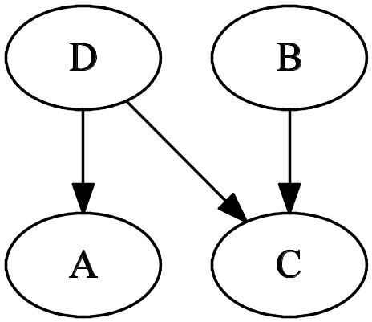
Bayesian networks
Directed acyclic graph with annotated edges
  Structure
  Parameters
Product of conditional probabilities
NP-hard
  A fitness score is assigned to candidates
  Score: how likely the candidate generated the data
Notes:
BN is a directed acyclic graph with annotated edges. In the context of gene regulatory networks, nodes are genes and …
The BN converts the joint statistical distribution of all variables to product of conditional probabilities. Finding the best network is NP-hard. So, a fitness score is assigned to candidate graphs and a search algorithm tries to find a graph with the best score. The probability that the candidate graph has generated the data is usually taken as the score.

Slide 6
Bayesian networks
Heuristics to find the best score
  Simulated annealing
  Hill-climbing
  Evolutionary algorithms
No notion of time steps
It needs discrete data
  At most ternary
  Due to scarce data
How to quantize data?
Notes:
The search algorithm for highest scoring graphs can be …
Over all, BN does not have any notion of time and its inputs should be discrete values.
Due to fact that the required time samples have a super exponential dependence on quantization levels.
The data is usually binary or at most ternary.
Now the question is this, how to quantize the data? Which is the focus of this project.

Slide 7
Quantization
Should be smoothed? (remove spikes)
Mean?
Median? (quantile quantization)
  More robust to outliers
(max+min)/2? (interval quantization)
…
Can we extract as much as information as possible?
Notes:
Should data be smoothed prior to quantization to remove spikes? Should we use the average for threshold of quantization. Why not median? What about the midpoint between maximum and minimum? As it is taught in statistic courses, the median is the most robust indicator of data against noise and we have found out that it has better performance.
But, can we extract as much as information from data by these common quantization techniques?

Slide 8
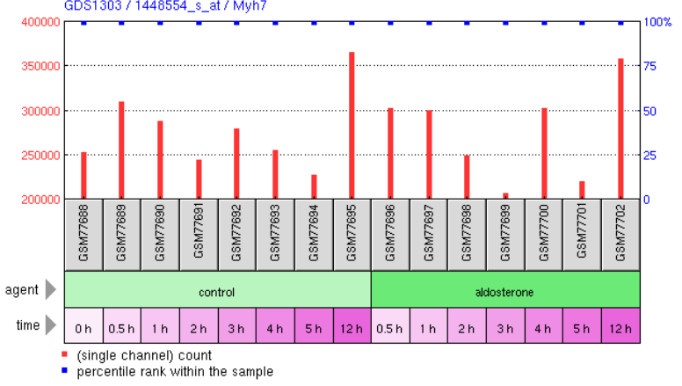
An example
Method of quantization impacts the inferred network
[1] GDS1303[ACCN], GEO database
Notes:
In here, you can see an example of a real data extracted from a public repository. You can see that first, the available time-points are just a few. There are some time-points in the figure that you are not sure about how you should quantize it. Should you assign them to ‘0’ or should you assign them ‘1’. Due to scarcity of data, your choice of quantization method has a huge impact on the inferred network. Data is also noisy which may even make the process completely unstable.

Slide 9
Time-series
Each sample is dependent on its neighbor
Gene expression samples are dependent
  Data does have some structure (it’s a waveform)
Common quantization removes this information
Notes:
The other often missed charactristic of microarray data, is that they are time-series. Something that has been neglected in literature so far.
Gene expressions over a course of an hours are statistically correlated as the weather of Anaheim at 3PM and 4PM are correlated.
However all of those quantization techniques just miss this information. Gene expression is a waveform and has some implied structure or up and down, and we should use in our quantization.
So, How can we preserve this information?

Slide 10
Better inference
Artificial ways to increase samples
Represent each sample n times
Takes ‘0’ and ‘1’ according to the probability
10 times, p(‘1’) = 0.20
  2 times ‘1’, 8 times ‘0’
Adds computational overhead
How to quantify probability
  Use correlation information
  Noise model?
Notes:
So, here comes our contributions. We looked into artificial ways to increase the available samples to us, and at the end we get better accurate network.
So, we represent each sample n times in the quantized dataset. These n samples take ‘0’ and ‘1’ according to probability of being ‘0’ and ‘1’.
For example, if we repeat it 10 times, and the probability of being ‘1’ is 20% then times from this 10 times we assing ‘1’ and the rest will be ‘0’.
Increasing the number of samples increase the computational complexity, but we’ll show later that it is worth it.
So, how we should find this probability with using correlation between samples? Do we need noise models?

Slide 11
Time-series Bootstrapping
Bootstrapping generates artificial data from the original
Artificial data is used to asses the accuracy
Time-series bootstrapping preserves data structure
[1] B. Efron, R. Tibshirani, “An introduction to the bootstrap”, chapter 8
Notes:
The first step of finding the probabilities is generating artifical data by bootstrapping.
Bootstrapping is a statistical process that generates instances of artificial data from the original data.
Time-series Bootstrapping is an extension of regular bootstrapping that is applied to time-series waveform. It generates artificial waveform from
The original waveform while preserving its underlying characteristics.
The details of time-series can be found in statistics book, and a good one is mentioned here.

Slide 12
Probability of ‘0’ and ‘1’
Find the threshold for each bootstrapped sample
Gives distribution of quantization threshold
Go back and quantize with the new set
The consensus gives probability
Benefits:
  Correlation information between samples preserved
  No need for a noise model
Notes:
After obtaining the artificial samples, we find the threshold of quantization for each of them.
It gives us a distribution of quantization threshold.
Now that we have this distribution of threshold, we go back and quantize the original data by using the obtained threshold values.
This gives us a set of quantized sample. The average over all this quantized samples gives the probability .
For example, we generate 1000 artificial waveform, and then 1000 quantization threshold. If an instance in the original data-set
is higher than 20% of these quantization threshold, this instance should be assigned to ‘1’ 20% of times and ‘0’ 80% of the times.
So, we managed to preserve the information from correlation between variables while avoiding any noise model.

Slide 13
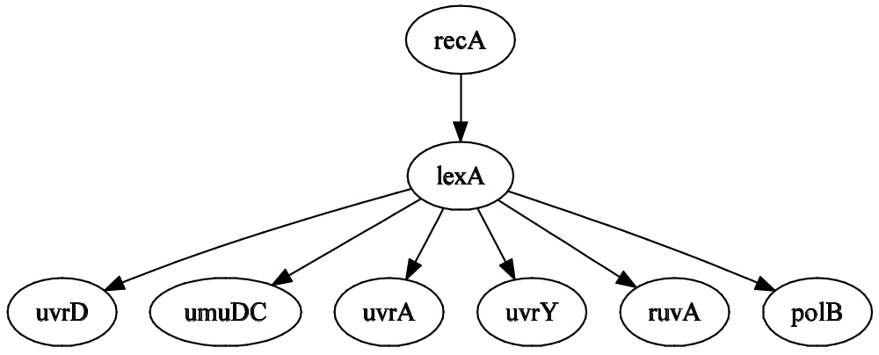
SOS network
SOS network
  8 genes, 50 time-sample, 4 experiments
  The true network is known
Notes:
Now we implement the method on SOS network.
Which consists of expression of 8 genes over 50 time-sample, repeated 4 times.
Its one of the best available data and the true network is known.

Slide 14
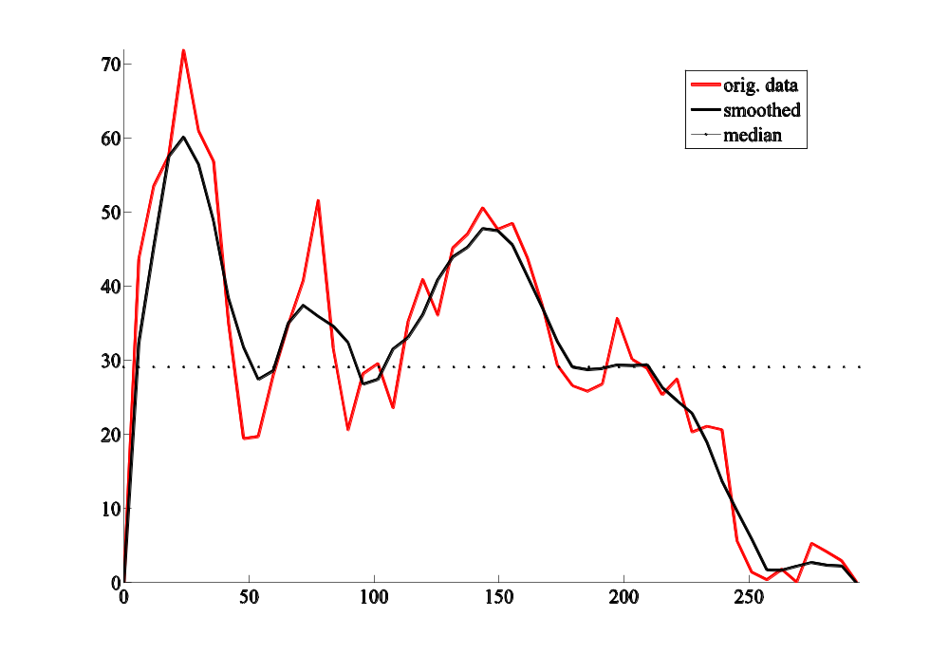
polB, experiment 1, SOS
Gene expression
Time
Notes:
In here you can see the waveform of gene expression of ‘polB’ from experiment 1. The original data is red, and as you can see
There a couple of instances that are very close to the median of the waveform. So, the choice of quantization will severely impact the
Accuracy of inferred network.

Slide 15
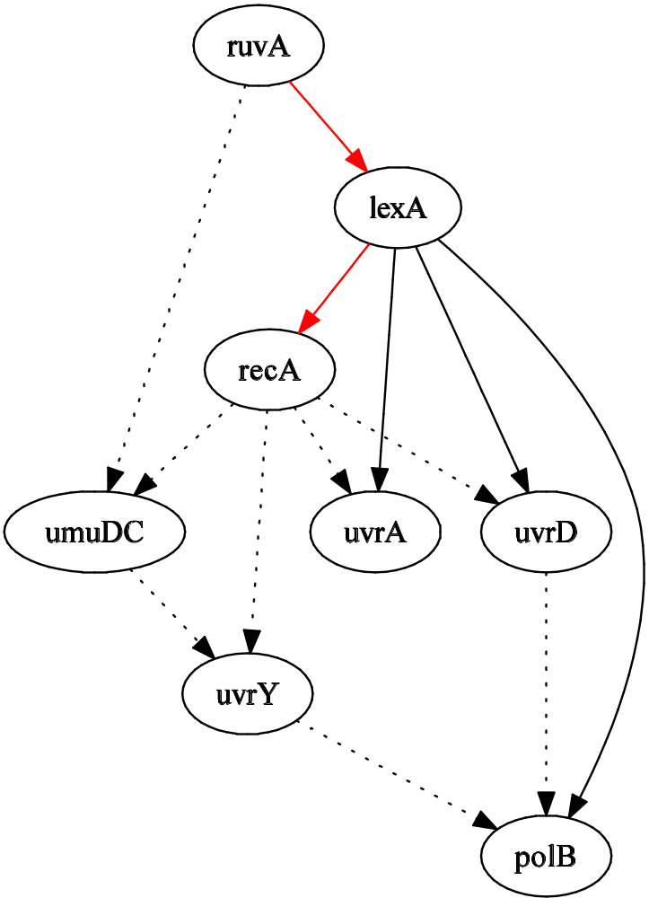
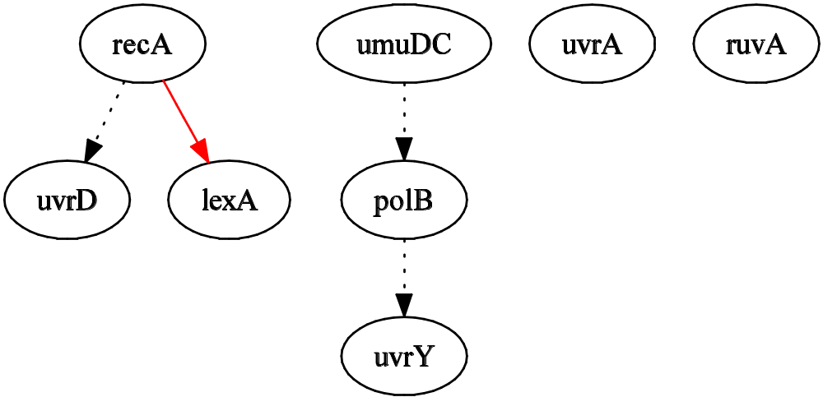
SOS, experiment-3, quantile quantization
Normal
Bootstrapped
Notes:
If the conventional quantization is performed by using just the median, the inferrred network will be something like the left graph.
If the time-series bootstrap quantization is used, the inferred network will be something like the right graph.
The dashed lines are false-positive and and solid ones are true recovered edges. The red edges are true edges but with wrong direction.

Slide 16
Results
Banjo (15min search)
  Consensus over top 5 scoring networks
Conventional | True edges | False edges | True direction
Exp1 | 2 | 11 | 0
Exp2 | 3 | 7 | 2
Exp3 | 1 | 3 | 0
Exp4 | 2 | 9 | 1
Average | 2 | 7.5 | 0.75
Bootstrapped | True edges | False edges | True direction
Exp1 | 3 | 10 | 2
Exp2 | 3 | 9 | 2
Exp3 | 5 | 8 | 3
Exp4 | 4 | 10 | 0
Average | 3.75 | 8.75 | 1.75
Notes:
Banjo from Duke university is used for BN inference. The search last 15min and the inferred network is the consensus over the top 5-scoring networks.
The results of BN inference is shown for 4 experiments of SOS networks. By using bootstrapped quantization, number of discovered true edges increases , and number of discovered true direction increases by almost two fold while the number of false edges increase by 17%

Slide 17
Conclusions
Networks inferred from time-series gene expression
Bayesian network is one of the most common
Data needs quantization
Time-series information is lost in conventional methods
Information is retrieved by bootstrap quantization
  No noise model
  Correlation information used
  Better accuracy in inference
Notes:
ssWe saw that biological networks are inferred from microarray gene expression data.
BN inference is one of the most common ones. Data needs quantization for BN inference. Common quantization techniques don’t’ take into the account
The not correlation between time-samples. We have proposed a quantization method based on time-series bootstrapping.
It requires no noise model and uses the correlation information between samples. More accurate networks can be inferred by using this method.

