Slide 1

Pathway Identification for Strain Engineering
Mona Yousofshahi, Prof. Soha Hassoun
Department of Computer Science
Prof. Kyongbum Lee
Chemical & Biological Engineering
Tufts University

Slide 2
Motivation
Production or overproduction by synthetic pathways
Drugs
Antimalarial
Anticancer
Biofuels
Alcohol
Diesel
Bioplastics
Organic plastics
Derived from biomass sources instead of petroleum

Slide 3
Pathway synthesis
Pathway identification
Identify a coherent set of enzyme-catalyzed reactions from existing databases
Integration with the host
Ensure that the pathway minimally affects growth and other essential functions of the host

Slide 4
Approach
Probabilistic graph search algorithm based on metabolite connectivity
Graph construction begins with a target metabolite and ends in a host
Explicitly accounts for cofactors
Search criteria is metabolite connectivity within the KEGG database:
Number of reactions in which a metabolite participates
More diversity in the search space
Host
Target metabolite
Database

Slide 5
Metabolite connectivity in the KEGG database
P(k) ≃ 3.48 k^{-2.04}

Slide 6
Calculating reaction probability distribution based on metabolite connectivity
A
Metabolite connectivity:
The number of reactions in which a metabolite participates
Weighting of a reaction:
Minimum connectivity in a reaction is the bottleneck
W_{R} = minimum metabolite connectivity of the metabolites in reaction R (on the side opposite to the parent metabolite)
R₁
R₂
B
C
D
6

Slide 7
Probabilistic graph search algorithm
Target metabolite
Construct the graph recursively starting from the target metabolite
Select a random reaction based on metabolite connectivity
Search termination
Limit the number of reactions
Perform flux balance analysis on the constructed pathways
Host

Slide 8
Exhaustive search algorithm
Constructing the tree recursively, starting from the root and by adding all reactions to the tree
Applying FBA to rank the constructed pathways

Slide 9
Test cases
Genome-scale model of E. coli (iAF1260) (Feist, Henry et al. 2007) as a host
Target metabolites
Drug: Isopentenyl diphosphate
Biofuels: Biodiesel, Fatty acid methyl ester
Biofuel feedstock: Triacylglycerol
Polymer: 1, 3-propanediol
Compare three search algorithms based on yield results
Probabilistic, random and exhaustive
Yield is defined as the optimal flux of the target metabolite
Fixed biomass flux

Slide 10
Results
 | Probabilistic algorithm |  | Random algorithm |  | Exhaustive algorithm
Metabolite name | Number of pathways | Max. Yield | Number of pathways | Max. Yield | Number of pathways | Max. Yield
Isopentenyl diphosphate | 11 | 1.28 | 14 | 1.28 | 15 | 1.28
1,3-Propanediol | 1 | 2.19 | 1 | 2.19 | 1 | 2.19
Biodiesel | 17 | 3.30 | 19 | 2.09 | 504 | 3.58
Fatty acid methyl ester | 69 | 1.25 | 46 | 0.76 | 1121 | 1.25
Triacylglycerol | 71 | 1.94 | 45 | 0.44 | 2949 | 1.97
Run times:
Exhaustive search for maximum 10 reactions in a pathway: hours
Probabilistic and random search: minutes

Slide 11
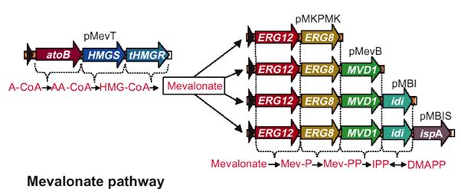
Comparing with literature
Identified pathway for isopentenyl diphosphate by probabilistic algorithm:
Acetyl-CoA + Acetoacetate ⬄ (S)-3-Hydroxy-3-methylglutaryl-CoA ⬄ (R)-Mevalonate ⬄ (R)-5-Phosphomevalonate ⬄ (R)-5-Diphosphomevalonate ⬄ Isopentenyl diphosphate
(Martin, Piteral et al. 2003)

Slide 12
Yield distributions
Triacylglycerol yield distribution
Probabilistic search
Exhaustive search

Slide 13
Number of required iterations
50 runs for each iteration
Fatty acid methyl ester

Slide 14
Probabilistic vs. random search
50 runs for each iteration
Fatty acid methyl ester

Slide 15
Prior works
PathMiner (McShan, Rao et al. 2003)
exploring the biochemical state space using a heuristic search based on minimizing the cost of transformation
Atom mapping (Blum, Kohlbacher 2008)
Optstrain (Pharkya, Burgard et al. August 2004)
building a framework for identifying stoichiometrically balanced pathways while maximizing product yield
Requires database curation

Slide 16
Conclusion & future work
A probabilistic graph search algorithm to identify synthetic pathways
Using the notion of the metabolite connectivity
Does not require any database curation
Reproduce experimentally obtained pathways reported in the literature
Future work:
Integration with the host
Gene interactions

