Slide 1

Predictably Profitable Paths in Metabolic Networks
Ehsan Ullah, Prof. Soha Hassoun
Department of Computer Science
Mark Walker, Prof. Kyongbum Lee
Department of Chemical and Biological Engineering
Tufts University

Slide 2
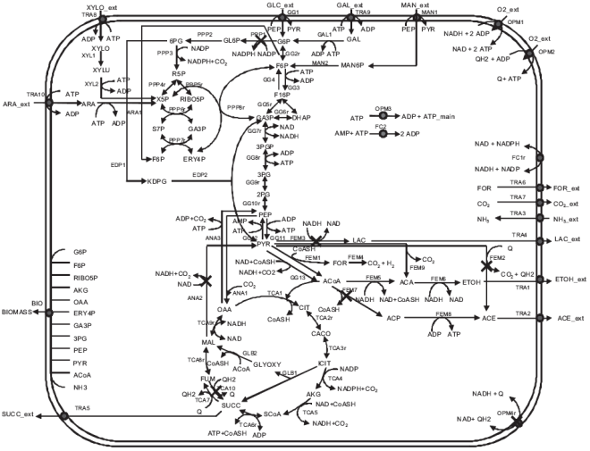
Engineered Pathway Interventions
Embedding new pathways
Removing pathways
Improving existing pathways
(Atsumi et al., 2008) (Trinh et al., 2006) (Steen et al., 2010)

Slide 3
Pathway Analysis
Enumeration
Elementary Flux Mode (Schuster et al., 2000)
Graph traversal
Dominant-Edge Pathway Algorithm (Ullah et al., 2009)
Favorite Path Algorithm*
s
4th
R₁
b
2nd
R₂
R₃
c
d
R₄
R₅
3rd
e
Dominant-Edge
1st
R₆
t
*Unpublished

Slide 4
Problem: Pathway Analysis in Presence of Flux Variations
Flux variations arise from different conditions
Given a metabolic network graph G = (V,E), source vertex s and destination vertex t and a flux range associated with each edge, find the predictably profitable path in the graph

Slide 5
Profitable Network
A network in which any path from s to t can carry at minimum v_{p} amount of flux
G_{p} = G(V,E) such that w_{e} ≥ v_{p}
v_{p} is obtained from the best flux-limiting step
s
R₁ (10)
b
R₃ (4)
R₂ (6)
R₃ (4)
d
c
d
R₄ (6)
R₅ (4)
R₅ (4)
e
R₆ (10)
t

Slide 6
Predictable Path
A path in the network having reactions with smallest variations in flux
s
R₁ [10 15]
b
R₃ [7 12]
R₂ [8 14]
R₃ [7 12]
d
c
d
R₄ [6 10]
R₅ [3 11]
R₅ [3 11]
e
R₆ [9 18]
t

Slide 7
Approach to Find Predictably Profitable Path
Identification of profitable network
Assign the lower limit of each flux range as edge weight
Find flux limiting step using favorite path algorithm
Prune all edges having weight less than the flux liming step found in (b)
Identification of predictable path in profitable network
Assign the flux ranges as edge weight
Use favorite path algorithm to find predictably profitable path

Slide 8
Test Cases
Escherichia coli
62 Reactions
51 Compounds
Liver Cell
121 Reactions
126 Compounds

Slide 9
Escherichia coli
Production of ethanol from glucose in anaerobic state
Flux data generated from Carlson, R., Scrienc, F. 2004
9
Notes:
9

Slide 10
Escherichia coli
glucose
PEP
ethanol
Pyruvate
10
Notes:
10

Slide 11
Escherichia coli
glucose
Flux-limiting step
Flux Limiting Step
PEP
ethanol
Pyruvate
11
Notes:
11

Slide 12
Escherichia coli
glucose
Flux-limiting step
Profitable network
Profitable Network
PEP
ethanol
Pyruvate
12
Notes:
12

Slide 13
Escherichia coli
glucose
Flux-limiting step
Profitable network
Predictably profitable path
Glycolysis is more predictable than PPP
Matches maximal production path identified by (Trinh et al., 2006)
Glycolysis
PEP
ethanol
Pyruvate
13
Notes:
13

Slide 14
Liver Cell
Production of glutathione from glucose
Flux data taken from HepG2 cultures*
Two observed states
Drug free state
Drug fed state (0.1mM of Troglitazone)
*Unpublished results

Slide 15
Liver Cell
glucose
glutathione
glu
cys
gly
ala
akg
lys
glu
akg
15

Slide 16
Liver Cell
glucose
glutathione
glu
Drug free state
cys
gly
ala
akg
lys
glu
akg
16

Slide 17
Liver Cell
glucose
glutathione
glu
Drug free state
PPP, Alanine biosynthesis, Lysine degradation
cys
gly
ala
akg
lys
glu
akg
17

Slide 18
Liver Cell
glucose
glutathione
glu
Drug fed state
cys
gly
ala
akg
lys
glu
akg
18

Slide 19
Liver Cell
glucose
glutathione
glu
Drug fed state
PPP, Cystine biosynthesis
cys
gly
ala
akg
lys
glu
akg
19

Slide 20
Conclusions
Efficient way of identifying target pathways for analyzing and engineering metabolic networks
Capable of handling variations in flux data
Polynomial runtime

