Slide 1

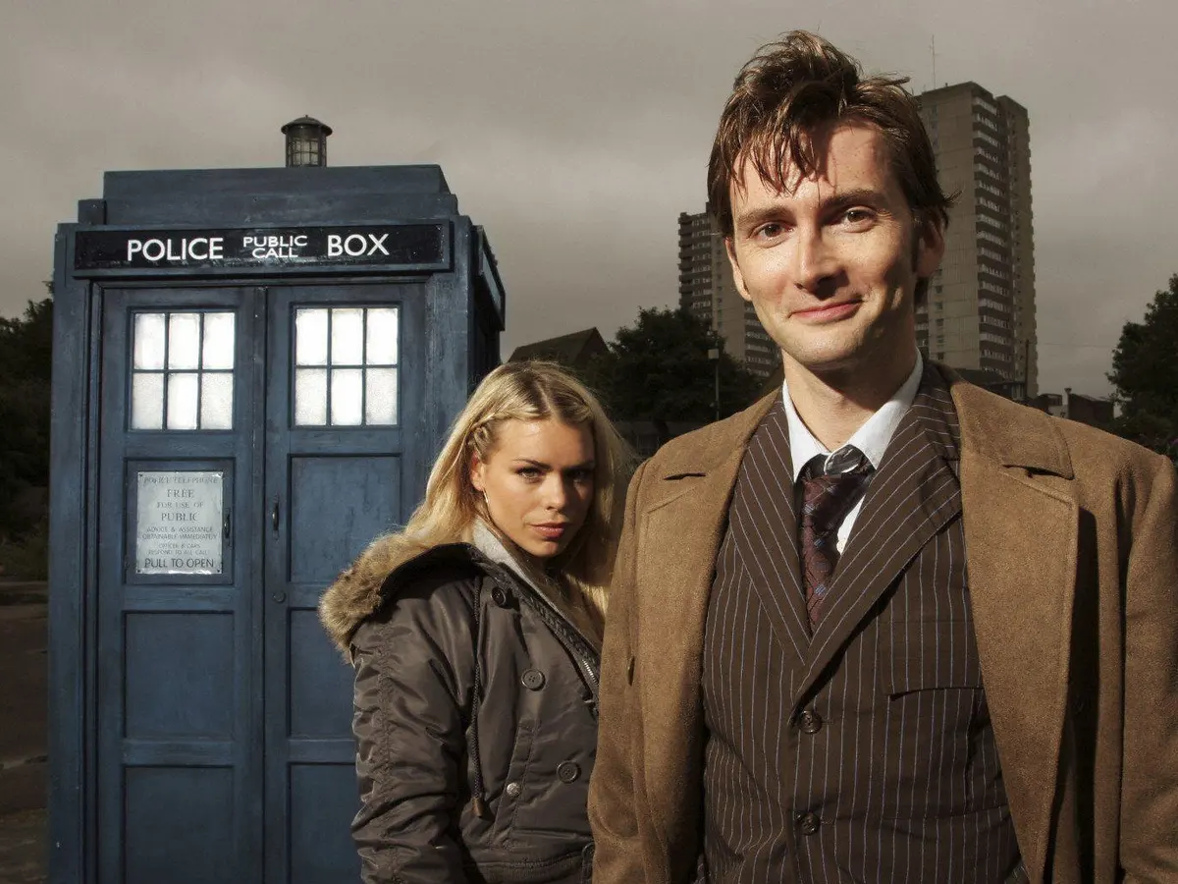
Time Series – 24th March 2021
Notes:
https://www.theguardian.com/tv-and-radio/2020/sep/21/david-tennant-voted-the-peoples-favourite-doctor-who

Slide 2
What is a time series?
- Put simply: a visualisation of data that changes across time
- Most commonly line plots, but often scatter or boxplots too
- A way to analyse seasonal or otherwise cyclical trends
- A dataset that can be used to model forecasts

Slide 3
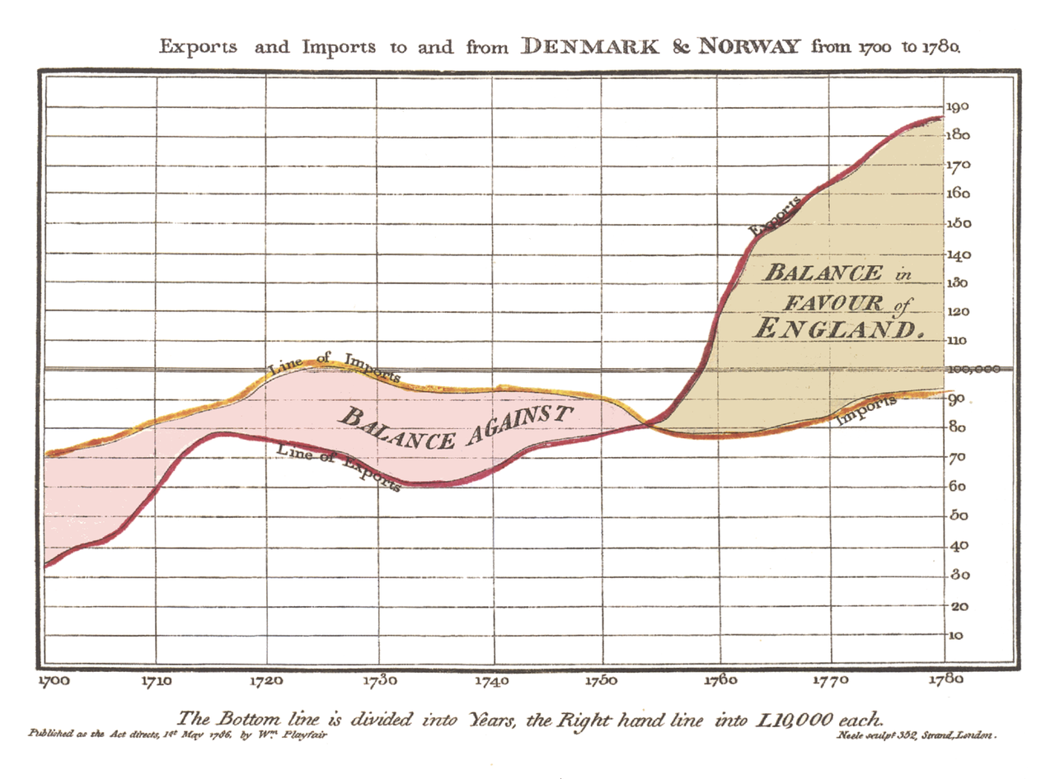
An age old practice

Slide 4
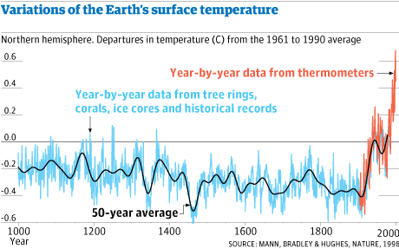
Perhaps the most famous time series:

Slide 5
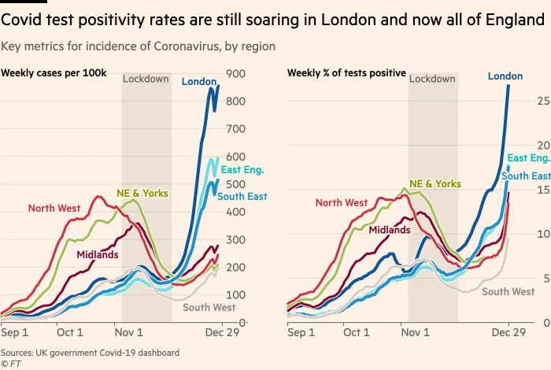
Useful for non-academic visualisation too!

Slide 6
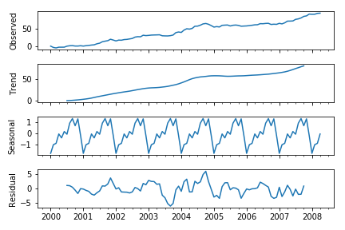
Chronological data at different resolutions
Notes:
https://stackoverflow.com/questions/52870252/decompose-a-time-series-only-in-trend-and-residual-with-python

Slide 7
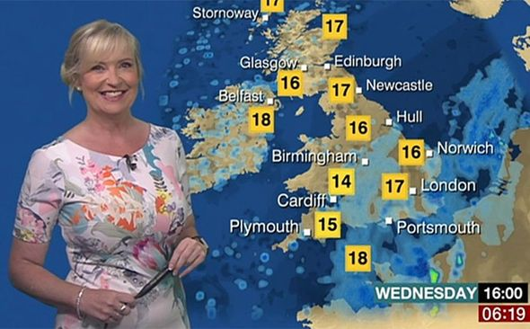
Forecasting!

Slide 8
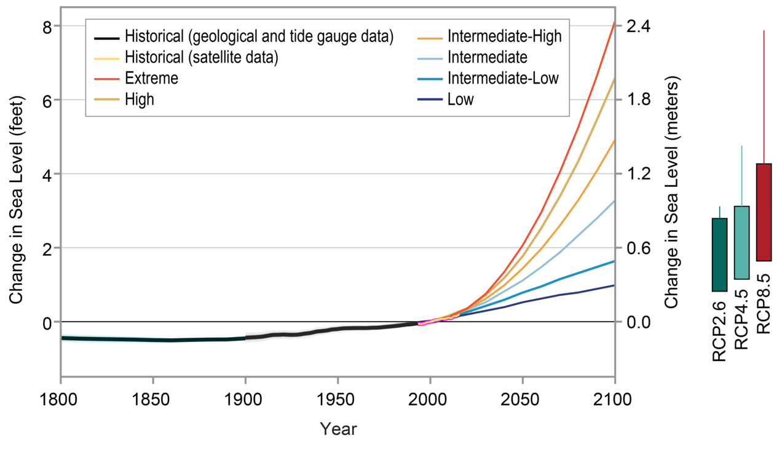
But really, we mean forecasting like this:

Slide 9
Today’s workshop: Analysing time series data
Find the tutorial here: https://ourcodingclub.github.io/tutorials/time/
Work through the tutorial in your own time, we’re not testing you!
Any questions, ask in the chat box or over zoom to your tutor in the breakout room.
If you see a question in the chat box that you can help somebody else with, feel free to answer.

