Slide 1

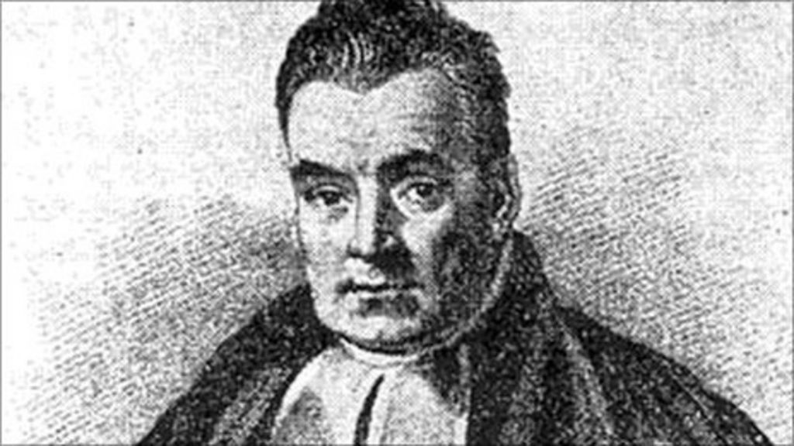
Intro to Meta-Analysis using Bayes

Slide 2

I have a coin – I'll flip it now!

Slide 3
Frequentist approach:
"If you flipped the coin 500 times, 50% of the time it would be heads, so 250 heads. Therefore, the probability of the coin flip result being heads is 50%, but only if we run the flip loads."

Slide 4

Bayesian approach:
"If I have flipped the coin but have not shown you the coin result, you know from the fact that there are only 2 sides of the coin that the probability of it being heads is 50%. It's either heads or tails, but you don't know the result for sure."

Slide 5
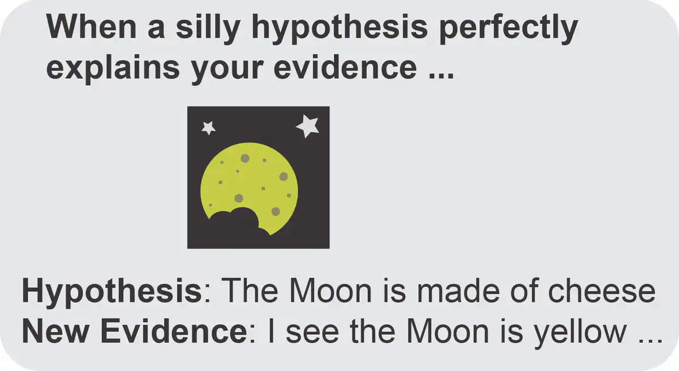
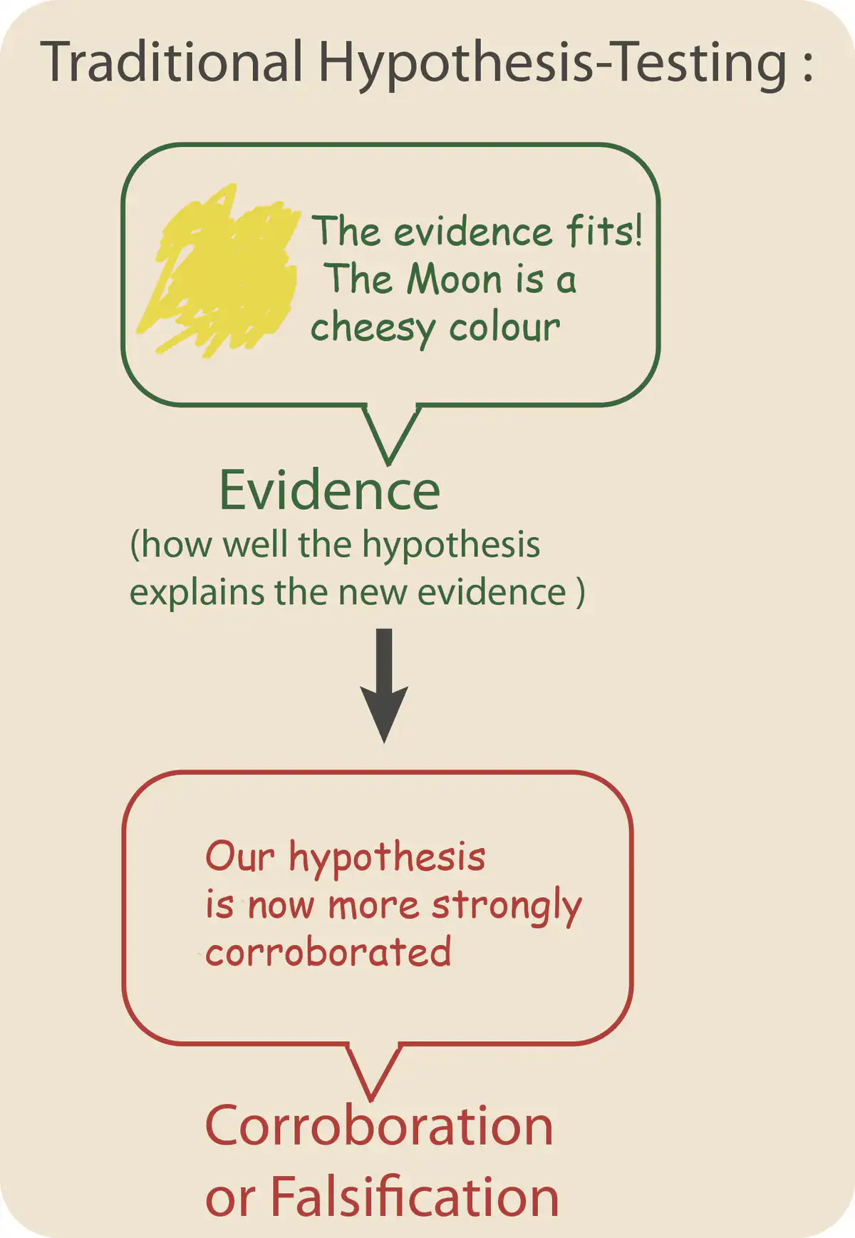
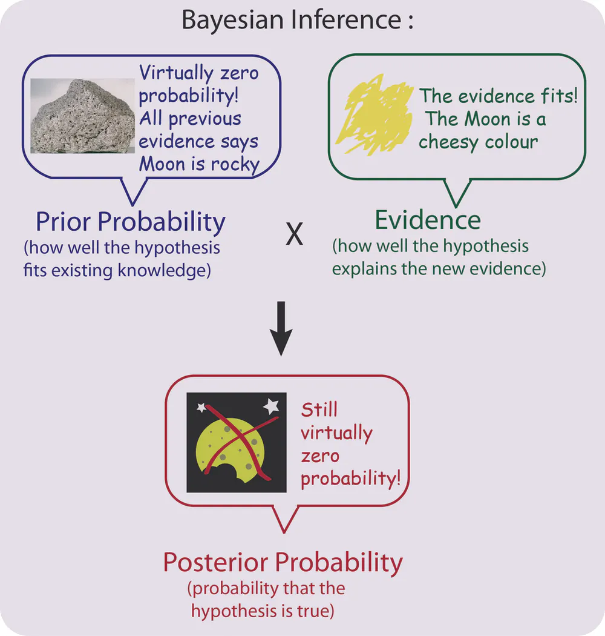
https://theconversation.com/bayes-theorem-the-maths-tool-we-probably-use-every-day-but-what-is-it-76140

Slide 6
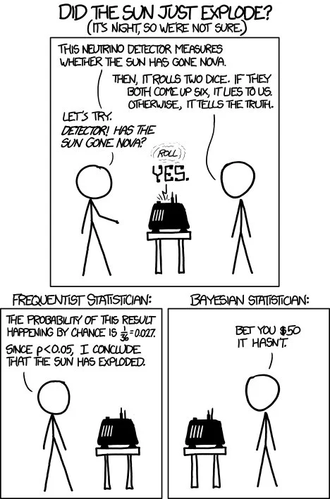

Slide 7
Notes:
The Reverend Thomas Bayes is best known for devising a theory that helps people forecast outcomes more reliably.
Bayesian theory is widely used every day across the world.
A workshop and public talk will take place to mark 250 years since the cleric's death in 1761.
Bayes studied logic and theology at the university from 1719 until 1722.
His theory is built into software that forecasts events, from movements in the financial market to changes in the weather.
Bayesian statistics are also used to filter email spam.

Slide 8
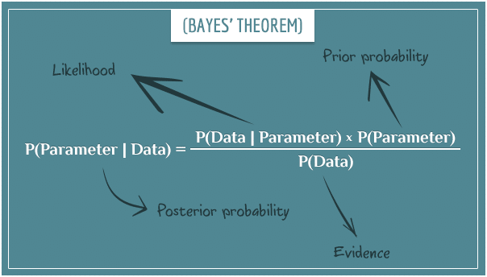

Slide 9
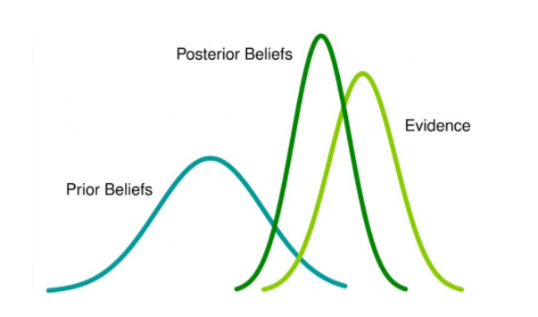

Slide 10
How do I want to deal with prior information?
Think carefully about your study system and prior knowledge
Are you modelling the timing of an event per year? If there are only 365 days in a year, you can set your prior distribution range to 0-365.
Are you modelling the length of cats? You can account for the fact that cats are neither going to be negative length, or the length of a train.

Slide 11
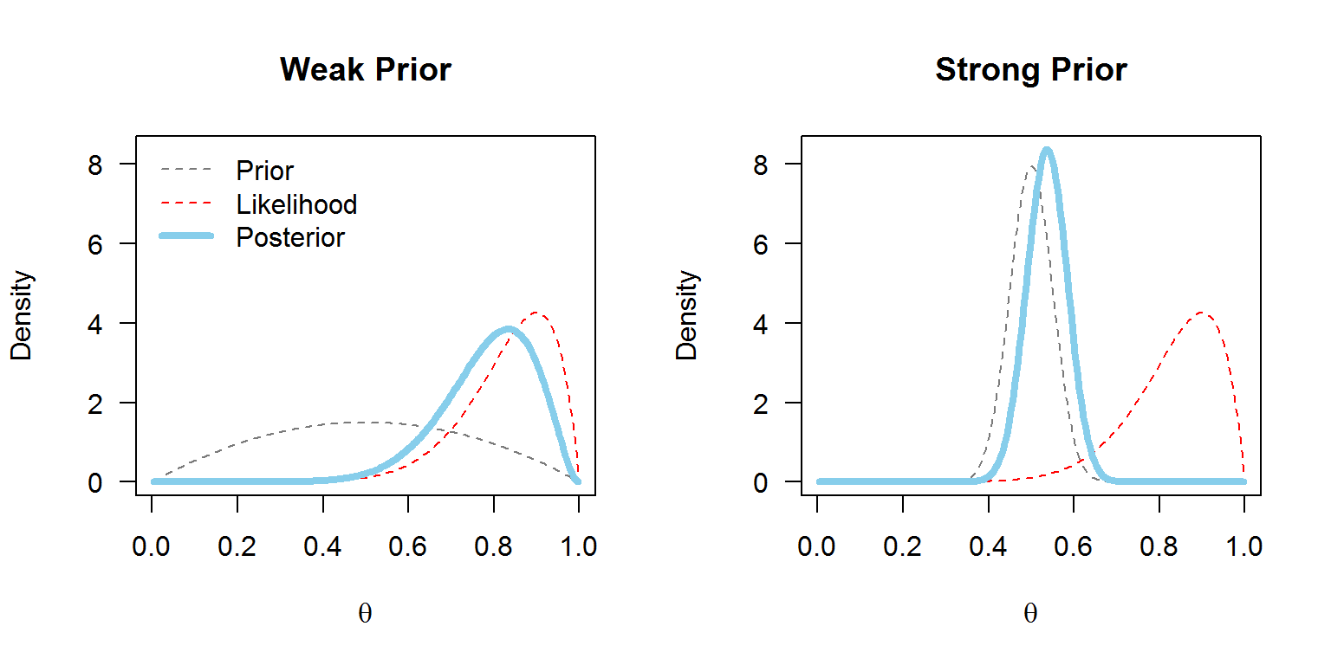

Slide 12
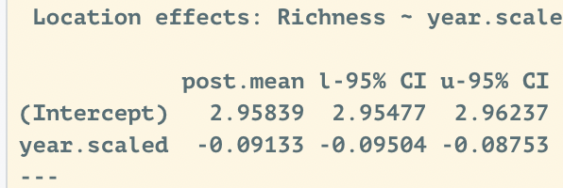
The model output is easy to read:
Our estimate!
Report this as you would an estimate for a frequentist model
Credibility Intervals:
The estimate will fall within this range.
If it spans zero, the error is pretty big.
Here it doesn't span zero, so many Bayesians would use this as a proxy of significance.

Slide 13
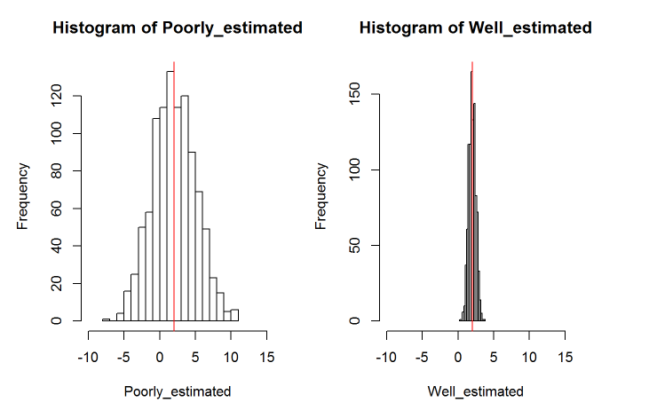
What does "significance" look like?

Slide 14
Today's example: Meta-Analysis
Link:
https://ourcodingclub.github.io/tutorials/mcmcglmm/

Slide 15
Link:
https://ourcodingclub.github.io/tutorials/mcmcglmm/

