Slide 1
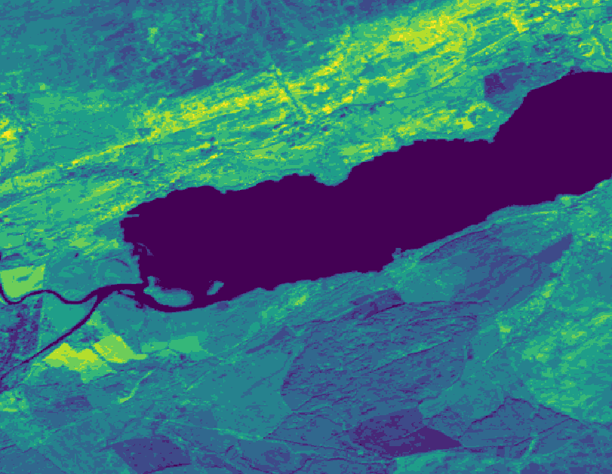

Raster Analysis in R

Slide 2
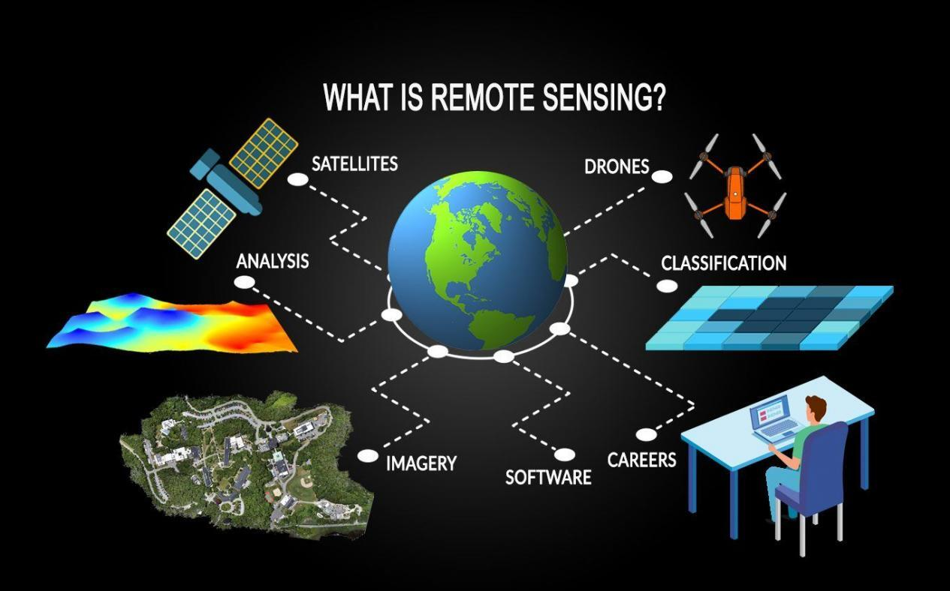
What is a raster layer?
- Each pixel on your map represents a value (e.g. elevation, temperature, slope)
- Like laying a blanket of pixels across a geographical space
- Each raster layer = one layer of an interesting variable
- Can interact with other raster layers and with vector layers
- You can easily customise maps using ggplot and base R functions
- You can easily adapt functionality from GIS software
https://gisgeography.com/remote-sensing-earth-observation-guide/

Slide 3
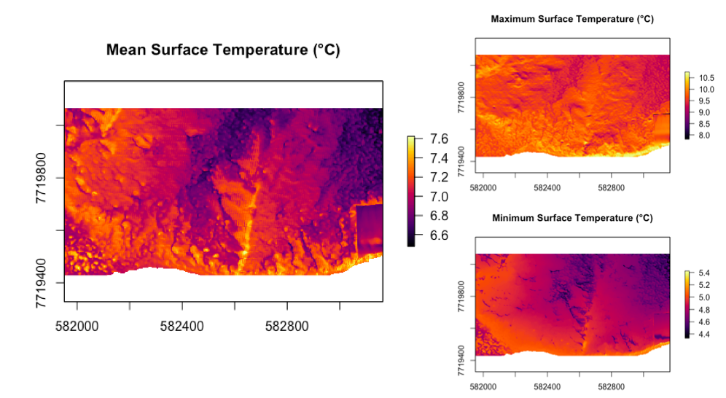

Slide 4
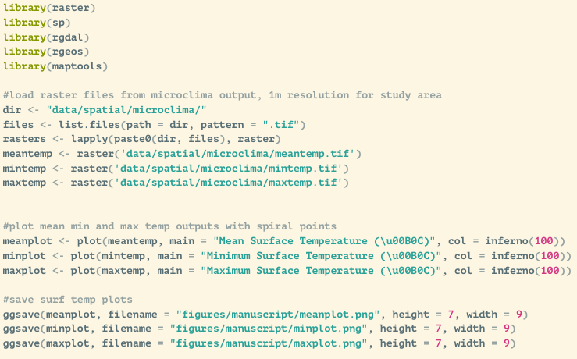

Slide 5
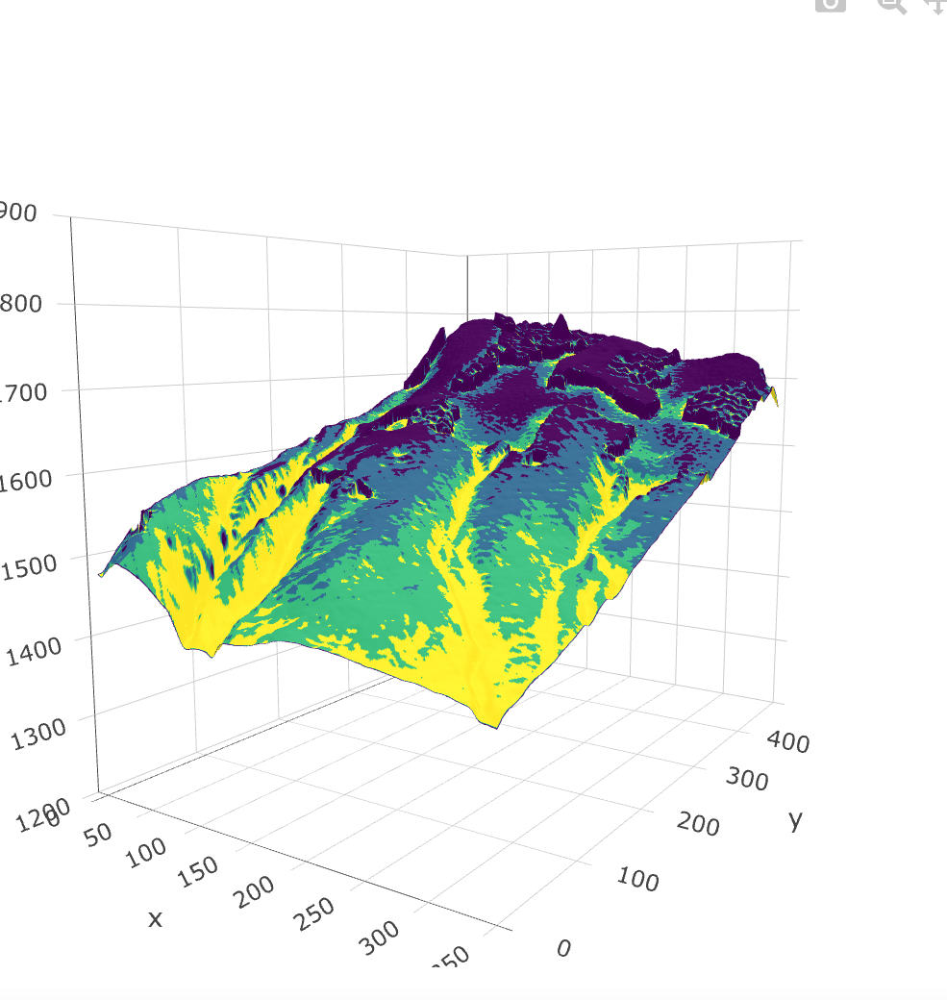
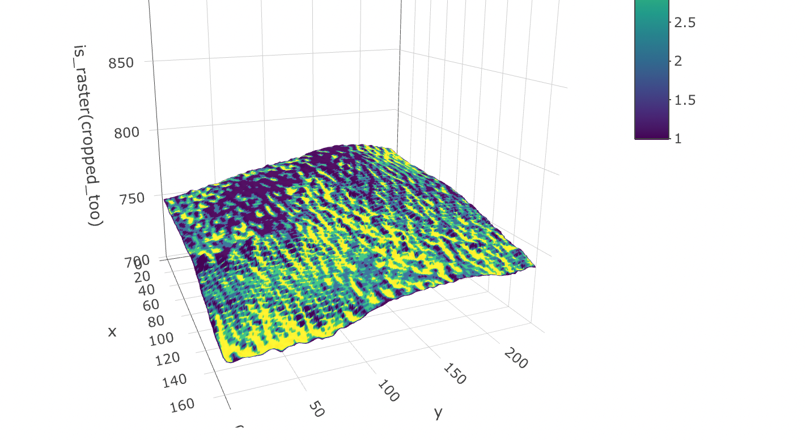
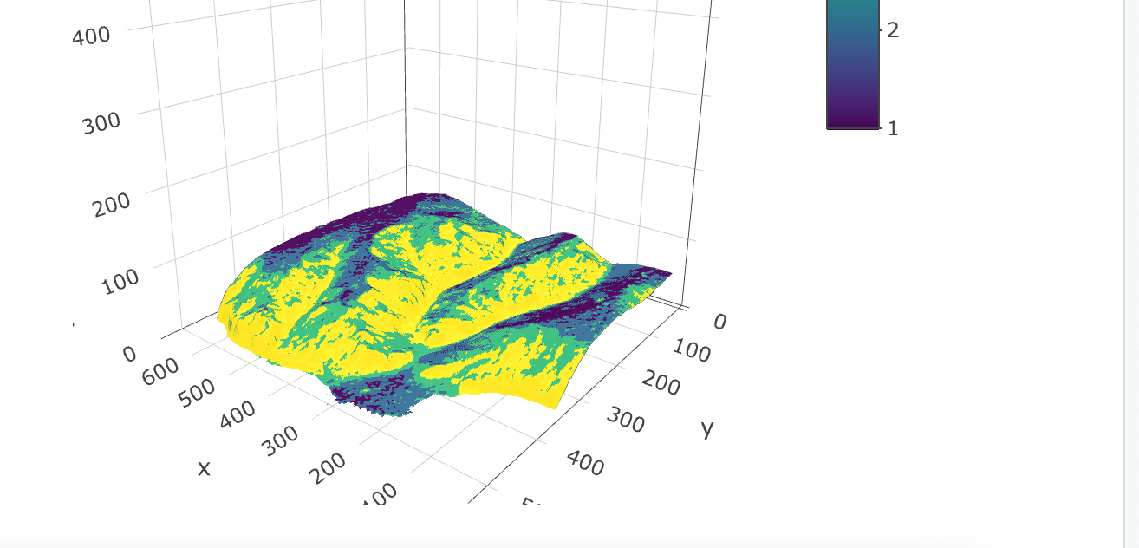

Slide 6
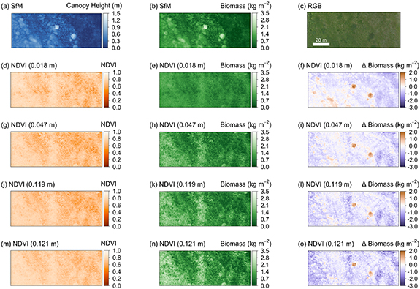
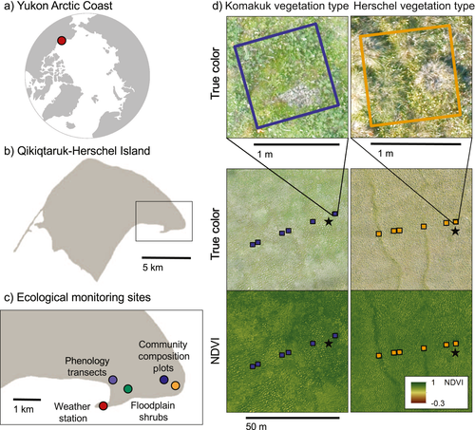
Myers-Smith et al 2019: https://esajournals.onlinelibrary.wiley.com/doi/full/10.1002/ecm.1351
Cunliffe, A. M et al 2020). Aboveground biomass corresponds strongly with drone-derived canopy height but weakly with greenness (NDVI) in a shrub tundra landscape. Environmental Research Letters, 15(12), 125004.

Slide 7
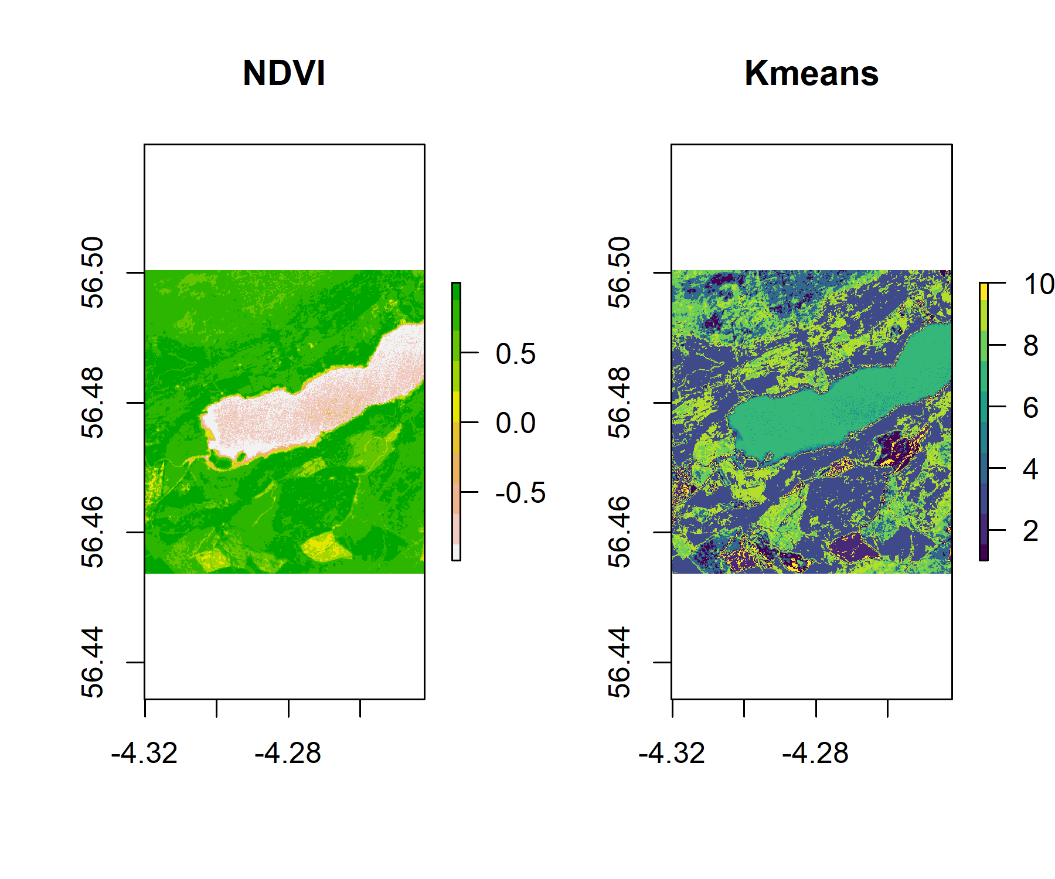
Make static raster map and perform raster calculations in R

Slide 8
Give it a go!
Spatial Data and Maps:
https://ourcodingclub.github.io/tutorials/spatial/
Ask any of us tutors if you have a question ☺

