Slide 1
Phase 1: Data gathering and strategic planning
Gather data
Compile metadata
Research biases & data gaps
Clean & filter data
Convert to CSV or SQL dataframe
Select a pre-trained genAI model
Decide on temperature & verbosity parameters
Phase 2: Prompt engineering and agent evaluation
Create an AI agent to interact with your matrix dataframe
Test the agent with basic queries
Design meaningful prompt instructions
Add metadata descriptions
Add Q&A examples
Create a bank of questions & answers
Test the LLM using the question bank
Compare prompts
Phase 3: Optional multi-model orchestration, and deployment
Optional: include more text sources using multi-modal graph based LLM apps
Deploy on a chatbot user interface
Provide information on data provenance and model reliability

Slide 2
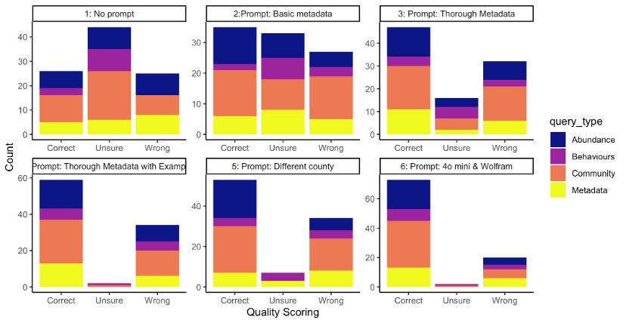
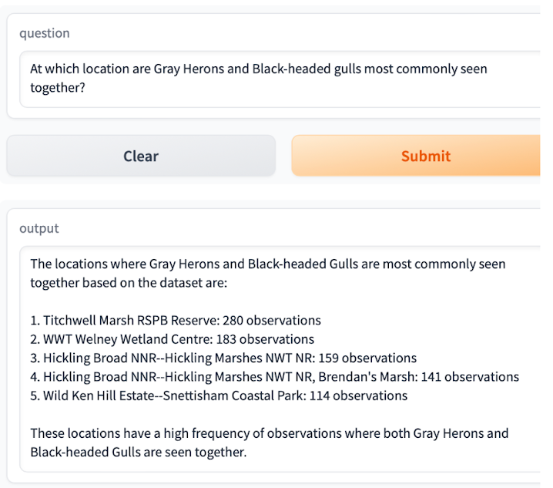
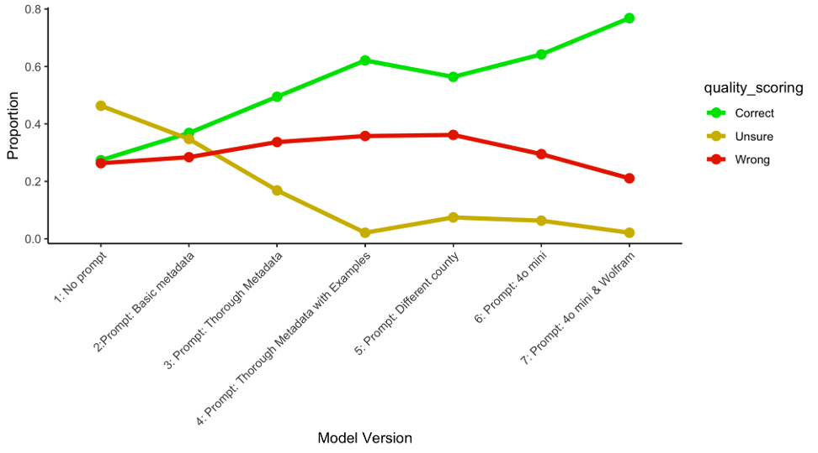
(a)
(b)
(c)

