Slide 1
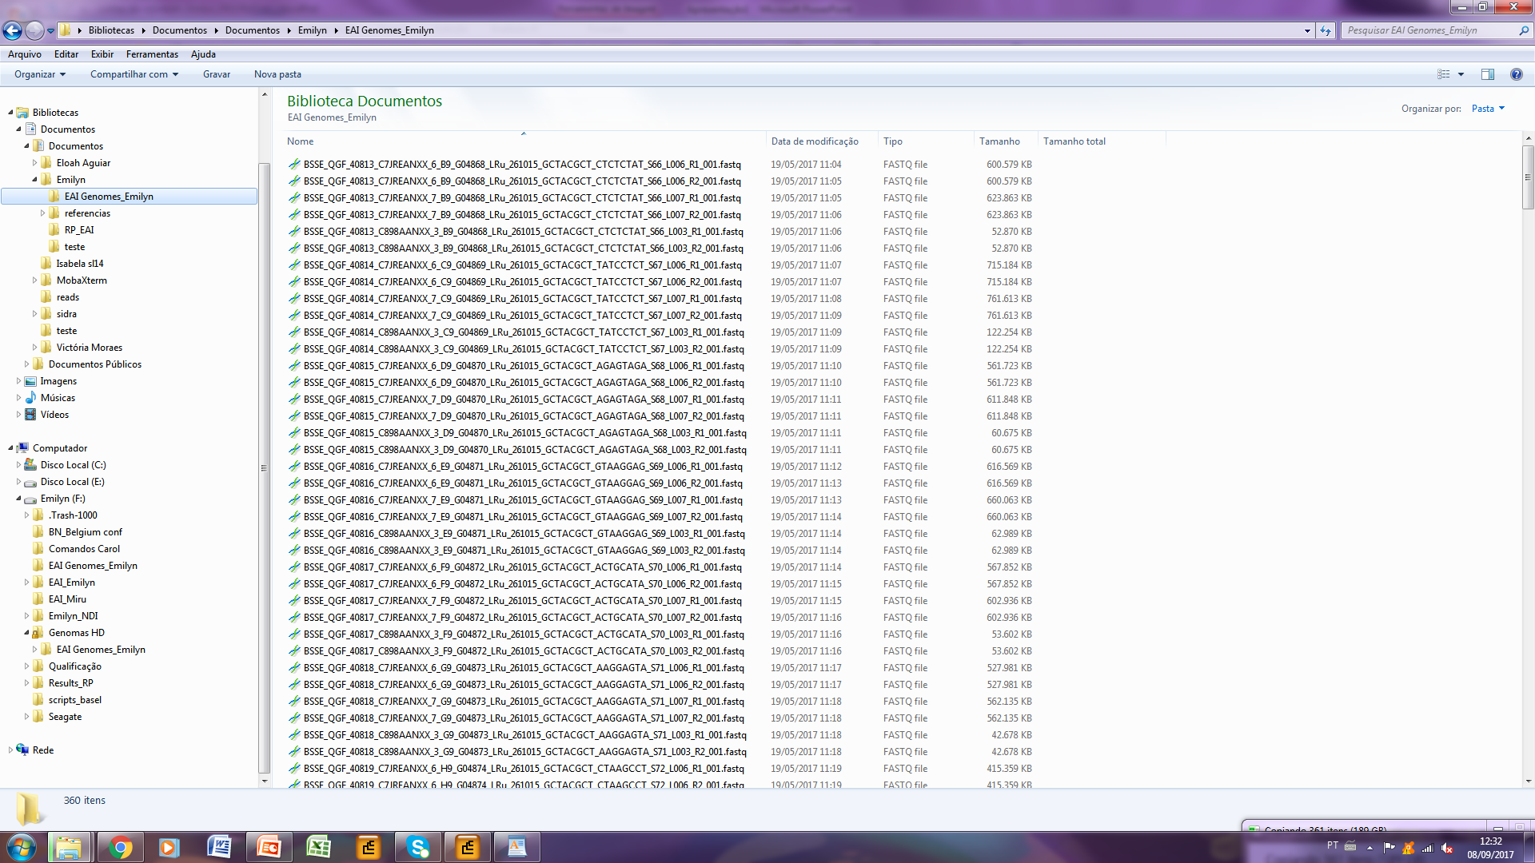
I have one directory (EAI Genome_Emilyn) with 360 files...

Slide 2
6 files are related to only one sample (genome)... For example: G04868.

Slide 3
I have to merge all R1 files into only one R1 file. Then, rename it: G04868_R1.fastq
(the same for R2 files)

Slide 4
So, what I’ve been doing is...
I go to this directory by terminal and I give the follow command line for each genome (like G04868, G04869, G04870, etc.) which takes almost one day...
cat BSSE_QGF_40815_C7JREANXX_6_D9_G04870_LRu_261015_GCTACGCT_AGAGTAGA_S68_L006_R1_001.fastq BSSE_QGF_40815_C7JREANXX_7_D9_G04870_LRu_261015_GCTACGCT_AGAGTAGA_S68_L007_R1_001.fastq BSSE_QGF_40815_C898AANXX_3_D9_G04870_LRu_261015_GCTACGCT_AGAGTAGA_S68_L003_R1_001.fastq > G04870_R1.fastq && cat BSSE_QGF_40815_C7JREANXX_6_D9_G04870_LRu_261015_GCTACGCT_AGAGTAGA_S68_L006_R2_001.fastq BSSE_QGF_40815_C7JREANXX_7_D9_G04870_LRu_261015_GCTACGCT_AGAGTAGA_S68_L007_R2_001.fastq BSSE_QGF_40815_C898AANXX_3_D9_G04870_LRu_261015_GCTACGCT_AGAGTAGA_S68_L003_R2_001.fastq > G04870_R2.fastq
My question is… Did you do something similar to this already? If not, do you know a way to do this faster than coping and pasting each file’s name in the command line? In Basel they have developed a script, but they reanme the genomes only after many others data analysis using BAM files, not FASTQ files… So, we don’t know how to apply it here… Could you see if is possible try to get information from this script? I do think I will have to make a course to learn how to Program.

