Slide 1
A request
MRI of the lower back
+ the patient's record
Vaglio
Prior authorization that has to prove its answer
A decision engine for health plans. It never denies care without showing why,
and it never denies care just because something was missing from the file.
This deck explains what it does, in plain words: no software background needed.
Source-available · PolyForm Shield 1.0.0
One program, nothing to install
Works with Perfuse
An answer, with its proof
each step quotes the plan's rule
and points to the record
BioDream LLC · github.com/BioDream-LLC/vaglio

Slide 2
THE BACKGROUND
What is prior authorization?
Before some tests, surgeries and drugs, a doctor must ask the patient's health plan whether it will pay.
“May we do this?”
+ the medical record
✓
Yes: approved
The doctor
The health plan
wants to order an MRI of the lower back for a patient with back pain.
checks the request against its written coverage rules, called policies.
×
No: denied
Until the answer comes, the patient waits.
?
Send more information
New US rules for health plans (CMS-0057-F)
Words used in this deck
Most plans that serve Medicare Advantage, Medicaid, CHIP and the federal marketplace must:
Answer within 7 days, or 72 hours when it is urgent (from 2026).
Give a specific reason for every denial.
Publish how often they approve, deny and take longer.
Take requests electronically through a standard API by 2027; the Da Vinci PAS standard is the recommended way.
Policy: the plan's written rules for when it covers a service.
Evidence: facts in the request: diagnoses, answers to questions, past tests, medicines.
Pend: “not decided yet: please send this information.”
PAS server: the plan's front desk that receives requests electronically (for example, Perfuse).
Reviewer, clinician: a person at the plan who checks cases; a clinician is a licensed one, such as a doctor or nurse.
Vaglio · BioDream LLC · github.com/BioDream-LLC/vaglio
2 / 18

Slide 3
THE PROBLEM
What goes wrong today
Prior authorization is meant to stop unnecessary care. Too often it stops necessary care instead.
Denied for what was not there
No clear reason
Slow and manual
Hard to check later
The file did not mention a symptom, so the answer was no, even though the patient has it. Silence was treated as a no.
The doctor is told “not medically necessary”, but not which rule, or what would change the answer.
Faxes, phone calls and paperwork sent again and again, while the patient waits for care.
Months later, nobody can show exactly why a decision was made, or replay it under new rules.
?
What Vaglio changes
It never treats a missing fact as a “no”. Every answer comes with a proof that quotes the plan's own rule and points to the exact place in the record. Every pend names what is needed, and every denial says what would turn it into an approval. Every decision is kept, so it can be checked, explained and replayed.
Vaglio · BioDream LLC · github.com/BioDream-LLC/vaglio
3 / 18

Slide 4
THE IDEA
Vaglio's one rule
A denial may rest on evidence of absence, never on absence of evidence.
The record says “no”
The record says nothing
The record
The record
Red-flag symptoms, such as numbness or loss of bladder control?
Vaglio may deny, and cites that answer
Red-flag symptoms, such as numbness or loss of bladder control?
Vaglio asks for it, by name
Doctor answered: No
(not answered)
The doctor has told the plan the patient does not have the symptom. That is evidence, and a denial can rest on it: Vaglio quotes the rule and points to the answer.
Nobody has said either way. A missing answer is not a “no”. If it could change the decision, Vaglio pends the request and asks the doctor for exactly that.
Anything unclear, contradictory or unreadable is treated as “not addressed”: the one state that can never support a denial. A record that says both yes and no goes to a person.
Vaglio · BioDream LLC · github.com/BioDream-LLC/vaglio
4 / 18

Slide 5
THE ANSWERS
Three possible answers, each with a reason
The doctor's system receives the answer in the standard electronic format, with its reason in words.
✓
Approve
×
Deny, with proof
?
Pend: send this
Every rule the plan requires is met, and each one points to where in the record it was found.
Only when the record shows the patient does not meet a rule. The answer names the rule, quotes the policy word for word, and lists what in the record shows it.
Something that could change the answer is missing. Vaglio names exactly what is needed, and the documents that would show it, and asks the doctor's system for them.
Example: six weeks of physical therapy without improvement, answered “Yes” on the plan's questionnaire.
Example: a repeat MRI within six months, and the doctor answered that nothing has changed.
Example: whether there are red-flag symptoms was not answered.
What would change it. Every pend and every denial also lists the smallest sets of evidence that would turn it into an approval, so the doctor knows exactly what to send. When the only route would need the record to be wrong, Vaglio says so instead of suggesting it.
Vaglio · BioDream LLC · github.com/BioDream-LLC/vaglio
5 / 18

Slide 6
HOW IT DECIDES
From request to answer, step by step
All of this happens in a fraction of a second, on the plan's own computer.
1 The request arrives
2 The evidence is read
3 The policy is applied
4 A proof is built
5 It is recorded and sent
The plan's PAS server (its electronic front desk, such as Perfuse) passes the doctor's request to Vaglio.
Answers to the plan's questions, diagnoses, past procedures, test results and medicines. Each finding keeps a pointer to where it came from.
The plan's signed policy for that service: each rule says which evidence meets it and which evidence overrides it.
The answer and every step behind it, each citing the rule it applies and the record it rests on. The one rule is enforced here.
Kept in a tamper-evident log, then sent back to the PAS server, which tells the doctor. A pended case waits for a reviewer.
What counts as evidence
Questionnaire answers
Diagnoses
Procedures, with dates
Test results, with units
Medicines and days supplied
Attached notes
Only final results and completed procedures count: a test still being processed, or a diagnosis someone ruled out, is never read as present. Attached notes are read by a person, or by an AI model as proposals a person confirms.
Vaglio · BioDream LLC · github.com/BioDream-LLC/vaglio
6 / 18

Slide 7
EXAMPLE
What a proof looks like
A request for a repeat MRI of the lower back, from Vaglio's illustrative example policy (not a real plan's rules).
The plan's rule, quoted exactly
“A repeat MRI within six months of a prior study is not indicated unless the condition has changed.”
Lumbar MRI in the last six months?
source: questionnaire answer “prior-imaging-6mo”
“Yes”
present
×
Deny
Symptoms new or worse since the prior study?
source: questionnaire answer “new-or-worsening”
“No”
documented absent
A repeat study within six months with no change in the condition. Documented as absent: a red-flag finding; new or worsening symptoms.
A red-flag finding (suspected cauda equina, infection, fracture …)?
source: questionnaire answer “red-flag”
“No”
documented absent
Had either question been left unanswered, the answer would have been a pend asking for it: never a denial.
Each step of the proof cites the rule it applies and where in the record its evidence was found, so the doctor, a reviewer or an auditor can check every link.
Vaglio · BioDream LLC · github.com/BioDream-LLC/vaglio
7 / 18

Slide 8
POLICIES
A plan's policy, written as plain rules
Each policy is a short text file in a small, readable language. The plan's own sentences stay in it, word for word.
evidence red_flag
text "A red-flag finding (suspected cauda equina, infection, fracture …)"
clause "MRI is indicated without a trial of conservative therapy when a
red-flag condition is suspected."
find question red-flag
find condition icd10 G83.4 M46.26 C79.51 when confirmed provisional
criterion duplicate_study
text "The request repeats a recent study with no change in the condition."
defeated by no_recent_imaging new_or_worsening_symptoms red_flag
decision approve approves
defeated by indication_unestablished duplicate_study
evidence
A fact about the patient, and every place in a request it may be found: a question's answer, a diagnosis code, a past procedure.
clause
The sentence of the plan's policy that the rule encodes, quoted exactly. It is what the doctor is shown.
find …
Where to look. Diagnoses count only with the statuses named; a ruled-out diagnosis never counts.
defeated by
What overrides what. An approval holds unless something defeats it; the engine works out which holds.
Policies can be written by hand, in the console's editor, or drafted by an AI model from a published coverage document, behind strict checks. Either way, nothing decides until the plan's clinician signs it off.
Vaglio · BioDream LLC · github.com/BioDream-LLC/vaglio
8 / 18

Slide 9
SAFETY CHECK
Every policy is tested on every possible case before it is used
Not just the examples its author thought of: every combination of evidence the policy can be given.
✓
Every combination gets exactly one answer
No case where the policy contradicts itself or leaves the engine with nothing to say.
✓
Every decision can actually happen
A rule that no combination ever reaches is a mistake, and is caught.
✓
Quotes are exact
Each rule's sentence must appear word for word in the source document. A misquote is refused.
The facet joint policy: 128 combinations. 1 approves; 127 deny, each for a stated rule.
✓
Codes are real
Every billing and diagnosis code must appear in the source document.
At decision time the absence rule applies on top: a denial whose rule rests on something the record does not address becomes a pend. The test proves the policy has no gaps; the rule keeps the patient safe from missing paperwork.
✓
A person signs it off
Until a clinician signs it, the server refuses to decide anything with it.
The largest library policy, lumbar MRI from a Washington State guideline, is tested on all 32,768 combinations.
Vaglio · BioDream LLC · github.com/BioDream-LLC/vaglio
9 / 18

Slide 10
POLICY LIBRARY
Ready-made policies, from public coverage rules
Each one is drafted from a published document, kept beside it, and quoted word for word.
Policy | What it covers | Based on | Cases tested
CPAP for sleep apnea | Breathing machine (E0601) | Medicare LCD L33718 | 64
Total knee replacement | Surgery (27447) | Medicare LCD L36575 | 16,384
Facet joint nerve ablation | Spine pain procedure (64633-64636) | Medicare LCD L38773 | 128
Heart CT angiography | Cardiac imaging (75574) | Medicare LCD L35121 | 256
Lower back MRI | Spine imaging (72148, 72149, 72158) | Washington State L&I guideline | 32,768
Weight-loss surgery | Bariatric surgery | Medicare NCD 100.1 | 8
Adalimumab (Humira) for RA | Specialty drug, with step therapy | Utah Medicaid criteria | 4,096
Kinds
Equipment
Surgery
Spine procedures
Imaging
Specialty drugs
An industry list of 66 standard services (from AHIP and BCBSA) would be the natural next set, but it is not public. The library is built from documents anyone can read instead.
Every library policy ships as a draft. The plan's own medical director reviews each one against its source and signs it off before it decides anything.
Vaglio · BioDream LLC · github.com/BioDream-LLC/vaglio
10 / 18

Slide 11
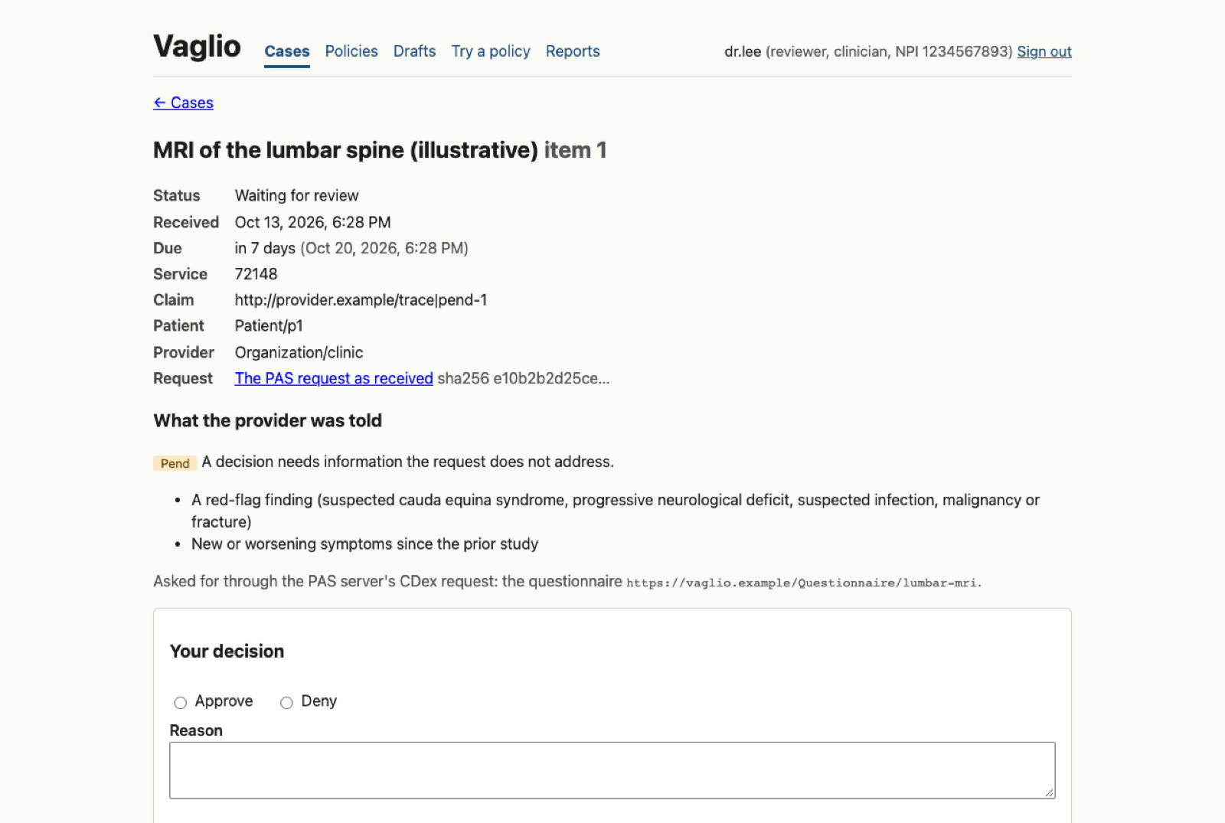
HUMAN REVIEW
People stay in charge
Vaglio decides what the rules settle. People decide everything else, and their decisions are recorded.
Reviewers
Work the queue of pended cases in the console: the request, the evidence found, what is missing, the due date. Their decision and reason go back to the doctor.
Clinicians
Sign policies off. The signature is their account's name and credential, never typed in; the server checks they are recorded as a clinician.
Clinician-only denials
An option for states such as California (SB 1120): the engine never denies on its own; it proposes the denial, and only a clinician may make it.
Appeals and overrides
The console: a pended case, what is missing, the due date, and the reviewer's decision form.
Every time a person overrides the engine, or an appeal overturns a denial, it is counted by rule, by provider and by state, to show which rules need work.
Narrower access for each person: some may only write drafts, read the audit log or record appeals, or see only one policy's cases. Sign-in can use the plan's own single sign-on.
Vaglio · BioDream LLC · github.com/BioDream-LLC/vaglio
11 / 18

Slide 12
DOCUMENTS
Asking for records, and reading them
When a fact is only in a doctor's note, Vaglio asks for the note the standard way, and helps a reviewer read it.
1
2
3
4
5
6
Vaglio pends
The PAS server asks
The doctor sends
Text is made
AI proposes
A reviewer confirms
and names the documents that would show what is missing, by their standard codes.
the doctor's system for them (the Da Vinci CDex standard).
the note, a PDF or a scan. Vaglio fetches it into the case.
by programs on the plan's own computer (PDF text, or OCR for scans).
findings, each with an exact quote from the document.
each finding against the original. Then the policy decides again.
The quote check
Patient records stay private
“She completed eight weeks of physical therapy without relief.”
Found word for word: kept as a proposal
“Patient failed conservative care.”
Not in the document: refused
The AI model must run on the plan's own computer, unless the plan says its provider is covered by a business associate agreement. A proposal is nothing until a person confirms it.
Vaglio · BioDream LLC · github.com/BioDream-LLC/vaglio
12 / 18

Slide 13
TIMEFRAMES
Deadlines, extensions and lateness
The queue shows how long each waiting case has left. The reports count what was late.
Urgent: 72 hours
Standard: 7 days
One extension: up to 14 more days
day 0
day 3
day 7
day 14
day 21
Drugs: 72 hours, or 24 hours when urgent, and never extended.
When a reviewer may extend
What is recorded
What the queue shows
What the reports count
Once per case, before its deadline, for one of the three reasons the federal rule allows:
• the patient asked for more time;
• more medical evidence is needed that could change a denial;
• extraordinary circumstances.
Who extended it, by how many days, the reason, and what the patient is told the delay is for. All in the audit log.
Each waiting case's time left: amber within a day, red when overdue, and a mark on extended cases.
Extensions, approvals after an extension, and decisions made late or still waiting past their deadline, as the CMS rule asks plans to publish.
Telling the patient by letter is the plan's own process; Vaglio records the reason so the letter can say it.
Vaglio · BioDream LLC · github.com/BioDream-LLC/vaglio
13 / 18

Slide 14
REPORTS
Gold cards and public numbers, straight from the record
Because every decision is kept, the numbers plans must publish come from the decisions themselves.
Gold cards
Some states (Texas, for example) exempt doctors whose recent requests were nearly all approved. Vaglio works out each doctor's standing from the record (approval rate, look-back window, minimum number of decisions) and approves exempt doctors without review, with an answer naming the exemption.
The CMS numbers
Approved, denied and still waiting; standard and urgent apart, drugs apart; time to decision; approvals after appeal and after extension. On screen or as a spreadsheet.
Which missing evidence pends most. The pend report shows which facts most often hold requests up, and whether the plan's questionnaire asks for them, so the questions can be fixed at the source.
Vaglio · BioDream LLC · github.com/BioDream-LLC/vaglio
14 / 18

Slide 15
THE RECORD
Every decision is kept, and can be replayed
A log that shows if it was changed, and a way to see what a new policy would have done.
Request received
case opened
hash 3f9a… ← start…
Decision
pend: two facts missing
hash b71c… ← 3f9a…
Document arrived
neurology note
hash 0de4… ← b71c…
Reviewer
approve, with reason
hash 9a52… ← 0de4…
Sent to the doctor
delivered
hash e60b… ← 9a52…
Each record carries a fingerprint of the one before it. Edit, delete or reorder any record and the chain breaks: the server will not start on a broken log.
What is in the log
Replay
• every request, decision and proof
• every review, extension, appeal and override
• every sign-in, failed sign-in and account change
• every time someone opened a case
• every policy draft saved and signed off, by its fingerprint
Before a new version of a policy is signed off, run it over every past request it covers. Vaglio lists each decision that would change, and flags any that would overrule a reviewer. Nothing is changed by a replay, and the replay itself is logged.
Vaglio · BioDream LLC · github.com/BioDream-LLC/vaglio
15 / 18

Slide 16
WHERE IT FITS
Vaglio and the plan's other systems
Vaglio is the reviewer in the back office. A PAS server is the front desk providers talk to.
The doctor's system
EHR, practice system or DTR app
PAS server
Perfuse (free, Apache-2.0), or any server that calls the decision hook
asks
Vaglio
request
answer
• reads the evidence, with citations
• applies the plan's signed policies
• proves the answer, or asks
• the reviewers' console
• the audit log, reports, replay
• the policy editor and library
decides
Reviewers and clinicians
use Vaglio's console in a web browser
The plan's systems
appeals system (feed or CSV), sign-in (SSO)
console
The PAS server speaks the standards providers use: it receives requests, asks for documents, answers status checks and notifies the doctor when a pended request is decided.
Perfuse never needs Vaglio. It makes its own decisions with simple rules and a reviewer queue. Vaglio is an optional engine a plan adds behind it.
Vaglio · BioDream LLC · github.com/BioDream-LLC/vaglio
16 / 18

Slide 17
SECURITY AND PRIVACY
Built for patient data
Vaglio runs on the plan's own computers. Nothing is sent to BioDream.
On the plan's own servers
Encrypted off this machine
One program, run by the plan. Patient records stay in a folder only that program's owner can read; it refuses to start otherwise.
Anywhere but the local computer, it requires HTTPS and refuses requests addressed to any other name.
Who may do what
Single sign-on
Viewers read; reviewers decide; admins manage. Narrower scopes: write drafts, read the log, record appeals, see one policy's cases.
Sign in with the plan's identity provider (OpenID Connect). It proves who someone is; the plan's accounts in Vaglio say what they may do.
Sessions and passwords
Every read is recorded
Sessions end after 30 minutes idle or 12 hours. Five wrong passwords lock a name for 15 minutes.
Opening a case is logged, as is every decision, sign-in and account change.
AI kept on a short leash
Small, readable code
Drafting policies uses only public documents. Reading patient notes needs a model on this machine, or a business associate agreement.
Written in Go with almost nothing outside its standard library. One program to check and patch.
Vaglio · BioDream LLC · github.com/BioDream-LLC/vaglio
17 / 18

Slide 18
STATUS
Where Vaglio is today, and how to get it
Working and tested
Not yet
Licence
• decisions with proofs, and the absence rule
• the reviewers' console and the queue
• questionnaires made from policies
• asking for and reading documents
• drug requests and step therapy
• gold cards, CMS reports, replay
• the policy editor and clinician sign-off
• extensions, appeals feed, scopes, SSO
• run end to end through a real Perfuse
• version 0.0.1: early, not yet in production anywhere
• the example policies are illustrative, not any plan's rules
• library policies need the plan's clinician to sign them off
• single sign-on is tested against a test provider only
• reading scanned images needs an OCR program installed
• letters to patients are the plan's own process
PolyForm Shield 1.0.0: source-available.
Anyone may read, run, change and share it, including a health plan deciding its own requests, at no cost.
Not allowed without a commercial licence: offering a product or service that competes with Vaglio.
Perfuse, which it works with, stays Apache-2.0 open source.
Get it: github.com/BioDream-LLC/vaglio · Bug reports welcome; code contributions are not accepted.
Vaglio · BioDream LLC · github.com/BioDream-LLC/vaglio
18 / 18

