Slide 1
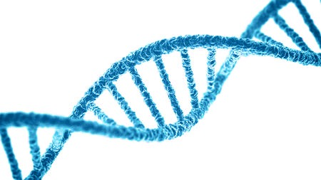

Differentially Methylated Regions
analysis
From normalized data to DMRs discovery

Slide 2
Methylation: what is it and why should we care?
Changes in
gene transcription
Methylome
The set of nucleic acid methylation modifications in an organism's genome
Illumina 450k array can probe ~480.000 CpGs in a sample

Slide 3
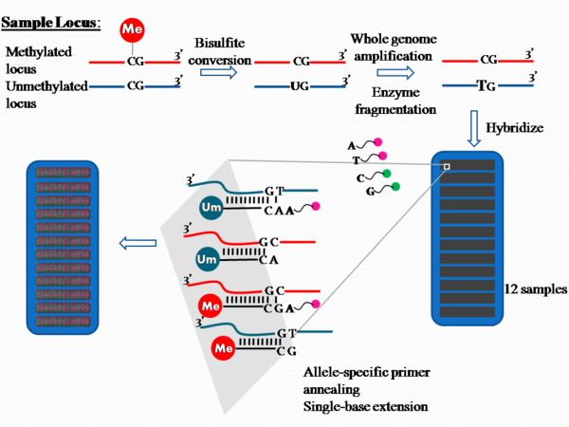
Illumina array: how does it work?
2 probes for each CpG
more than 450K CpGs in one shot
12 samples in one shot
cheap and easy to perform
It requires a lot of normalizations, corrections and filtering

Slide 4
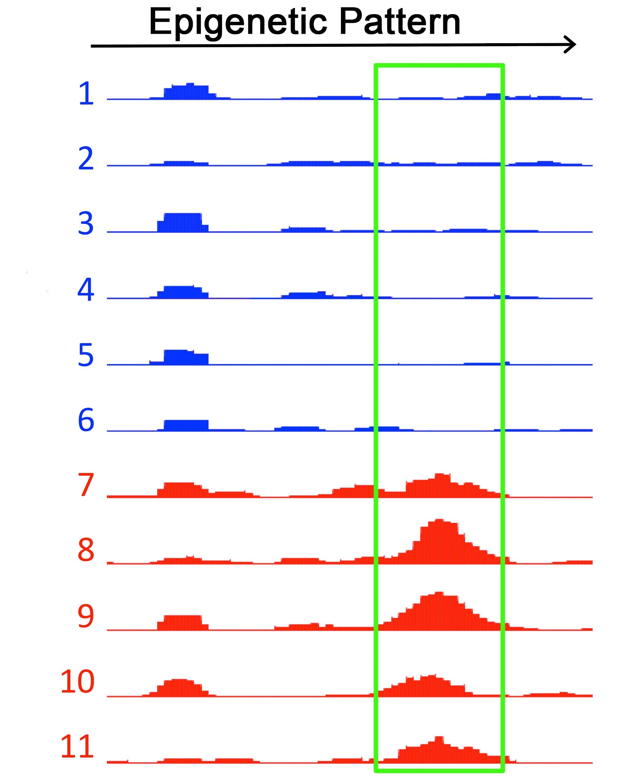
Why do you want to study DMRs?
Sex
Age
Ethnicity
Drugs usage
Environment
Diseases
Food
Stress

Slide 5
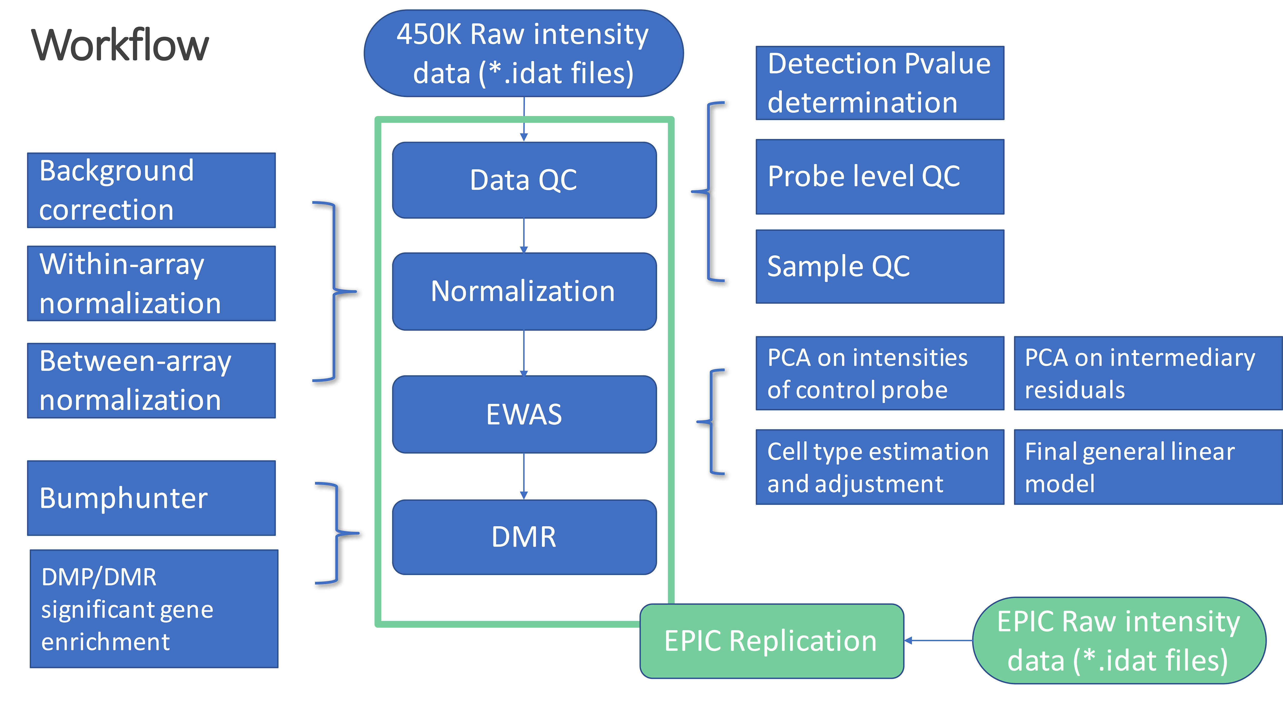
The last proposed workflow
Nature, Zhang et al, 2018

Slide 6


How to normalize the data?
GenomeStudio
Software
RnBeads
Assenov Y et al (2014). “Compehensive Analysis of DNA Methylation Data with RnBeads.” Nature Methods, 11(11), 1138–1140.
Freely available
It works on R
Nice graphic interface
Huge package
“Convert array data into meaningful results”
Freely available (now)
Graphic interface
Assistence & support
ATTENTION!!!
It is possible to obtain different results!

Slide 7
An example of public methylomes
Samples
Beta values
Estimation of methylation level using ratio of intensities between methylated and unmethylated alleles.
They range from 0 (unmethylated) to 1 (methylated).
ID_REF | GSE0000001 | GSE0000002 | GSE0000003
CG00001 | 0,32145 | 0,58955 | 0,111002
CG00002 | NA | 0,92480 | 0,800089
CG00003 | 0,00011 | 0,01230 | 0,323598
~ 480.000
CpGs
Not detectable probe for biological or computational reasons.
Hemimethylated probe.
Due to different allelic methylation or to different cells with different methylation.

