Slide 1


Metagenomics data analysis
workflow
PART 1
From fastq files to Alpha & Beta Diversity

Slide 2
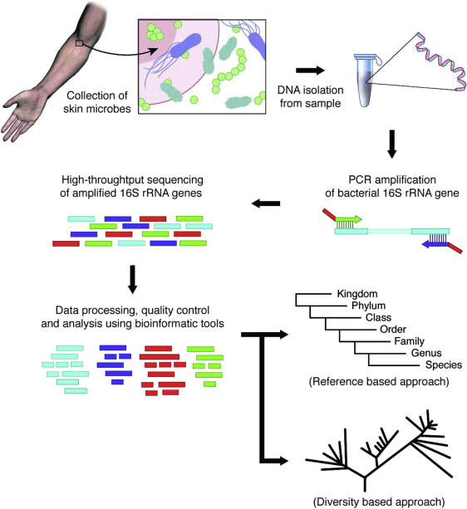
How does it work?

Slide 3
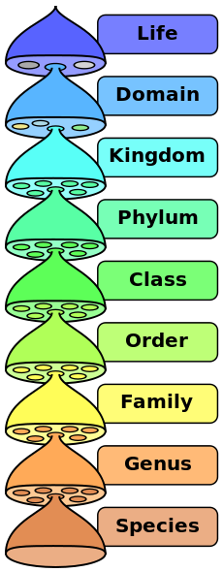
Things to know
TAXA: In biology, a taxon is a group of one or more populations of an organism or organisms seen by taxonomists to form a unit.
OTU: An operational taxonomic unit (OTU) is an operational definition used to classify groups of closely related individuals. Nowadays, however, the term "OTU" is also used in a different context and refers to clusters of (uncultivated or unknown) organisms, grouped by DNA sequence similarity of a specific taxonomic marker gene

Slide 4


What I need to start a metagenomic project?
Good sample number
A metadata file (sample ID, Group, Age, Description, ecc…)
Choose the environment:

Slide 5
What are the differences?
R code
Versatile
Very used by bioinformaticians
Possible problems in loading many data (but allows multithreading)
There is no standard (everything is up to you)
Python code (in miniconda or GUI)
Not very versatile
Very used by biologist
It works good on hundreds of samples (older version do not allow multithreading)
Standard pipeline to follow (from raw data to publication-quality figures)

Slide 6
What are the main steps?
Filter and trim the reads
Use a reference genome to annotate each read to a taxon
Calculate taxa relative abundance
Calculate Alpha diversity (refers to the average species diversity in a habitat and it is a local measure.)
Calculate Beta diversity (this is the diversity of species between two habitats or regions.)

Slide 7
What about the reference?
Three possible reference database:
GreenGenes
Last release May 2013
http://greengenes.secondgenome.com/
RDP
Release 11 Update 5
https://rdp.cme.msu.edu/
SILVA
Release 138 in November 2019
https://www.arb-silva.de/
The most used one
But it’s not updated anymore!
PAY ATTENTION
THE RESULTS WILL CHANGE

Slide 8
Let’s start
https://github.com/BioH4z/Bioc_microbiome_analysis
or
https://bit.ly/38hBBhZ

