Slide 1
Bio-Hackathon 2019
Analyse du transcriptome et des données de ChIP-seq de leucémies aigues à cellules T (T-ALL) induites par l’oncogène NUP98-PHF23 chez les souris transgéniques
Supervisée par Caroline Lebelle
Projet de recherche du labo Hoang

Slide 2
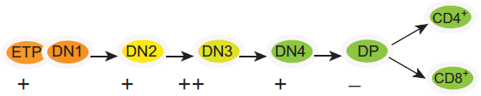
Figure 1. Schematic diagram of thymocyte differentiation.
( from Hoang, Lambert & Martin, Curr Top Dev Biol. 2016, PMID: 27137657)
The earliest T lineage progenitor (ETP) in the thymus proceed through the double negative 2 (DN2) and DN3 stages, at which point the cells are irreversibly committed to the T-lineage. Subsequently, DN4 thymocytes proliferate and acquire CD4 as well as CD8 expression to become CD4+CD8+ double positive (DP) cells. Finally, DP thymocytes commit to the CD4 or CD8 lineage to produce mature CD4+ and mature CD8+ T lymphocytes that are released in the peripheral blood.

Slide 3
“NUP98–PHF23 Is a Chromatin-Modifying Oncoprotein That Causes a Wide Array of Leukemias”
Gough et al, Cancer Discov. 2014, PMID: 24535671
We chose to study the transgenic mouse line that preferentially develops T-cell acute lymphoblastic leukemia (T-ALL)
Gene Expression Profiling*
“Tissues were analyzed using Illumina MouseRef-8 v2.0 Expression BeadChips (Illumina). Details are described in Supplementary Methods. This gene expression dataset can be accessed at National Center for Biotechnology Information’s (NCBI) Gene Expression Omnibus (GEO) under accession number GSE54787.”
ChIP and ChIP-Seq
ChIP was performed using a ChIP-IT kit from Active Motif following the manufacturer’s recommended protocol with minor modifications as described in Supplementary Methods. Antibodies used were anti-H3K4me3 (17-614; Millipore), anti-H3K27me3 (07-449; Millipore), anti-V5** (R960-25; Life Technologies), anti-FLAG (M2; Sigma-Aldrich), and anti-RNA polymerase II (CTD4H8; Santa Cruz Biotechnology). This ChIP-seq dataset can be accessed under GEO accession number GSE54786.
*RNA was extracted from thymocytes (THY) from the following mice: wild type (WT), preleukemic (PLK) and leukemic (TALL) NP23 transgenic mice.
**The NP23 transgene was tagged with C-terminal V5 epitope. Therefore, the anti-V5 immunoprecipitates the NP23 oncoprotein.

Slide 4
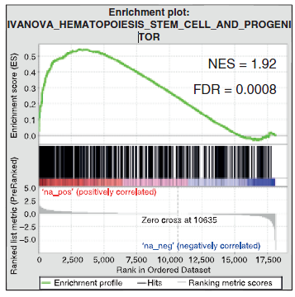
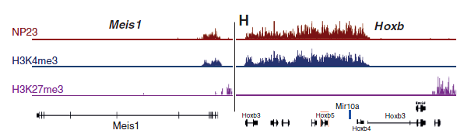
Analyze the differentially gene sets (DEG) using 1.5 fold cut-off (or gene ranking) to compare
PLK versus WT
TALL versus WT
2) Enrichment profiles of genes overexpressed or down-regulated in NP23 PLK AND NP23 TALL compared to ETP, DN2, DN3, DN4 and DP genesets (GSEA, Figure 3)
3) Are these differentially expressed genes direct targets of NP23 (anti-V5 ChIP-seq peaks, e.g. Figure 5) ? What is the chromatin structure at DEG (anti-H3K27me3; anti-H3K4me3 )? Focus on 3 loci: Hhex, Lyl1 and Kit
GSEA
ChIP-seq
Figure 3. “Enrichment profiles of genes overexpressed in NP23 AML compared
to human HSPC and early progenitor genesets” (PMID: 24535671)
Figure 5. “H3K4me3, H3K27me3, and NP23 ChIP-seq at Meis1 and the Hoxb locus” from tumor 961C (PMID: 24535671)

