Slide 1

FastAPI as a
Microservice Gateway
Building an Async, Event-Driven Pipeline in Python
Student: Alireza Dantism (učo 256649)
Supervisor: RNDr. Michal Batko, Ph.D.
Course: FI: PA053 Distributed Systems and Middleware (Spring 2026)
1 / 10

Slide 2

Why FastAPI?
A modern Python web framework built for speed and correctness
▸ Async-first — built on ASGI (Starlette), handles concurrent I/O natively
▸ Type hints everywhere — Python annotations drive validation, docs, and serialisation
▸ Pydantic integration — request validated automatically before your handler runs
▸ Auto-generated docs — OpenAPI (Swagger UI + ReDoc) at runtime, zero extra work
▸ Dependency Injection — clean, testable wiring of DB sessions, config, and auth
Performance
Comparable to
Node.js and Go
~3–5× faster than
Flask / Django
on I/O-bound workloads
“If your code imports FastAPI and Pydantic, you already have a contract, a validator, and a live documentation site — for free.”
2 / 10

Slide 3
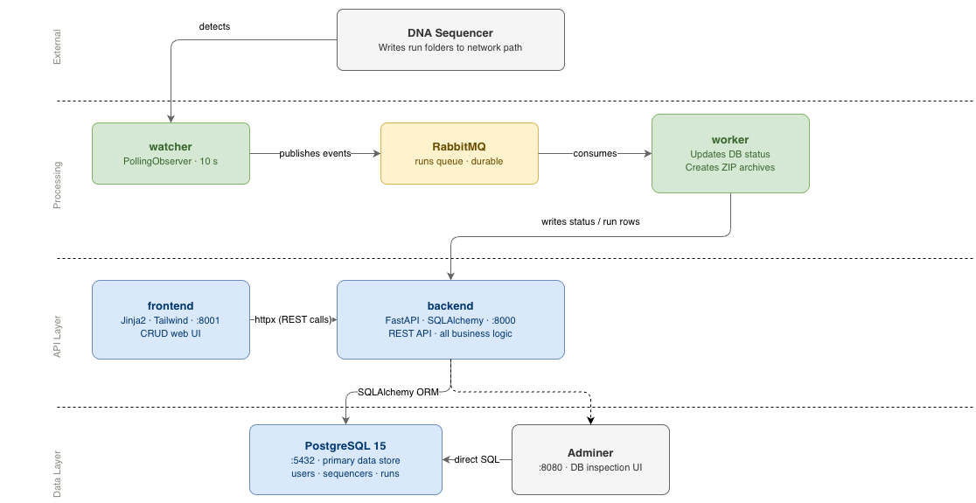
System Architecture
7 Docker Compose services orchestrated together
3 / 10

Slide 4
FastAPI Routing & Path Parameters
Declarative, type-safe route definitions
1
2
3
4
5
6
7
8
9
10
11
12
13
14
15
16
# api/v1/runs.py
@router.get("/{uuid}", response_model=ShowRun)
def get_run(uuid: UUID, db: Session = Depends(get_db)):
run = run_repo.get_run(db, uuid)
if not run:
raise HTTPException(status_code=404, detail="Run not found")
return run
@router.post("/{uuid}/start-upload", response_model=ShowRun)
def start_upload(uuid: UUID, db: Session = Depends(get_db)):
run = run_repo.get_run(db, uuid)
if run.status not in ("running_finished", "move_failed"):
raise HTTPException(status_code=409, detail="Invalid state")
publisher.publish("run_checksum_requested", run.name,
str(run.sequencer_uuid))
return run
▸ UUID path params — parsed & validated automatically
▸ Depends(get_db) — DB session lifecycle via DI
▸ response_model — Pydantic filters the return value
▸ HTTPException — structured JSON error responses
▸ State machine enforced at the HTTP layer (409)
4 / 10

Slide 5
Pydantic: Validation & Serialisation
Schemas are the contract between client and API
1
2
3
4
5
6
7
8
9
10
11
12
13
14
15
16
17
18
19
20
21
22
# schemas/sequencers.py
class SequencerCreate(BaseModel):
name: str
location: str
sent_to_tre: Literal["auto", "manual"] = "manual"
type_uuid: UUID
class ShowSequencer(BaseModel):
uuid: UUID
name: str
status: str
sent_to_tre: str
created_at: datetime
model_config = ConfigDict(from_attributes=True)
# schemas/runs.py
class ShowRun(BaseModel):
uuid: UUID
name: str
status: str
sequencer_name: str # resolved via ORM relationship
sequencer_sent_to_tre: str
▸ Literal["auto","manual"] — rejected before hitting the DB
▸ from_attributes=True — reads SQLAlchemy ORM objects directly
▸ Joined field sequencer_name resolved via ORM relationship
▸ Separate Create vs Show — internal IDs never exposed
▸ 422 Unprocessable Entity returned automatically on bad input
5 / 10

Slide 6
Database Layer: SQLAlchemy + Repository Pattern
FastAPI stays thin; all DB logic lives in repositories
1
2
3
4
5
6
7
8
9
10
11
12
13
14
15
16
17
# db/models/runs.py
class Runs(Base):
__tablename__ = "runs"
id = Column(Integer, primary_key=True)
uuid = Column(UUID(as_uuid=True), unique=True,
index=True, default=uuid4)
name = Column(String, nullable=False)
sequencer_uuid = Column(UUID(as_uuid=True),
ForeignKey("sequencers.uuid"))
status = Column(String, default="running")
# db/repositories/runs.py
def update_run_status(db, run_uuid, new_status):
run = db.query(Runs).filter(Runs.uuid == run_uuid).first()
run.status = new_status
db.commit(); db.refresh(run)
return run
▸ Dual PK — integer id (internal) + uuid (API surface)
▸ Soft deletes — is_deleted=True, rows are never removed
▸ Repository pattern — DB ops isolated from routes
▸ Alembic — versioned schema migrations
▸ runs_status_history — permanent timestamped audit log
6 / 10

Slide 7
Async Event-Driven Communication
FastAPI publishes events; a separate worker consumes them
1
2
3
4
5
6
7
8
9
10
11
12
13
14
# services/publisher.py
def publish(event: str, name: str, sequencer_uuid: str):
connection = pika.BlockingConnection(
pika.ConnectionParameters(host=RABBITMQ_HOST))
channel = connection.channel()
channel.queue_declare(queue=QUEUE_NAME, durable=True)
message = json.dumps({
"event": event,
"name": name,
"sequencer_uuid": sequencer_uuid
})
channel.basic_publish(
exchange="", routing_key=QUEUE_NAME, body=message)
connection.close()
Event Pipeline
watcher detects RTAComplete.txt
-> publishes run_completed
-> worker: status = running_finished
-> publishes run_checksum_requested
-> worker: checksums folder
-> publishes run_upload_requested
-> worker: S3 upload
-> status = completed
▸ HTTP response is instant — publish is fire-and-forget
▸ Worker is a separate container and scales independently
▸ Every status transition recorded in runs_status_history
7 / 10

Slide 8
Filesystem Watcher as an Event Source
Bridging physical sequencer machines to the event pipeline
1
2
3
4
5
6
7
8
9
10
11
12
13
14
15
16
# services/watcher.py
class RunEventHandler(FileSystemEventHandler):
def on_created(self, event):
path = Path(event.src_path)
if self.sequencer.is_completion_signal(path.name):
run_name = path.parent.name
publisher.publish(
"run_completed",
run_name,
str(self.sequencer.uuid))
observer = PollingObserver(timeout=10)
observer.schedule(handler,
path=sequencer.location,
recursive=True)
observer.start()
▸ watchdog library with PollingObserver
› Polls every 10 s — reliable inside Docker on macOS
▸ Configurable completion signal per sequencer type
› exact / prefix / suffix matching (e.g. RTAComplete.txt)
▸ Polls DB every 60 s for newly added sequencers
› No container restart needed after adding a sequencer
▸ Startup scan — catches runs that appeared while offline
8 / 10

Slide 9
Two FastAPI Services: API + Frontend
A clean split: one service owns data, one owns presentation
Backend :8000
Frontend :8001
api/v1/runs.py
REST JSON API only
schemas/
Pydantic contracts
db/
SQLAlchemy + Alembic
services/
publisher, worker, watcher
Speaks JSON only.
No HTML. No sessions.
Any client can consume it.
routers/runs.py
calls backend via httpx
templates/runs/
Jinja2 HTML templates
main.py
mounts /static, registers routers
Server-side rendering.
No DB connection.
Replace with React — backend
stays unchanged.
HTTP
(httpx)
9 / 10

Slide 10
Key Takeaways
What makes FastAPI the right choice as a gateway
Concern
Solution
Request validation
Pydantic schemas with Python type hints
DB access
SQLAlchemy + Repository pattern
Async processing
RabbitMQ + dedicated worker container
Physical event source
watchdog filesystem monitor
Data integrity
Dual id/uuid PKs · soft deletes · status history
Deployment
Docker Compose — all services orchestrated
FastAPI stays thin — validate inputs, enforce state rules, publish events, return JSON. The async pipeline handles the rest. The result: a fully automated, auditable pipeline in Python.
10 / 10

Slide 11
Thank YOU

