Slide 1

BioIT Hackathon 2026
Mining the CFDE for Post-Translational Modification (PTM) Secrets
Christina Akirtava, Vlado Dancik, Jana Moubarak, Viveka Patil, Amy Reese, Chase Yakaboski

Slide 2
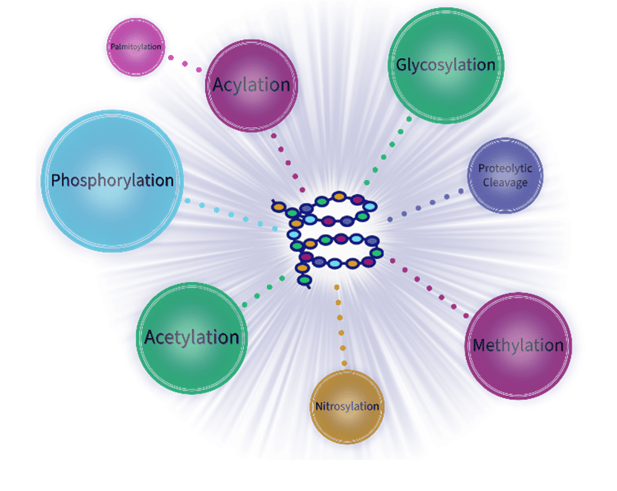
VLADO
Why PTMs and Why CFDE?
Post-translational modifications (PTMs) (e.g. glycosylation, phosphorylation) regulate virtually every cellular process and are central to disease biology
The problem: PTM data is scattered across siloed databases
CFDE (Common Fund Data Ecosystem) hosts rich PTM data across multiple Data Coordinating Centers
MoTrPAC for condition-driven PTM changes
GlyGen for glycosylation and disease annotations
Our approach: We built two interactive dashboards using Akleao, an agentic workspace developed by Chase Yakaboski+ prior to Bio-IT World, to mine this data for exploration and generate hypotheses

Slide 3
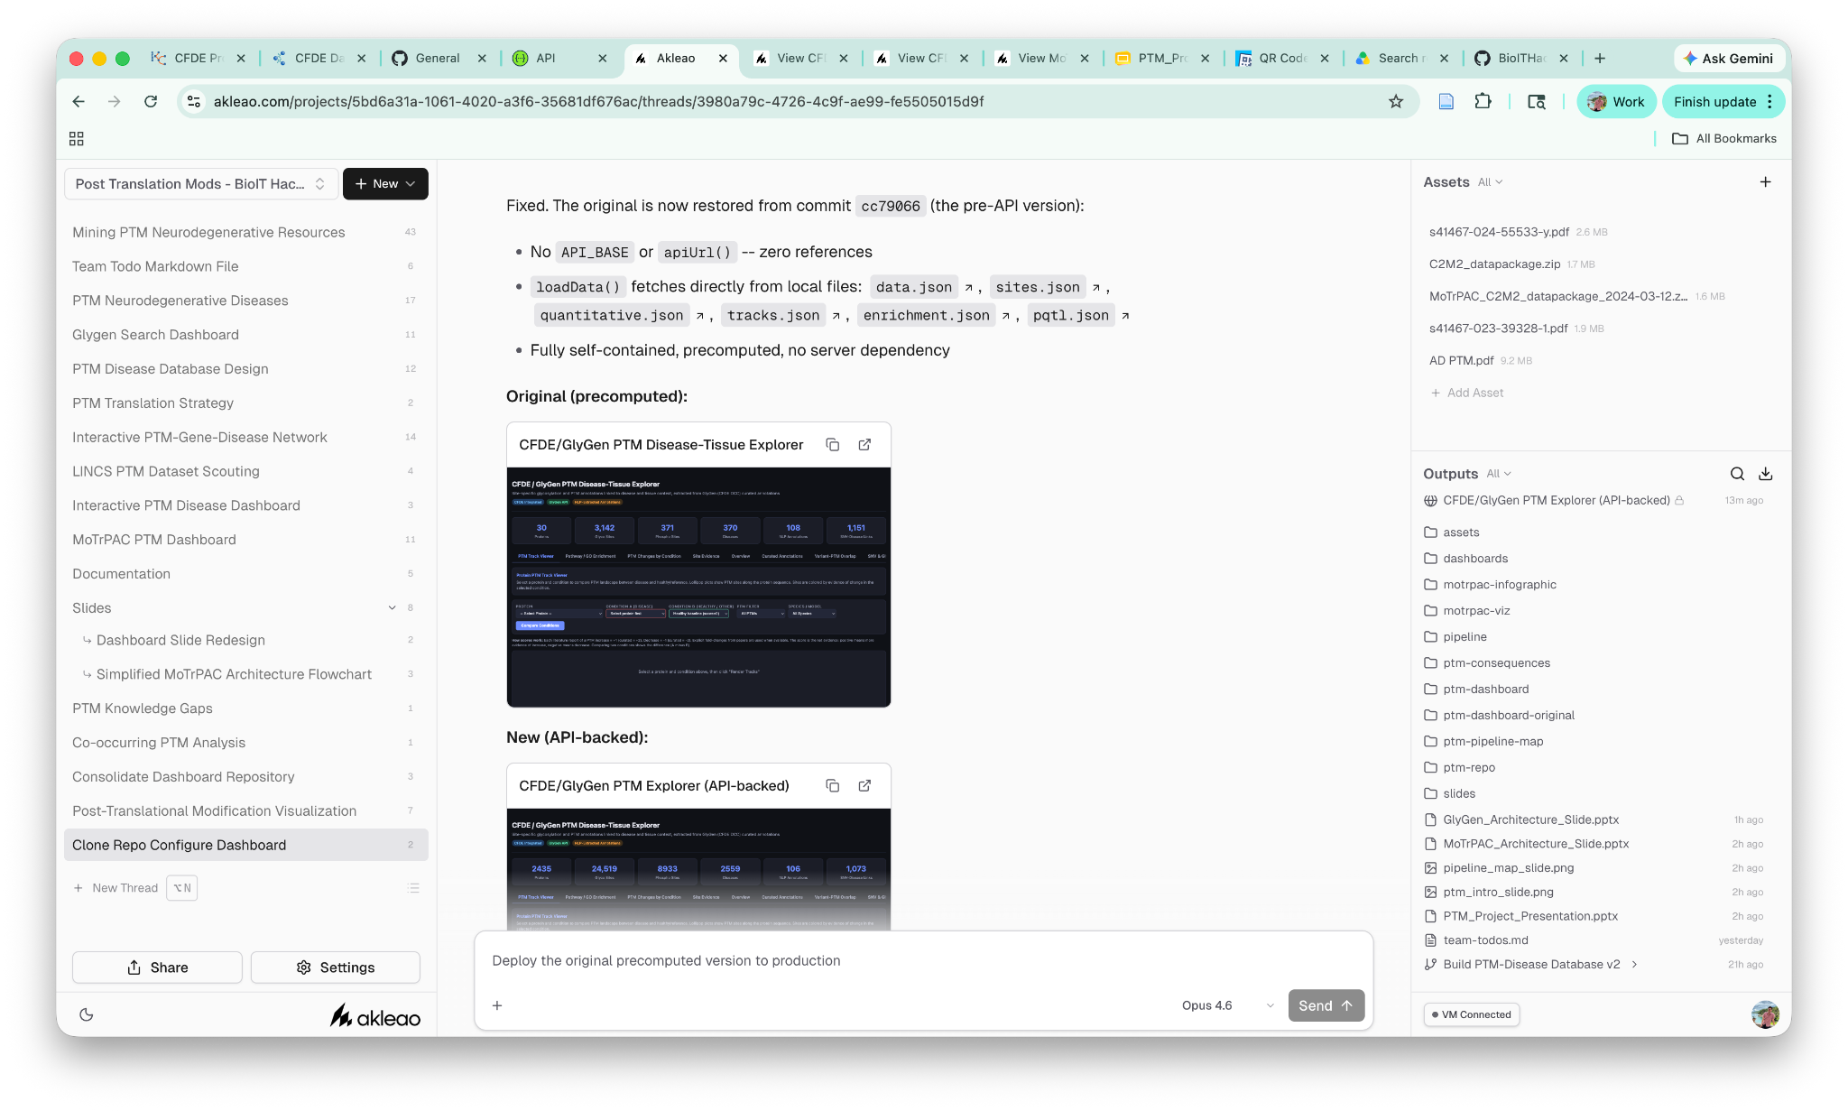
CHASE

Slide 4
JANA
DASHBOARD 1 ARCHITECTURE
CFDE/MoTrPAC PTM Exercise Response Explorer
1
2
4
4
3
Select Protein
Compare Conditions
Data Dimensions
Explore Outputs
7 Tissues
Positional Chart
2,200 Proteins
Condition A
Sex + Timepoint +Tissue
Search by gene symbol or UniProt accession
3 PTM Types
Site Detail Type
vs
4 Timepoints
3D Structure
Condition B
Sex + Timepoint +Tissue
2 Sexes
PTM Network
41,816 Records
CSV Export
MoTrPAC PTM Explorer lets you pick any protein, define two exercise conditions (sex, timepoint, tissue), and instantly compare site-level PTM fold-changes across phosphorylation, acetylation, and ubiquitylation.

Slide 5
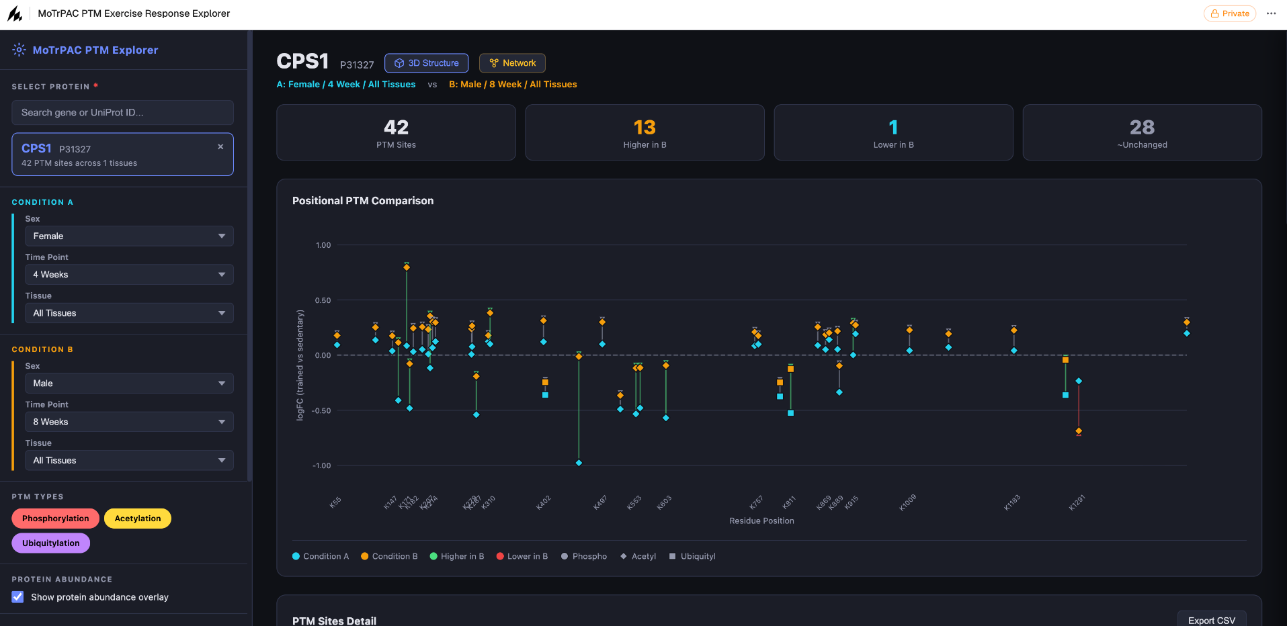
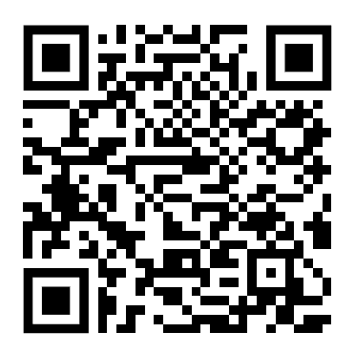
JANA
DASHBOARD 1 DEMO
MoTrPAC PTM Exercise Response Explorer
Next Steps:
Correlate perturbations to function
Add protein-protein interaction information
Notes:
Protein - PRKAA2

Slide 6
JANA
DASHBOARD 2 ARCHITECTURE
CFDE/GlyGen PTM Disease-Tissue Explorer
1
2
3
Data Sources
Core Entities
Explorer Views
GlyGen API
2435 Proteins
PTM Track Viewer
Glycosylation sites, disease associations
Condition Changes
2,400+ Glyco Sites
PubMed / NLP
Pathway Enrichment
474 abstracts mined
2,000+ Diseases
Variant-PTM Overlap
BioMuta / dbSNP
Tissues / Cell Types
Disease-associated SNVs
Multi-Filter Search
SNVs at PTM Sites
UniProtKB
Protein metadata
100+ NLP Annotations
GlyGen PTM Explorer integrates glycosylation and phosphorylation data from GlyGen with NLP-mined literature annotations, connecting neurodegeneration proteins to 40+ disease conditions with site-level variant overlap and pathway enrichment.

Slide 7
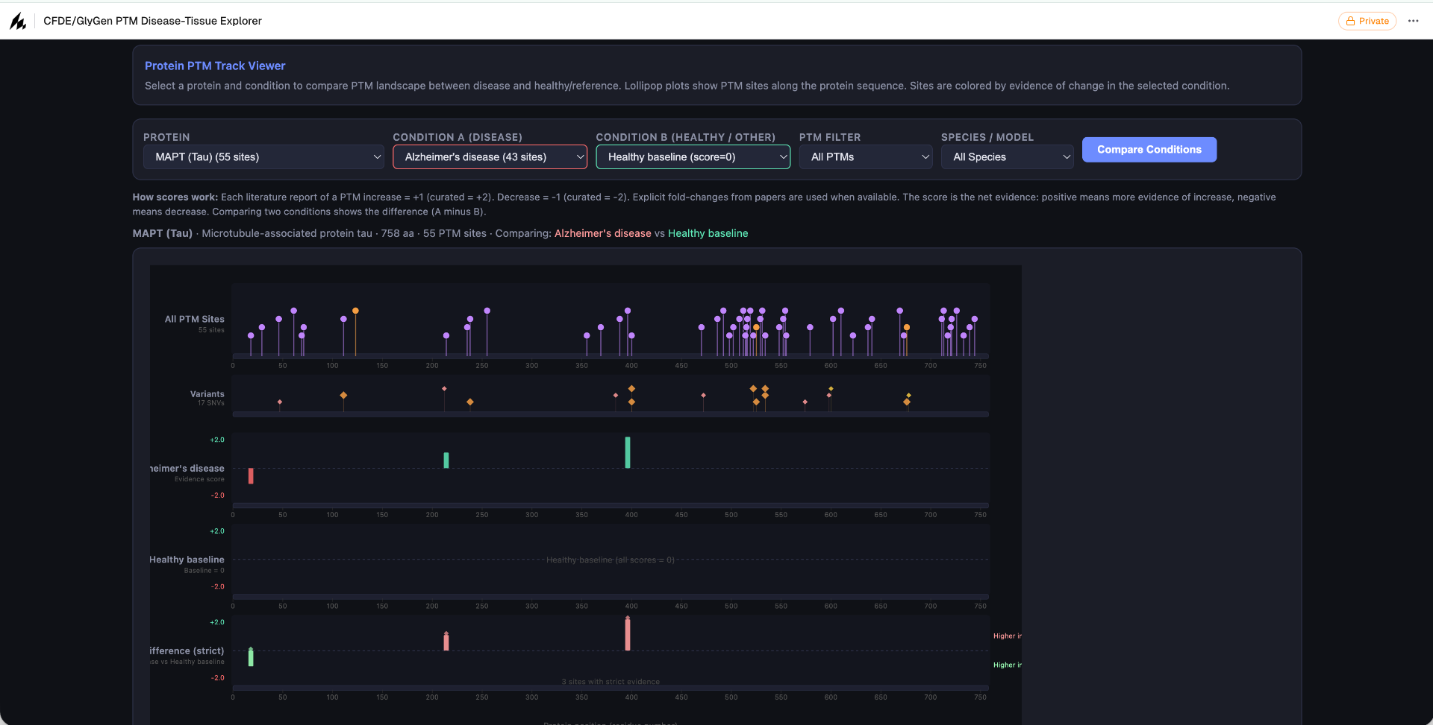
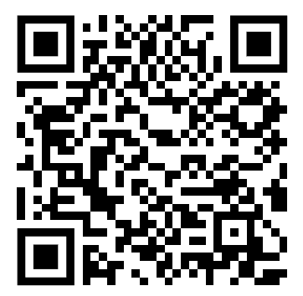
JANA
DASHBOARD 2 DEMO
CFDE/GlyGen PTM Disease-Tissue Explorer
QR code here
dashboard link
Next Steps:
Uploaded user data comparison feature

Slide 8
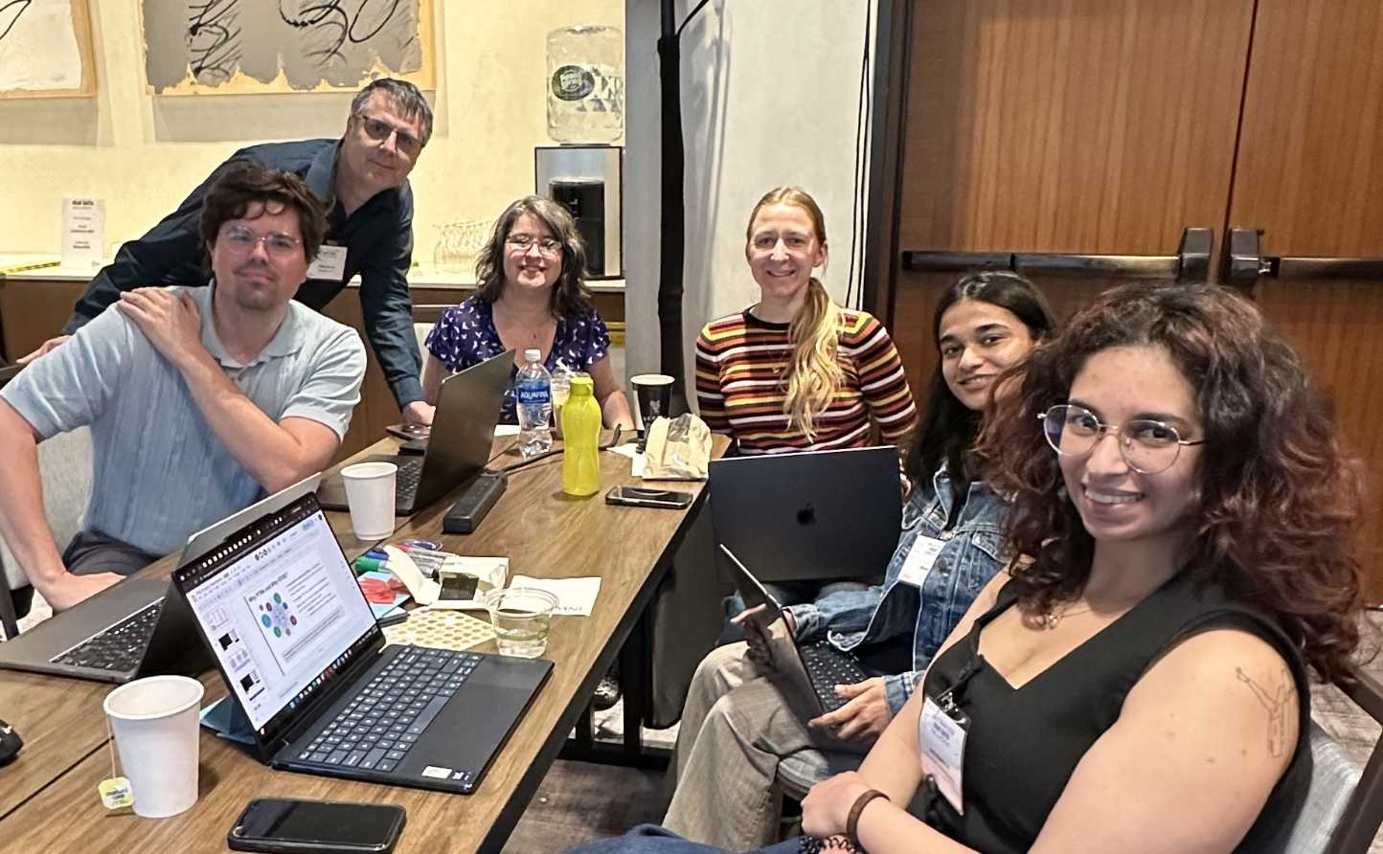
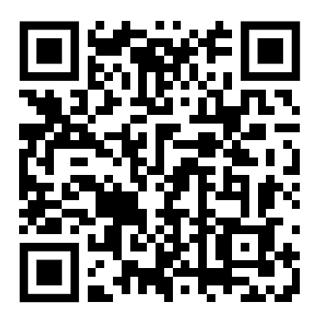
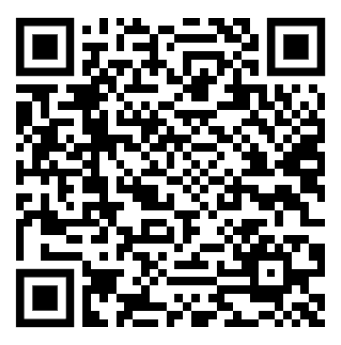

Mining the CFDE for Post-Translational Modification Secrets
BioIT Hackathon 2026 -- Thank you :)
Acknowledgements
Bio-IT Hackathon Organizers
Akleao
CFDE
DASHBOARD 1
DASHBOARD 2
AKLEAO WORKSPACE

