Slide 1
Introduction to Object-Oriented Programming
Faculty of Science
Department of Computer Science
Vorkurs Programming - Informatik 4 Lifescientists
https://github.com/BioInfPrep/python_oop

Slide 2
Concepts

Slide 3
What is an
Object?

Slide 4
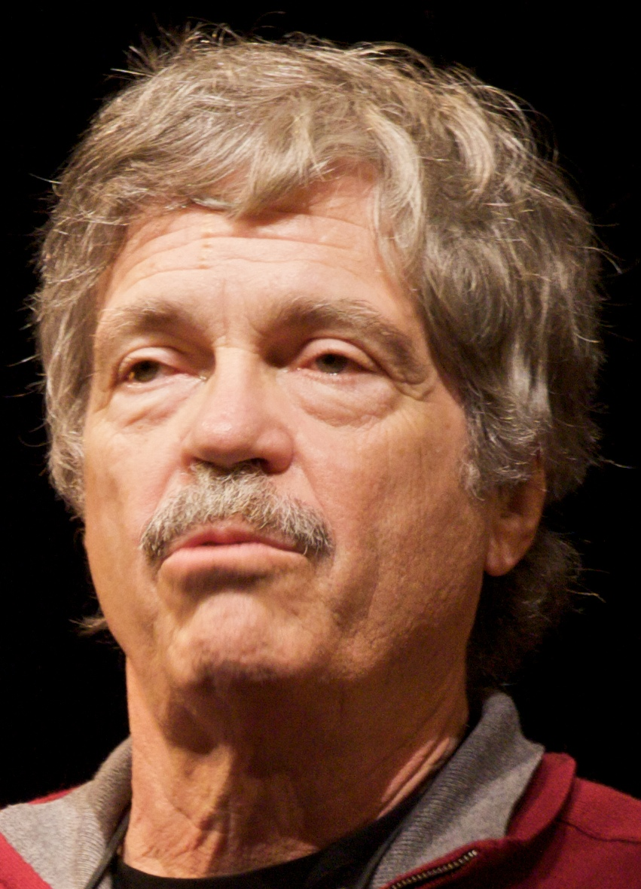
What is an
Object?
“I thought of objects being like biological cells and/or individual computers on a network, only able to communicate with messages” -Alan Levy

Slide 5
Attributes. Attributes define characteristics, such as the type of a cell, or its pH.
Methods. Methods instruct the object to perform tasks, such as phagocytose or undergo mitosis.
Events. Events fire when something happens to an object, for example, antigen presentation. (not natively present in Python)

Slide 6
Why do we use
Objects?

Slide 7
Simplify your life. OOP helps make it possible for you to communicate what you want the computer to do in a way that the computer can understand.
Define ideas consistently. OOP creates a common way to express what you want to do so that others will understand.
Specify the manner used to create objects. Each object uses specific techniques to define attributes, methods, and events.
Write code with less effort. Creating an animal object means that you specify the things that make animals different from other objects only once.

Slide 8
Concepts of Objects

Slide 9
What is a
Some key concepts of OOP?

Slide 10
Classes. A class is a template for creating objects. Eg. Cell may be a class, “that cell over there” is an object
Encapsulation. Some characteristics of an object are accessible from other objects some are only accessible to the object itself
Inheritance. Classes can be defined to inherit methods and attributes from another class. Eg erythrocyte inherits cell membranes, and cytoplasm
Polymorphism. Functions acting on a parent class can be applied to its daughter classes

Slide 11
An aside about
MSPeaks

Slide 12
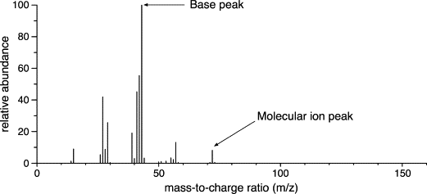
An aside about
MSPeaks
Our preferred example class
Represents a reading from a mass spectrometer
Has intensity and mass-to-charge ratio (MZ)

Slide 13
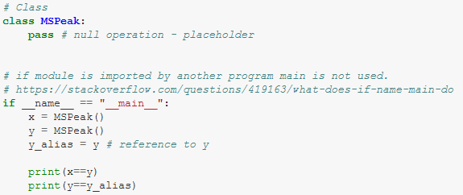
What is a
Class?

Slide 14
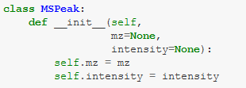
What are
Attributes?

Slide 15
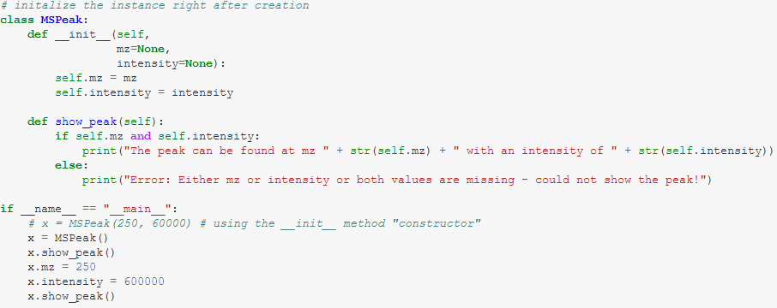
What are
Methods?

Slide 16
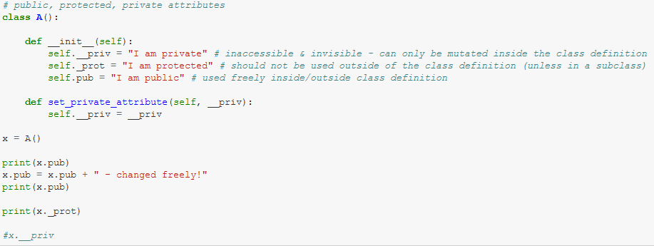
What is
Encapsulation?

Slide 17
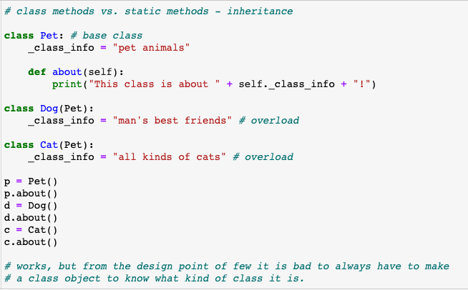
What are
Methods?

Slide 18
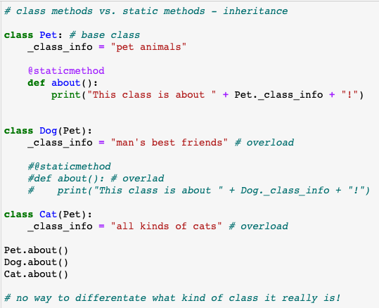
What are
Static Methods?

Slide 19
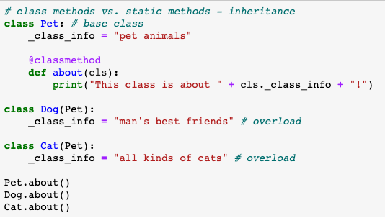
What are
Class Methods?

Slide 20
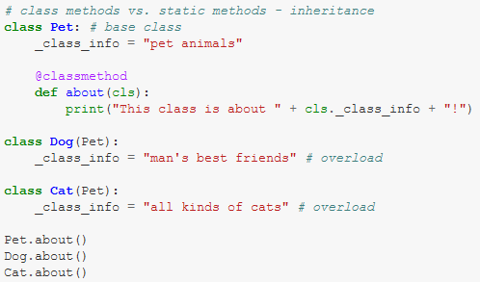
What is
Inheritance?

Slide 21
Questions?

Slide 22
Project:
Build a decoy database generator

Slide 23
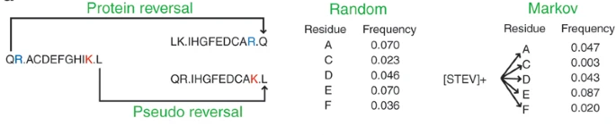
What is a
Decoy database?
False discovery rate in proteomics is determined by searching for known-bad sequences (decoys).
Simplest way to generate decoys is to reverse input sequences.

