Slide 1
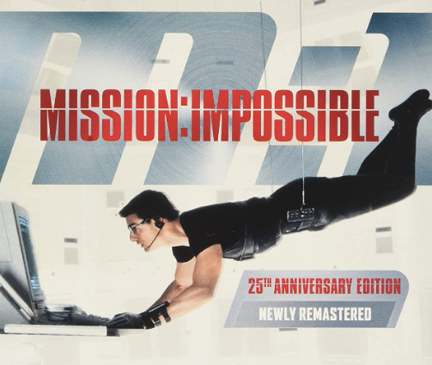
Babysitter network
Mission: Finding a good babysitter for our kids

Slide 2
Current solution:
Joining whatsapp groups with parent and babysitters
However, this is extremely not optimal:
Babysitters and parents are constantly getting non-relevant notifications from other parents / babysitter
Babysitter replies are often not relevant (for example, too young babysitters).
Reply from unfamiliar babysitters.
Limited number of users in one whatsapp group.

Slide 3
My solution:
Babysitter network
Each parent is connected to a group of babysitters he is familiar with.
Each user have a profile page, so parents can see the details of the babysitters and vice versa.
Users can add or remove connections.
When parent wants to find one, he can send a message to the babysitters based on specific filtering: gender and years of experience

Slide 4



Software architecture

Slide 5
Models
User: Django build-in model.
Profile: Include user personal details – name , gender, email, phone etc.
Details: Babysitter specific information – age, years of experience (babysitters only).
Connection: Include username and all connected users in ManyToMany relationship.
Search: Information about a search done by a parent – this includes the parameters of the search as well as the list of results and babysitter replies (if any).
Reply: Babysitter reply content.
ReplySearch: search reply model for babysitters – this include the Search ForeignKey and babysitter reply ForeignKey.

Slide 6
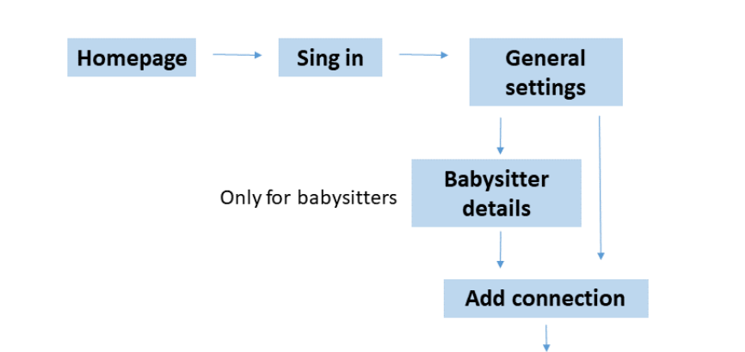
App overview – new user
User model
User model
User model
User model
Profile model
Profile model
Profile model
Detail model
Detail model
Detail model
Present only babysitter / parents for selection
Connection model
Connection model
User page

Slide 7
App overview – registered user
My profile
Add connections
Present users NOT connected yet
Homepage
Login
User page
Remove connections
Present only connected users
feed
Reply to a massage
Only for babysitters
Search model
Find a babysitter
Only for parents
ReplySearch model
Connected users profiles
Reply model

Slide 8


Slide 9
Improvements …
Check password quality.
Validation of user details (email, phone, etc. ).
Edit profile for registered user.
Add parameters for babysitter search.
Use mySQL as database.
build a chat app for babysitter-parent communication

