Slide 1
MHV High Voltage cable assembly
GAA Custom Electronics, LLC

Slide 2
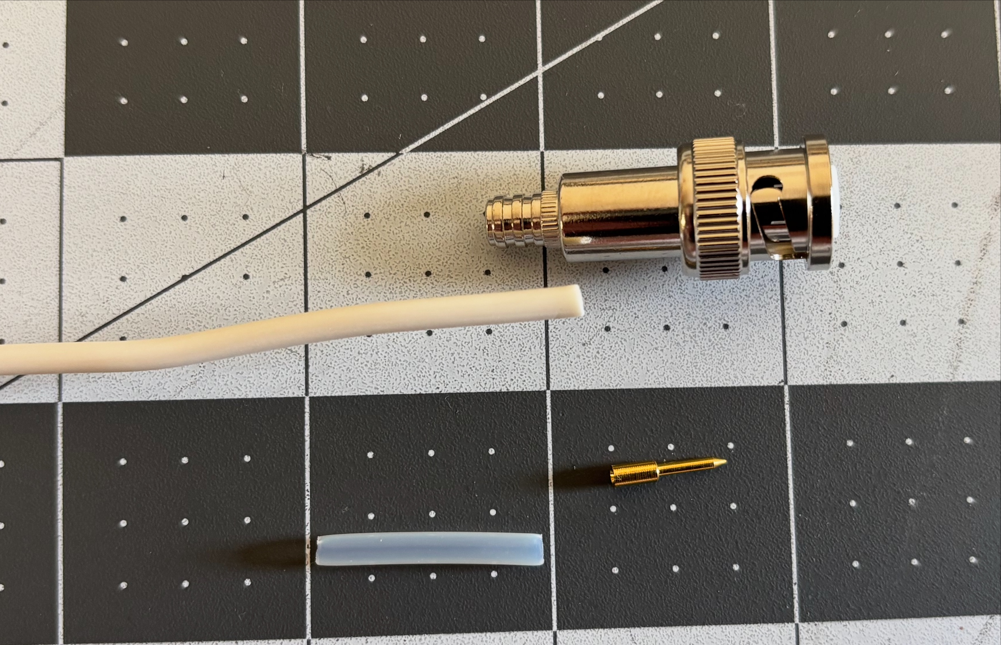
AlphaWire, 39x2015 WH001, HV wire, cut to required length
High voltage power RF connector MHV 3000V RG59 RG8X RG62, eBay various suppliers
McMaster-Carr 5335K21, High-Temperature Tube Sleeving, cut to 0.9”

Slide 3
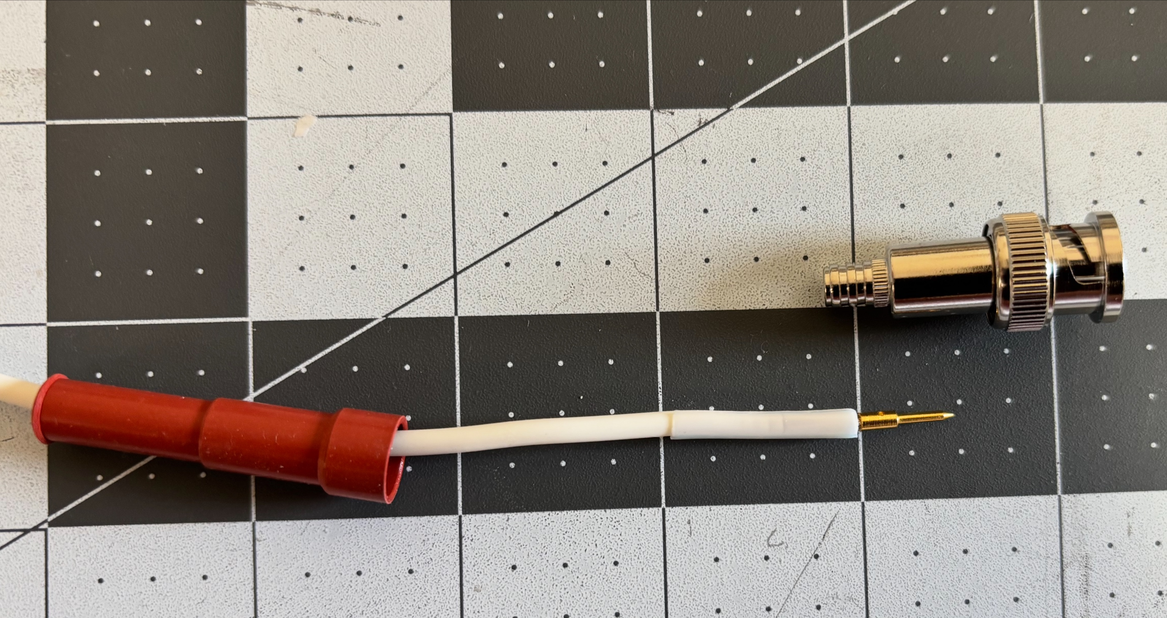
Strip wire and solder pin
Cut one side of tube and slip over HV lead, align with end of wire

Slide 4
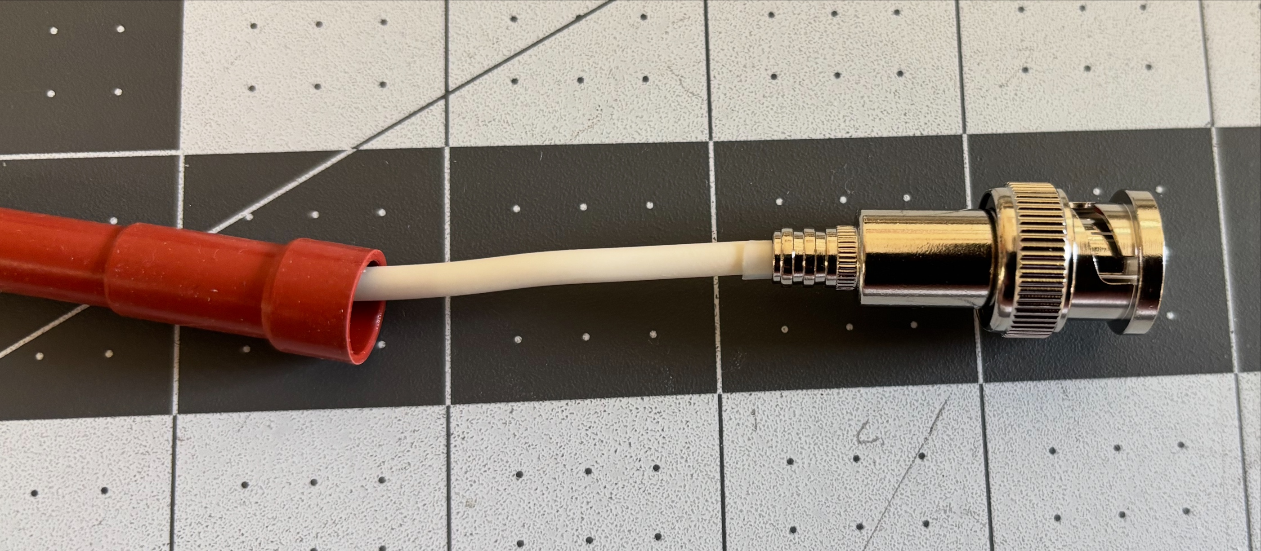
Insert wire and pin assembly into connector body
Cover this area with epoxy putty to secure wire to connector body
Slide protective boot over wire to connector body interface, boot supplied with connector

