Slide 1

ARDUINO ZERO
Dr Guillermo Sobreviela Falces

Slide 2

Arduino and C programming
The structure of the program is based on two void funtion() functions, and it’s going to be like this in most of the cases. These two functions are:
void setup() and void loop()
void setup() is executed at the start of the program, and Will define all the variables and starting point of the system. Then, the function void loop() is repeated until infinite, and will contain the core of the code.
Code skeleton Example:
void setup()
{
SETUP CONTENT }
void loop()
{
PROGRAM CONTENT }

Slide 3
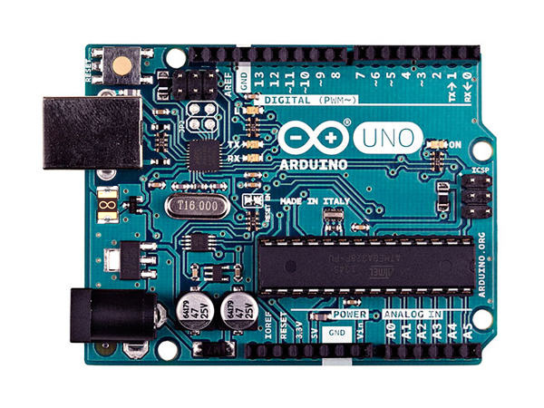
ARDUINO UNO
Power
Analog Input Pins
Digital Pins
AREF analogReference()
ICSP (In Chip Serial Programmer)

Slide 4
ARDUINO UNO
Power
https://www.open-electronics.org/the-power-of-arduino-this-unknown/
Analog Input Pins
https://www.arduino.cc/en/Tutorial/AnalogInputPins
Digital Pins
https://www.arduino.cc/en/Tutorial/DigitalPins
AREF analogReference()
ICSP (In Chip Serial Programmer)

Slide 5
POWER
RESET
5V 3.3V and Ground
Each one of these pins can be used as power supply for the sensors/actuators/transducers that we will use in our projects.

Slide 6
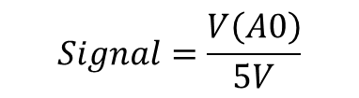
Analog Input Pins
This is only a read pin. Only works as an input of information, and is used for sensing.
analogRead(sensorPin)
Example: Read the signal at A0
Int Signal; //Signal is defined as a integer
Signal = analogRead(A0);
Signal will have a value between 0 and 1023. This value can be estimated from the equation:
*Where V(A0) is the voltage at the pin A0.
$$Signal=\frac{V\left(A0\right)}{5V}$$
5 Analog inputs

Slide 7
Digital Pins (Output)
This is a read/write pin. Works in both directions, but the direction has to be defined before performing the action of writing or measuring.
pinMode(Pin_Number,INPUT/OUTPUT);
Example: Pin 13 will work as an input and pin 12 as an output.
pinMode(13,INPUT);
pinMode(12,OUTPUT);
Now, the pin 12 can generate a signal that can be HIGH or LOW (5V or 0V), and provide a máximum current of 40uA.
digitalWrite(pin, value)
Example: Pin 11 and 12 have been defined as output pins. We want to generate 5V at 12 and 0V at 11.
digitalWrite(12, HIGH);
digitalWrite(11, LOW);
13 Digital outputs

Slide 8
Digital Pins (Input)
Example: Pin 13 and 12 will work as an input pin.
pinMode(13,INPUT);
pinMode(12,INPUT);
Now, the pin can read the digital input voltage (HIGH or LOW). But, we have to define another parameter. The pull-up or pull-down resistors.
digitalWrite(pin, value)
Example: Pin 13 will have a pull-up resistor and pin 12 a pull-down resistor.
digitalWrite(13, HIGH);
digitalWrite(12, LOW);
Example: Based on the previous configuration, we want to read both, pin 13 and 12.
bool In13, In12; // We define as boolean, 1 bit variable.
In13 = digitalRead(13);
In12 = digitalRead(12);
13 Digital inputs

Slide 9
ARDUINO ZERO
Full example
Guillermo Sobreviela Falces

Slide 10
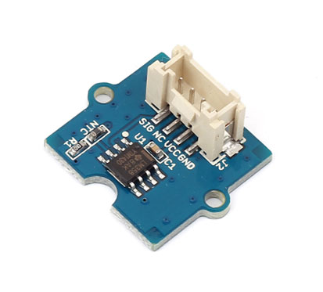
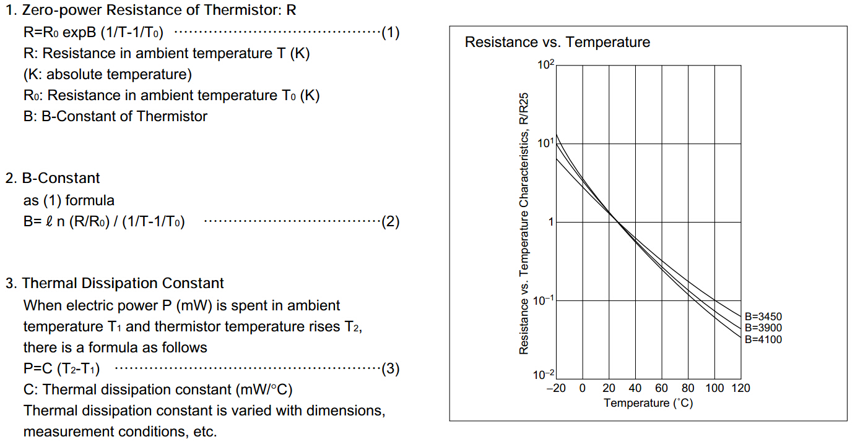
Temperature sensor
Voltage: 3.3 ~ 5V
Zero power resistance: 100 KΩ
Resistance Tolerance: ±1%
Operating temperature range:
-40 ~ +125 ℃
Nominal B-Constant：
4250 ~ 4299K

Slide 11
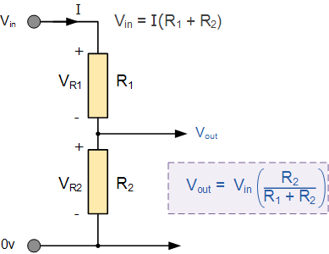
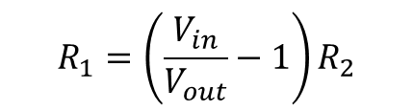
Some maths about the sensor
The sensor is a temperature dependent resistor, connected in series with a second resistor.
R1 is the thermometer resistance.
R2 is a resistor of 500kOhm.
Vin is 5V.
Vout can be estimated by the equation.
Also, R1 can be obtained from:
$$R_{1}=\left(\frac{V_{in}}{V_{out}}−1\right)R_{2}$$

Slide 12
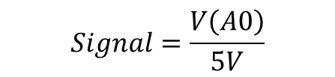
Temperature extraction (I)
First, we need to know the values of Vin and Vout. Vin is 5V, and Vout will take a value between 0 and 5V. But, how can we read Vout?
We Will use the “Analog Input Pins”.
Signal will have a value between 0 and 1023. This value can be estimated from the equation:
*Where V(A0) is the voltaje at the pin A0.
Remember!!!
$$Signal=\frac{V\left(A0\right)}{5V}$$

Slide 13
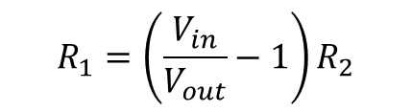
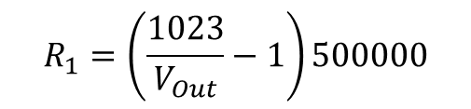
Temperature extraction (II)
To process the information we can use the voltages as an adimensional variable, since on the equation is a quotient.
The value of Vin will vary from 0 to 1023, meanwhile Vin (5V) will take the equivalent value of 1023. Taking into account that R2 is 500kOhm, the final equation is:
$$R_{1}=\left(\frac{V_{in}}{V_{out}}−1\right)R_{2}$$
$$R_{1}=\left(\frac{1023}{V_{Out}}−1\right)500000$$

Slide 14
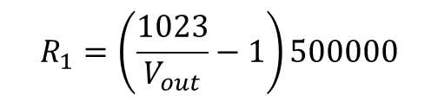

Temperature extraction (III)
Once we calculate the value of R1, we can estimate the temperature with the equation given on the datasheet.
$T={\left(\frac{\ln\left(\frac{R_{0}}{R_{1}}\right)}{B}+\frac{1}{T_{0}}\right)}^{−1}$ [T]=K
B = 4275
R0 = 100000 Ohm
T0 = 298.15 K
Now the electric concept is understood.
$$R_{1}=\left(\frac{1023}{V_{out}}−1\right)500000$$

Slide 15

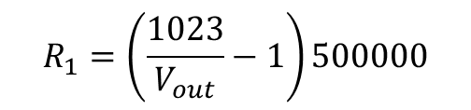
Code for the temperature sensor
#include <math.h>
B = 4275;
int R0 = 100000;
int pinTempSensor = A5;
void setup() {
}
void loop() {
int a = analogRead(pinTempSensor);
float R = 1023.0/a-1.0;
R = R0*R;
float temperature = 1.0/(log(R/R0)/B+1/298.15)-273.15;
}
$T={\left(\frac{\ln\left(\frac{R_{0}}{R_{1}}\right)}{B}+\frac{1}{T_{0}}\right)}^{−1}$ [T]=K
B = 4275
R0 = 100000 Ohm
T0 = 298.15 K
Now the electric concept is understood.
$$R_{1}=\left(\frac{1023}{V_{out}}−1\right)500000$$

Slide 16
The code is ready but…
HOW CAN WE KNOW WHAT IS HAPPENING INSIDE THE SYSTEM????
We need to display the internal information of the system, namely the temperature or value of R1. The first solution uses the serial port communications.
Serial.begin(9600);
Serial.print(“Temperature = ");
(Prints the text)
Serial.println(temperature);
(Prints the value of temperature)

Slide 17
#include <math.h>
B = 4275;
int R0 = 100000;
int pinTempSensor = A5;
void setup() {
Serial.begin(9600);
}
void loop() {
int a = analogRead(pinTempSensor);
float R = 1023.0/a-1.0;
R = R0*R;
float temperature = 1.0/(log(R/R0)/B+1/298.15)-273.15;
Serial.print(“Temperature = ");
Serial.print(temperature);
delay(100);
}

Slide 18
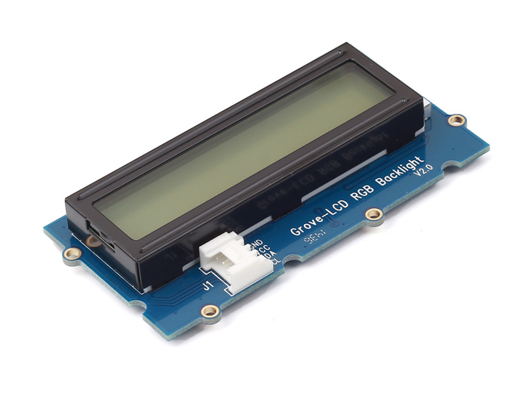
But I want an autonomous system
How can I see the data without using the computer?
We can use the LCD RGB Backlight screen to plot the data.
http://wiki.seeed.cc/Grove-LCD_RGB_Backlight/
This is a primitive 16x2 LCD module. It takes I2C as communication method with your microcontroller.

Slide 19
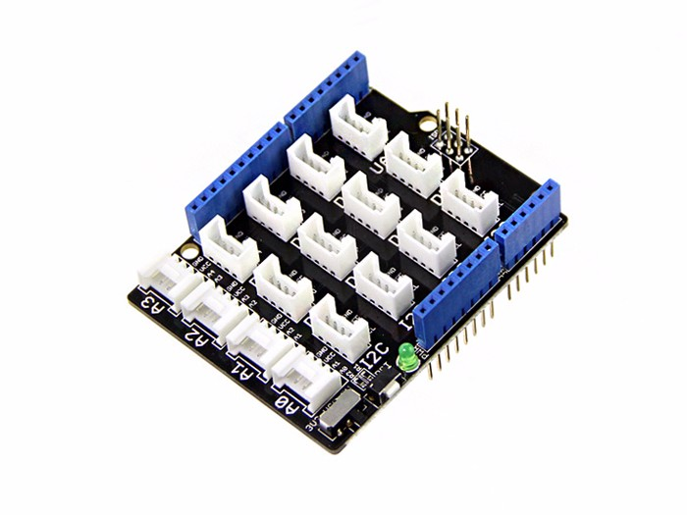

The Base Shield
In order to make easy the connection between the LCD screen and the Arduino system we will use this base shield.
https://www.seeedstudio.com/Base-Shield-V2-p-1378.html

Slide 20
Needed libraries fot this LCD screen
Wire library
This library allows you to communicate with I2C / TWI devices.
RGB_LCD library
This is the library that has the simplified instructions for the LCD screen.
In order to call this library the code has to start with these lines:
#include <Wire.h>
#include "rgb_lcd.h"

Slide 21
Some functions for the LCD screen
lcd.begin(16,2);
Start up the LCD system.
void setRGB(int r, int g, int b);
Set the back colour.
void clear();
Clean the data of the screen.
lcd.print(‘’text’’);
Plot the message “text” on the screen starting at the point set on lcd.begin.

Slide 22
#include <math.h>
#include <Wire.h>
#include "rgb_lcd.h"
rgb_lcd lcd;
int B = 4275;
int R0 = 100000;
int pinTempSensor = A5;
void setup() {
Serial.begin(9600);
lcd.begin(16,2);
lcd.setRGB(0, 0, 255);
}
void loop() {
int a = analogRead(A0);
float R = 1023.0/a-1.0;
R = R0*R;
float temperature = 1.0/(log(R/R0)/B+1/298.15)-273.15;
Serial.print("Temperature = ");
Serial.print(temperature);
lcd.setCursor(0, 0);
lcd.print("Temperature =");
lcd.setCursor(0, 1);
lcd.print(temperature);
lcd.print(" C");
delay(100);
}

Slide 23
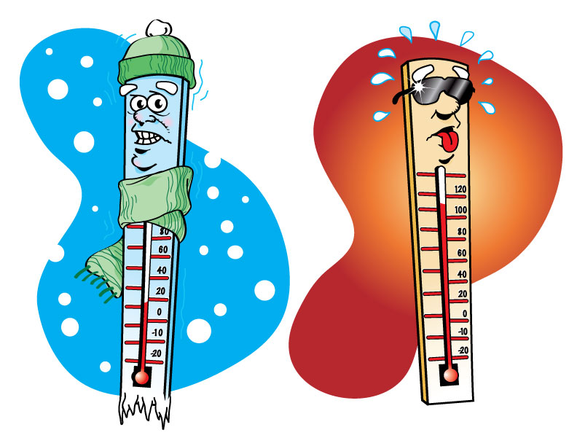
Modified code example
void loop() {
int a = analogRead(A0);
float R = 1023.0/a-1.0;
R = R0*R;
float temperature = 1.0/(log(R/R0)/B+1/298.15)-273.15;
float sensation=temperature-25;
int red= sensation*255/5;
int blue= 255-sensation*255/5;
lcd.setRGB(red, 0, blue);
Serial.print("Temperature = ");
Serial.print(temperature);
lcd.setCursor(0, 0);
lcd.print("Temperature =");
lcd.setCursor(0, 1);
lcd.print(temperature);
lcd.print(" C");
delay(100);
}
#include <math.h>
#include <Wire.h>
#include "rgb_lcd.h"
rgb_lcd lcd;
int B = 4275;
int R0 = 100000;
int pinTempSensor = A5;
void setup() {
Serial.begin(9600);
lcd.begin(16,2);
lcd.setRGB(0, 0, 255);
}
http://www.kiss959.com/2015/08/17/hot-and-cold-in-yyc/

Slide 24
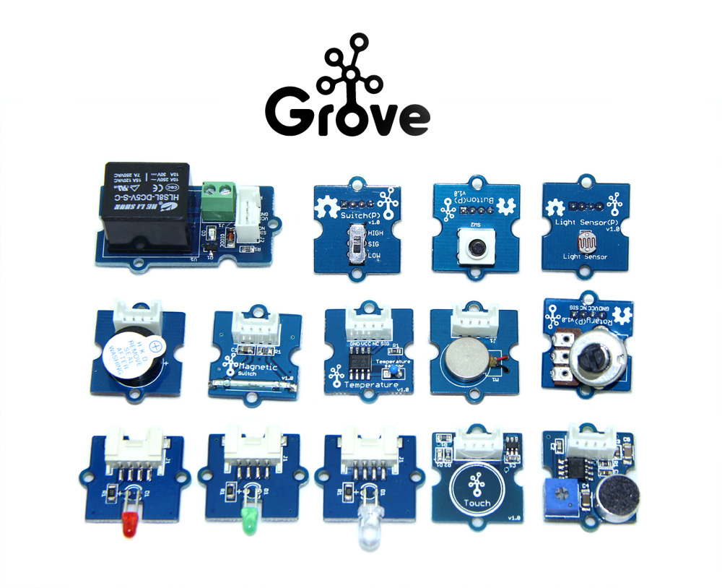
More examples?
1x Base Shield
1x Grove - LCD RGB Backlight
1x Grove - Smart Relay
1x Grove - Buzzer
1x Grove - Sound Sensor
1x Grove - Touch Sensor
1x Grove - Rotary Angle Sensor
1x Grove - Temperature Sensor
1x Grove - LED
1x Grove - Light Sensor
1x Grove - Button
1x DIP LED Blue-Blue
1x DIP LED Green-Green
1x DIP LED Red-Red
1x Mini Servo
10x Grove Cables
1x 9V to Barrel Jack Adapter
1x Grove starter kit Manual
1x Green Plastic Box

