Slide 1


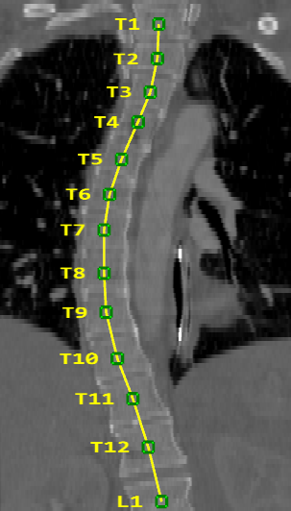
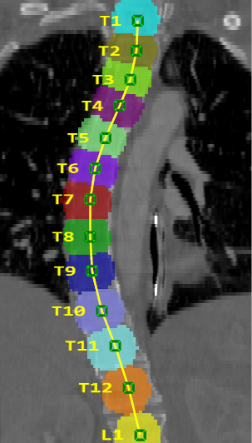
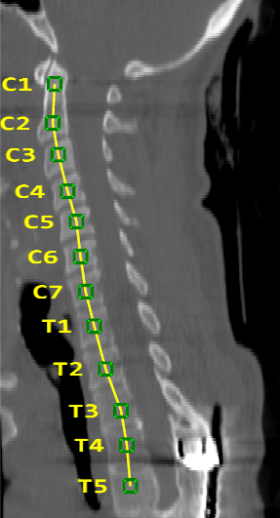
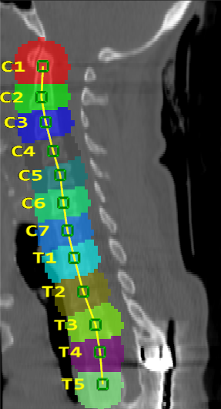
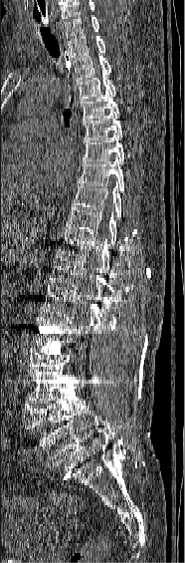
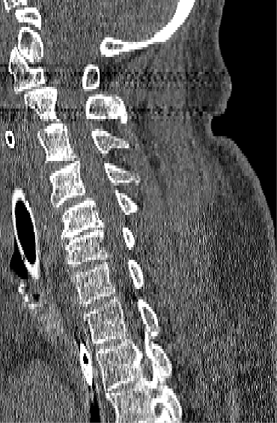
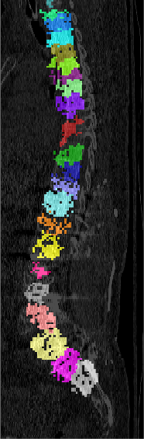
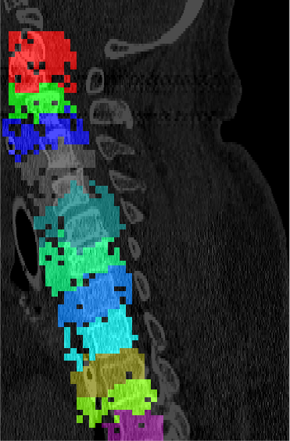
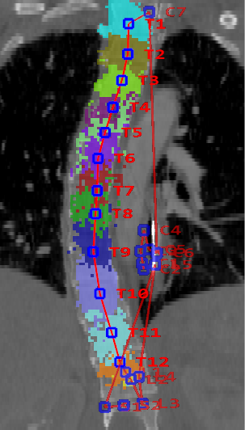
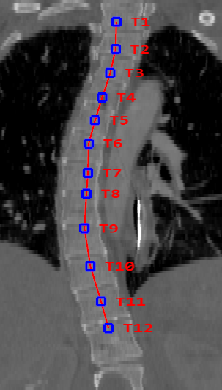
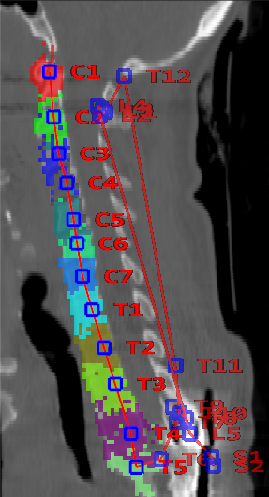
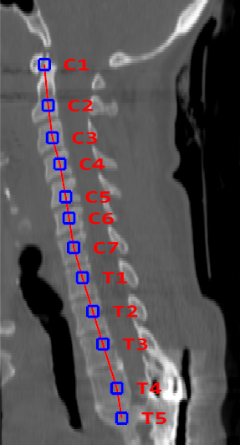
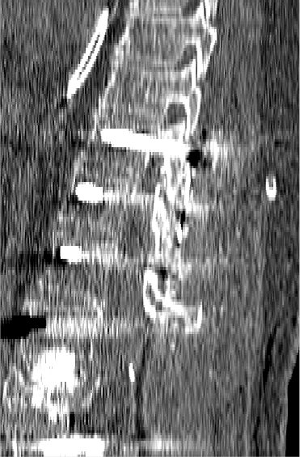
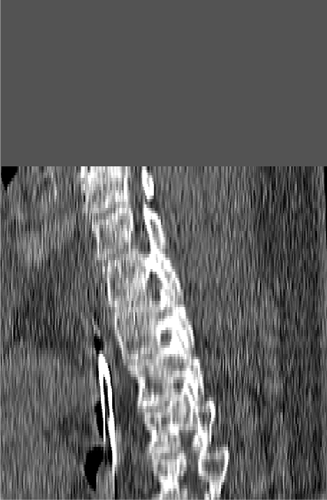
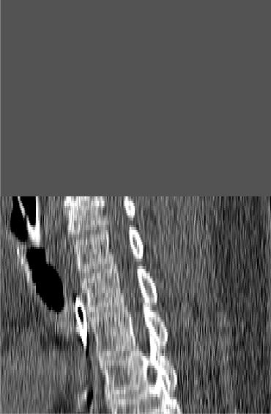

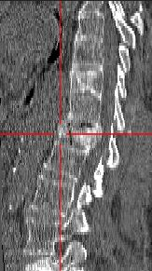
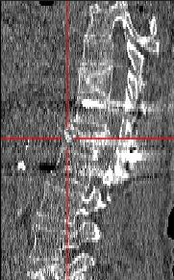
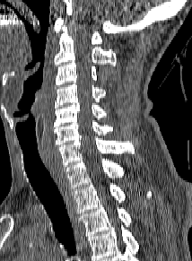
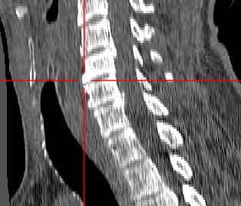
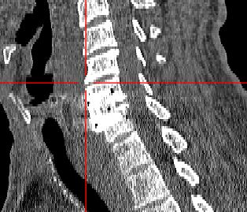
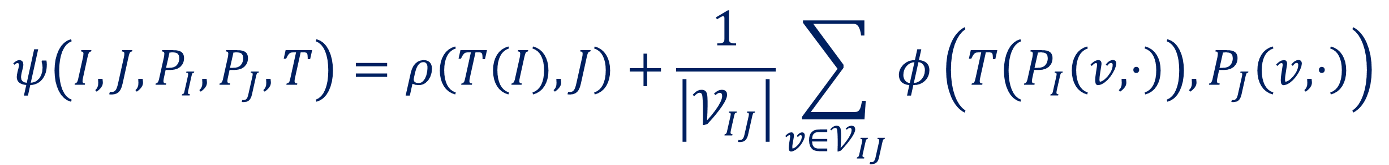
Robust Registration of Longitudinal Spine CT
Ben Glocker¹, Darko Zikic² , David R. Haynor³
¹Biomedical Image Analysis Group, Imperial College London, UK ²Microsoft Research Cambridge, UK ³University of Washington, Seattle, USA
Longitudinal Registration
Localization Priors via Classification
Glocker et al. “Vertebrae Localization in Pathological Spine CT via Dense Classification from Sparse Annotations”. MICCAI 2013
Dense Labels from Sparse Annotations Generate training data for learning a dense classifier
Centroid Estimation from Dense Classification Voxel-wise classification, mean shift, and outlier removal
Challenge: Fully automatic, robust initialization
Robust initialization is a major challenge for automatic methods
Pre- and post-operative scans can vary significantly, e.g. small overlap
Shape differences after treatment of deformities, e.g. scoliosis
Appearance differences due to surgical implants, e.g. metal screws
Solution: Use of location priors during registration
Learning-based extraction of semantic information from images
Location priors provide patient-specific coordinate system
Priors are used to initialize the registration and guide the optimization
Integrating priors significantly reduces the number of failure cases
Training
Annotations
Dense Labels
Annotations
Dense Labels
C6
C6
Testing
T3
T3
Moving
Fixed
Vertebrae Location Priors
Classification
Outlier Removal
Classification
Outlier Removal
Registration Procedure
1. Prior-based Initialization
2. Rigid Registration
3. FFD-based Non-rigid Registration
Prior-based Registration Objective Incorporating priors into optimization problem
Quantitative Evaluation
Centers of Mass
1D Exhaustive
Initialization with different methods
Priors
C6
T3
Moving
Moving
Moving
Fixed
$$ψ\left(I,J,P_{I},P_{J},T\right)=ρ\left(T\left(I\right),J\right)+\frac{1}{\left|𝒱_{IJ}\right|}\sum_{v∈𝒱_{IJ}}{φ\left(T\left(P_{I}\left(v,⋅\right)\right),P_{J}\left(v,⋅\right)\right)}$$
Visual registration examples
Images
Prior Maps
Intensity-based objective
Detected Vertebrae
Prior-based objective
Baselines for Comparison
‘Centers of Mass’: pre-aligns centers of intensity masses
‘1D Exhaustive’: exhaustive search along the main anatomical axis
Computational Efficiency
Intel Xeon 3.5GHz, C# implementation
Registration including prior computation takes 2 min
Moving
Registered
Fixed
Moving
Registered
Fixed
Statistics of registration errors for different methods
Clinical Spine CT Dataset* *available on http://research.microsoft.com/spine
CT scans from 93 patients
A total of 276 registrations
pre- and post-operative scans
limited view, 5-15 visible vertebrae
include high-grade scoliosis, kyphosis, fractures, implants
manual annotations of all vertebrae centroids available
Contact: b.glocker@imperial.ac.uk

