Slide 1
Resting state MEG Analysis
Initial test with FieldTrip by Osama Abdullah 4/6th - 4/9th)
2 online tutorials were used:
https://www.fieldtriptoolbox.org/tutorial/networkanalysis/
https://www.fieldtriptoolbox.org/getting_started/yokogawa/

Slide 2
Steps
Open 2 Con files in Matlab FieldTrip library, concatenate them
Find corresponding Eye Closed (EC) and Eye Open (EO) recording using the 224 (in Matlab 225) and 225 (in Matlab 226)
Trigger channels, save the data to desk separately to simplify independent analysis (not sure if this optimal)
3. Follow the basic tutorial steps (see Matlab code)
4. Plotted the power spectrum focusing on alpha band 9-11 Hz.
5. Verified (albeit not robust yet) that the power in the EC condition is higher than the EO condition around 10Hz
Challenges, things unsure about, and future steps:
Whether my cleanup (which was by visual inspection is sufficient or need to be enhanced (e.g., add ICA rejection)
Source Localization to be done, I will need the MRI scans for this subject, along with FreeSurfer reon
Try to replicate Figure 1 in the paper by Petro et al (shared via email)

Slide 3
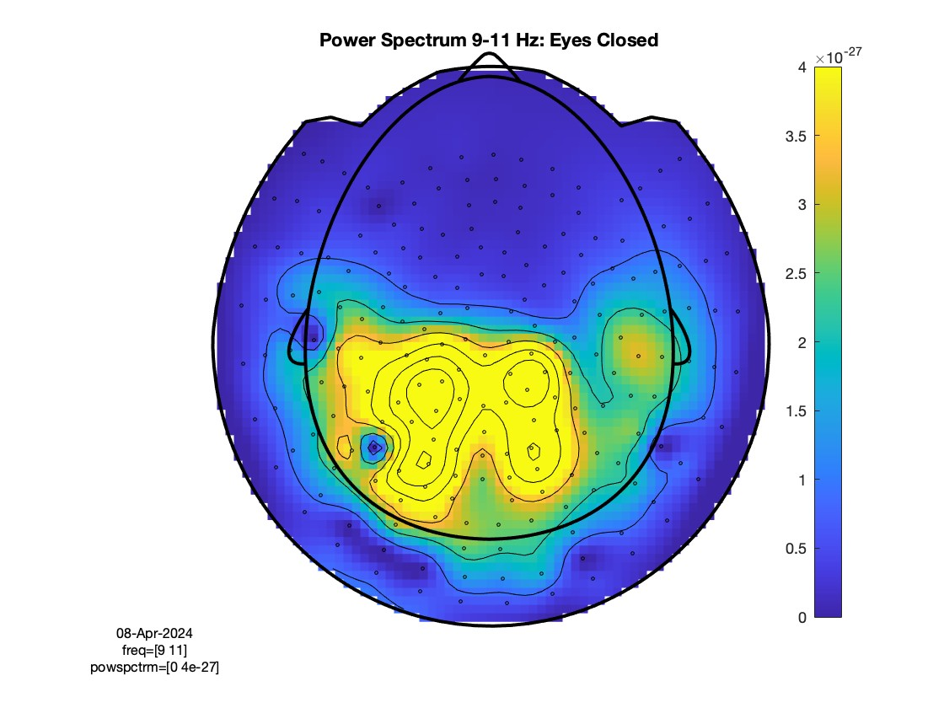
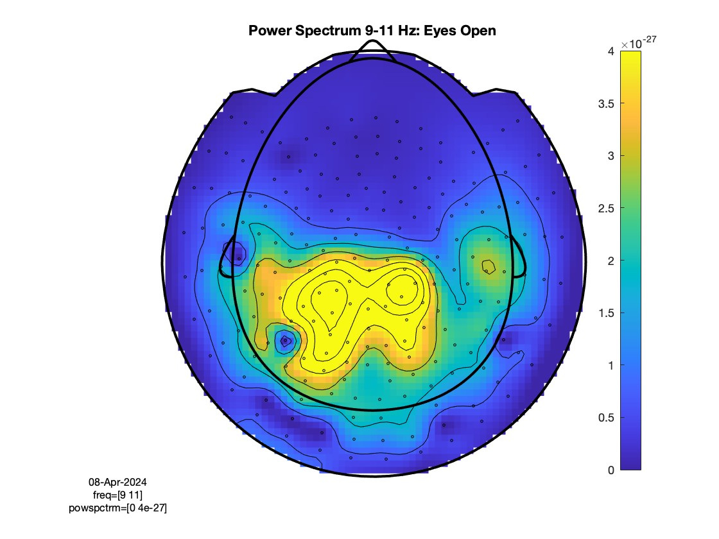
Topography Power Spectrum

Slide 4
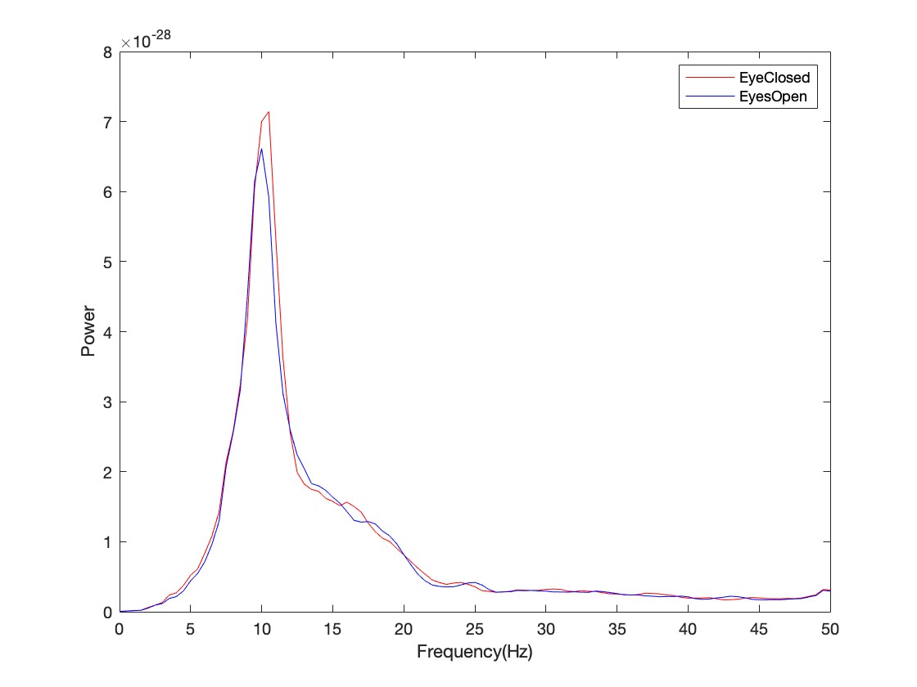
Plots of sensor AG64

Slide 5
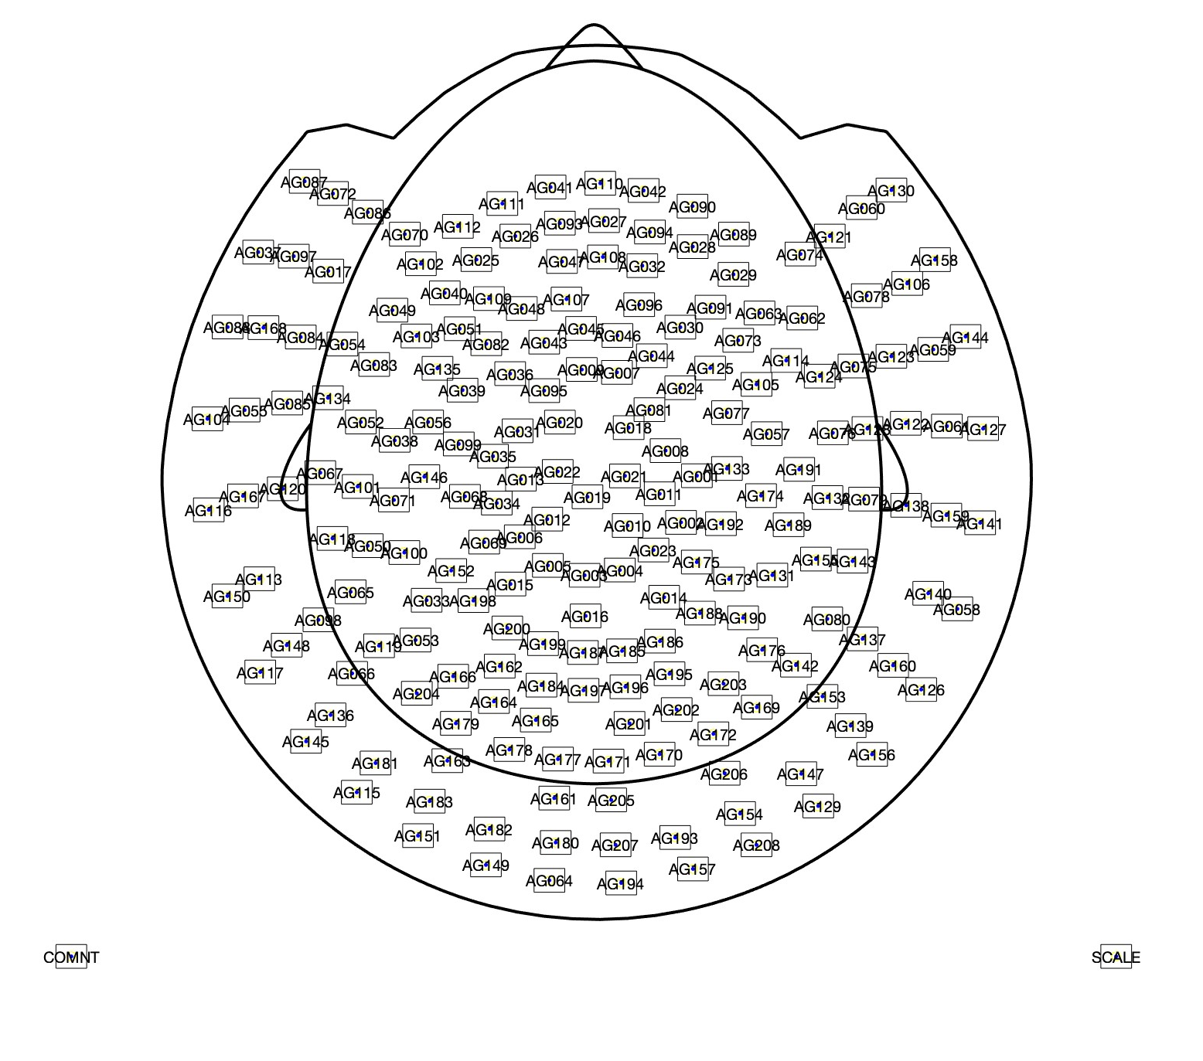
KIT Sensor Layout (need to make sure this is correct because I made it from using their tutorial)

