Slide 1
BIOE 498 / BIOE 599: Computational Systems Biology for Medical Applications Lecture 15: Testing Models
Joseph L. Hellerstein*
Herbert Sauro**
*eScience Institute, Computer Science & Engineering
**BioEngineering

Slide 2
Notes
Kinds of tests
Validation
Verification
Static
Dynamic
Static tests in software
Static tests for biological models
MEMOTE
Mass balance errors
Problems with atomic mass analysis
Moiety analysis and its shortcomings
Stoichiometric inconsistencies
SI with isolation - GAMES

Slide 3
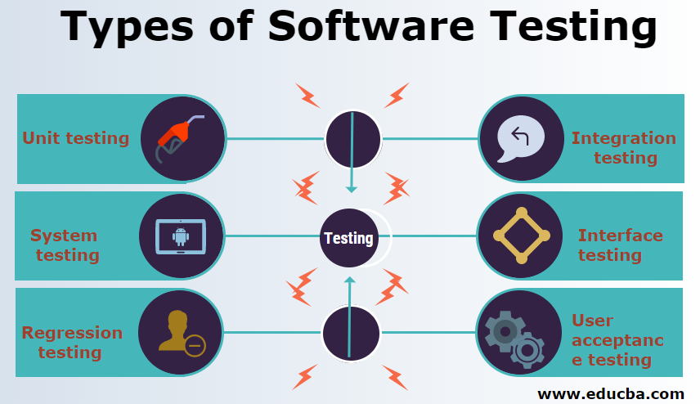

Slide 4
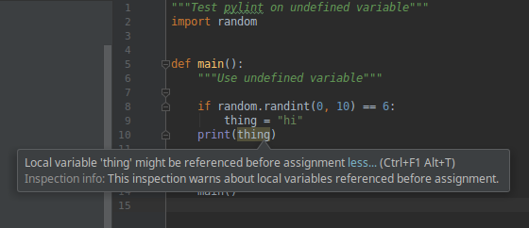
Software Linting Catches Errors Without Running the Program

Slide 5
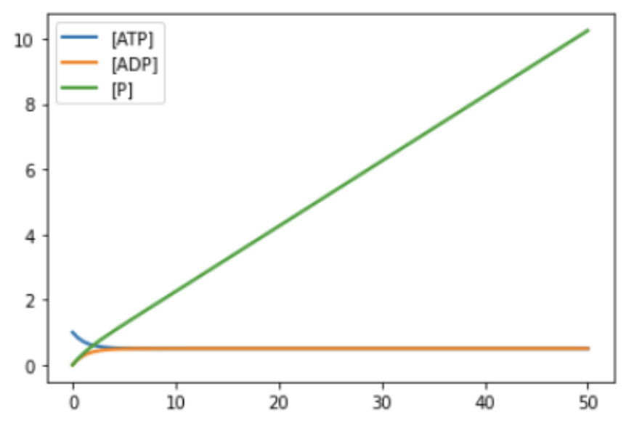
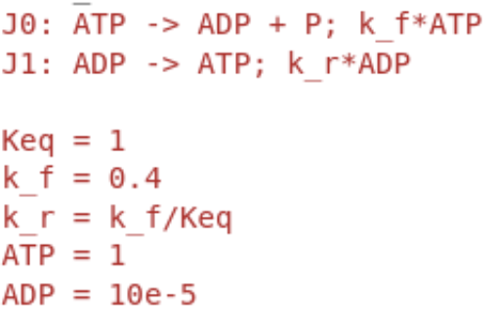
What’s Wrong With This Model?
Why does [P] increase without bound?
We have treated inorganic phosphate inconsistently.
P is included in J0
P is not included in J1
Broadly referred to as a mass balance error.

Slide 6
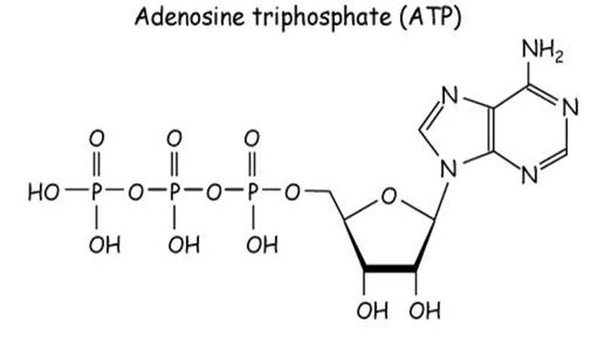
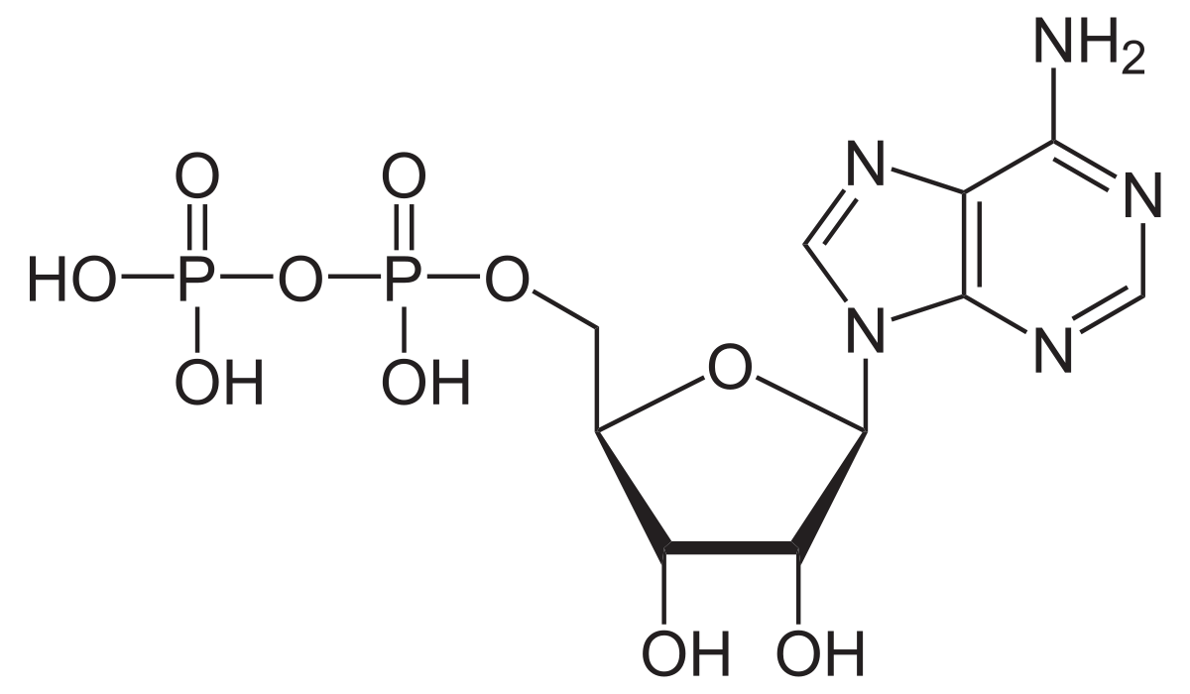
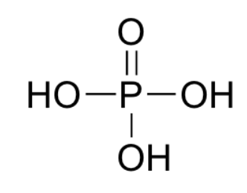
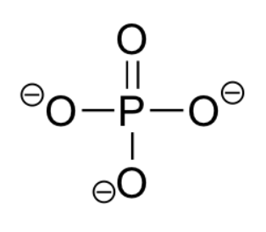



What Do We Mean by Mass Balance Errors
Is there mass missing in this reaction?
$$ATP→ADP$$
ATP
{
Has extra O and 2H.
In this reaction?
$$ATP→ADP+P$$
ADP
P?
$$ATP+H_{2}O→ADP+P$$
Mass balanced.
Notes:
Even if we ignore the issue of protonation (which Pi), we still have a missing O when we add the atoms in Pi to ADP. This is because we haven’t included water in the reaction.

Slide 7

True Mass Balance May Not Be Desirable
$$ATP+H_{2}O→ADP+P$$
True mass balance precludes having implicit chemical species
Present in large quantities so that concentration does not change (e.g., water)
Appeal of implicit chemical species
Simpler reactions
More efficient simulation

Slide 8



Moietities
A moiety refers to a collection of chemical species that have similar chemical functions.
Example: Variations in the chemical structure of inorganic phosphates.
$$γ$$
$$β$$
$$α$$
Instances of inorganic phosphate moieties

Slide 9


Moiety Analysis
Moiety analysis provides a way to check consistency of reactions while having flexibility about the exact chemical formula
Chemical species are represented by their moiety structure
A reaction is “moiety preserving” if the counts of moieties in the reactants is the same as the counts in the products.
Moiety | ATP | ADP | P
A | 1 | 1 | 0
P | 3 | 2 | 1
$$ATP→ADP+P$$
Moiety | ATP | ADP + P | Equal
A | 1 | 1 | Yes
P | 3 | 3 | Yes
$$ATP→ADP$$
Moiety | ATP | ADP | Equal
A | 1 | 1 | Yes
P | 3 | 2 | No
Implicit chemical species: P

Slide 10
Challenges With Moiety Analysis
Requires database of moiety structures for chemical species
Requires annotating models to identify chemical species
Moiety | ATP | ADP | P
A | 1 | 1 | 0
P | 3 | 2 | 1

Slide 11


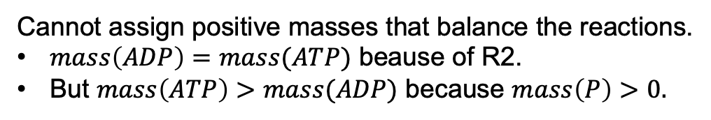

Stoichiometric inconsistency: There is no assignment of positive values of mass to chemical species such that all reactions are mass balanced.
Example
R1: $ATP→ADP+P$
Cannot assign positive masses that balance the reactions.
$mass\left(ADP\right)=mass(ATP)$ beause of R2.
But $mass\left(ATP\right)>mass(ADP)$ because $mass\left(P\right)>0.$
R2: $ADP→ATP$

Slide 12




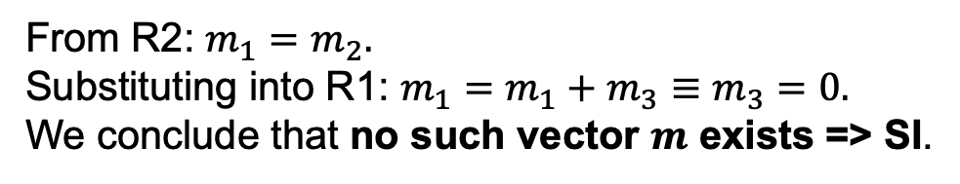
Finding Stoichiometric Inconsistencies (SI)
R1: $ATP→ADP+P$
Stoichiometric inconsistency: There is no assignment of positive values of mass to chemical species such that all reactions are mass balanced.
R2: $ADP→ATP$
1. Construct the mass equations for the reactions.
Let $m_{1}, m_{2}, m_{3}$ be the masses of ATP, ADP, P, respectively.
R1: $m_{1}=m_{2}+m_{3}$
R2: $m_{2}=m_{1}$
2. Determine if there are$m_{i}>0$ that satisfy R1, R2.
From R2: $m_{1}=m_{2}.$
Substituting into R1: $m_{1}=m_{1}+m_{3}≡m_{3}=0.$
We conclude that no such vector $m$ exists => SI.
Is there way to detect SI in general?

Slide 13
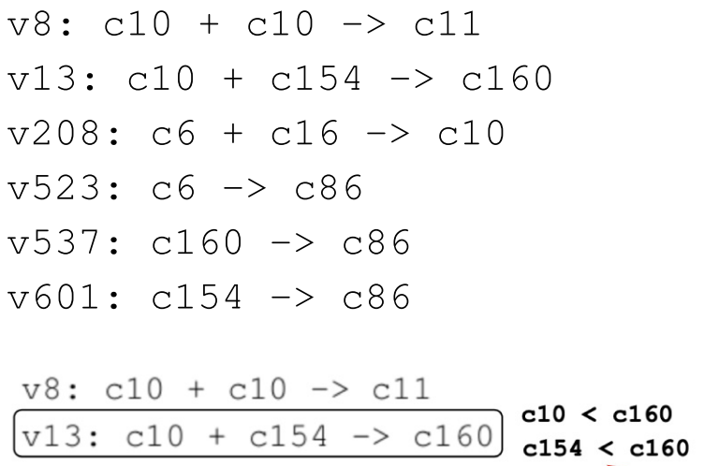
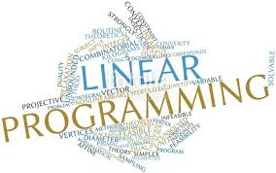
Finding More Complicated Mass Balance Errors
Part of ErbB signaling (BioModels 255)

Slide 14


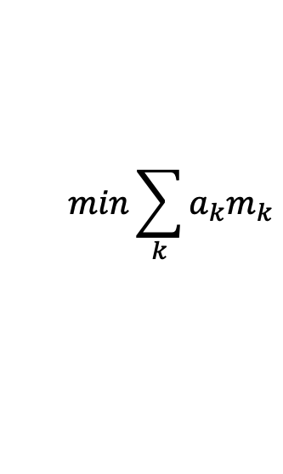





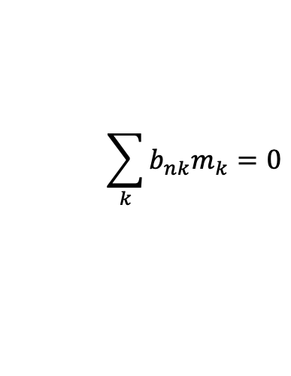

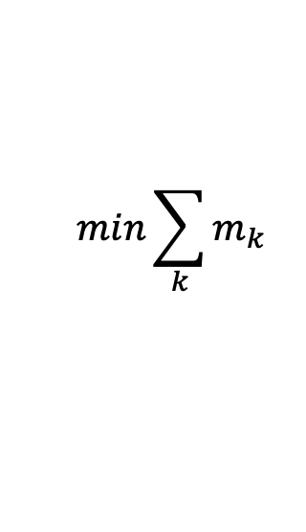
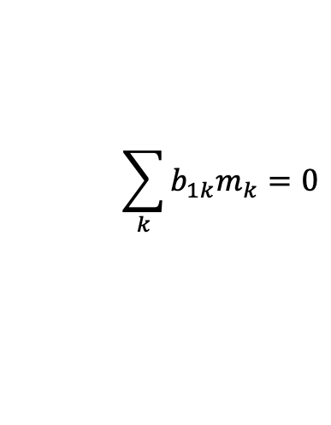
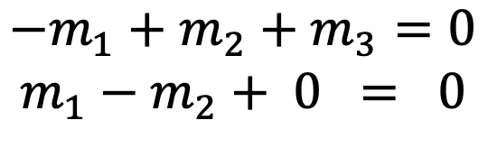

SI as a Linear Program
Linear Program
SI for ATP Hydrolysis
R1: $ATP→ADP+P$
R2: $ADP→ATP$
$$min\sum_{k}{a_{k}m_{k}}$$
$$min\sum_{k}{m_{k}}$$
$$a_{k}=1$$
Constraints:
$$\sum_{k}{b_{1k}m_{k}=0}$$
$$\begin{matrix}−m_{1}+m_{2}+m_{3}=0 \\ m_{1}−m_{2}+ 0 = 0\end{matrix}$$
$$\sum_{k}{b_{nk}m_{k}=0}$$
$b_{ik}$ from stoichiometry matrix
$$m_{1}>0,⋯,m_{K}>0$$
$$m_{1}>0,⋯,m_{K}>0$$
$m_{k}$ are unknowns to find
$a_{k}$ are constants of the problem
Feasibility problem: Verify constraints.
$b_{ik}$ are constants of the problem
SI ⬄ Cannot solve feasibility.
Notes:
If we ignore the maximization, then this is a feasibility problem.

Slide 15

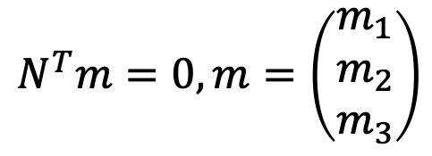
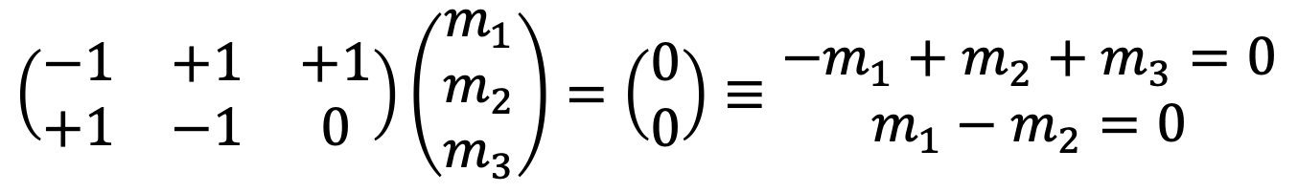
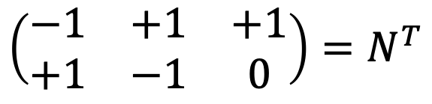
Equality constraints are determined by the stoichiometry matrix.
R1: $ATP→ADP+P$
R2: $ADP→ATP$
Transpose of stoichiometry matrix
ATP
ADP
P
R1
$$\left(\begin{matrix}−1 & +1 & +1 \\ +1 & −1 & 0\end{matrix}\right)=N^{T}$$
R2
Mass balance means that the sum of masses of reactants equals the sum of masses of the products for all reactions.
$$\left(\begin{matrix}−1 & +1 & +1 \\ +1 & −1 & 0\end{matrix}\right)\left(\begin{matrix}m_{1} \\ m_{2} \\ m_{3}\end{matrix}\right)=\left(\begin{matrix}0 \\ 0\end{matrix}\right)≡\begin{matrix}−m_{1}+m_{2}+m_{3}=0 \\ m_{1}−m_{2}=0\end{matrix}$$
Matrix representation of the equality constraints.
$$N^{T}m=0, m=\left(\begin{matrix}m_{1} \\ m_{2} \\ m_{3}\end{matrix}\right)$$

Slide 16
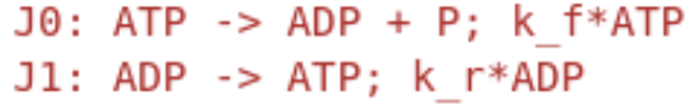
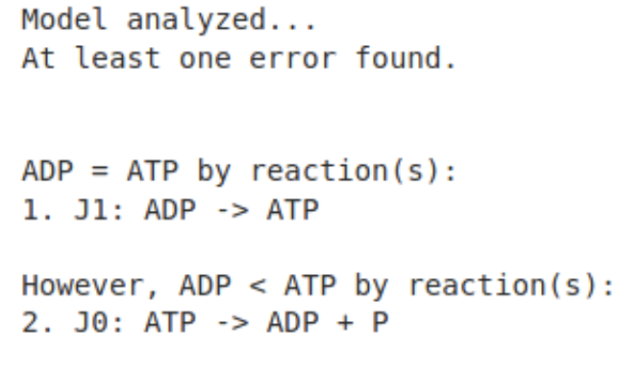
GAMES: Graphical Analysis of Mass Equivalent Sets
Isolates the cause of stoichiometric inconsistencies so that they can be resolved.
Isolation is accomplished by showing that a small subset of reactions explains the SI. These reactions are the focus for error remediation.

Slide 17
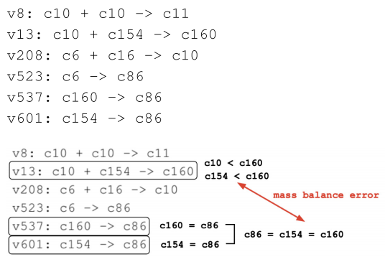
Isolating ErbB Signaling (BioModels 255)
Is there a stoichiometric inconsistency here? Where?
Isolating errors is required to remediate complex errors.

Slide 18
GAMES: Graphical Analysis of Mass Equivalent Sets

Slide 19
BACKUP

Slide 20
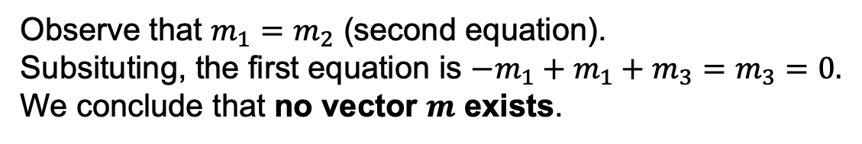
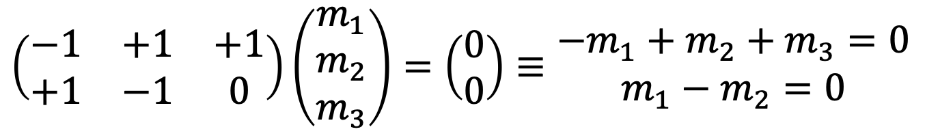
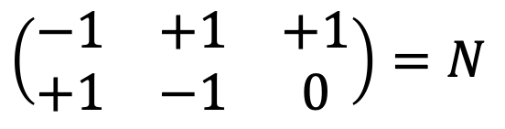
Finding Stoichiometric Inconsistencies (SI)
R1: $ATP→ADP+P$
Stoichiometric inconsistency: There is no assignment of positive values of mass to chemical species such that all reactions are mass balanced.
R2: $ADP→ATP$
1. Construct transpose of stoichiometry matrix
ATP
ADP
P
R1
$$\left(\begin{matrix}−1 & +1 & +1 \\ +1 & −1 & 0\end{matrix}\right)=N$$
R2
2. Determine if there is no a vector $m=(m_{1},⋯m_{k})$ of mass assignments for the k chemical species such that $Nm=0$, where $m_{i}>0$.
$$\left(\begin{matrix}−1 & +1 & +1 \\ +1 & −1 & 0\end{matrix}\right)\left(\begin{matrix}m_{1} \\ m_{2} \\ m_{3}\end{matrix}\right)=\left(\begin{matrix}0 \\ 0\end{matrix}\right)≡\begin{matrix}−m_{1}+m_{2}+m_{3}=0 \\ m_{1}−m_{2}=0\end{matrix}$$
Observe that $m_{1}=m_{2}$ (second equation).
Subsituting, the first equation is $−m_{1}+m_{1}+m_{3}=m_{3}=0.$
We conclude that no vector $m$ exists.

Slide 21
Stoichiometric Inconsistency
ErbB signaling (BioModels 255)

Slide 22
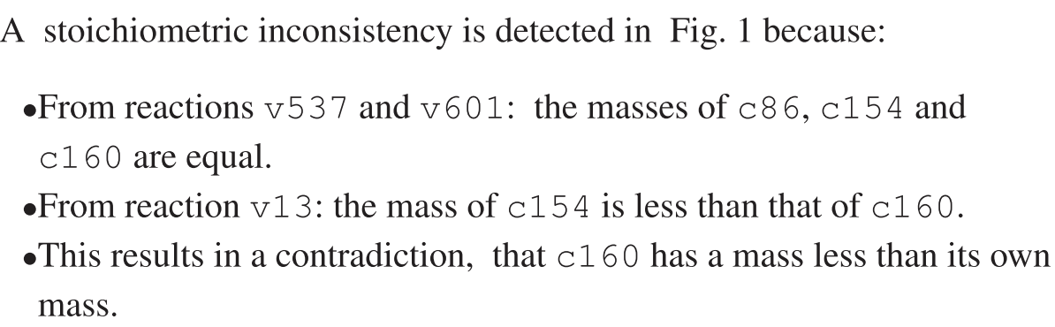

Slide 23
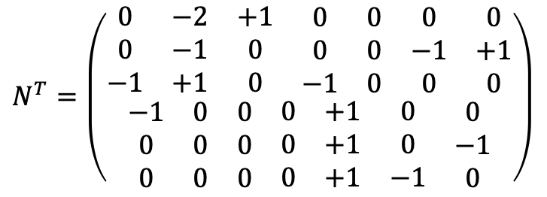
Finding More Complicated Mass Balance Errors
BioModels 255: Model of Erb signaling pathways.
c6
c10
c11
c16
c86
c154
C160
$$N^{T}=\left(\begin{matrix}\begin{matrix}\begin{matrix}0 & −2 & +1 \\ 0 & −1 & 0 \\ −1 & +1 & 0\end{matrix} & \begin{matrix}0 & 0 & 0 \\ 0 & 0 & −1 \\ −1 & 0 & 0\end{matrix} & \begin{matrix}0 \\ +1 \\ 0\end{matrix}\end{matrix} \\ \begin{matrix}\begin{matrix}−1 & 0 & 0 \\ 0 & 0 & 0 \\ 0 & 0 & 0\end{matrix} & \begin{matrix}0 & +1 & 0 \\ 0 & +1 & 0 \\ 0 & +1 & −1\end{matrix} & \begin{matrix}0 \\ −1 \\ 0\end{matrix}\end{matrix}\end{matrix}\right)$$
v8
v13
v208
v523
v537
v601

