Slide 1
BIOE 498 / BIOE 599: Computational Systems Biology for Medical Applications Lecture 5: Design of Experiments
Joseph L. Hellerstein*
Herbert Sauro**
*eScience Institute, Computer Science & Engineering
**BioEngineering

Slide 2
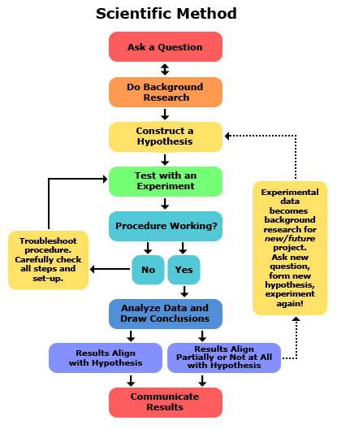
Design of experiments (DOE)
What’s changed and what’s measured.

Slide 3
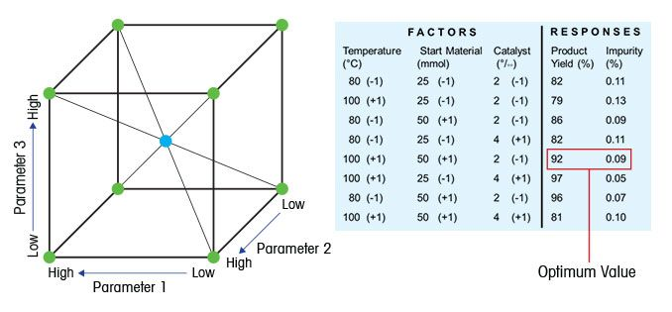
Key Concepts in DOE
Factor: Something changed in the experiment (e.g., parameter)
Level of factor: Value of a parameter
Response: Something measured
An experimental design consists of:
the system under study
the factors varied
the responses measured.
An experimental design is developed to address a research question.

Slide 4
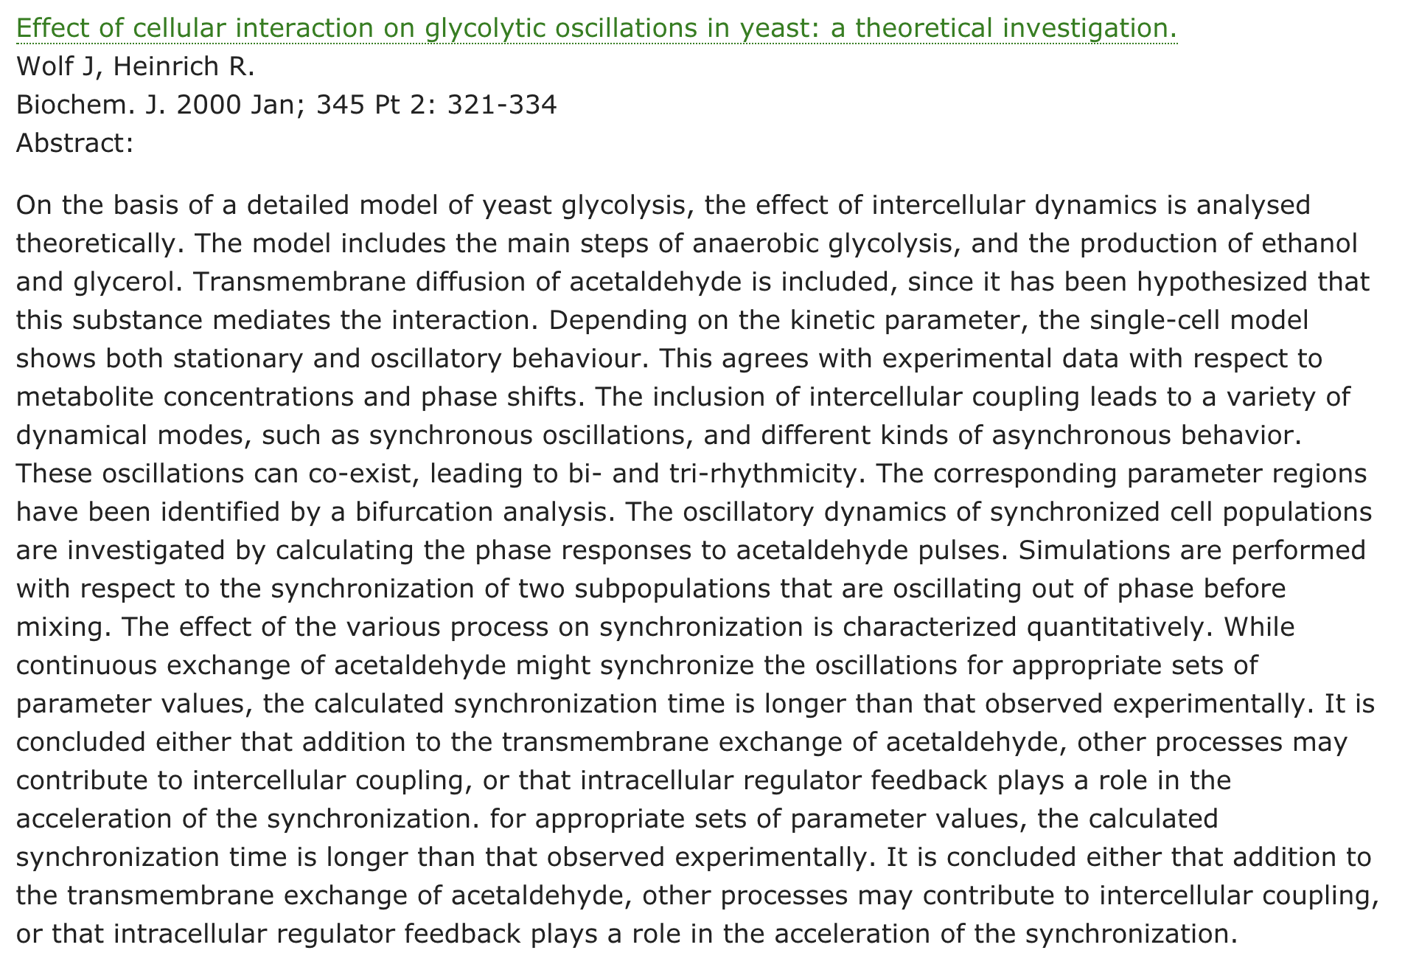
Question
Experimental system
Factors
Responses

