Slide 1
Computational Systems Biology for Medical Applications Lecture 9: Model Fitting-Dealing With Uncertainty
Joseph L. Hellerstein*
Herbert Sauro**
*eScience Institute, Computer Science & Engineering
**BioEngineering

Slide 2
Downloads
Lecture_9* at http://shorturl.at/crOS2

Slide 3
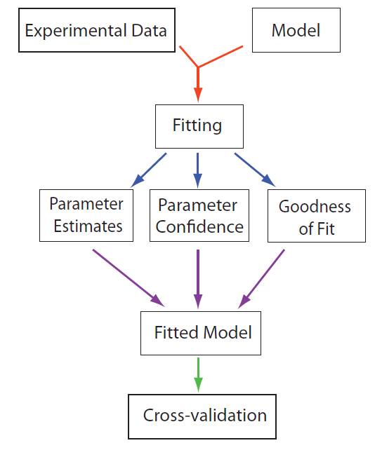
Model Fitting Work flow

Slide 4
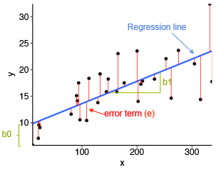




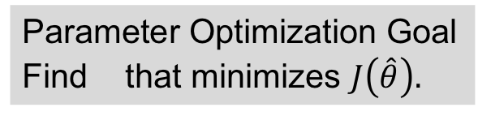
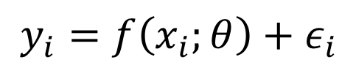

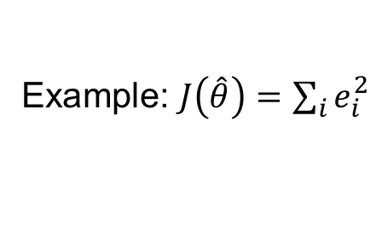


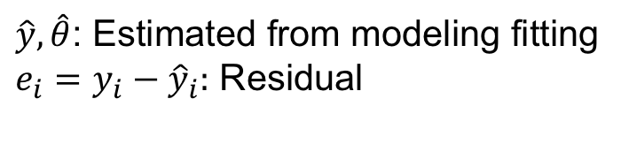
Parameter Optimization Summary
The Model
Ex: Linear Model
$$y_{i}=f\left(x_{i};θ\right)+ε_{i}$$
$$y_{i}=θ_{0}+θ_{1}x_{i}+ε_{i}$$
Observations
residuals
Model
$$e_{i}$$
Explanatory variables
K Parameters
$$\hat{y}$$
predicted
Noise (random variable) – i.i.d.
$${\hat{θ}}_{1}$$
$${\hat{θ}}_{0}$$
Parameter Optimization Goal
Find that minimizes $J\left(\hat{θ}\right).$
$\hat{y}, \hat{θ}$: Estimated from modeling fitting
$e_{i}=y_{i}−{\hat{y}}_{i}:$ Residual
$$\hat{θ}$$
$J\left(\hat{θ}\right):$Non-zero measure of model quality
Example: $J\left(\hat{θ}\right)=\sum_{i}{e_{i}^{2}}$

Slide 5
Agenda
Statistical philosophy for modeling
Assessing model quality
R², Chi-Square, AIC, cross validation
Parameter confidence intervals
Cross validation, bootstrapping

Slide 6
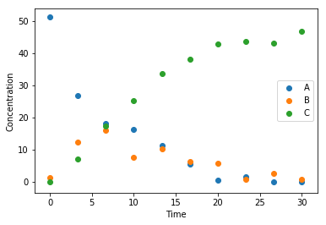
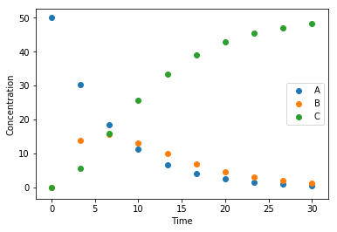
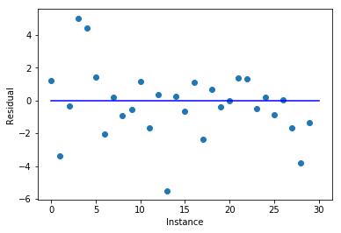
Statistical Philosophy of Models It’s All About Residuals
Observations
A statistical model is good if
Residuals have small magnitude
Residuals are i.i.d.
Residuals have no pattern
Ideally, residuals are normally distributed
Model
Residuals

Slide 7
Assessing Model Quality

Slide 8


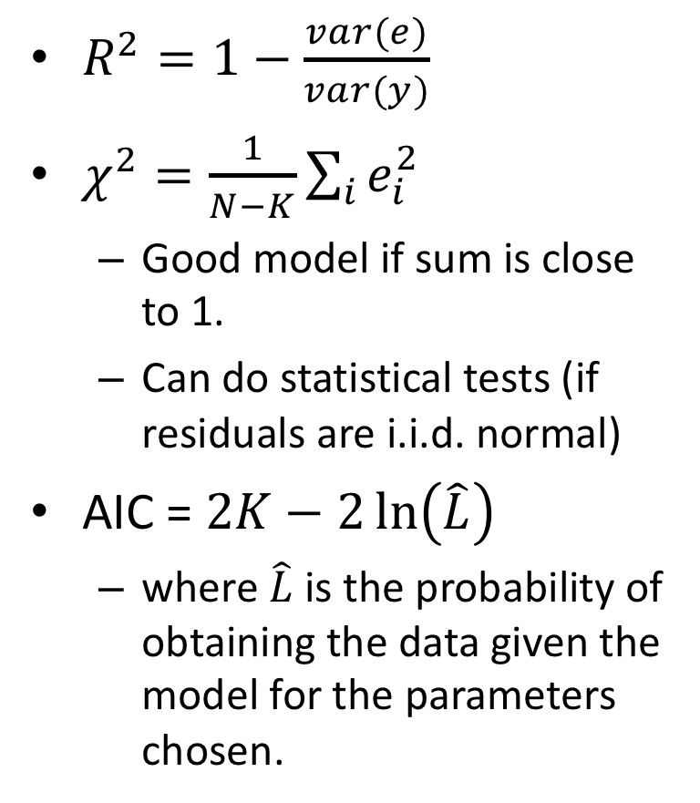

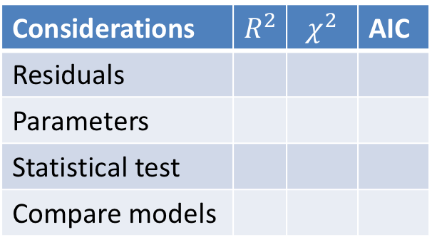
Metrics for Model Quality $y=f(x;θ)$; $e=y−\hat{y}$
$R^{2}=1−\frac{var(e)}{var(y)}$
$χ^{2}=\frac{1}{N−K}\sum_{i}{e_{i}^{2}}$
Good model if sum is close to 1.
Can do statistical tests (if residuals are i.i.d. normal)
AIC = $2K−2\ln\left(\hat{L}\right)$
where $\hat{L}$ is the probability of obtaining the data given the model for the parameters chosen.
Considerations | $$R^{2}$$ | $$χ^{2}$$ | AIC
Residuals
Parameters
Statistical test
Compare models

Slide 9




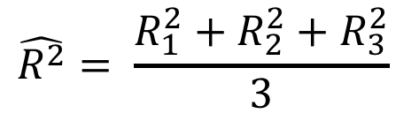


Cross Validation Summary
Divide full data set into N Folds
Data
Train 1
Test 1
{
$$R_{1}^{2}$$
Construct N training data sets and N test data sets
$${\hat{θ}}^{[1]}$$
Train 2
Test 2
{
$$R_{2}^{2}$$
$${\hat{θ}}^{[2]}$$
Obtain N parameter fits and model evaluations
Train 3
Test 3
{
$$R_{3}^{2}$$
$${\hat{θ}}^{[3]}$$
Report statistics of the evaluations
$$\hat{R^{2}}= \frac{R_{1}^{2}+R_{2}^{2}+R_{3}^{2}}{3}$$

Slide 10
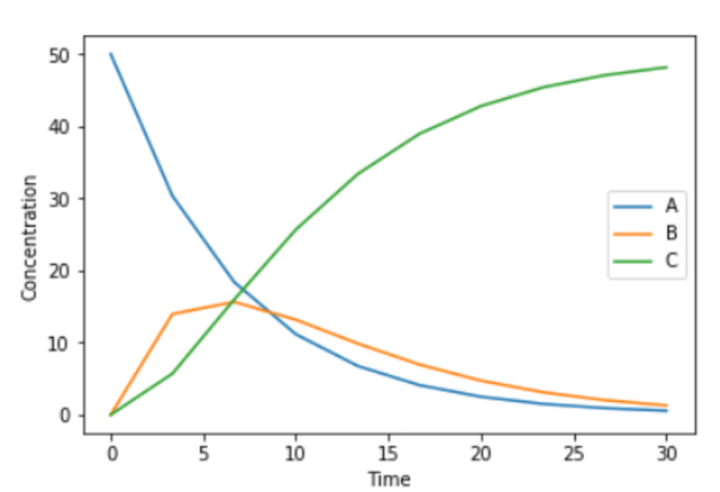
Choosing Folds Choose Wisely
X
Folds have very different functional characteristics
Folds have similar functional characteristics

Slide 11
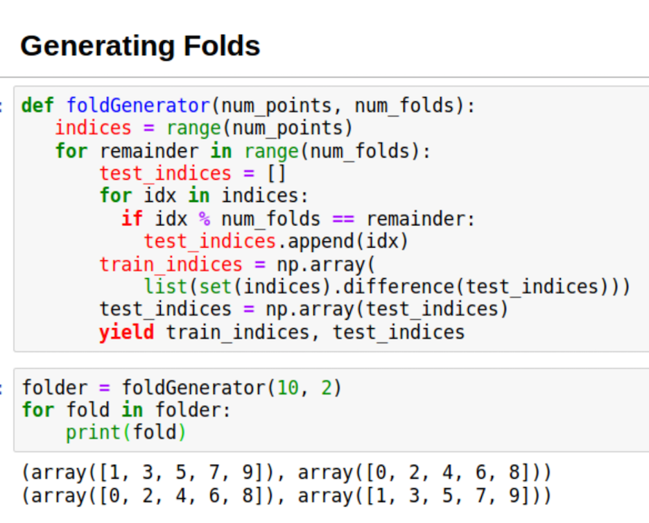
Generating Alternating Folds

Slide 12
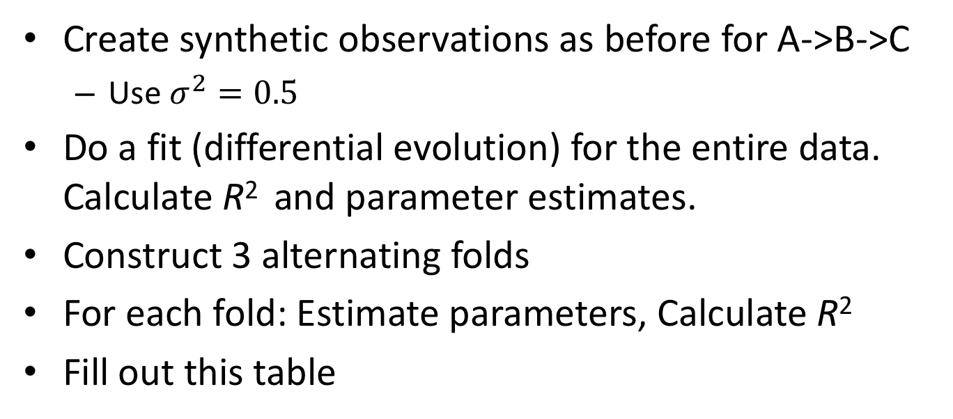
Exercise
Create synthetic observations as before for A->B->C
Use $σ^{2}=0.5$
Do a fit (differential evolution) for the entire data. Calculate R² and parameter estimates.
Construct 3 alternating folds
For each fold: Estimate parameters, Calculate R²
Fill out this table
Fold | R² | Parameter
1
2
3

Slide 13
Parameter Confidence Intervals

Slide 14




Estimating Parameters Using Cross Validation
Data
Train 1
$$θ^{[1]}$$
Issue: Only using subset of data to estimate parameters.
Train 2
$$θ^{[2]}$$
Train 3
$$θ^{[3]}$$
$$\hat{θ}=mean_{m}\left(θ^{\left[m\right]}\right)±std_{m}\left(θ^{\left[m\right]}\right)$$

Slide 15
Bootstrapping is an efficient way to quantify the uncertainty of parameter estimates.

Slide 16
Bootstrapping Workflow
Fit model to data
Compute Residuals
Generate synthetic response data using the fitted model and randomly selected residuals.
Estimate model parameters for each synthetic data set.
Calculate parameter variances.

Slide 17
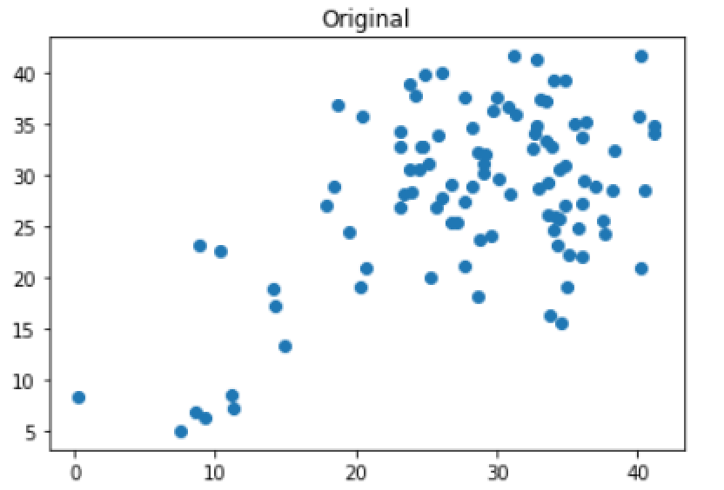
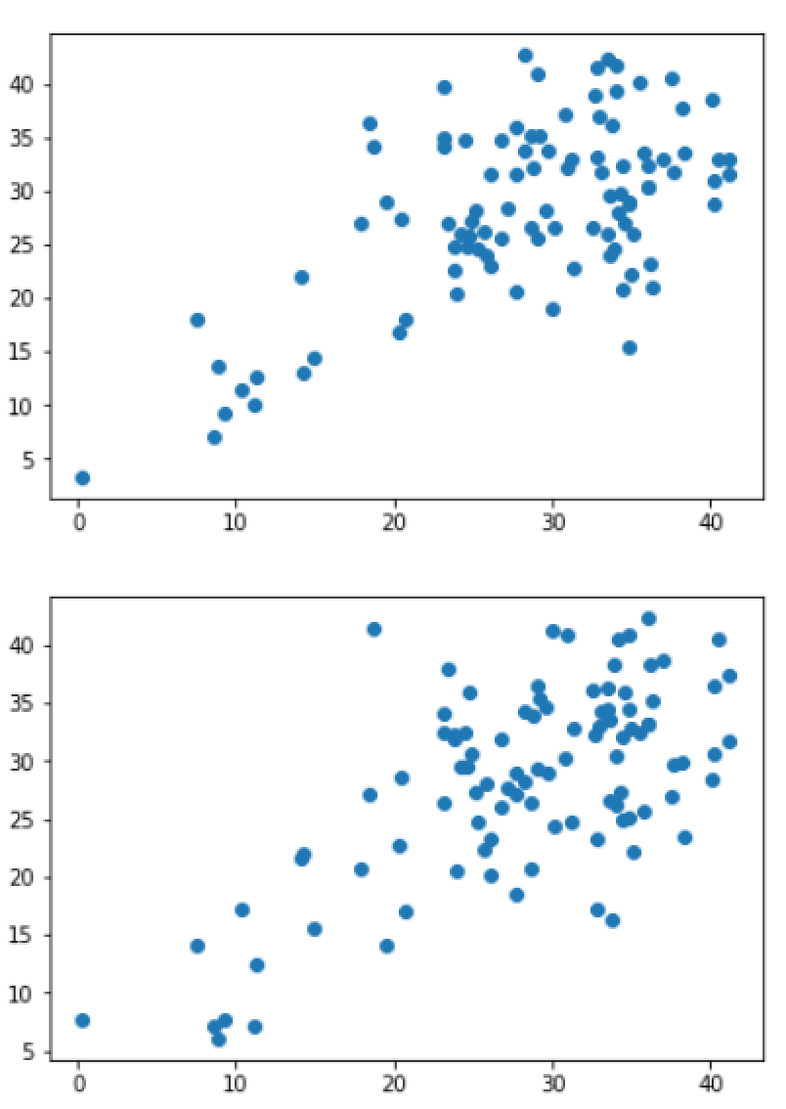
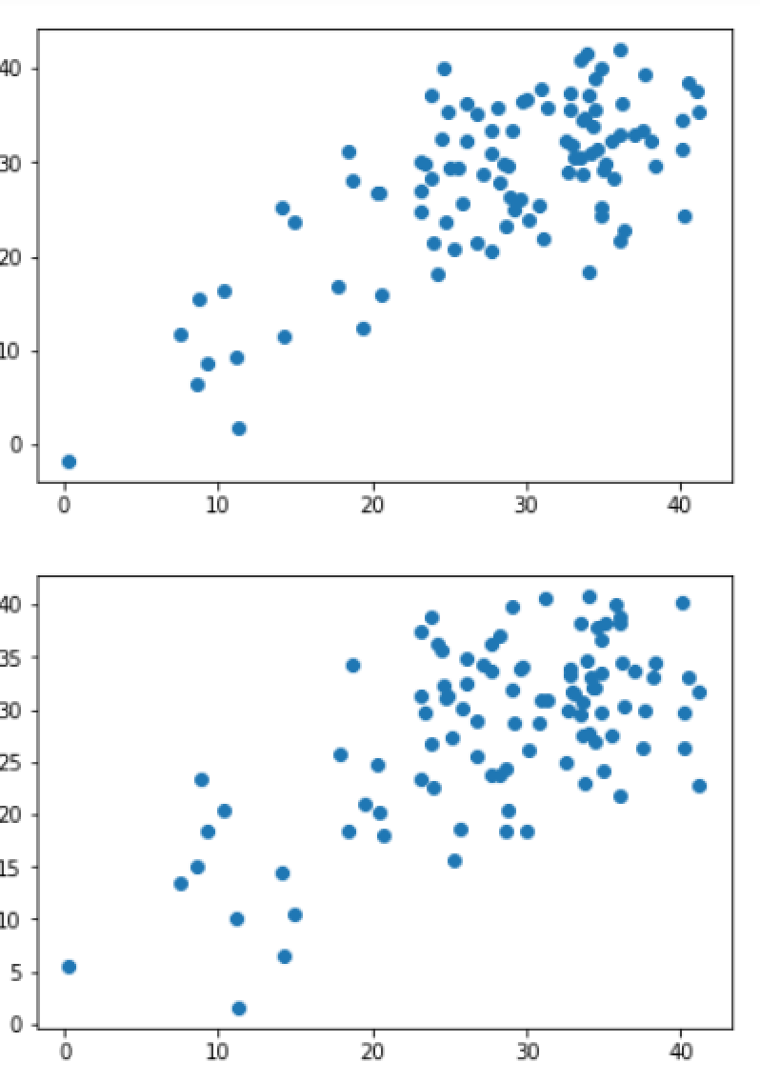
Synthetic Observations With Bootstrapping

Slide 18
Generating a Synthetic Response Data
def generateData(y_obs, y_fit):
"""
:param np.array y_obs
:param np.array y_fit
:return np.array: bootstrap data
"""
residuals = y_obs - y_fit
length = len(y_obs)
residuals = residuals.reshape(length)
samples = np.random.randint(0, length, length)
result = y_fit + residuals[samples]
result = result.reshape(length)
return result

Slide 19

Exercise
Create synthetic observations as before for A->B->C
Use $σ=0.5$
Do a fit (differential evolution) for the entire data.
Do bootstrapping on the fitted model

