Slide 1
BIOE 498 / BIOE 599: Computational Systems Biology for Medical Applications CSE 599V: Advancing Biomedical Models Lecture 2: Dynamical Systems Essentials
Joseph L. Hellerstein*
Herbert Sauro**
*eScience Institute, Computer Science & Engineering
**BioEngineering
Notes:
Diverse students. Some with bio-backgrounds; some without. Some with CS background; some with very limited. Two separate courses combined because of a substantial shared curriculum.

Slide 2
Dynamical Systems

Slide 3
Agenda
Differential equations
Definition, fixed points
Linear differential equations
Definition, behaviors
Uni-reaction
Nonlinear differential equations
Why: non-uni, enzymes
Classifications
Linearization -> classifications
Phase diagrams
Bifurcation plots

Slide 4
BACKUP

Slide 5
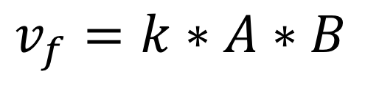
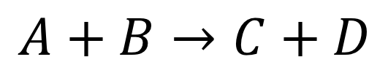


Chemical Kinetics Basics
How fast do reactions go:
Mass action kinetics
Constant times the concentrations of the reactants
$$v_{f}$$
$$v_{f}$$
$$A+B→C+D$$
$$v_{f}=k∗A∗B$$

Slide 6


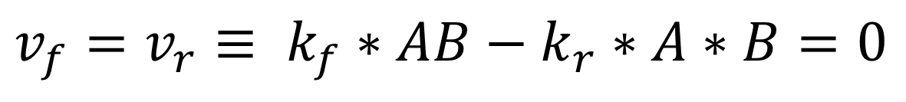
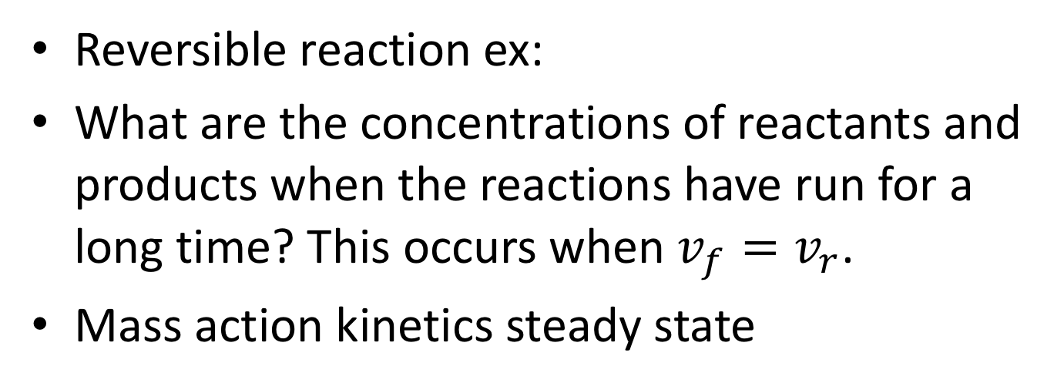


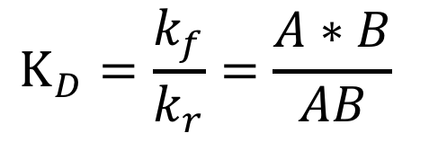


Reversible Reactions & Steady State
$$←$$
$$v_{f}$$
Reversible reaction ex:
What are the concentrations of reactants and products when the reactions have run for a long time? This occurs when $v_{f}=v_{r}$.
Mass action kinetics steady state
$$AB$$
$$←$$
$A+B$
$$v_{r}$$
$$v_{f}=v_{r}≡ k_{f}∗AB−k_{r}∗A∗B=0$$
Disassociation Constant
$$K_{D}=\frac{k_{f}}{k_{r}}=\frac{A∗B}{AB}$$

Slide 7
Biochemical Reactions
Reactant
Molecules
Product
Molecules
Enzyme
But Arcs are often bidirectional
(since chemical reactions can be reversed)
And enzymes may be modified in pathway regulation
(self-modifying code!)
Another Enzyme

Slide 8
Enzymes
Proteins that accelerate biochemical reactions.
Omni-present in biology
Enzymes work by induced fit.

Slide 9
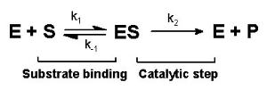
Enzymes and Reaction Kinetics
Notes:
Ask about the rates at each step.

Slide 10
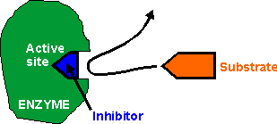
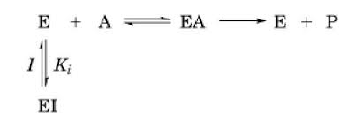
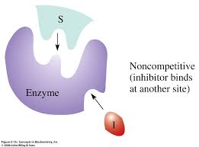
Enzyme Inhibition
Competitive Inhibition
S
ES
Noncompetitive Inhibition

