Slide 1
Computational Systems Biology for Medical Applications Lecture 13: Modeling Case Study - MAPK
Joseph L. Hellerstein*
Herbert Sauro**
*eScience Institute, Computer Science & Engineering
**BioEngineering

Slide 2
Downloads
http://shorturl.at/crOS2
Open Lecture_13
Download all files into the same directory

Slide 3
Why Mitogen Activated Protein Kinase (MAPK) Cascade?
Critical for cellular decisions to proliferate, differentiate, or undergo apoptosis
Evolutionarily conserved
Multiple (usually three) levels: MAPK, MAPKK, MAPKKK
Activated kinase at each level phosphorylates the kinase at the next level down the cascade.
Each individual level is a two-site phosphorylation required for full activation and dephosphorylation
Referenced paper (link)

Slide 4
MAPK Cascade

Slide 5
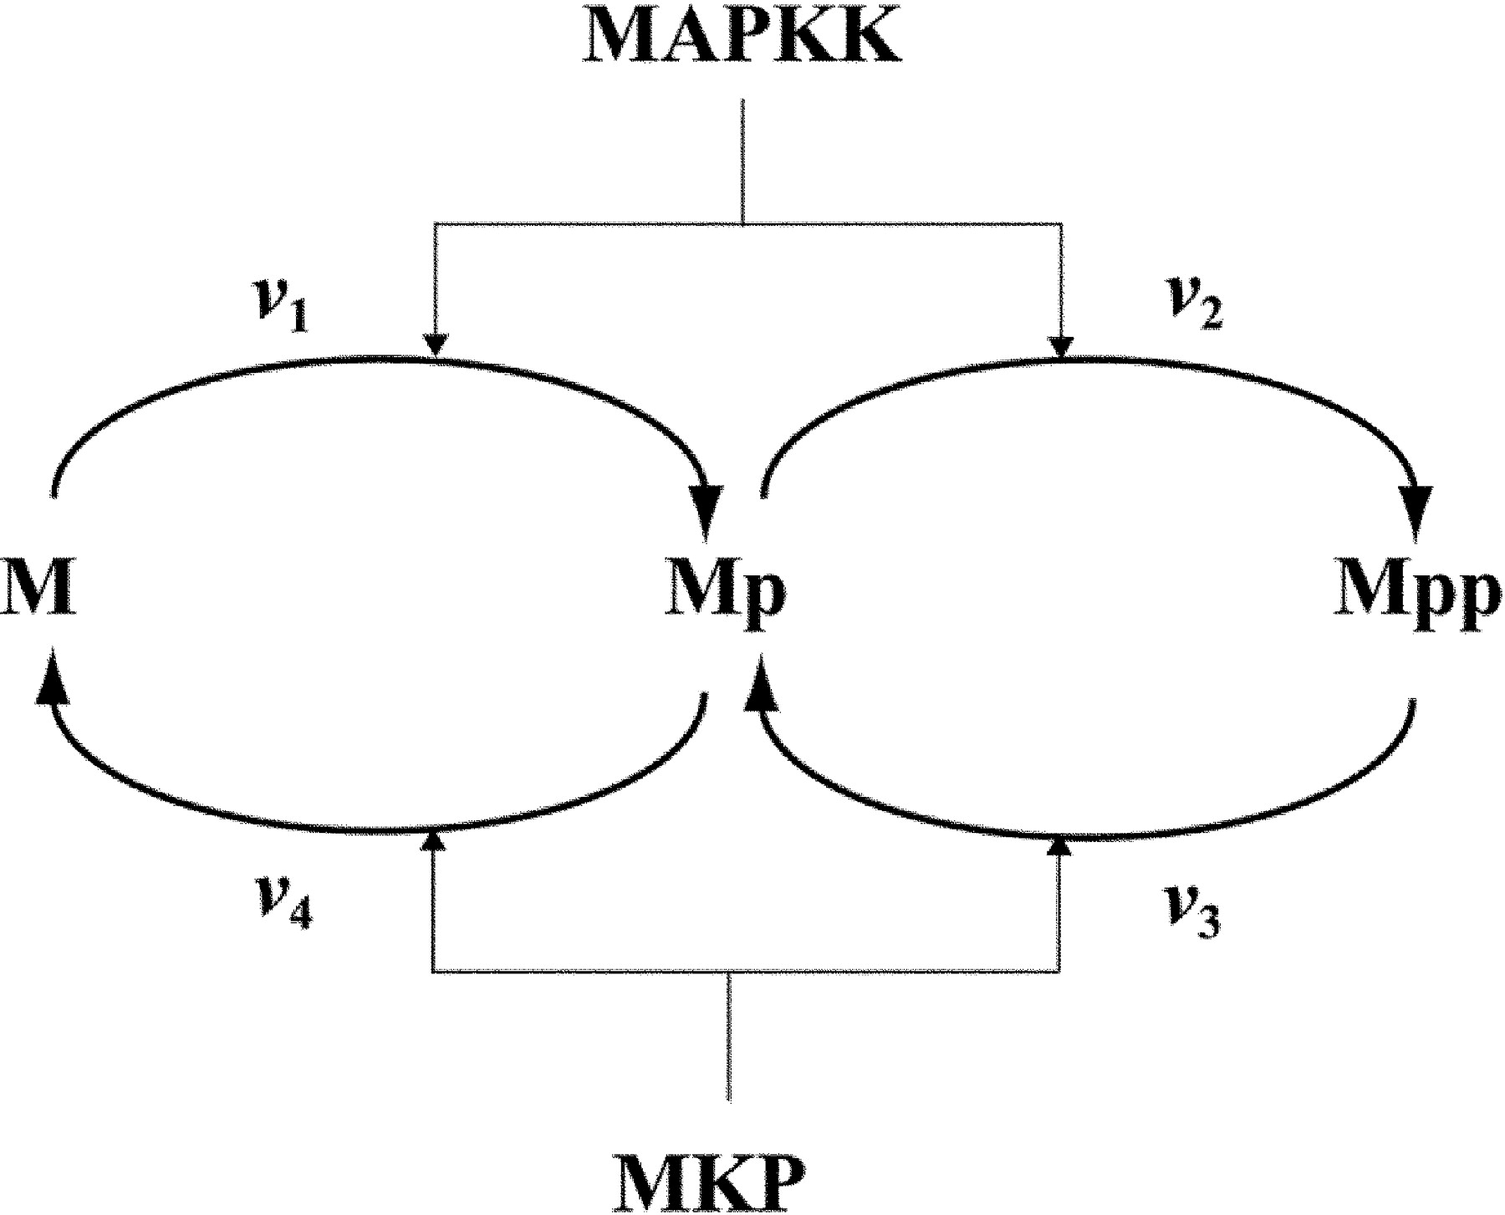
Our Focus in the Cascade
Kinase: Catalyzes phosphorylation
M = MAPK
Phosphatase: Catalyzes dephosphorylation

Slide 6
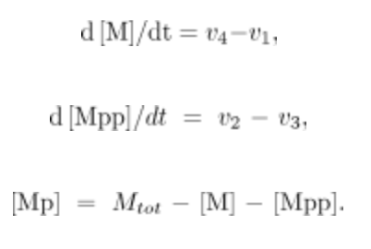
Write The Differential Equations for These Reactions

Slide 7
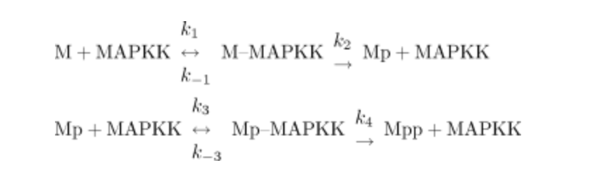
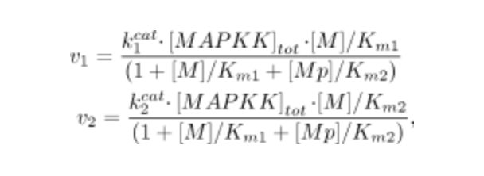
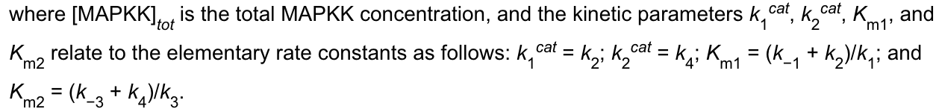
Calculating the Rates
Assume Michaelis-Menten kinetics
p

