Slide 1


Notes on Reaction Kinetics Continued
In collaboration with James Glazier, Bloomington

Slide 2

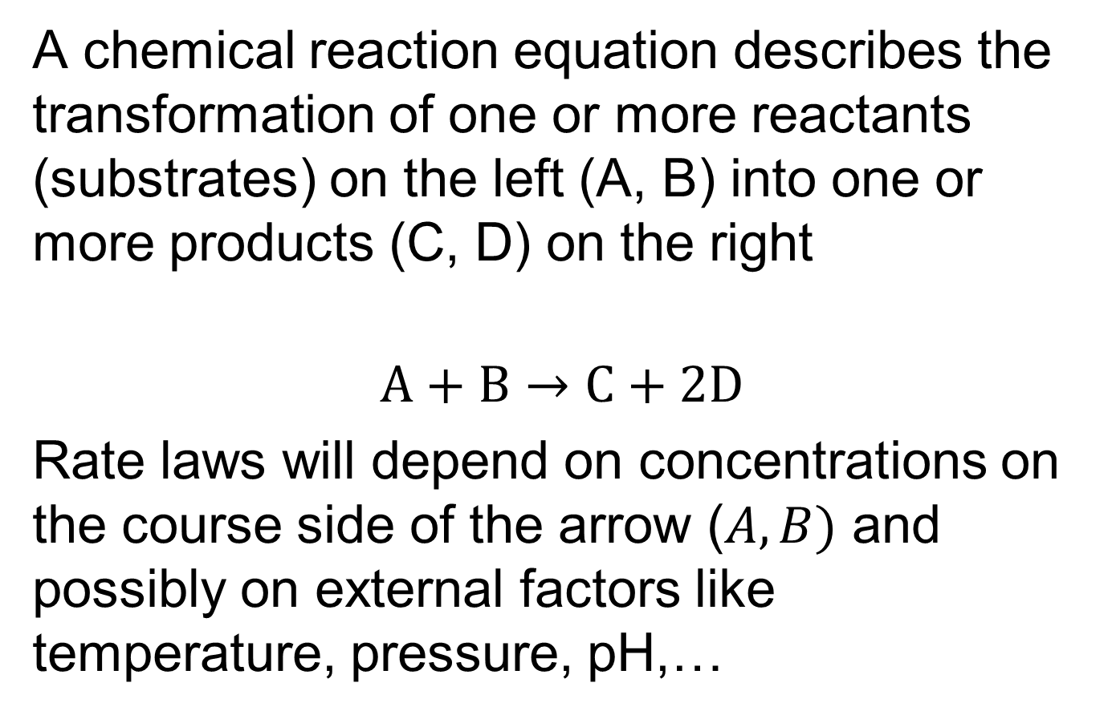
Chemical Reactions—Notation and Rate Laws
A chemical reaction equation describes the transformation of one or more reactants (substrates) on the left (A, B) into one or more products (C, D) on the right
$$A+B→C+2D$$
Rate laws will depend on concentrations on the course side of the arrow ($A, B)$ and possibly on external factors like temperature, pressure, pH,…
$$v_{f}$$
Slide Courtesy of Herbert Sauro

Slide 3

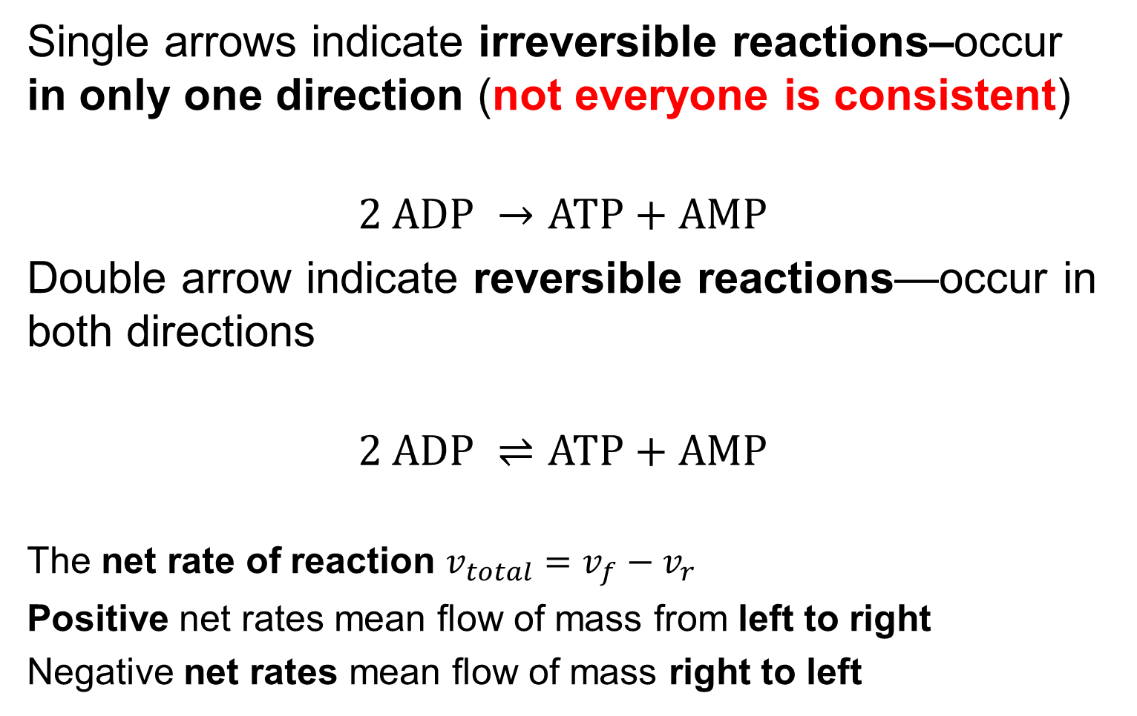


Reversible and Irreversible Reactions
Single arrows indicate irreversible reactions–occur in only one direction (not everyone is consistent)
$$2 ADP →ATP+AMP$$
Double arrow indicate reversible reactions—occur in both directions
$$2 ADP ⇌ATP+AMP$$
The net rate of reaction $v_{total}=v_{f}−v_{r}$
Positive net rates mean flow of mass from left to right
Negative net rates mean flow of mass right to left
$$v_{f}$$
$$v_{f}$$
$$v_{r}$$

Slide 4
Mass Conservation and Stoichiometry
The ensemble of chemical reactions inside a cell should conserve mass
So, when we write complete chemical reaction networks, we expect them to conserve mass (we call them stoichiometric)
When our networks contain nodes that don’t correspond to chemical species, or we leave out reaction sources, sinks or steps, we need not conserve mass

Slide 5
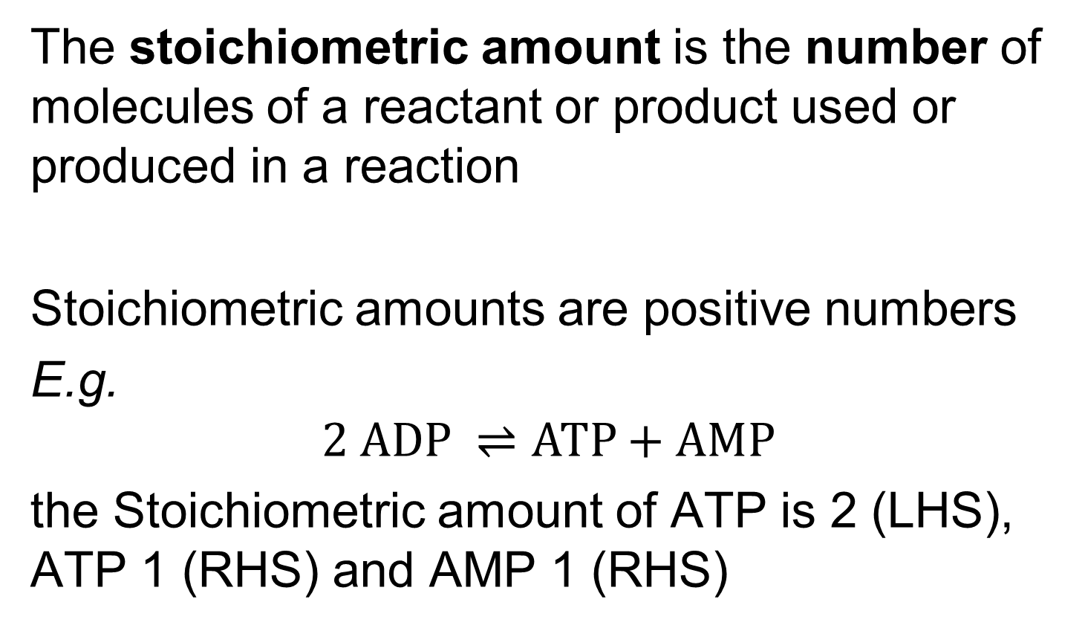
Stoichiometric Amounts
The stoichiometric amount is the number of molecules of a reactant or product used or produced in a reaction
Stoichiometric amounts are positive numbers
E.g.
$$2 ADP ⇌ATP+AMP$$
the Stoichiometric amount of ATP is 2 (LHS), ATP 1 (RHS) and AMP 1 (RHS)
Slide Courtesy of Herbert Sauro

Slide 6
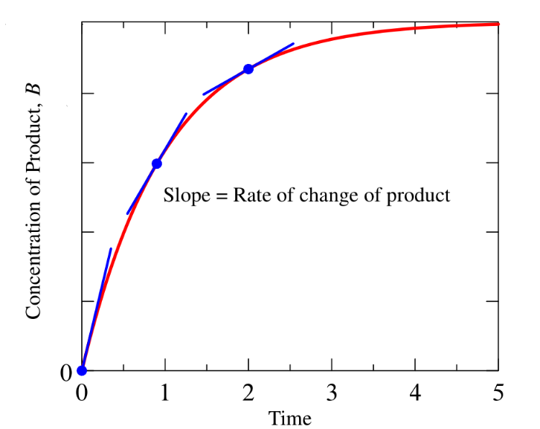


Dynamics: Rates of Change
The rate of change is the time derivative of concentration or amount (depending on units) of a species
$$\text{Rate}=\frac{dA}{dt}$$
$$A →B$$
Rates usually depend on the concentration of the reactants and thus change as the reaction progresses
Slide Courtesy of Herbert Sauro

Slide 7
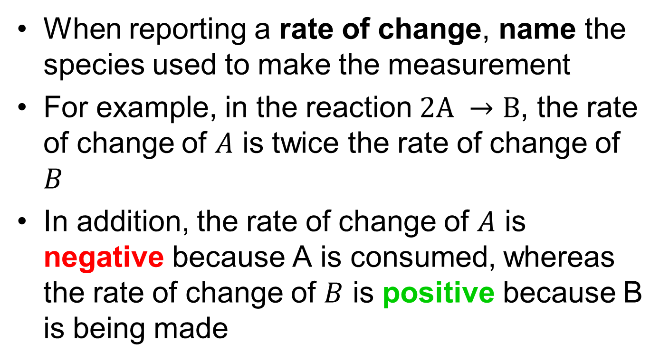
Rates of Change
When reporting a rate of change, name the species used to make the measurement
For example, in the reaction $2A →B$, the rate of change of $A$ is twice the rate of change of $B$
In addition, the rate of change of $A$ is negative because A is consumed, whereas the rate of change of $B$ is positive because B is being made
Slide Courtesy of Herbert Sauro

Slide 8
Stoichiometric Coefficients: Definition
The stoichiometry coefficient is the relative amount of substance a reaction consumes and/or produces
The species stoichiometric coefficient is the difference between the stoichiometric amount on the product side and the stoichiometric amount of the same species on the reactant side
Slide Courtesy of Herbert Sauro

Slide 9
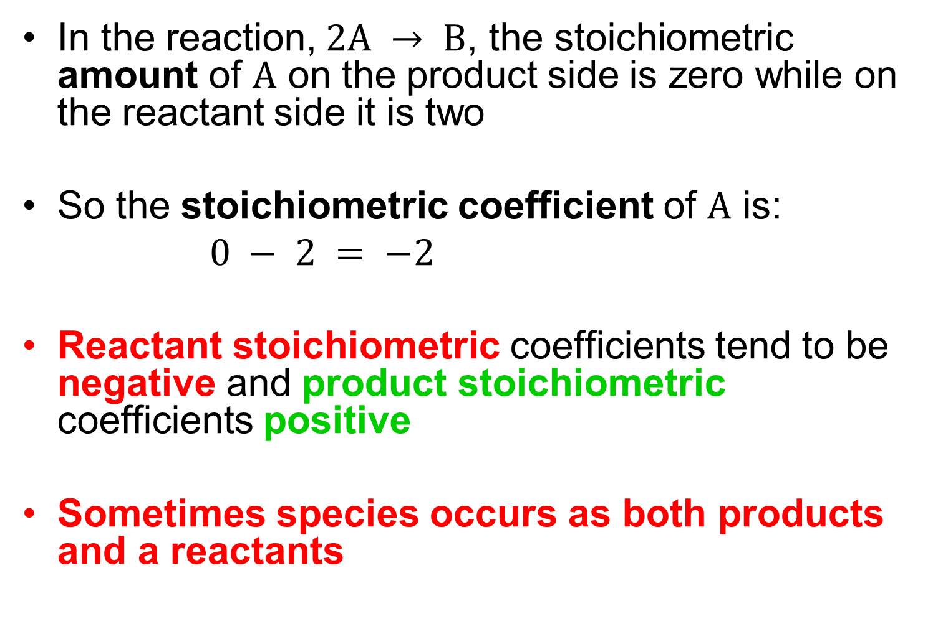
Stoichiometric Coefficients: Calculation
In the reaction, $2A → B$, the stoichiometric amount of $A$ on the product side is zero while on the reactant side it is two
So the stoichiometric coefficient of $A$ is:
$0 − 2 = −2$
Reactant stoichiometric coefficients tend to be negative and product stoichiometric coefficients positive
Sometimes species occurs as both products and a reactants
Slide Courtesy of Herbert Sauro

Slide 10
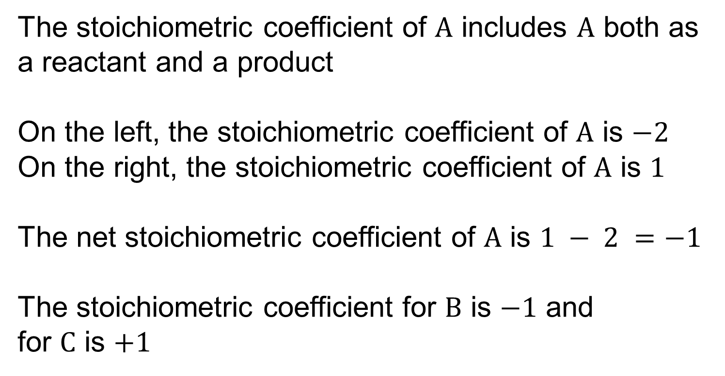
Stoichiometric Coefficients: Example
$$2A+B→A+C$$
The stoichiometric coefficient of $A$ includes $A$ both as a reactant and a product
On the left, the stoichiometric coefficient of $A$ is $−2$
On the right, the stoichiometric coefficient of $A$ is $1$
The net stoichiometric coefficient of $A$ is $1 − 2 =−1$
The stoichiometric coefficient for $B$ is $−1$ and
for $C$ is $+1$
Slide Courtesy of Herbert Sauro

Slide 11
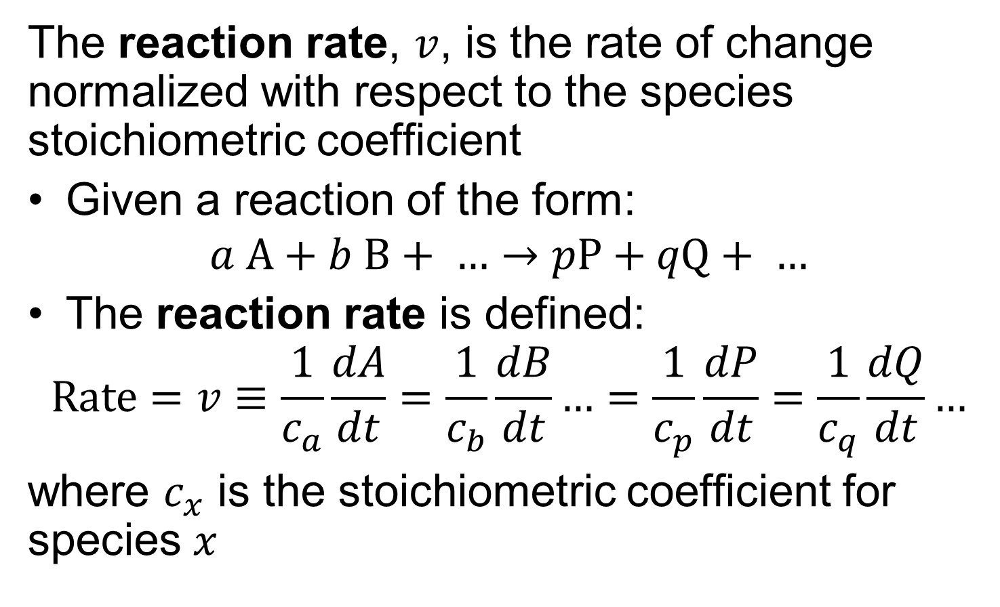
Reaction Rates
The reaction rate, $v$, is the rate of change normalized with respect to the species stoichiometric coefficient
Given a reaction of the form:
$$a A+b B+ …→pP+qQ+ …$$
The reaction rate is defined:
$$\text{Rate}=v≡\frac{1}{c_{a}}\frac{dA}{dt}=\frac{1}{c_{b}}\frac{dB}{dt}…=\frac{1}{c_{p}}\frac{dP}{dt}=\frac{1}{c_{q}}\frac{dQ}{dt}…$$
where $c_{x}$ is the stoichiometric coefficient for species $x$
Slide Courtesy of Herbert Sauro

Slide 12
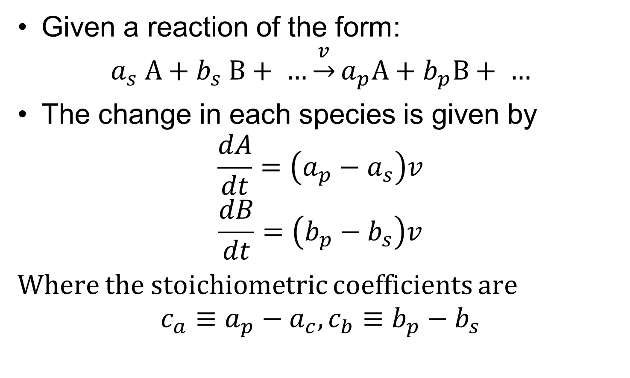
Calculating Stoichiometry from Reaction Rates and Formulae
Given a reaction of the form:
$$a_{s} A+b_{s} B+ …\underset{→}{v}a_{p}A+b_{p}B+ …$$
The change in each species is given by
$$\frac{dA}{dt}=\left(a_{p}−a_{s}\right)v$$
$$\frac{dB}{dt}=\left(b_{p}−b_{s}\right)v$$
Where the stoichiometric coefficients are
$$c_{a}≡a_{p}−a_{c}, c_{b}≡b_{p}−b_{s}$$
Slide Courtesy of Herbert Sauro

Slide 13
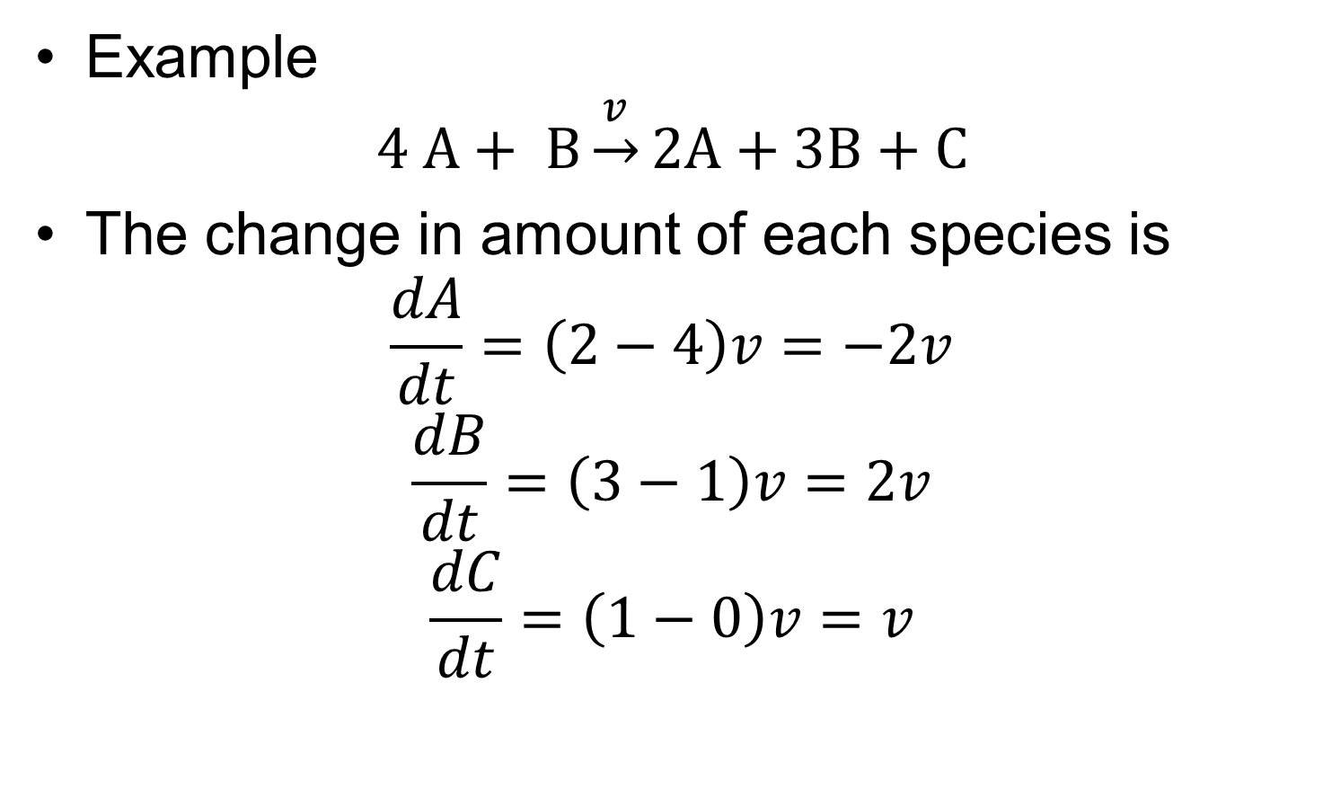
Calculating Stoichiometry Example
Example
$$4 A+ B\underset{→}{v}2A+3B+C$$
The change in amount of each species is
$$\frac{dA}{dt}=\left(2−4\right)v=−2v$$
$$\frac{dB}{dt}=\left(3−1\right)v=2v$$
$$\frac{dC}{dt}=\left(1−0\right)v=v$$
Slide Courtesy of Herbert Sauro

Slide 14
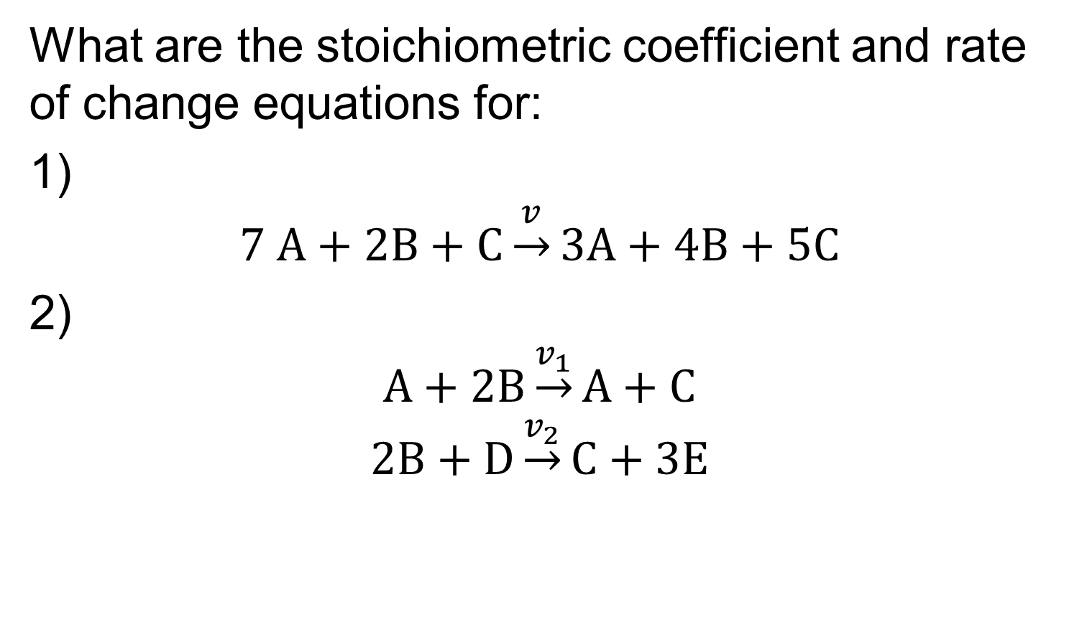
In Class Exercise: Calculating Stoichiometry
What are the stoichiometric coefficient and rate of change equations for:
1)
$$7 A+2B+C\underset{→}{v}3A+4B+5C$$
2)
$$A+2B\underset{→}{v_{1}}A+C$$
$$2B+D\underset{→}{v_{2}}C+3E$$
Slide Courtesy of Herbert Sauro

Slide 15
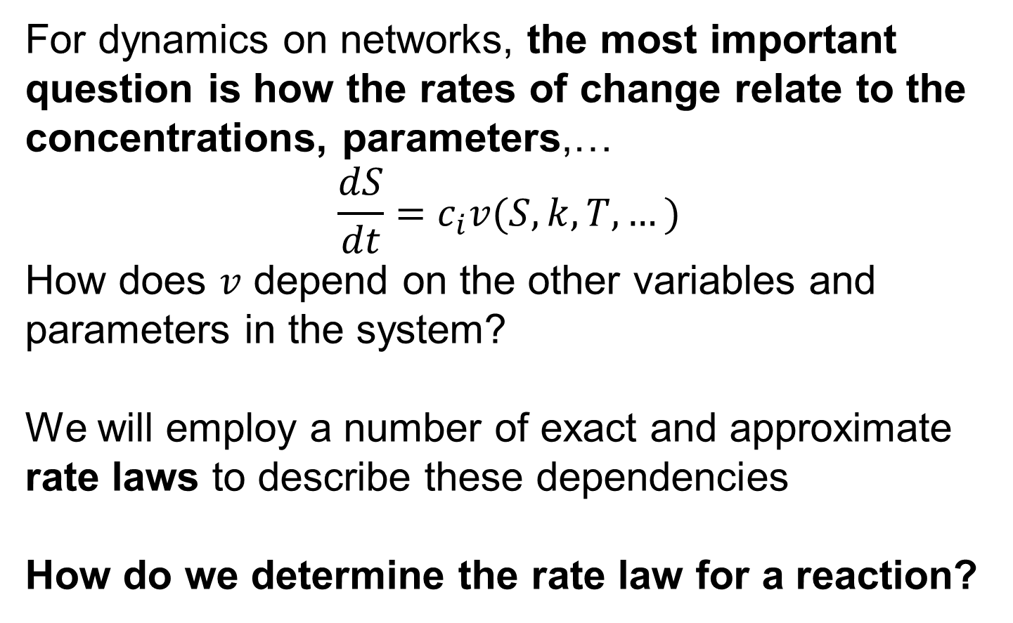
Reaction Dynamics and Rate Laws
For dynamics on networks, the most important question is how the rates of change relate to the concentrations, parameters,…
$$\frac{dS}{dt}=c_{i}v(S,k,T,…)$$
How does $v$ depend on the other variables and parameters in the system?
We will employ a number of exact and approximate rate laws to describe these dependencies
How do we determine the rate law for a reaction?
Slide Courtesy of Herbert Sauro

Slide 16
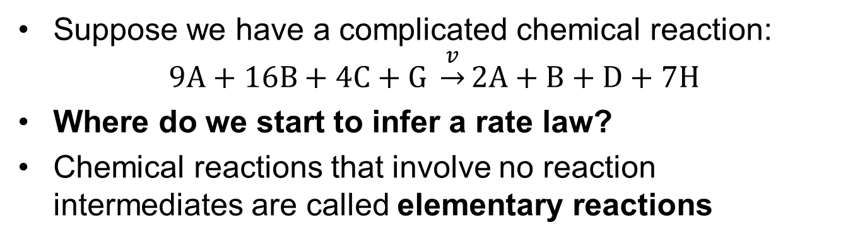
Irreversible Mass-Action Kinetics
Suppose we have a complicated chemical reaction:
$$9A+16B+4C+G \underset{→}{v}2A+B+D+7H$$
Where do we start to infer a rate law?
Chemical reactions that involve no reaction intermediates are called elementary reactions

Slide 17
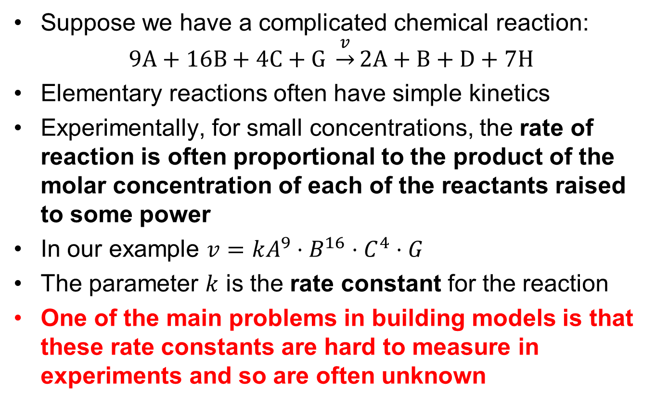
Irreversible Mass-Action Kinetics
Suppose we have a complicated chemical reaction:
$$9A+16B+4C+G \underset{→}{v}2A+B+D+7H$$
Elementary reactions often have simple kinetics
Experimentally, for small concentrations, the rate of reaction is often proportional to the product of the molar concentration of each of the reactants raised to some power
In our example $v=kA^{9}⋅B^{16}⋅C^{4}⋅G$
The parameter $k$ is the rate constant for the reaction
One of the main problems in building models is that these rate constants are hard to measure in experiments and so are often unknown

Slide 18

Mass-Action Kinetics—Physical Justification
For low enough concentrations, the probability of each instance of a specific reaction between reacting molecules over a given time interval is independent and proportional to the probability that the reacting components are simultaneously contained in a volume small enough for them to react
Figure from
Physical Biology of the Cell
For a detailed derivation see slides at the end of this lecture and Philips—Physical Biology of the Cell, p. 267-270
“Small enough volume” is complicated to determine!

Slide 19
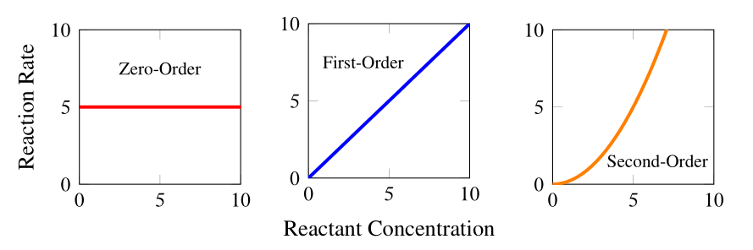
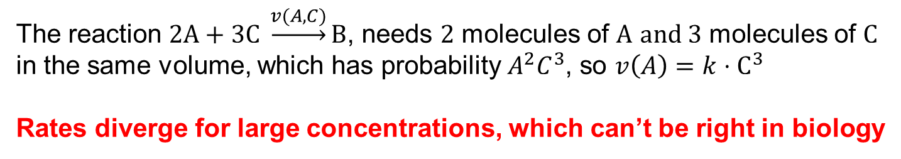

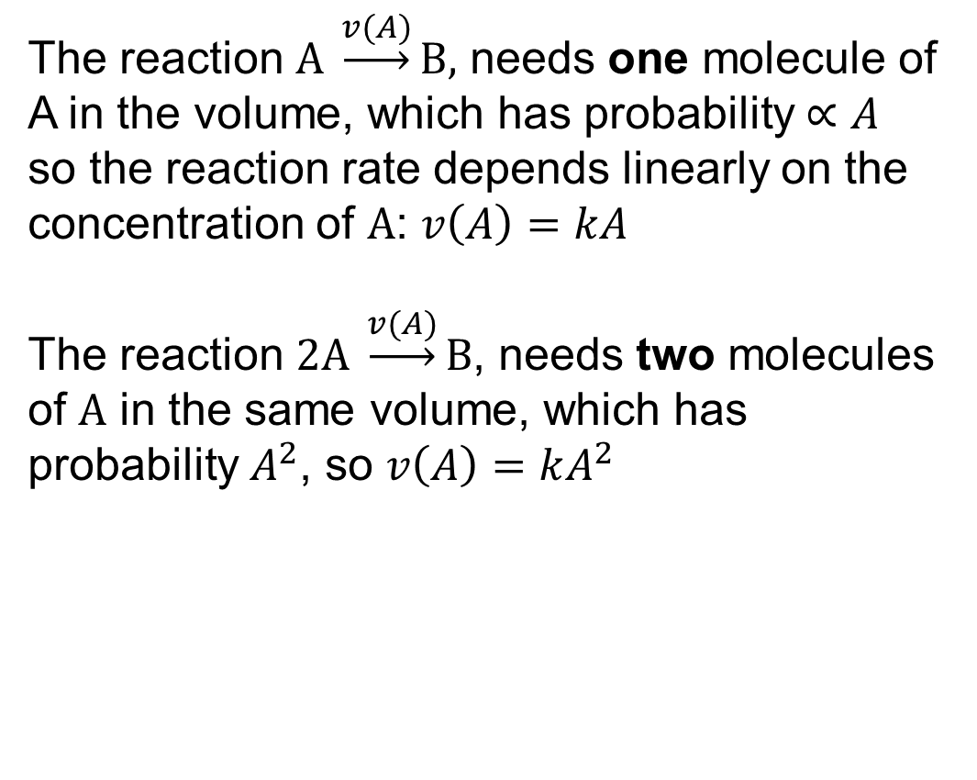



Mass-Action Kinetics—Simple Cases
The probability of finding a molecule in a small volume is proportional to its concentration for low concentrations
The reaction $A \underset{→}{v(A)}B,$ needs one molecule of A in the volume, which has probability $∝A$
so the reaction rate depends linearly on the concentration of $A$: $v\left(A\right)=kA$
The reaction $2A \underset{→}{v(A)}B$, needs two molecules of $A$ in the same volume, which has probability $A^{2}$, so $v\left(A\right)=kA^{2}$
$$v(A)$$
$$A$$
$$v(A)$$
$$A$$
The reaction $2A+3C \underset{→}{v(A,C)}B$, needs $2$ molecules of $A$ $and 3$ molecules of $C$ in the same volume, which has probability $A^{2}C^{3}$, so $v\left(A\right)=k⋅C^{3}$
Rates diverge for large concentrations, which can’t be right in biology

Slide 20

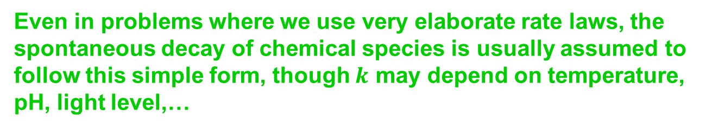

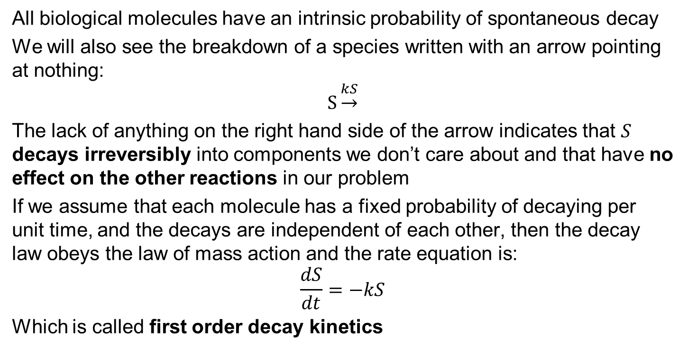
First Order Decay Kinetics
All biological molecules have an intrinsic probability of spontaneous decay
We will also see the breakdown of a species written with an arrow pointing at nothing:
$$S\underset{→}{kS}$$
The lack of anything on the right hand side of the arrow indicates that $S$ decays irreversibly into components we don’t care about and that have no effect on the other reactions in our problem
If we assume that each molecule has a fixed probability of decaying per unit time, and the decays are independent of each other, then the decay law obeys the law of mass action and the rate equation is:
$$\frac{dS}{dt}=−kS$$
Which is called first order decay kinetics
$$v$$
$$S$$
Even in problems where we use very elaborate rate laws, the spontaneous decay of chemical species is usually assumed to follow this simple form, though $k$ may depend on temperature, pH, light level,…

Slide 21
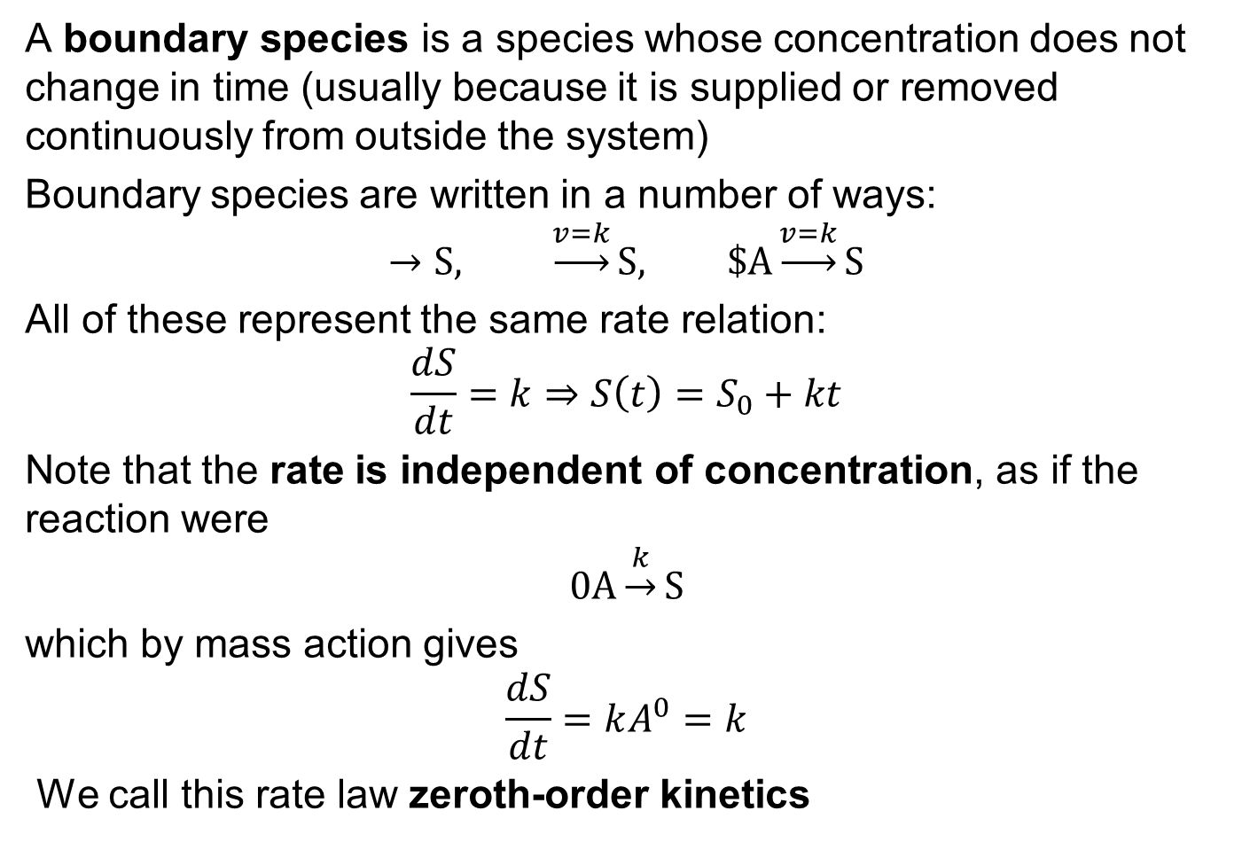

Boundary Species and Sources—Zeroth Order Kinetics
A boundary species is a species whose concentration does not change in time (usually because it is supplied or removed continuously from outside the system)
Boundary species are written in a number of ways:
$$→S, \underset{→}{v=k}S, \$A\underset{→}{v=k}S$$
All of these represent the same rate relation:
$$\frac{dS}{dt}=k⇒S\left(t\right)=S_{0}+kt$$
Note that the rate is independent of concentration, as if the reaction were
$$0A\underset{→}{k}S$$
which by mass action gives
$$\frac{dS}{dt}=kA^{0}=k$$
We call this rate law zeroth-order kinetics
$$A$$

Slide 22
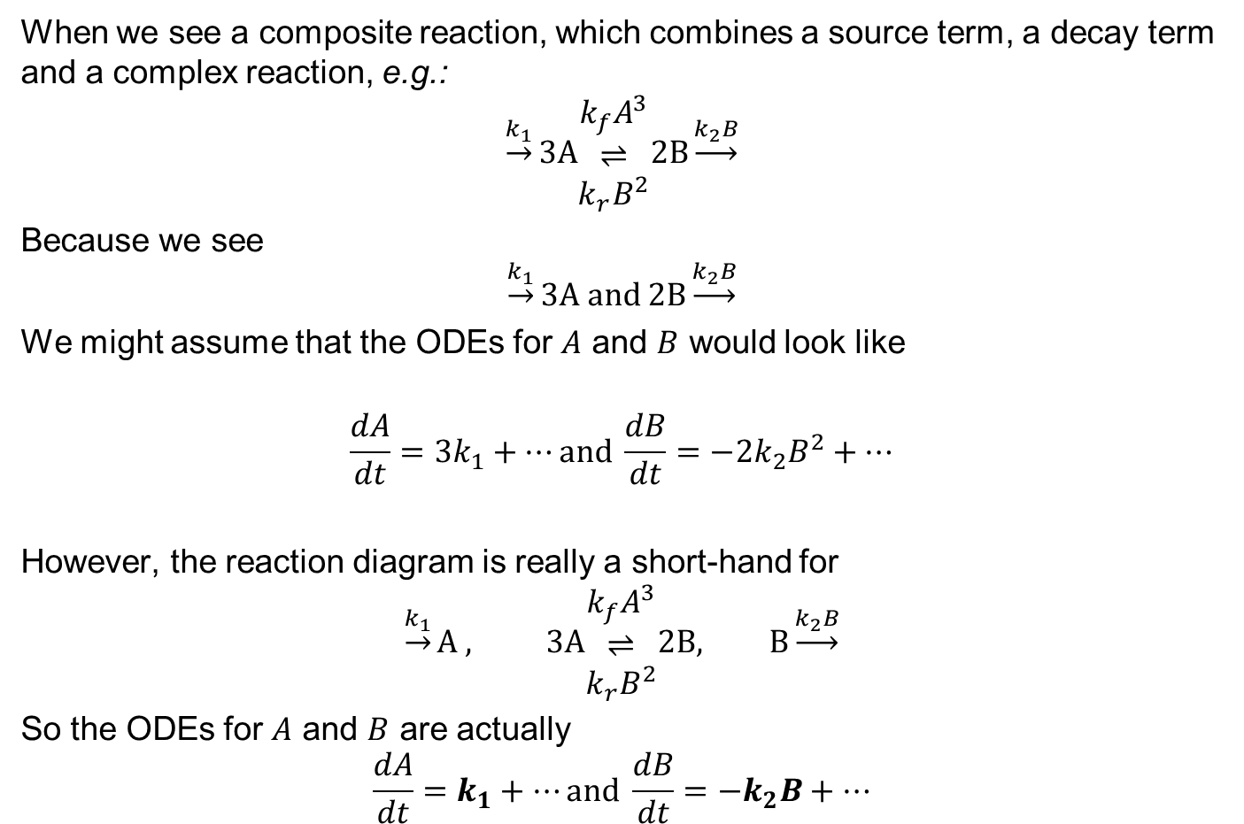
Note on Arrow Conventions for Source and Decay Terms
When we see a composite reaction, which combines a source term, a decay term and a complex reaction, e.g.:
$$\underset{→}{k_{1}}3A\begin{matrix}k_{f}A^{3} \\ ⇌ \\ k_{r}B^{2}\end{matrix}2B\underset{→}{k_{2}B}$$
Because we see
$$\underset{→}{k_{1}}3A and 2B\underset{→}{k_{2}B}$$
We might assume that the ODEs for $A$ and $B$ would look like
$$\frac{dA}{dt}=3k_{1}+…\text{and} \frac{dB}{dt}=−2k_{2}B^{2}+…$$
However, the reaction diagram is really a short-hand for
$$\underset{→}{k_{1}}A , 3A\begin{matrix}k_{f}A^{3} \\ ⇌ \\ k_{r}B^{2}\end{matrix}2B, B\underset{→}{k_{2}B}$$
So the ODEs for $A$ and $B$ are actually
$$\frac{dA}{dt}=k_{1}+…\text{and} \frac{dB}{dt}=−k_{2}B+…$$
Doesn’t matter that much for the source, but decay is almost always one molecule at a time and hence first order!

Slide 23
Order of Reactions
The order of the reaction for a given species is the power to which that species is raised in the rate law. For a mass-action reaction the order is just the stoichiometric amount
Slide Courtesy of Herbert Sauro

Slide 24
Mass-Action Caveats
Occupancy depends linearly on the concentration only if the presence of one molecule in the volume doesn’t change the probability of having a second molecule in the volume
Mass Action requires that the total volume occupied by the molecules (excluded volume) is very small (low concentrations)
At high concentrations the probability of simultaneous occupancy will increase more slowly than Mass Action predicts (saturation) because of volume effects

Slide 25
Mass-Action Caveats
The concentration at saturation depends on the size of the molecules!
Reactions between molecules of greatly different sizes have additional effects (depletion forces)
Cell cytoplasm is crowded with molecules of different sizes and densities, which can affect rates of reaction by molecules of different sizes
If molecules attract each other (e.g. electrostatically), rates of reaction can increase faster than Mass Action predicts
For a detailed derivation see Philips—Physical Biology of the Cell, Chapter 14

Slide 26
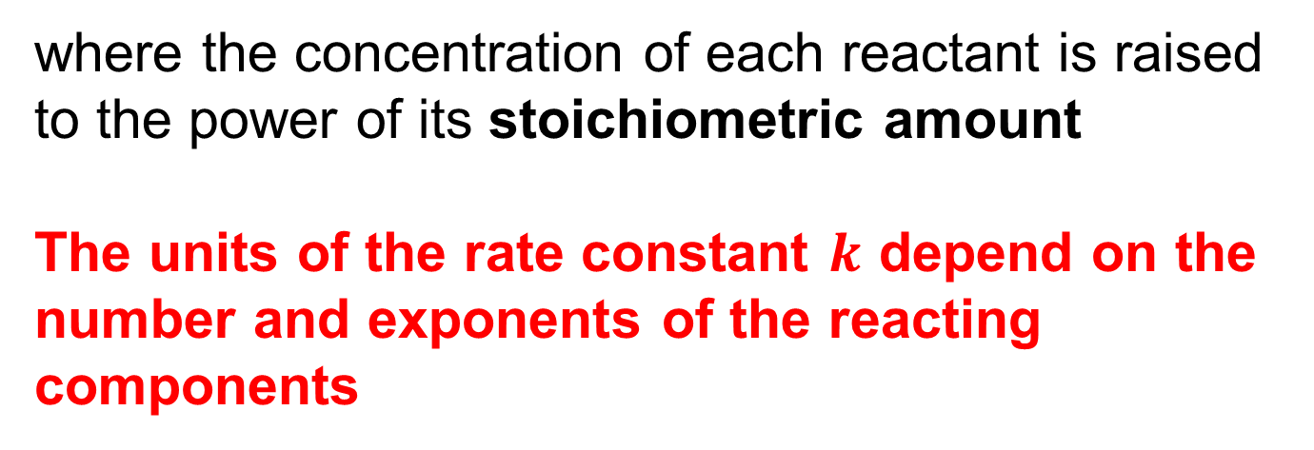
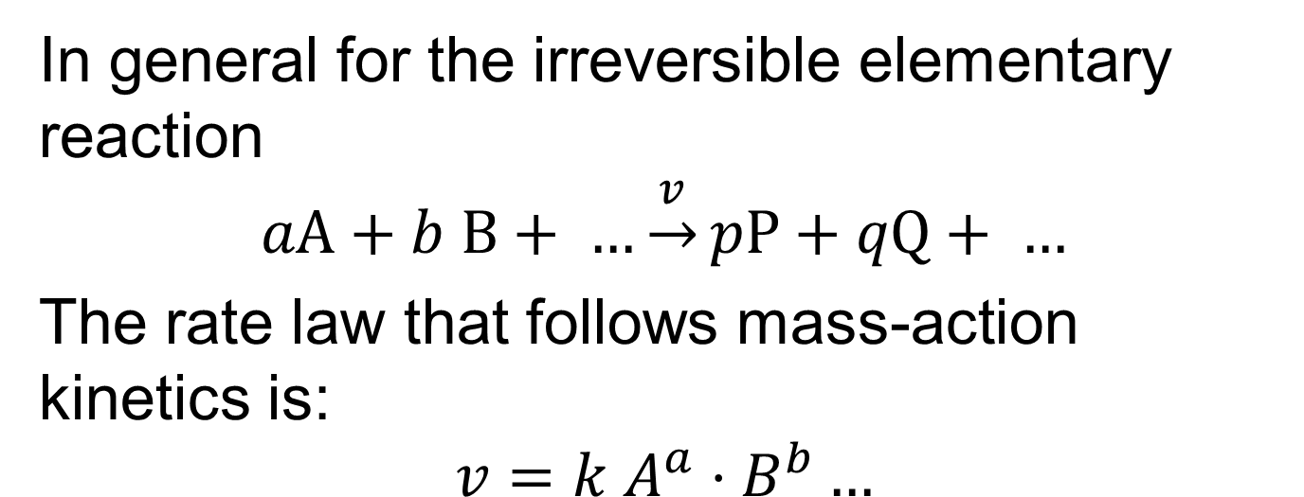
Rate Laws for Irreversible Mass-Action Kinetics
In general for the irreversible elementary reaction
$$aA+b B+ …\underset{→}{v}pP+qQ+ …$$
The rate law that follows mass-action kinetics is:
$$v=k A^{a}⋅B^{b}…$$
where the concentration of each reactant is raised to the power of its stoichiometric amount
The units of the rate constant $k$ depend on the number and exponents of the reacting components
Slide Courtesy of Herbert Sauro

Slide 27
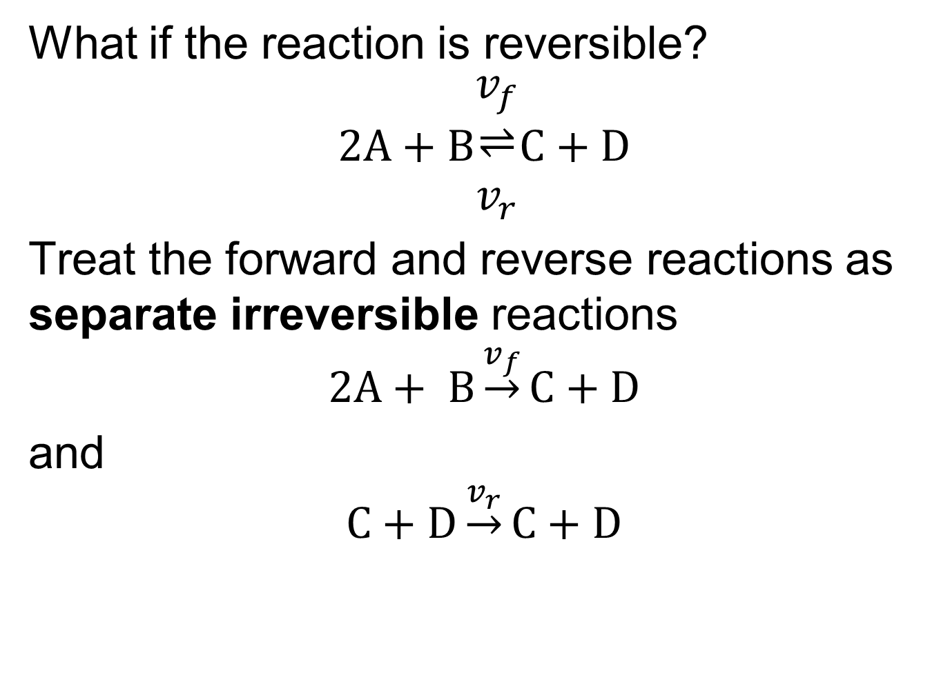
Rate Laws for Reversible Mass-Action Kinetics
What if the reaction is reversible?
$$2A+B\begin{matrix}v_{f} \\ ⇌ \\ v_{r}\end{matrix}C+D$$
Treat the forward and reverse reactions as separate irreversible reactions
$$2A+ B\underset{→}{v_{f}}C+D$$
and
$$C+D\underset{→}{v_{r}}C+D$$

Slide 28
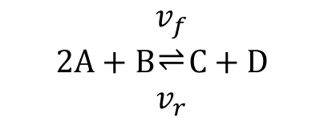
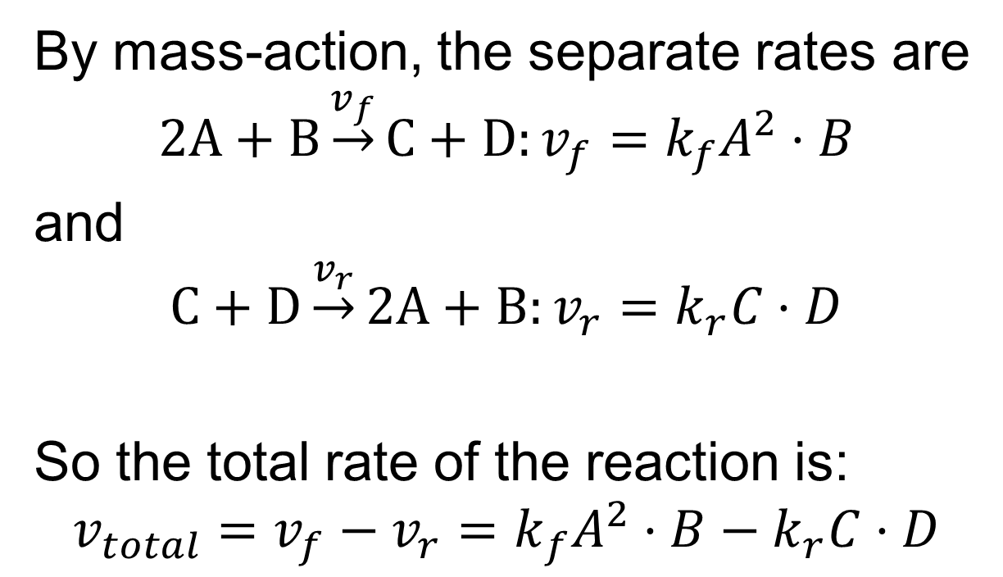
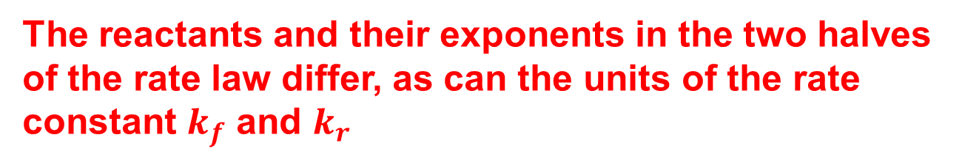

Deriving Reversible Mass-Action Rate Laws
$$2A+B\begin{matrix}v_{f} \\ ⇌ \\ v_{r}\end{matrix}C+D$$
By mass-action, the separate rates are
$$2A+B\underset{→}{v_{f}}C+D:v_{f}=k_{f}A^{2}⋅B$$
and
$$C+D\underset{→}{v_{r}}2A+B:v_{r}=k_{r}C⋅D$$
So the total rate of the reaction is:
$${v_{total}=v_{f}−v_{r}=k}_{f}A^{2}⋅B−k_{r}C⋅D$$
$$2A+B\underset{↔}{v_{total}}C+D$$
The reactants and their exponents in the two halves of the rate law differ, as can the units of the rate constant $k_{f}$ and $k_{r}$

Slide 29
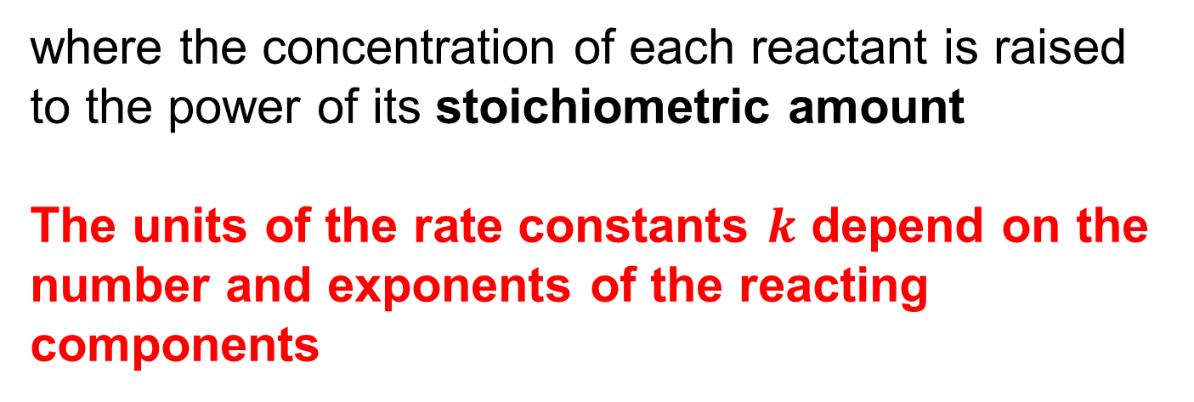
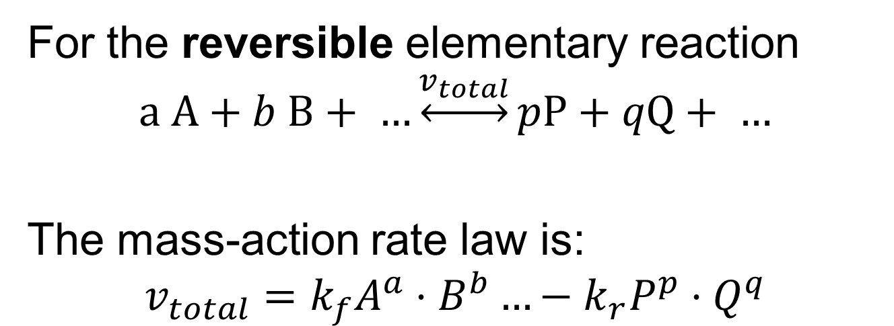
General Form for Reversible Mass-Action Rate Laws
For the reversible elementary reaction
$$a A+b B+ …\underset{↔}{v_{total}}pP+qQ+ …$$
The mass-action rate law is:
$$v_{total}=k_{f}A^{a}⋅B^{b}…−k_{r}P^{p}⋅Q^{q}$$
where the concentration of each reactant is raised to the power of its stoichiometric amount
The units of the rate constants $k$ depend on the number and exponents of the reacting components
Slide Courtesy of Herbert Sauro

Slide 30
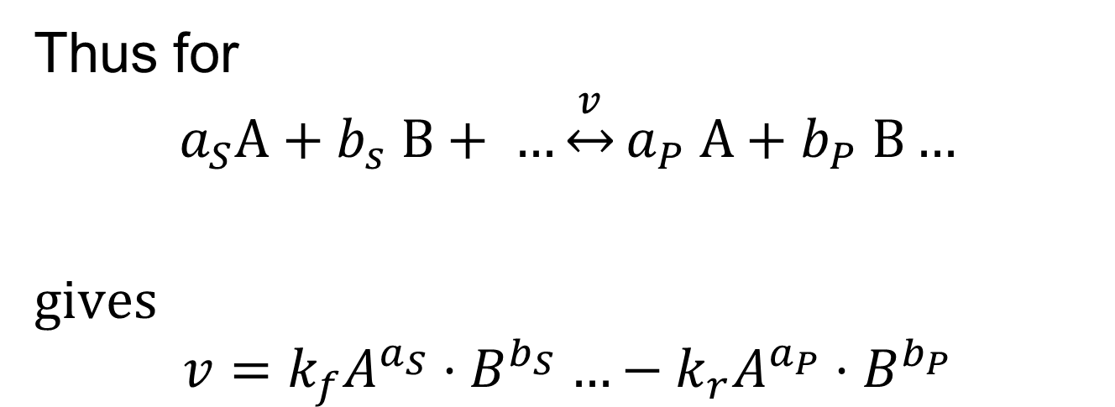
Thinking About Reversible Mass-Action Kinetics
Thus for
$$a_{S}A+b_{s} B+ …\underset{↔}{v}a_{P} A+b_{P} B…$$
gives
$$v=k_{f}A^{a_{S}}{⋅B}^{b_{S}}…−k_{r}A^{a_{P}}⋅B^{b_{P}}$$
Slide Courtesy of Herbert Sauro

Slide 31
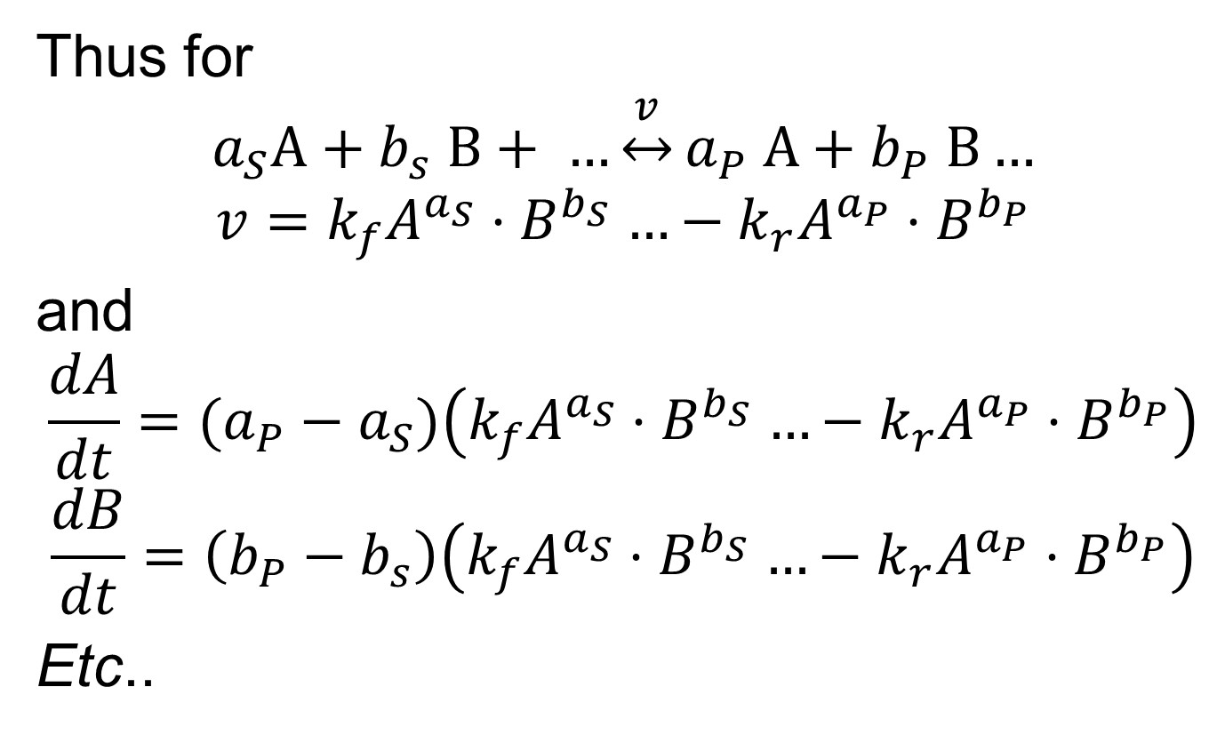
Thinking About Reversible Mass-Action Kinetics
Thus for
$$a_{S}A+b_{s} B+ …\underset{↔}{v}a_{P} A+b_{P} B…$$
$$v=k_{f}A^{a_{S}}{⋅B}^{b_{S}}…−k_{r}A^{a_{P}}{⋅B}^{b_{P}}$$
and
$$\frac{dA}{dt}=(a_{P}−a_{S})\left(k_{f}A^{a_{S}}{⋅B}^{b_{S}}…−k_{r}A^{a_{P}}{⋅B}^{b_{P}}\right)$$
$$\frac{dB}{dt}=\left(b_{P}−b_{s}\right)\left(k_{f}A^{a_{S}}{⋅B}^{b_{S}}…−k_{r}A^{a_{P}}{⋅B}^{b_{P}}\right)$$
Etc..
Slide Courtesy of Herbert Sauro

Slide 32
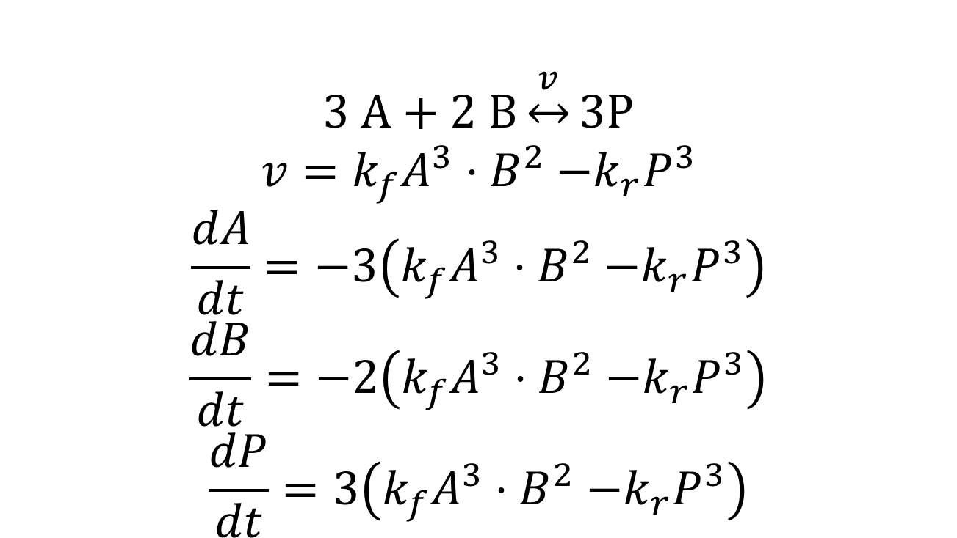
Example of Applying Reversible Mass-Action Kinetics
$$3 A+2 B\underset{↔}{v}3P$$
$$v=k_{f}A^{3}{⋅B}^{2}−k_{r}P^{3}$$
$$\frac{dA}{dt}=−3\left(k_{f}A^{3}{⋅B}^{2}−k_{r}P^{3}\right)$$
$$\frac{dB}{dt}=−2\left(k_{f}A^{3}{⋅B}^{2}−k_{r}P^{3}\right)$$
$$\frac{dP}{dt}=3\left(k_{f}A^{3}{⋅B}^{2}−k_{r}P^{3}\right)$$

Slide 33
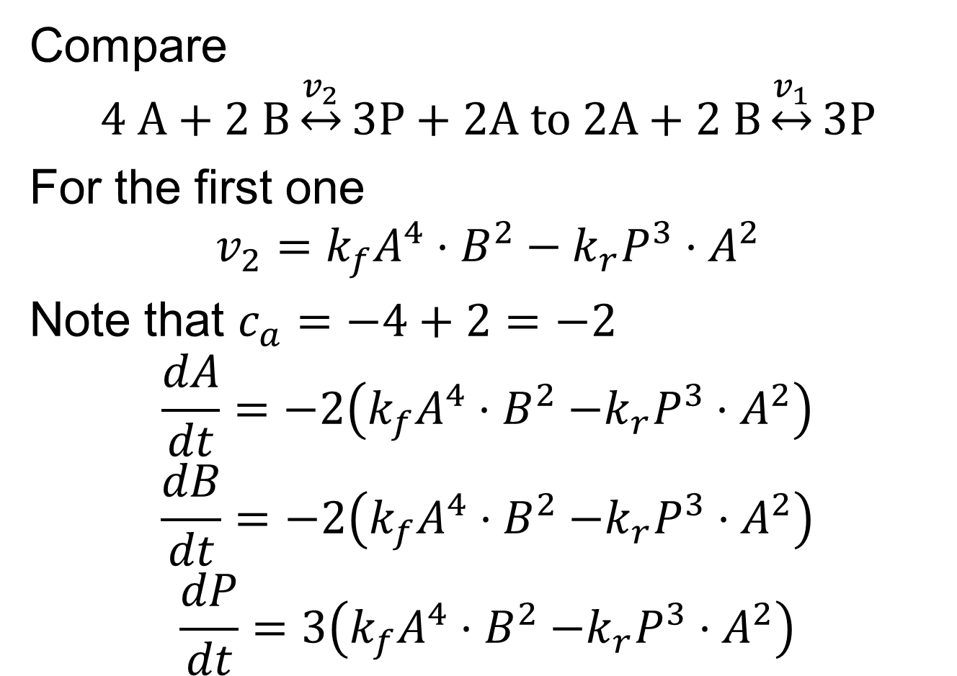
Examples of Reversible Mass-Action Kinetics
Compare
$$4 A+2 B\underset{↔}{v_{2}}3P+2A to 2A+2 B\underset{↔}{v_{1}}3P$$
For the first one
$$v_{2}=k_{f}A^{4}⋅B^{2}−k_{r}P^{3}{⋅A}^{2}$$
Note that $c_{a}=−4+2=−2$
$$\frac{dA}{dt}=−2\left(k_{f}A^{4}{⋅B}^{2}−k_{r}P^{3}⋅A^{2}\right)$$
$$\frac{dB}{dt}=−2\left(k_{f}A^{4}{⋅B}^{2}−k_{r}P^{3}⋅A^{2}\right)$$
$$\frac{dP}{dt}=3\left(k_{f}A^{4}{⋅B}^{2}−k_{r}P^{3}⋅A^{2}\right)$$

Slide 34
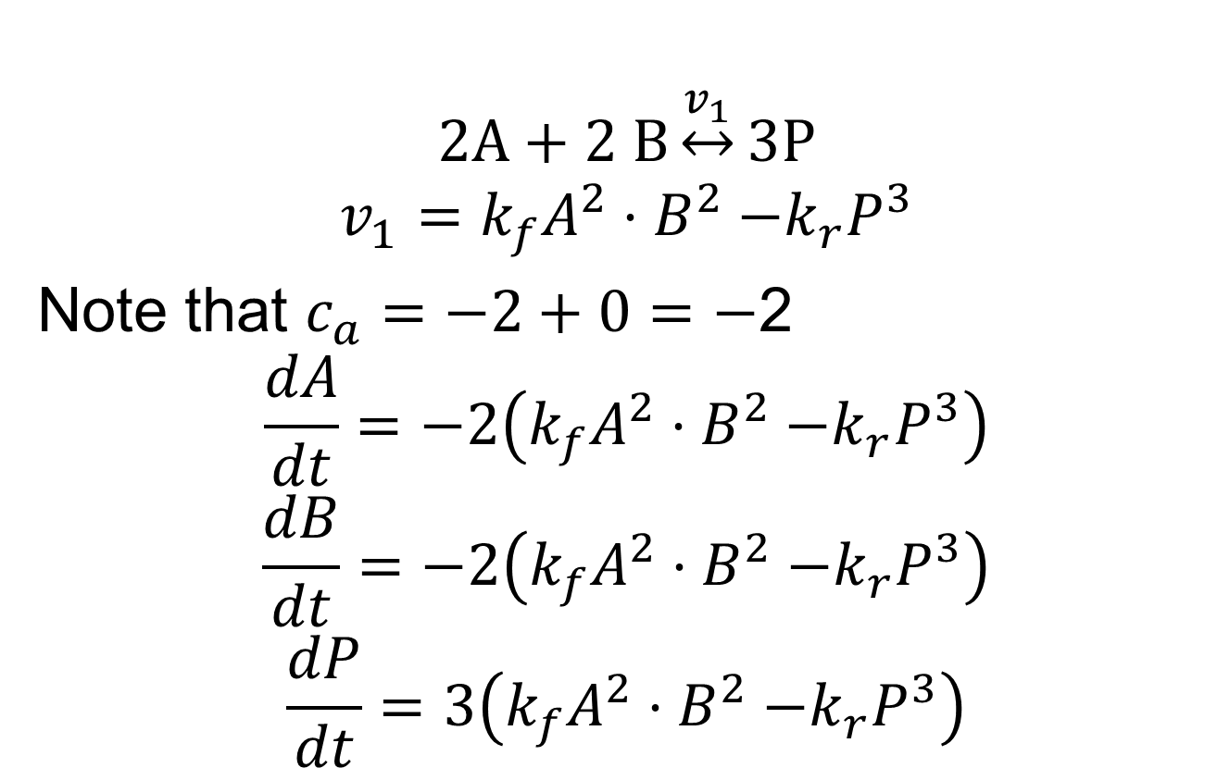
Examples of Reversible Mass-Action Kinetics
$$2A+2 B\underset{↔}{v_{1}}3P$$
$$v_{1}=k_{f}A^{2}{⋅B}^{2}−k_{r}P^{3}$$
Note that $c_{a}=−2+0=−$2
$$\frac{dA}{dt}=−2\left(k_{f}A^{2}{⋅B}^{2}−k_{r}P^{3}\right)$$
$$\frac{dB}{dt}=−2\left(k_{f}A^{2}{⋅B}^{2}−k_{r}P^{3}\right)$$
$$\frac{dP}{dt}=3\left(k_{f}A^{2}{⋅B}^{2}−k_{r}P^{3}\right)$$

Slide 35
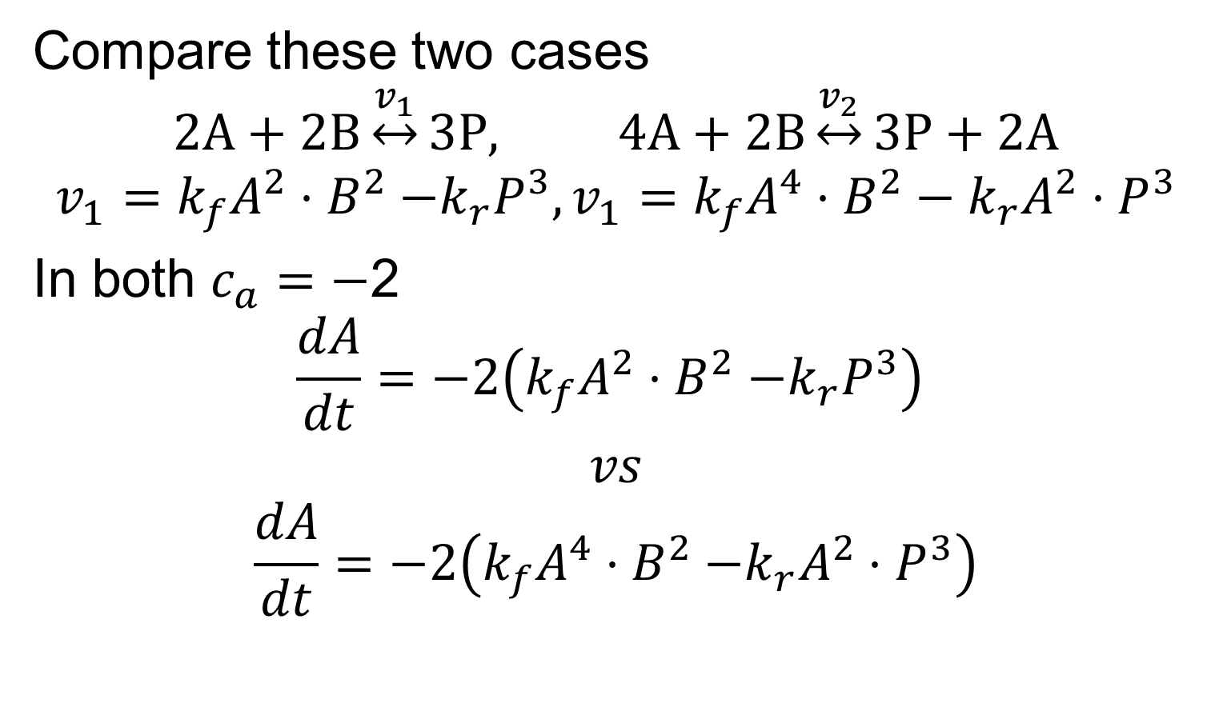
Examples of Reversible Mass-Action Kinetics
Compare these two cases
$$2A+2B\underset{↔}{v_{1}}3P, 4A+2B\underset{↔}{v_{2}}3P+2A$$
$$v_{1}=k_{f}A^{2}{⋅B}^{2}−k_{r}P^{3},v_{1}=k_{f}A^{4}⋅B^{2}−k_{r}{A^{2}⋅P}^{3}$$
In both $c_{a}=−$2
$$\frac{dA}{dt}=−2\left(k_{f}A^{2}{⋅B}^{2}−k_{r}P^{3}\right)$$
$$vs$$
$$\frac{dA}{dt}=−2\left(k_{f}A^{4}{⋅B}^{2}−k_{r}{A^{2}⋅P}^{3}\right)$$

Slide 36
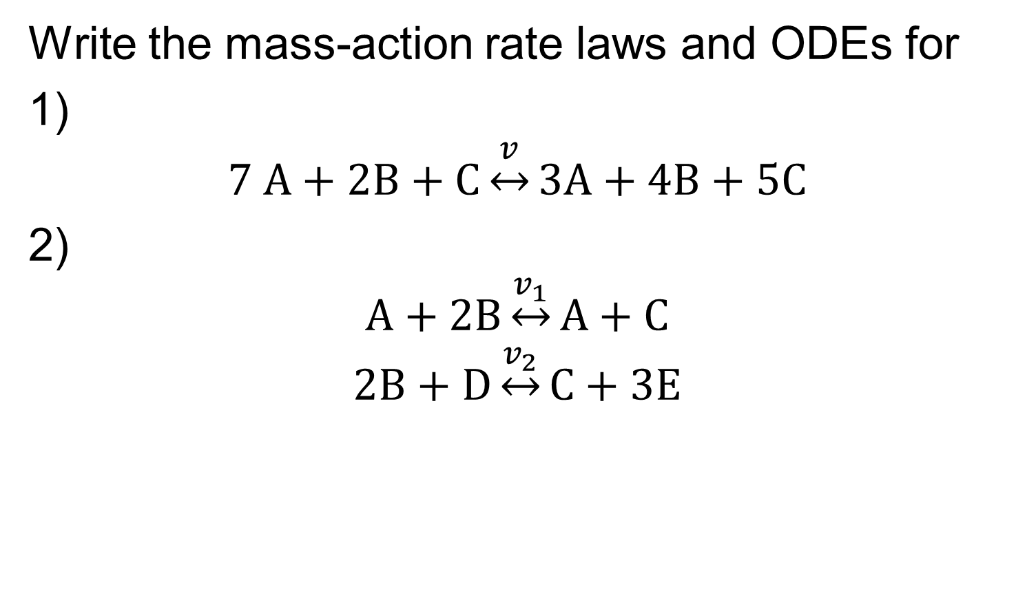
In Class Exercise Writing Mass-Action Rate Laws
Write the mass-action rate laws and ODEs for
1)
$$7 A+2B+C\underset{↔}{v}3A+4B+5C$$
2)
$$A+2B\underset{↔}{v_{1}}A+C$$
$$2B+D\underset{↔}{v_{2}}C+3E$$

Slide 37

Warning on Notation—Rate Constants vs Rate Laws
Many biochemistry texts and articles assume mass action and therefore denote rate laws only by the rate constant(s) $k$
So if you see
$$2A+B\underset{→}{k}C+D$$
It means
$$2A+B\underset{→}{kA^{2⋅}B}C+D$$
If you see
$$2A+B\begin{matrix}k_{f} \\ ⇌ \\ k_{r}\end{matrix}C+D$$
It means
$$2A+B\begin{matrix}k_{f}A^{2⋅}B \\ ⇌ \\ k_{r}C⋅D\end{matrix}C+D$$
Slide Courtesy of Herbert Sauro

Slide 38
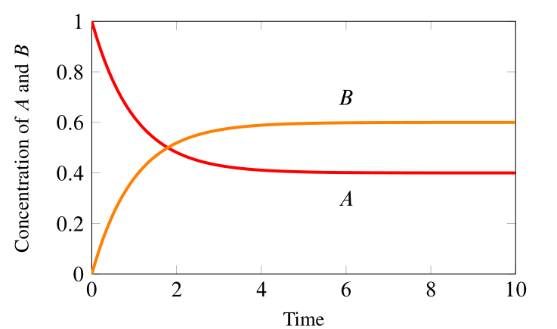
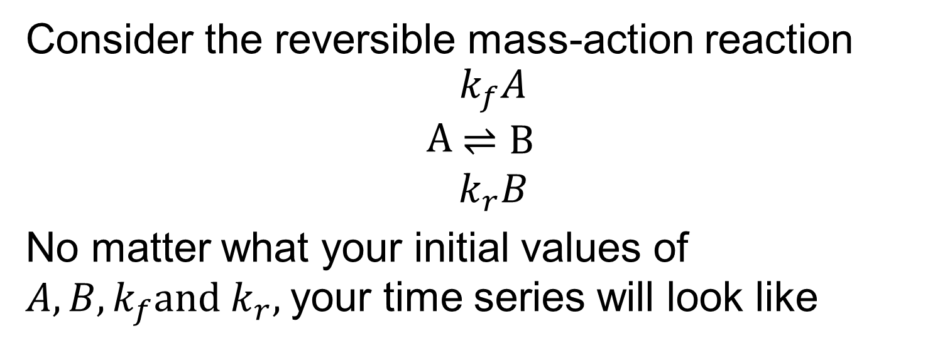
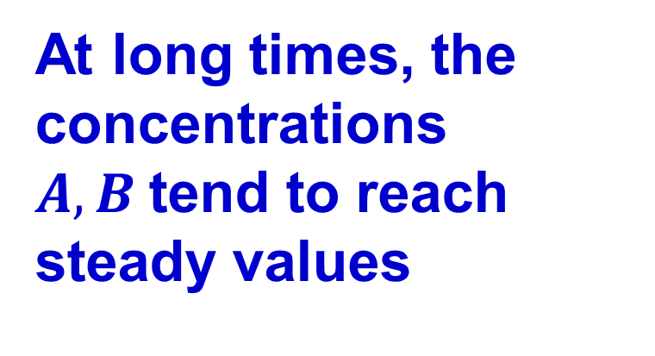
Chemical Equilibrium for Simple Reactions
Consider the reversible mass-action reaction
$$A\begin{matrix}k_{f}A \\ ⇌B \\ k_{r}B\end{matrix}$$
No matter what your initial values of $A, B, k_{f}and k_{r},$your time series will look like
At long times, the concentrations $A, B$tend to reach steady values
Slide Courtesy of Herbert Sauro

Slide 39
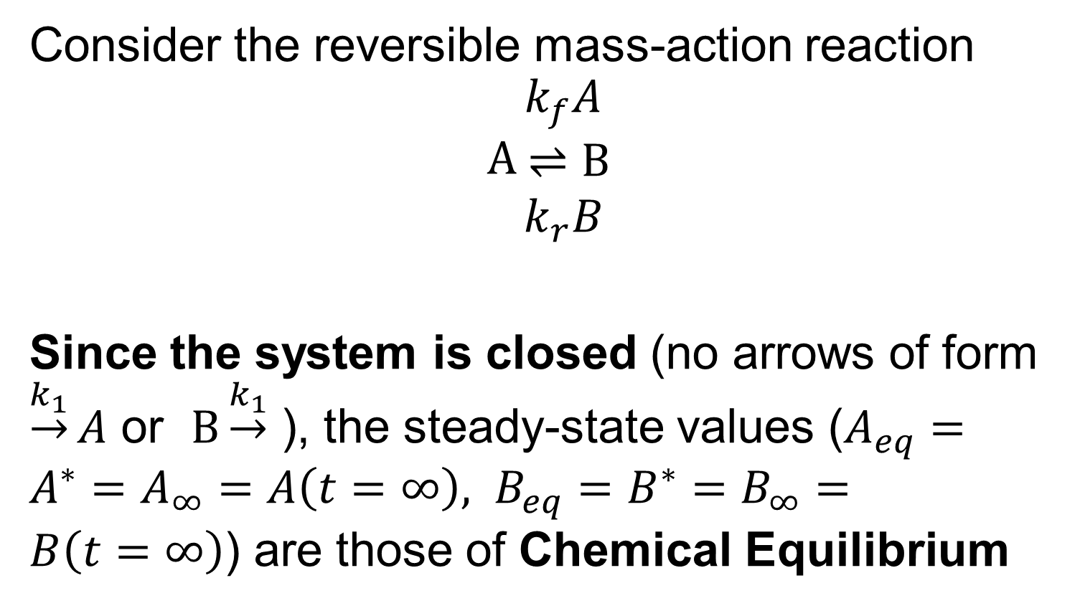
Circumstances for Chemical Equilibrium
Consider the reversible mass-action reaction
$$A\begin{matrix}k_{f}A \\ ⇌B \\ k_{r}B\end{matrix}$$
Since the system is closed (no arrows of form $\underset{→}{k_{1}}A$ or $B\underset{→}{k_{1}}$ ), the steady-state values ($A_{eq}=A^{∗}=A_{∞}=A\left(t=∞\right), B_{eq}=B^{∗}=B_{∞}=B\left(t=∞\right)$) are those of Chemical Equilibrium
Slide Courtesy of Herbert Sauro

Slide 40
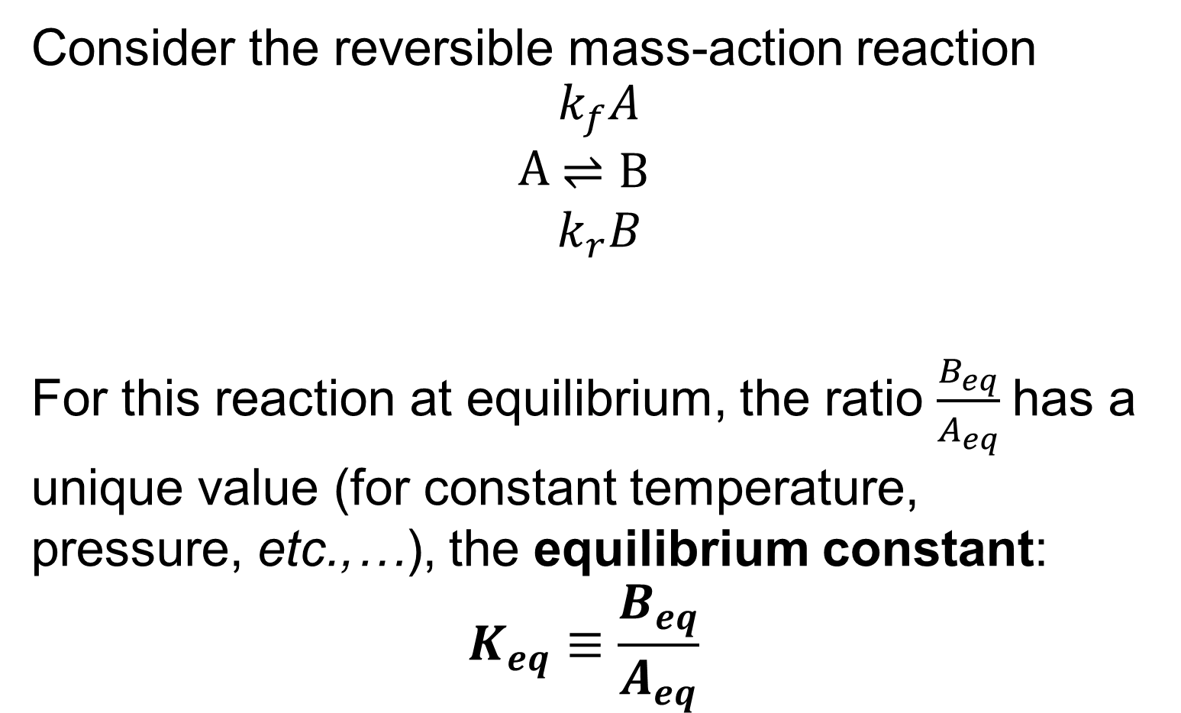
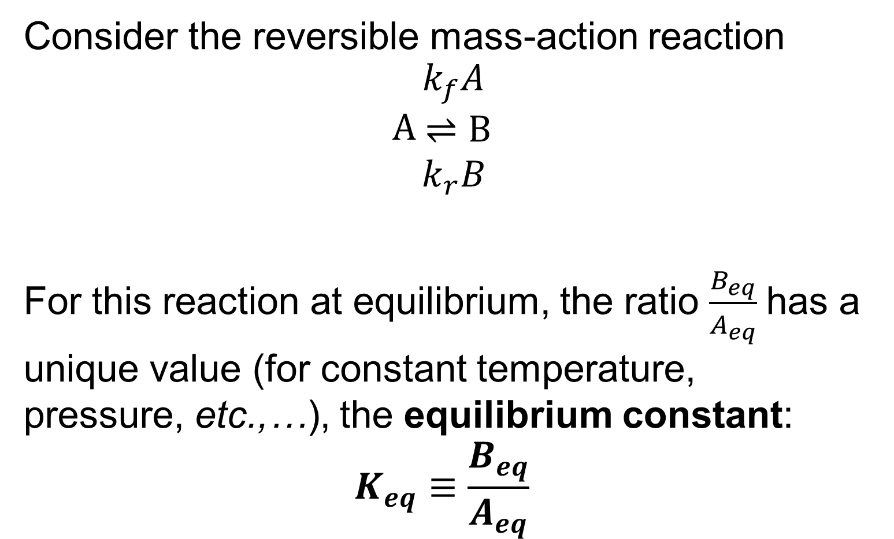
Equilibrium Constant Definition
Consider the reversible mass-action reaction
$$A\begin{matrix}k_{f}A \\ ⇌B \\ k_{r}B\end{matrix}$$
For this reaction at equilibrium, the ratio $\frac{B_{eq}}{A_{eq}}$has a unique value (for constant temperature, pressure, etc.,…), the equilibrium constant:
$$K_{eq}≡\frac{B_{eq}}{A_{eq}}$$

Slide 41
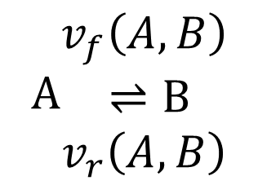
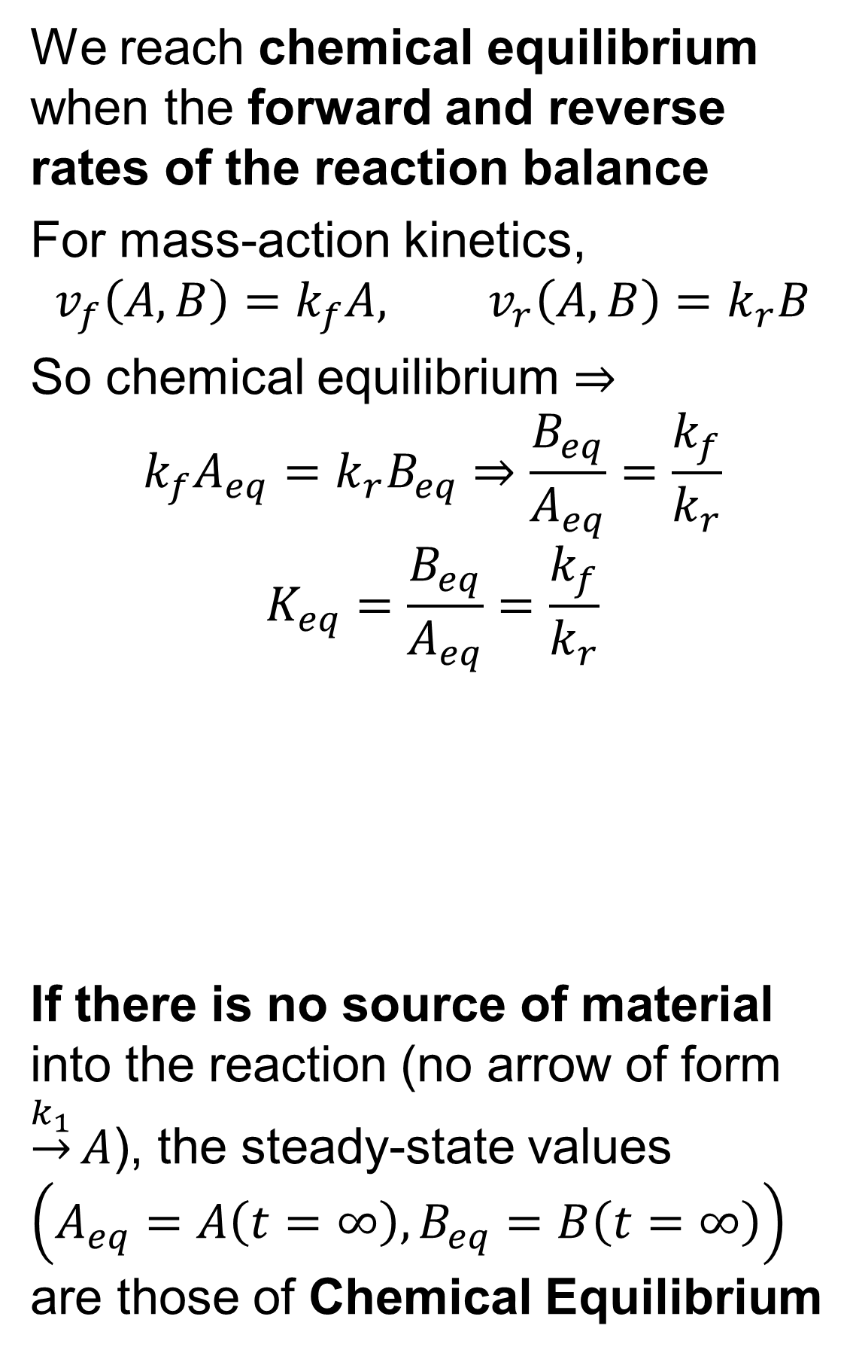
Chemical Equilibrium Conditions
We reach chemical equilibrium when the forward and reverse rates of the reaction balance
For mass-action kinetics,
$$v_{f}\left(A,B\right)=k_{f}A, v_{r}\left(A,B\right)=k_{r}B$$
So chemical equilibrium $⇒$
$$k_{f}A_{eq}=k_{r}B_{eq}⇒\frac{B_{eq}}{A_{eq}}=\frac{k_{f}}{k_{r}}$$
$$K_{eq}=\frac{B_{eq}}{A_{eq}}=\frac{k_{f}}{k_{r}}$$
If there is no source of material into the reaction (no arrow of form $\underset{→}{k_{1}}A$), the steady-state values $\left(A_{eq}=A\left(t=∞\right), B_{eq}=B\left(t=∞\right)\right)$ are those of Chemical Equilibrium
$$A\begin{matrix}v_{f}\left(A,B\right) \\ ⇌B \\ v_{r}\left(A,B\right)\end{matrix}$$

Slide 42
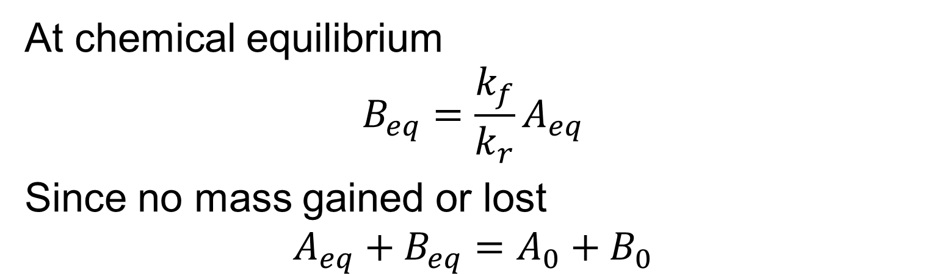
Chemical Equilibrium For a Simple Reaction
At chemical equilibrium
$$B_{eq}=\frac{k_{f}}{k_{r}}A_{eq}$$
Since no mass gained or lost
$$A_{eq}+B_{eq}=A_{0}+B_{0}$$
$$A\begin{matrix}v_{f}\left(A,B\right) \\ ⇌B \\ v_{r}\left(A,B\right)\end{matrix}$$

Slide 43
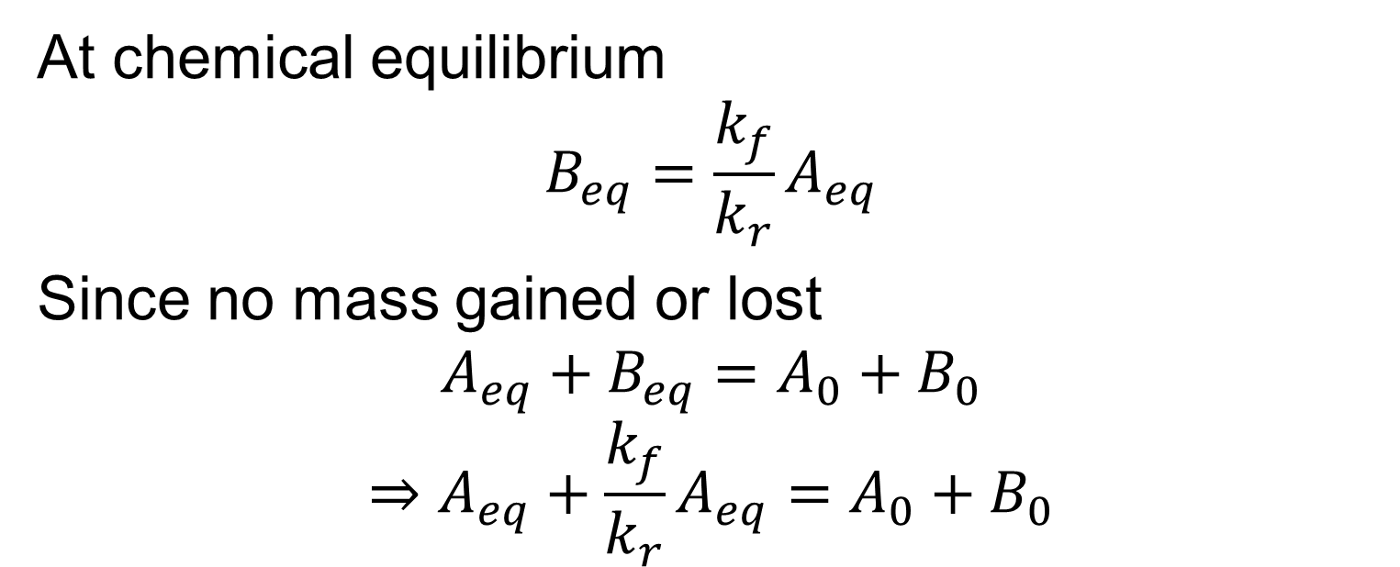
Chemical Equilibrium For a Simple Reaction
At chemical equilibrium
$$B_{eq}=\frac{k_{f}}{k_{r}}A_{eq}$$
Since no mass gained or lost
$$A_{eq}+B_{eq}=A_{0}+B_{0}$$
$$⇒A_{eq}+\frac{k_{f}}{k_{r}}A_{eq}=A_{0}+B_{0}$$
$$A\begin{matrix}v_{f}\left(A,B\right) \\ ⇌B \\ v_{r}\left(A,B\right)\end{matrix}$$

Slide 44
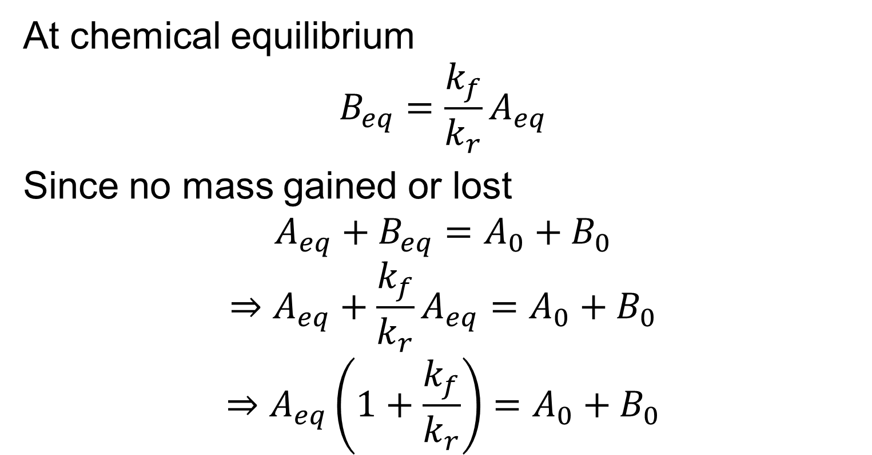
Chemical Equilibrium For a Simple Reaction
At chemical equilibrium
$$B_{eq}=\frac{k_{f}}{k_{r}}A_{eq}$$
Since no mass gained or lost
$$A_{eq}+B_{eq}=A_{0}+B_{0}$$
$$⇒A_{eq}+\frac{k_{f}}{k_{r}}A_{eq}=A_{0}+B_{0}$$
$$⇒A_{eq}\left(1+\frac{k_{f}}{k_{r}}\right)=A_{0}+B_{0}$$
$$A\begin{matrix}v_{f}\left(A,B\right) \\ ⇌B \\ v_{r}\left(A,B\right)\end{matrix}$$

Slide 45

Chemical Equilibrium For a Simple Reaction
At chemical equilibrium
$$B_{eq}=\frac{k_{f}}{k_{r}}A_{eq}$$
Since no mass gained or lost
$$A_{eq}+B_{eq}=A_{0}+B_{0}$$
$$⇒A_{eq}+\frac{k_{f}}{k_{r}}A_{eq}=A_{0}+B_{0}$$
$$⇒A_{eq}\left(1+\frac{k_{f}}{k_{r}}\right)=A_{0}+B_{0}$$
$$A_{eq}=\frac{k_{r}}{{k_{f}+k}_{r}}\left(A_{0}+B_{0}\right), B_{eq}=\frac{k_{f}}{{k_{f}+k}_{r}}\left(A_{0}+B_{0}\right)$$
$$A\begin{matrix}v_{f}\left(A,B\right) \\ ⇌B \\ v_{r}\left(A,B\right)\end{matrix}$$

