Slide 1
Computational Systems Biology for Medical Applications Lecture 11: Parameter Confidence Intervals With Boothstrapping
Joseph L. Hellerstein*
Herbert Sauro**
*eScience Institute, Computer Science & Engineering
**BioEngineering

Slide 2
Downloads
Lecture_11/ at http://shorturl.at/crOS2

Slide 3
The Layers of Modeling
Experimental
Data
Model
Bootstrapping
Cross Validation
Fitting
Parameter Estimates
Model Quality Metrics
Est.
Run
Model
Refined Parameter Estimates
Refined Model Quality Metrics
Parameter Confidence Intervals

Slide 4
Key Software Engineering Practices
Never write the same code (or data) twice
Why? Copies always diverge
Best practices: Use functions for code (and normalized data)
Software components should have well-defined interfaces
Why? Easy to understand, reuse, and modify components
Best practices: No global variables, use functions
Write readable code
Why? So others can understand and extend your work
Best practices: function, good documentation, meaningful names
Write reproducible code
Why? Reproducibility is the foundation of science
Best practices: write tests for each function, no manual steps in computational studies, automated installs

Slide 5
Agenda
Bootstrapping steps
Bootstrapping details (Jupyter notebook)
Class exercises

Slide 6
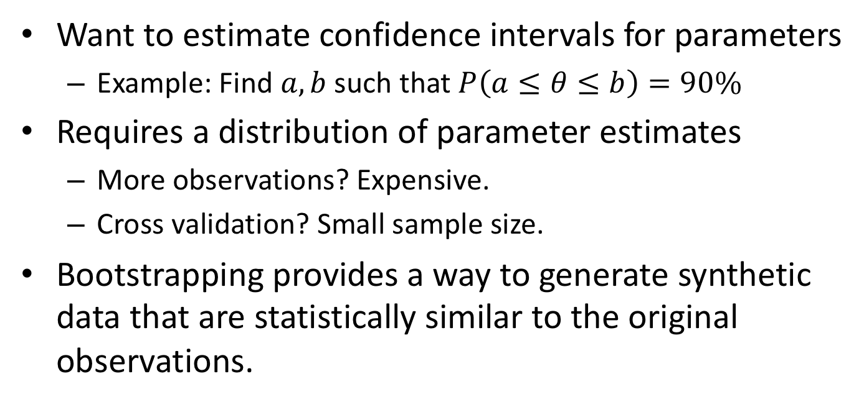
Bootstrapping
Want to estimate confidence intervals for parameters
Example: Find $a,b$ such that $P\left(a≤θ≤b\right)=90\%$
Requires a distribution of parameter estimates
More observations? Expensive.
Cross validation? Small sample size.
Bootstrapping provides a way to generate synthetic data that are statistically similar to the original observations.

Slide 7
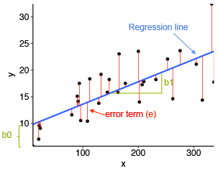

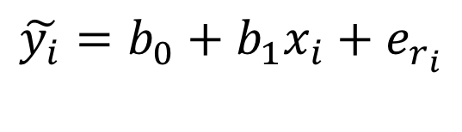


Principle of Bootstrapping
Use the residuals from a good model to generate synthetic observations.
The Model
The Fit
$$y_{i}=β_{0}+β_{1}x_{i}+ε_{i}$$
$$y$$
Parameters
i.i.d. random variable
$$x$$
Synthetic
Data
{
$$\tilde{y_{i}}=b_{0}+b_{1}x_{i}+e_{r_{i}}$$
{
Randomly chosen residual
Model estimate

Slide 8
Principles in Bootstrapping
Construct a good model.
Construct synthetic data from model estimates + randomly chosen residuals.
Estimate parameters.
Estimate residuals.
Construct confidence intervals from parameter estimates.

Slide 10
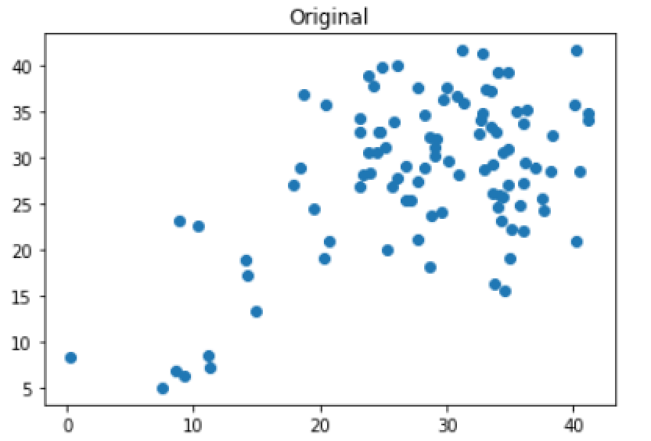
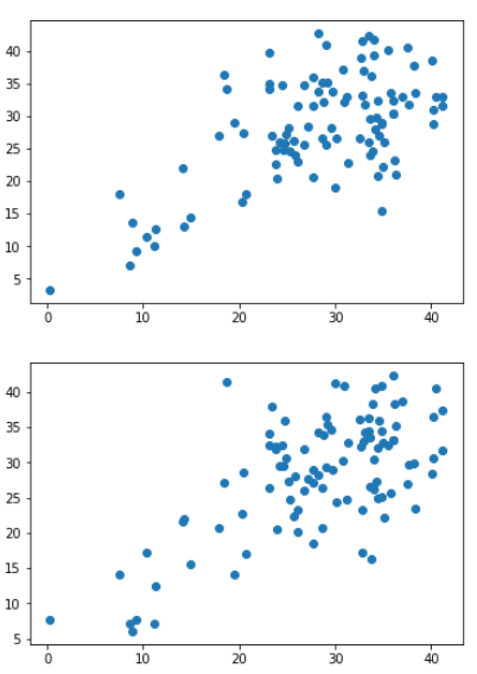
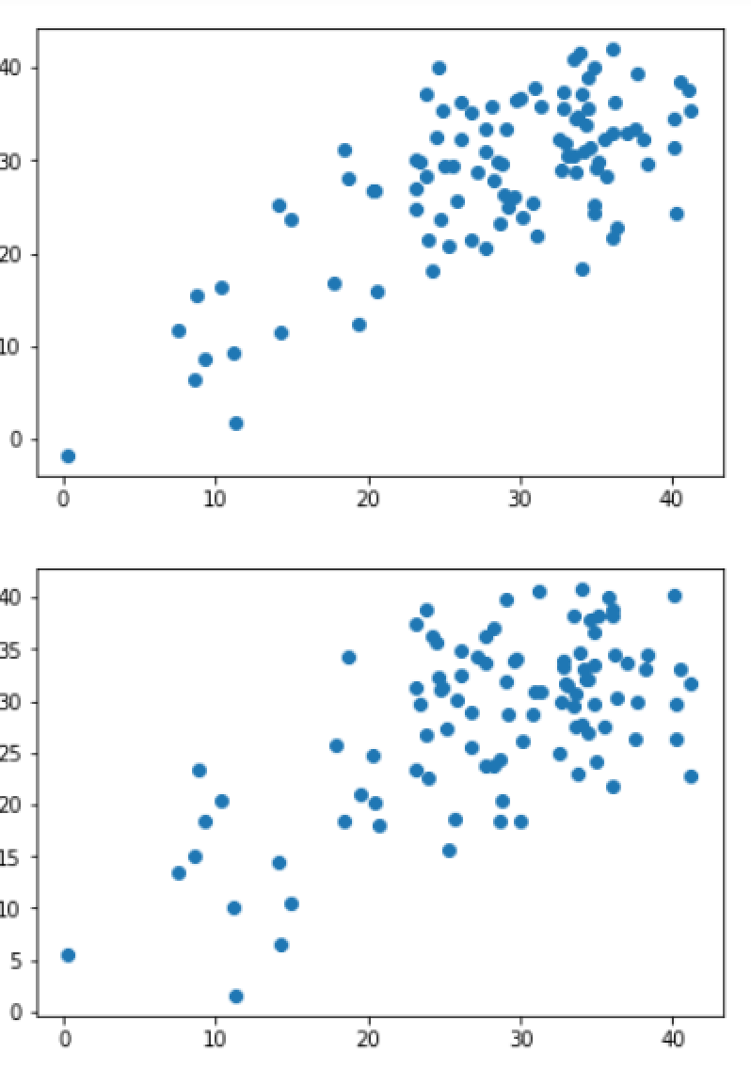
Synthetic Observations With Bootstrapping

Slide 11
Generating a Synthetic Response Data
def generateData(y_obs, y_fit):
"""
:param np.array y_obs
:param np.array y_fit
:return np.array: bootstrap data
"""
residuals = y_obs - y_fit
length = len(y_obs)
residuals = residuals.reshape(length)
samples = np.random.randint(0, length, length)
result = y_fit + residuals[samples]
result = result.reshape(length)
return result

Slide 12
Exercise

