Slide 1
Computational Systems Biology for Medical Applications Lecture 11: Estimating Parameter Confidence Intervals With Boothstrapping
Joseph L. Hellerstein*
Herbert Sauro**
*eScience Institute, Computer Science & Engineering
**BioEngineering

Slide 2
Downloads
http://shorturl.at/crOS2
Open Lecture_11
Download all files into the same directory

Slide 3
The Layers of Modeling
Experimental
Data
Model
Bootstrapping
Cross Validation
Fitting
Parameter Estimates
Model Quality Metrics
Est.
Run
Model
Refined Parameter Estimates
Refined Model Quality Metrics
Parameter Confidence Intervals

Slide 4
Agenda
Bootstrapping steps
Bootstrapping details (Jupyter notebook)
Class exercises

Slide 5
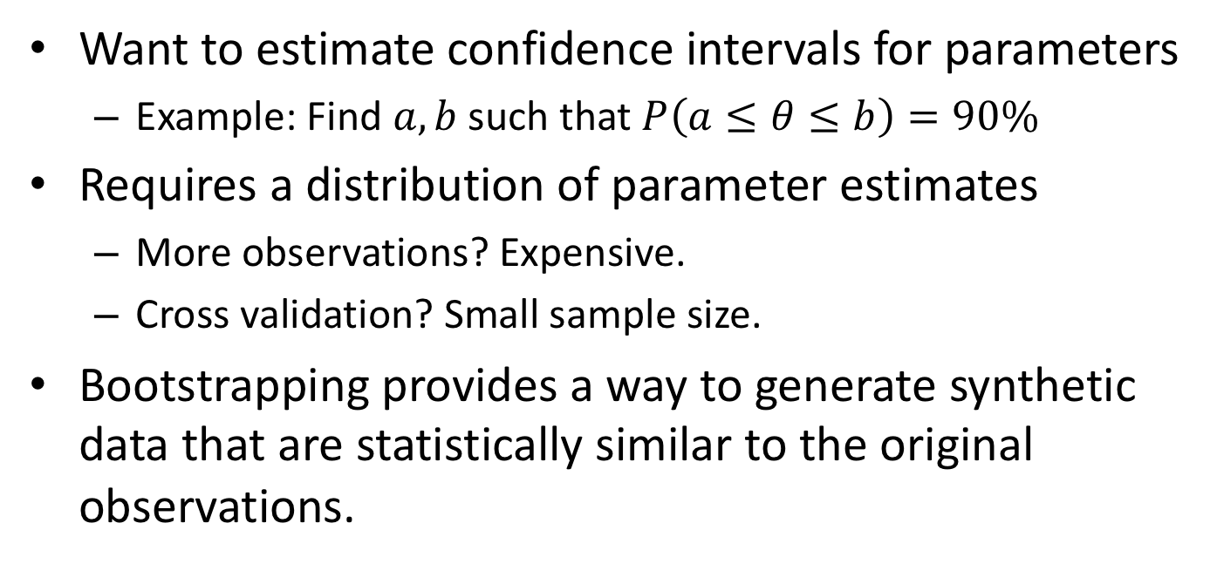
Bootstrapping
Want to estimate confidence intervals for parameters
Example: Find $a,b$ such that $P\left(a≤θ≤b\right)=90\%$
Requires a distribution of parameter estimates
More observations? Expensive.
Cross validation? Small sample size.
Bootstrapping provides a way to generate synthetic data that are statistically similar to the original observations.

Slide 6
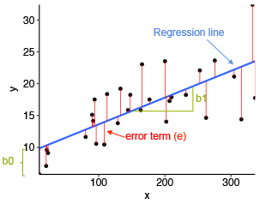

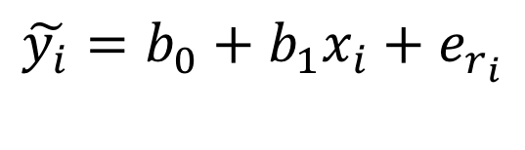


Principle of Bootstrapping
Use the residuals from a good model to generate synthetic observations.
The Model
The Fit
$$y_{i}=β_{0}+β_{1}x_{i}+ε_{i}$$
$$y$$
Parameters
i.i.d. random variable
$$x$$
Synthetic
Data
{
$$\tilde{y_{i}}=b_{0}+b_{1}x_{i}+e_{r_{i}}$$
{
Randomly chosen residual
Model estimate

Slide 7
Bootstrapping Workflow
Construct a good model.
Construct a collection of parameter fits.
Compute residuals.
Create synthetic observations.
Fit parameters.
Calculate the mean and standard deviations of the parameter estimates.
Construct confidence intervals for parameters.

Slide 8
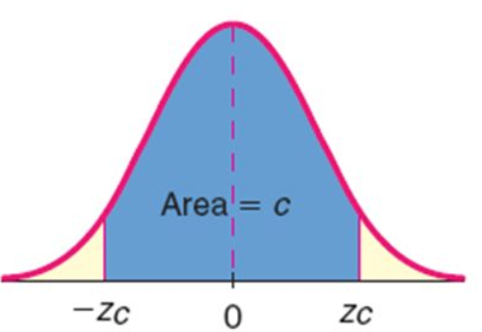
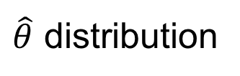

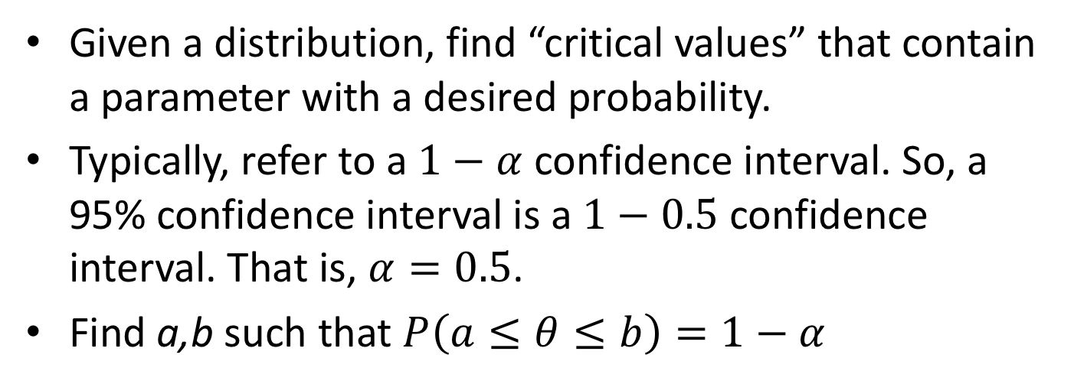





Confidence Intervals
Given a distribution, find “critical values” that contain a parameter with a desired probability.
Typically, refer to a $1−α$ confidence interval. So, a 95% confidence interval is a $1−0.5$ confidence interval. That is, $α=0.5$.
Find a,b such that $P\left(a≤θ≤b\right)=1−α$
$\hat{θ}$ distribution
Area = $\frac{α}{2}$
Area $=1−α$
Area = $\frac{α}{2}$
$$a$$
$$θ$$
$$b$$

Slide 9


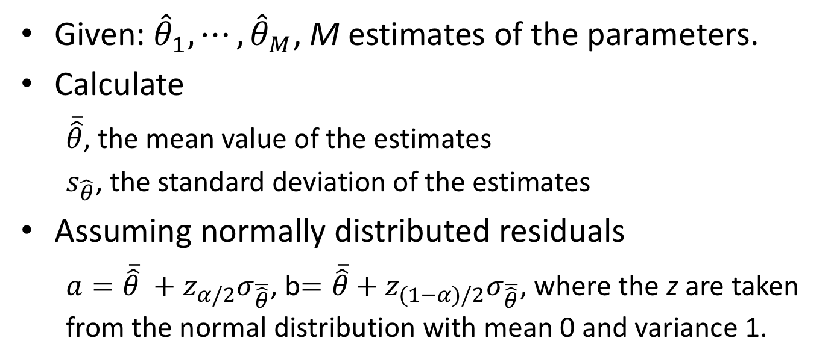





Constructing Confidence Intervals
$\hat{θ}$ distribution
Area = $\frac{α}{2}$
Area $=1−α$
Area = $\frac{α}{2}$
$$a$$
$$θ$$
$$b$$
Given: ${\hat{θ}}_{1},⋯,{\hat{θ}}_{M}$, M estimates of the parameters.
Calculate
$\overline{\hat{θ}}$, the mean value of the estimates
$s_{\hat{θ}}$, the standard deviation of the estimates
Assuming normally distributed residuals
$a={\overline{\hat{θ}} +z}_{α/2}σ_{\overline{\hat{θ}}}$, b$={\overline{\hat{θ}} \text{+} z}_{(1−α)/2}σ_{\overline{\hat{θ}}}$, where the z are taken from the normal distribution with mean 0 and variance 1.

Slide 10
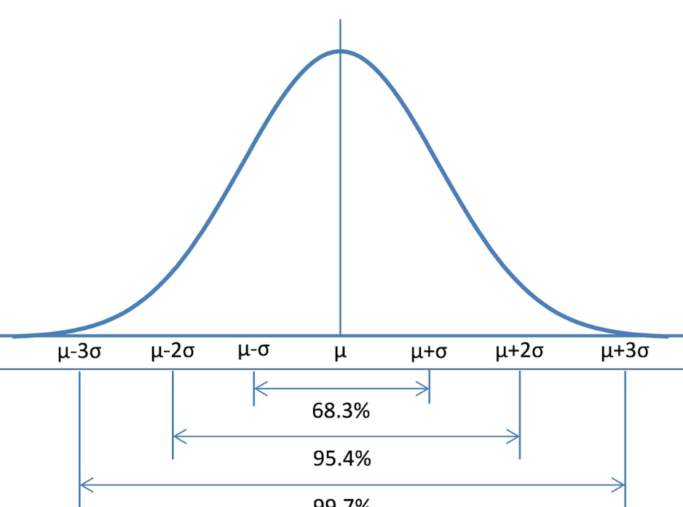


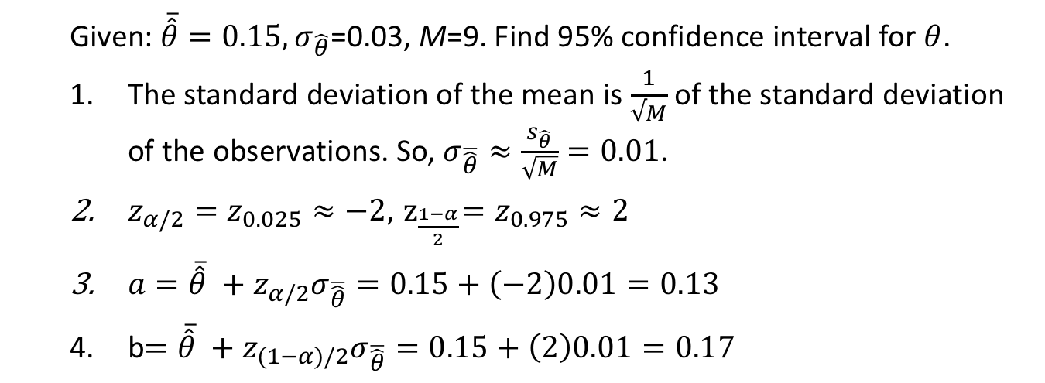





Confidence Interval Calculation
$\hat{θ}$ distribution
Normal distribution
Area = $\frac{θ}{2}$
Area $=1−α$
Area = $\frac{θ}{2}$
$$a$$
$$θ$$
$$b$$
Given: $\overline{\hat{θ}}=0.15, σ_{\hat{θ}}$=0.03, M=9. Find 95% confidence interval for $θ$.
The standard deviation of the mean is $\frac{1}{√M}$ of the standard deviation of the observations. So, $σ_{\overline{\hat{θ}}}≈\frac{s_{\hat{θ}}}{\sqrt{M}}=0.01$.
$z_{α/2}=z_{0.025}≈−2, { z}_{\frac{1−α}{2}}=z_{0.975}≈2$
$a={\overline{\hat{θ}} +z}_{α/2}σ_{\overline{\hat{θ}}}=0.15+\left(−2\right)0.01=0.13$
b$={\overline{\hat{θ}} +z}_{(1−α)/2}σ_{\overline{\hat{θ}}}=0.15+\left(2\right)0.01=0.17$

Slide 11
Go To Notebook for Lecture 11

Slide 12
Backup

Slide 13
Generating a Synthetic Response Data
def generateData(y_obs, y_fit):
"""
:param np.array y_obs
:param np.array y_fit
:return np.array: bootstrap data
"""
residuals = y_obs - y_fit
length = len(y_obs)
residuals = residuals.reshape(length)
samples = np.random.randint(0, length, length)
result = y_fit + residuals[samples]
result = result.reshape(length)
return result

Slide 14
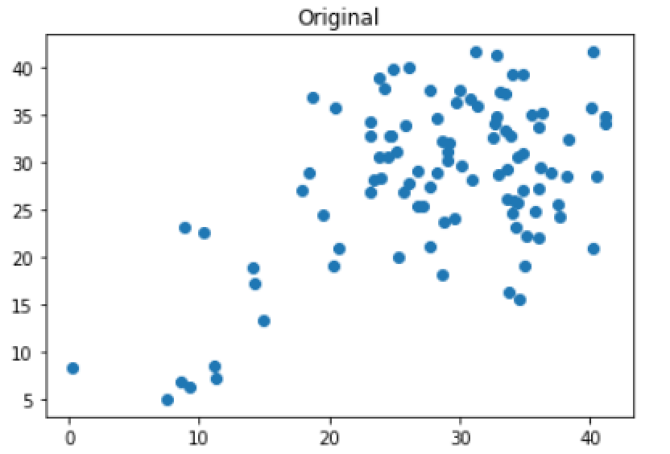
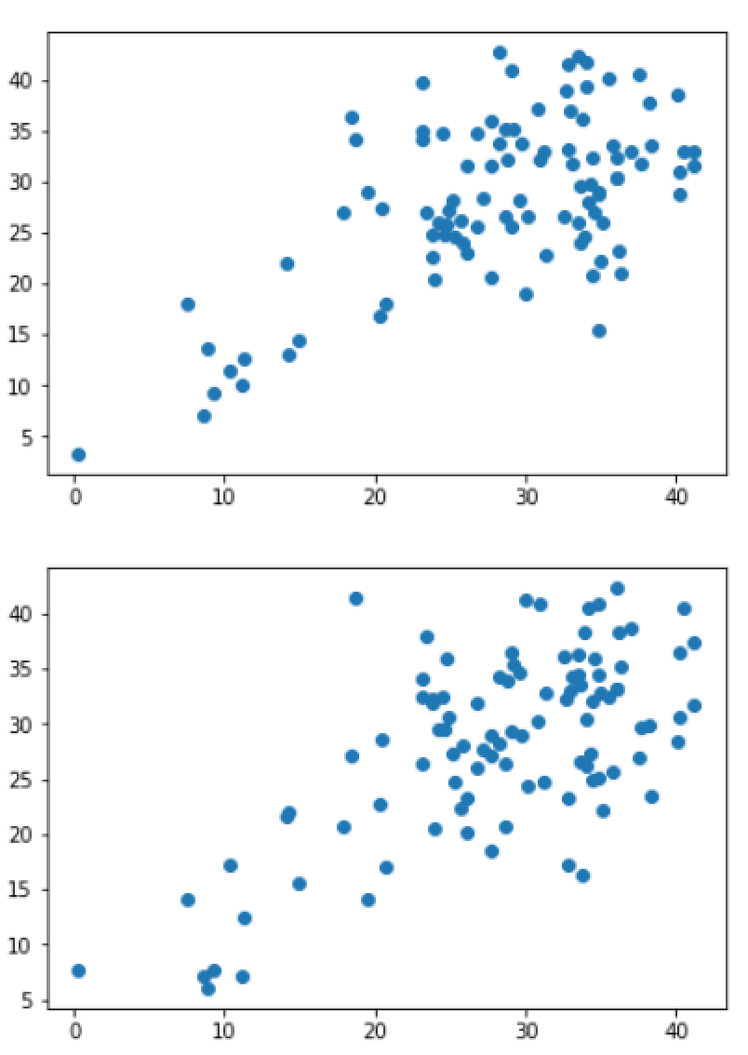
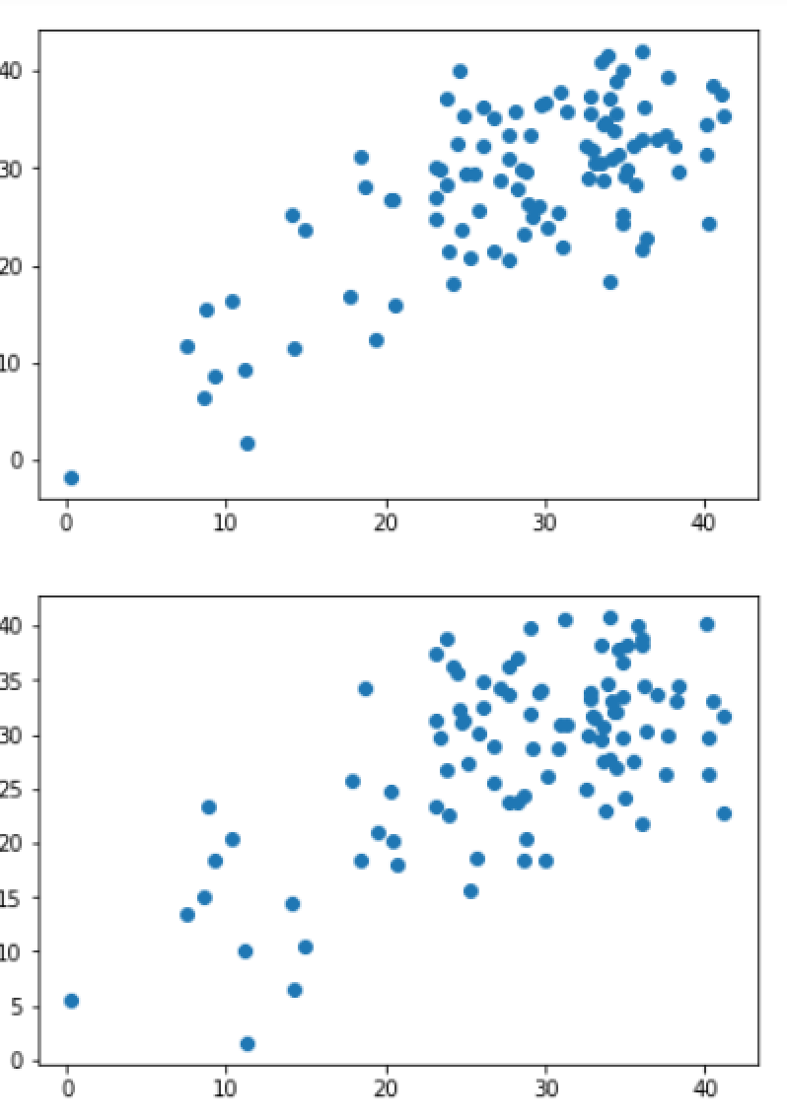
Synthetic Observations With Bootstrapping

