Slide 1
Computational Systems Biology for Medical Applications Modeling Fitting: Parameter Optimization Techniques
Joseph L. Hellerstein*
Herbert Sauro**
*eScience Institute, Computer Science & Engineering
**BioEngineering

Slide 2
Downloads
Lecture_8/ at http://shorturl.at/crOS2

Slide 3
Errata

Slide 4
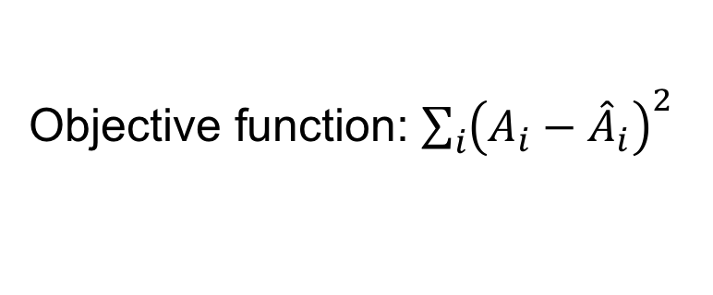
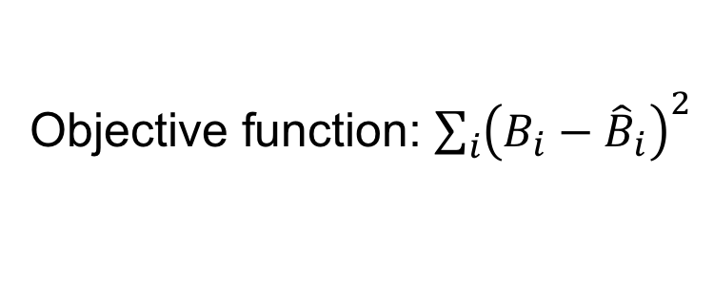

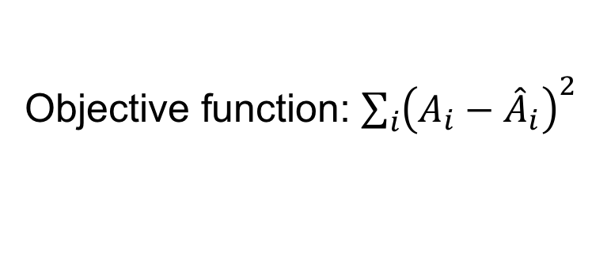


Correction to 2 Parameter Model
Choosing the right objective function
Model 1
$$A→B;k_{1}A$$
Objective function: ${\sum_{i}{\left(A_{i}−{\hat{A}}_{i}\right)}}^{2}$
Model 2
$$A→B;k_{1}A$$
Objective function: ${\sum_{i}{\left(A_{i}−{\hat{A}}_{i}\right)}}^{2}$
$$B→C;k_{2}B$$
Objective function: ${\sum_{i}{\left(B_{i}−{\hat{B}}_{i}\right)}}^{2}$
Why?

Slide 5
Review

Slide 6
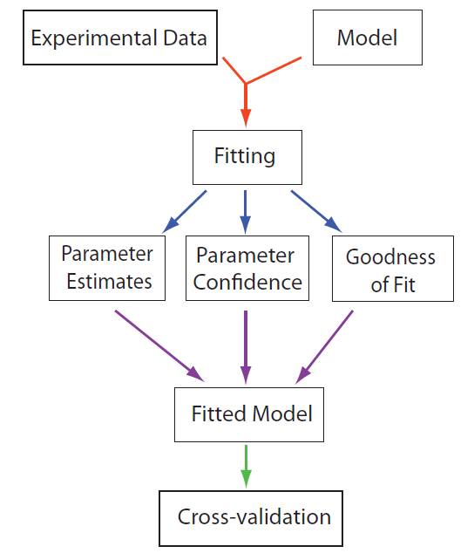
Model Fitting Work flow

Slide 7
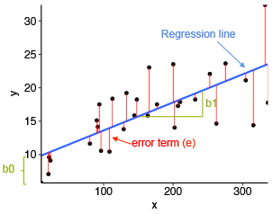




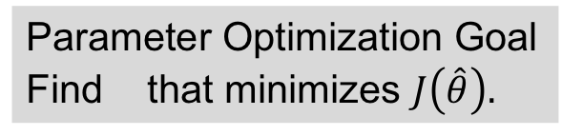
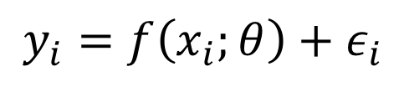

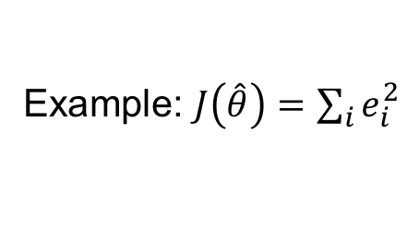


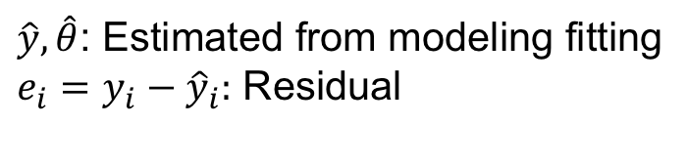
Parameter Optimization Summary
The Model
Ex: Linear Model
$$y_{i}=f\left(x_{i};θ\right)+ε_{i}$$
$$y_{i}=θ_{0}+θ_{1}x_{i}+ε_{i}$$
Observations
residuals
Model
$$e_{i}$$
Explanatory variables
Parameters
$$\hat{y}$$
predicted
Noise (random variable) – i.i.d.
$${\hat{θ}}_{1}$$
$${\hat{θ}}_{0}$$
Parameter Optimization Goal
Find that minimizes $J\left(\hat{θ}\right).$
$\hat{y}, \hat{θ}$: Estimated from modeling fitting
$e_{i}=y_{i}−{\hat{y}}_{i}:$ Residual
$$\hat{θ}$$
$J\left(\hat{θ}\right):$Non-zero measure of model quality
Example: $J\left(\hat{θ}\right)=\sum_{i}{e_{i}^{2}}$

Slide 8
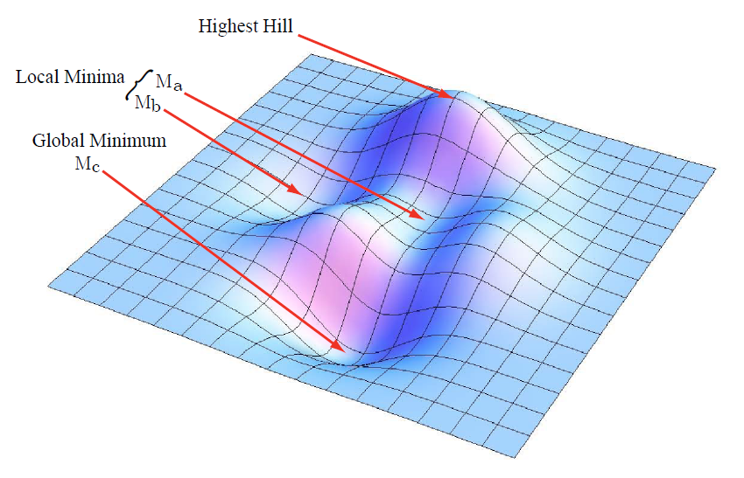



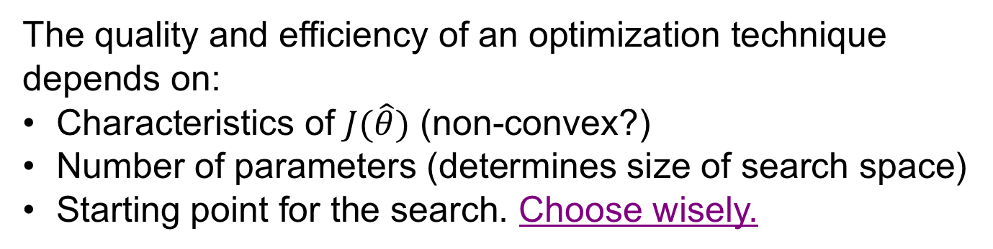
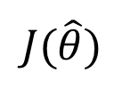
Parameter Optimization Minimize $J(\hat{θ})$
$$J(\hat{θ})$$
$${\hat{θ}}_{1}$$
$${\hat{θ}}_{0}$$
The quality and efficiency of an optimization technique
depends on:
Characteristics of $J(\hat{θ})$ (non-convex?)
Number of parameters (determines size of search space)
Starting point for the search. Choose wisely.
Notes:
Times in video: 0, 1:50, 2:20

Slide 9
Optimization Techniques

Slide 10
Optimization Techniques
Gradient decent
Gauss-Newton
Lavenberg-Marquardt
Simulated annealing
Differential evolution

Slide 11
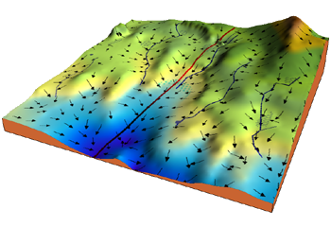
Gradient Descent
It’s the algorithm, that rivers and
streams use to get to the sea.
$$J(\hat{θ})$$
$${\hat{θ}}_{1}$$
$${\hat{θ}}_{0}$$

Slide 12
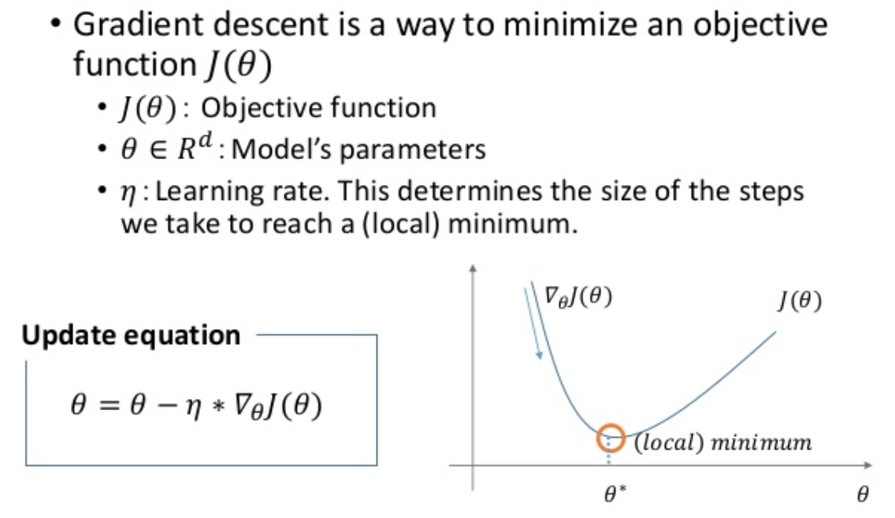

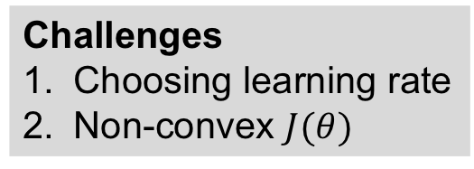
Gradient Descent In Brief
$$R^{M}$$
Challenges
Choosing learning rate
Non-convex $J(θ)$

Slide 13
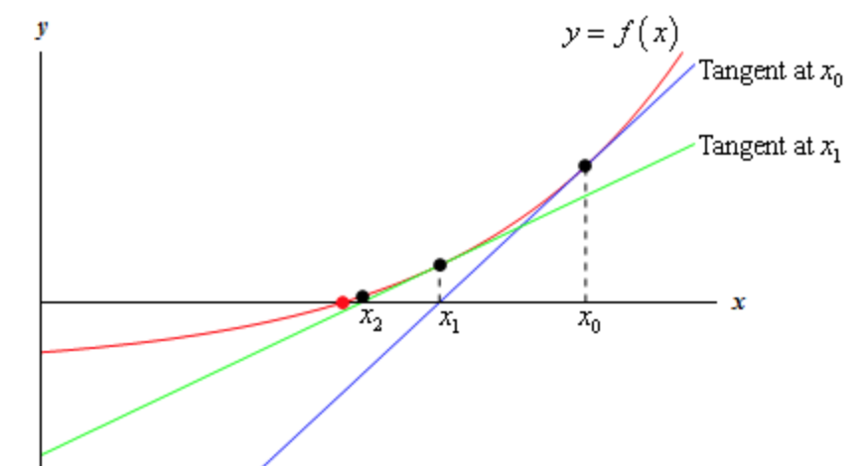


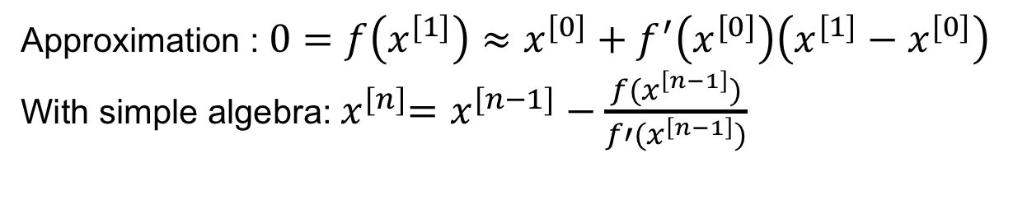



(Gauss) Newton
Extends Newton’s method for finding roots.
Newton’s method for finding roots, that is where f(x)=0.
Tangent at $x^{[0]}$
Tangent at $x^{[1]}$
$$x^{[2]}$$
$$x^{[1]}$$
$$x^{[0]}$$
Approximation : $0=f\left(x^{[1]}\right)≈x^{[0]}+f^{′}\left(x^{[0]}\right)\left(x^{[1]}−x^{[0]}\right)$
With simple algebra:${ x}^{[n]}=x^{[n−1]}−\frac{f(x^{\left[n−1\right]})}{f′(x^{\left[n−1\right]})}$

Slide 14
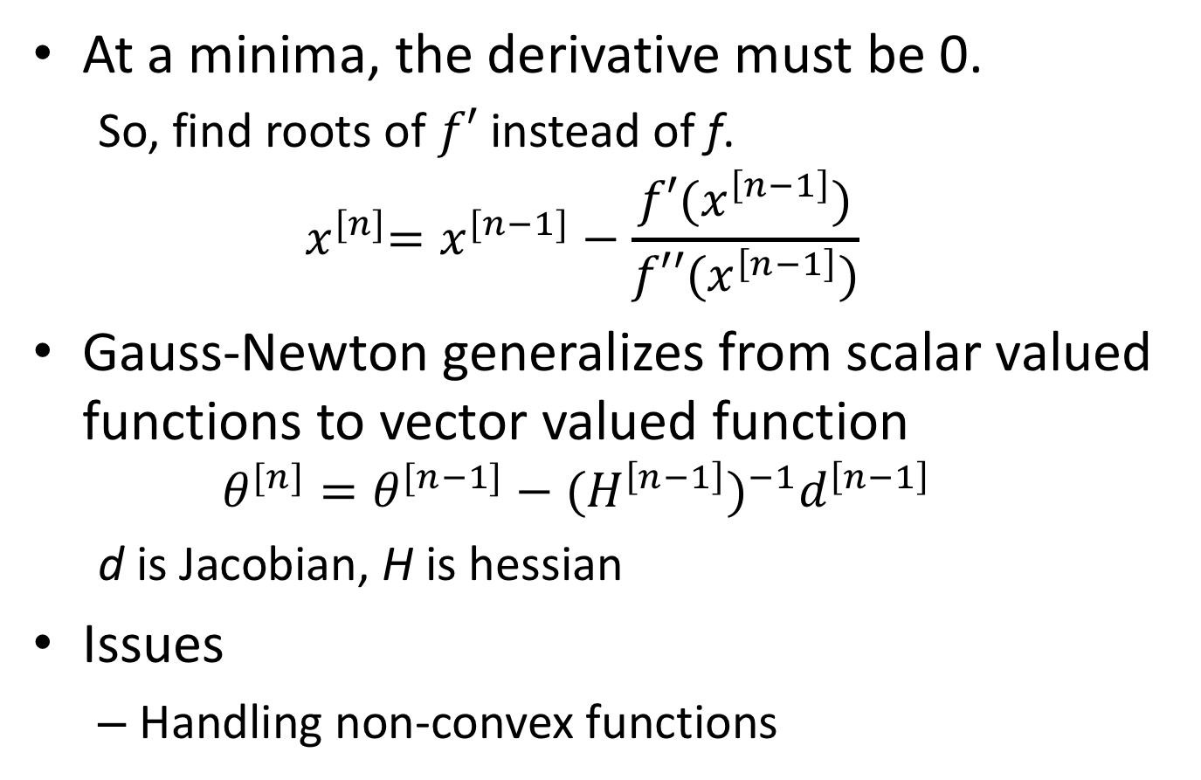
Gauss-Newton & Minima
At a minima, the derivative must be 0.
So, find roots of $f′$ instead of f.
$${ x}^{[n]}=x^{[n−1]}−\frac{f′(x^{\left[n−1\right]})}{f′′(x^{\left[n−1\right]})}$$
Gauss-Newton generalizes from scalar valued functions to vector valued function
$$θ^{[n]}=θ^{[n−1]}−{{(H}^{\left[n−1\right]})}^{−1}d^{\left[n−1\right]}$$
d is Jacobian, H is hessian
Issues
Handling non-convex functions

Slide 15
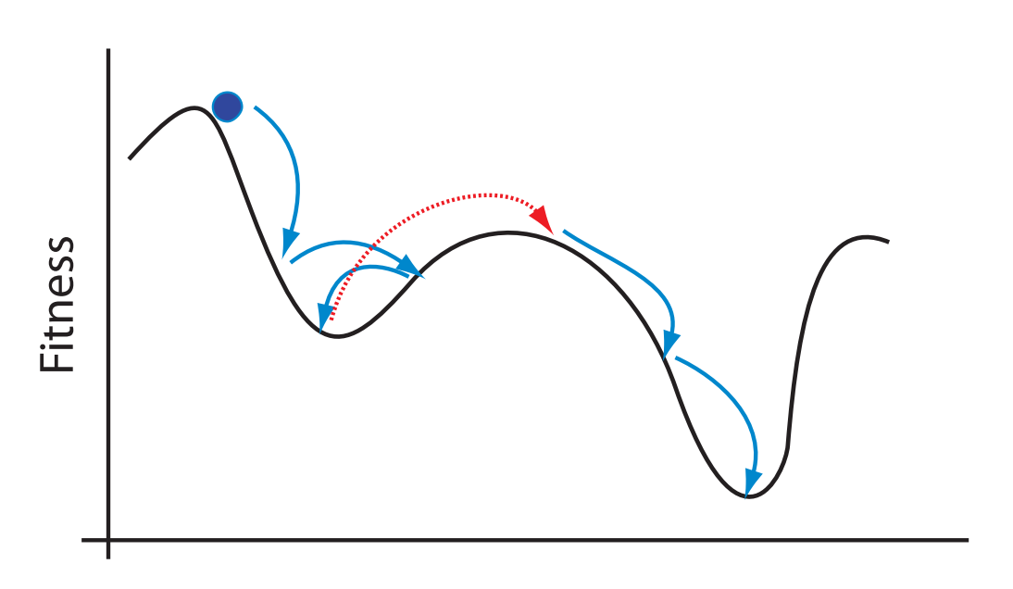
Simulated Annealing
Addresses local minima
Let s = s₀
For k = 0 through k_{max} (exclusive):
T ← temperature( k_{max}/(k+1) )
s_{new} ← random neighbour(s)
If P(E(s), E(s_{new}), T) ≥ random(0, 1):
s ← s_{new}
Output: the final state s

Slide 16
Differential Evolution
Basics
Solutions are vectors
Population of agents (candidate solutions
Create new agents by combining existing agents (combinations of vector elements)
Keep agents that improve the objective function
Does not consider gradients

Slide 17
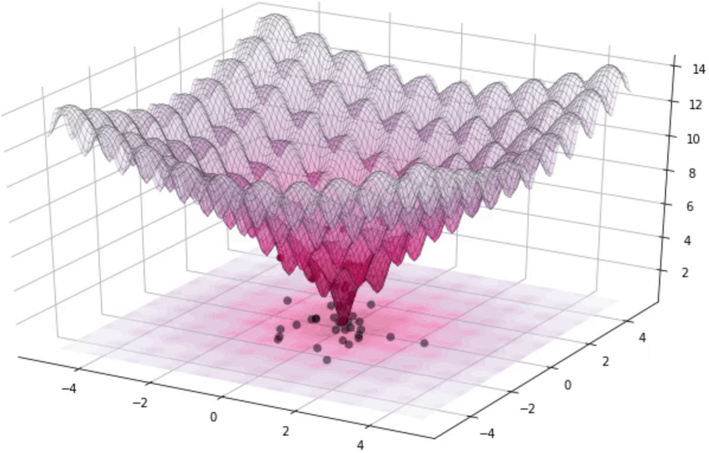
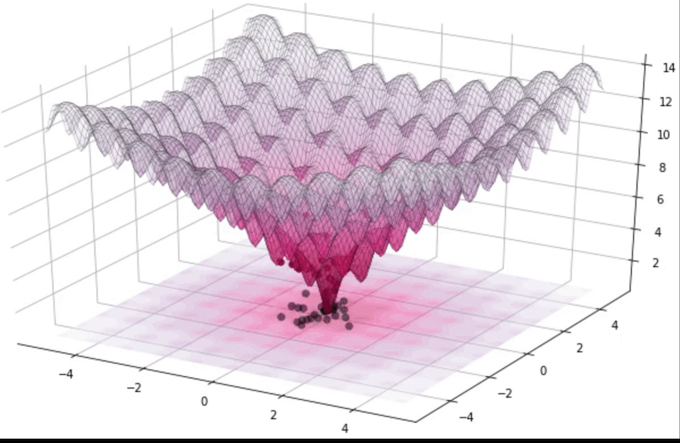

Illustration of Differential Evolution

Slide 18
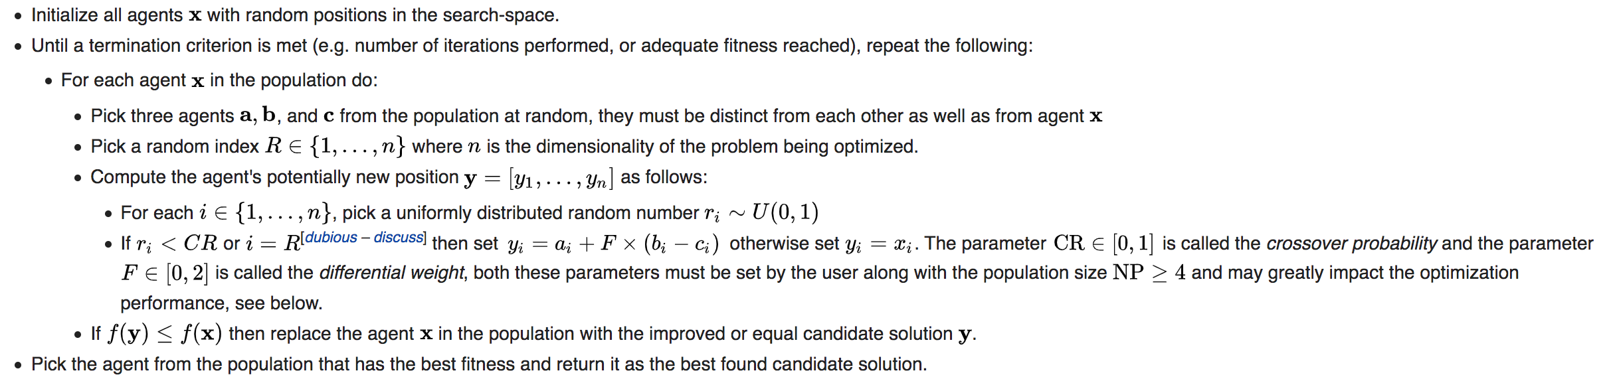
Details of Differential Evolution

Slide 19
Experimental Design

Slide 20
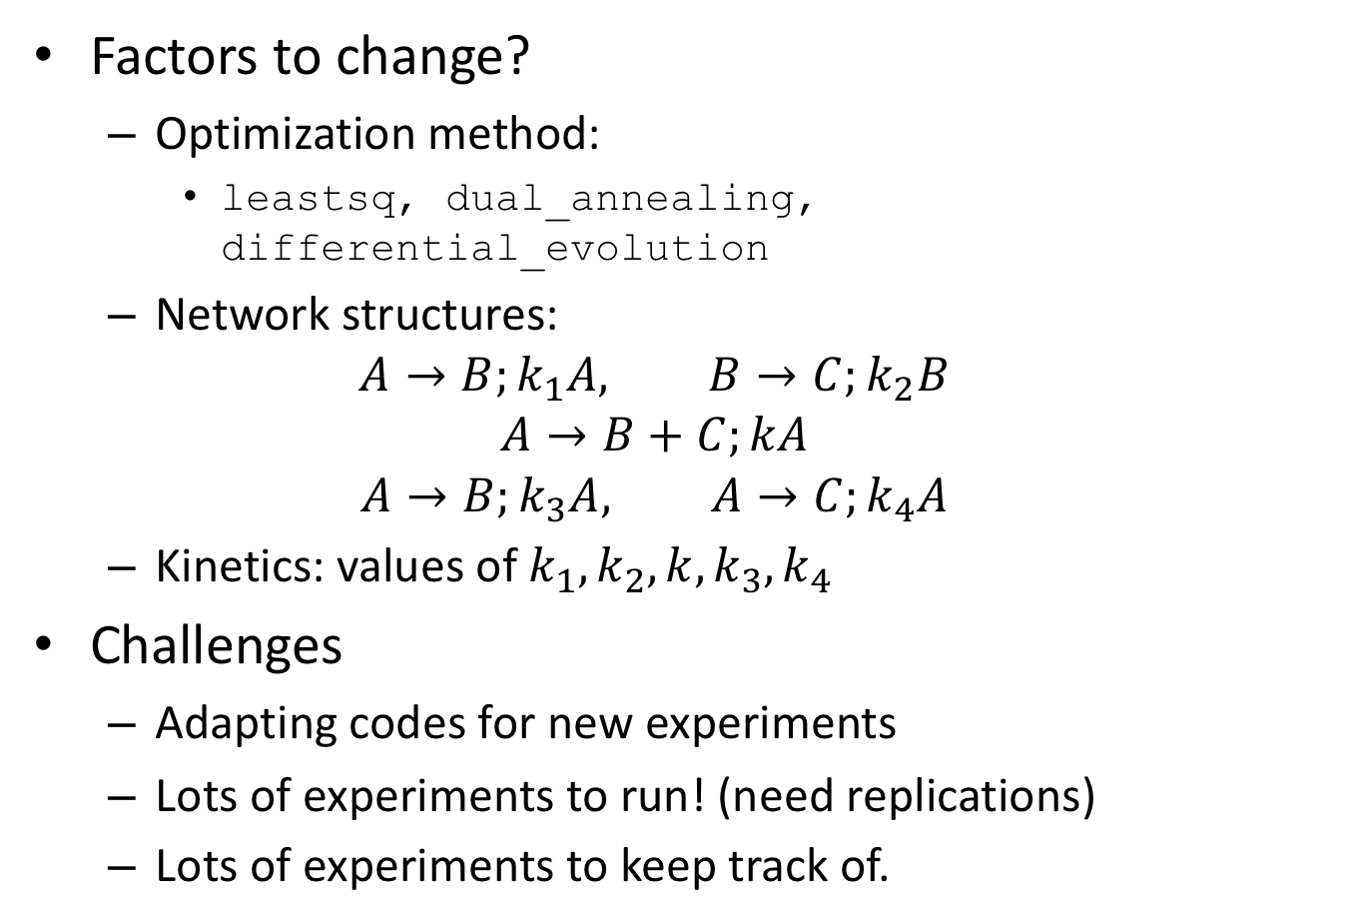
Question: Which optimization method is best?
Factors to change?
Optimization method:
leastsq, dual_annealing, differential_evolution
Network structures:
$$A→B;k_{1}A, B→C;k_{2}B$$
$$A→B+C;kA$$
$$A→B;k_{3}A, A→C;k_{4}A$$
Kinetics: values of $k_{1},k_{2},k,k_{3},k_{4}$
Challenges
Adapting codes for new experiments
Lots of experiments to run! (need replications)
Lots of experiments to keep track of.

Slide 21
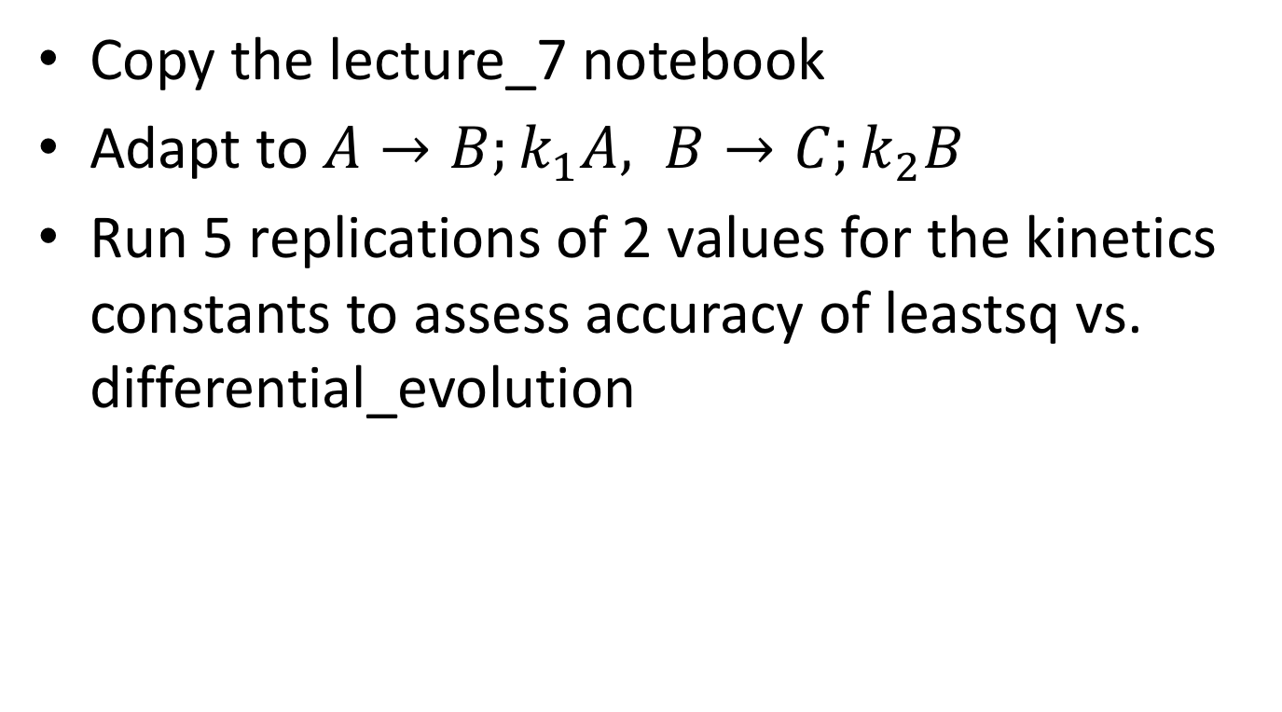
Class Exercise
Copy the lecture_7 notebook
Adapt to $A→B;k_{1}A, B→C;k_{2}B$
Run 5 replications of 2 values for the kinetics constants to assess accuracy of leastsq vs. differential_evolution

Slide 22
More Sophisticated Infrastructure
Don’t want to be constantly changing notebook codes
What is a more convenient computational abstraction?

