Slide 1
Computational Systems Biology for Medical Applications Lecture 9: Model Fitting-Dealing With Uncertainty
Joseph L. Hellerstein*
Herbert Sauro**
*eScience Institute, Computer Science & Engineering
**BioEngineering

Slide 2
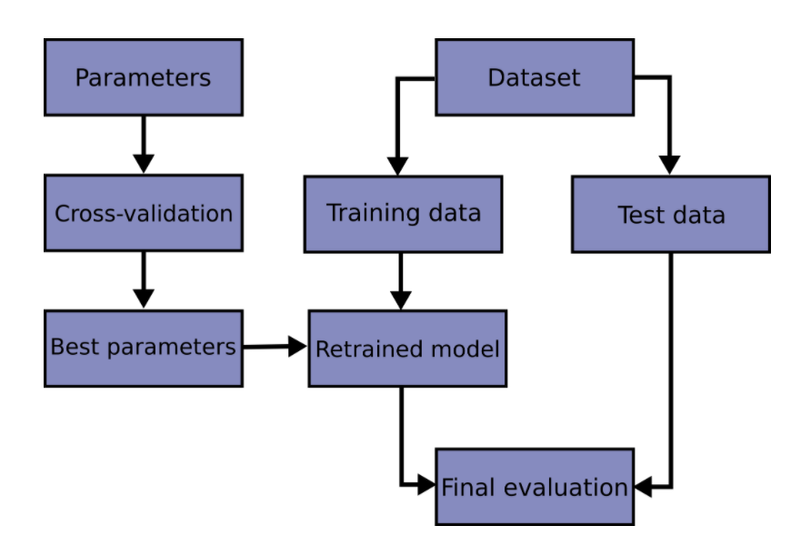
Workflow For Fitting With Uncertainty

Slide 3
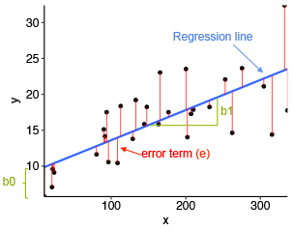




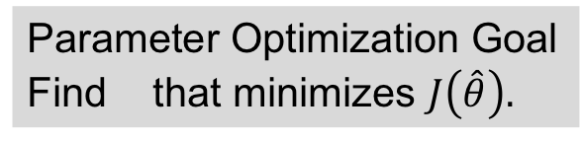
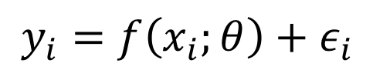

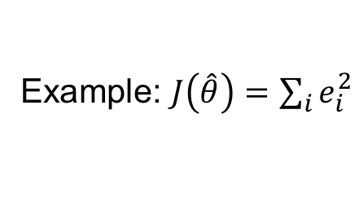


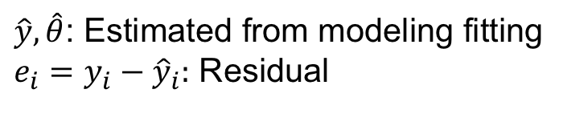
Parameter Optimization Summary
The Model
Ex: Linear Model
$$y_{i}=f\left(x_{i};θ\right)+ε_{i}$$
$$y_{i}=θ_{0}+θ_{1}x_{i}+ε_{i}$$
Observations
residuals
Model
$$e_{i}$$
Explanatory variables
K Parameters
$$\hat{y}$$
predicted
Noise (random variable) – i.i.d.
$${\hat{θ}}_{1}$$
$${\hat{θ}}_{0}$$
Parameter Optimization Goal
Find that minimizes $J\left(\hat{θ}\right).$
$\hat{y}, \hat{θ}$: Estimated from modeling fitting
$e_{i}=y_{i}−{\hat{y}}_{i}:$ Residual
$$\hat{θ}$$
$J\left(\hat{θ}\right):$Non-zero measure of model quality
Example: $J\left(\hat{θ}\right)=\sum_{i}{e_{i}^{2}}$

Slide 4
Agenda
Statistical philosophy for modeling
Assessing model quality
R², Chi-Square, AIC, cross validation
Parameter confidence intervals
Cross validation, bootstrapping

Slide 5
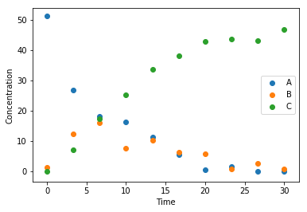
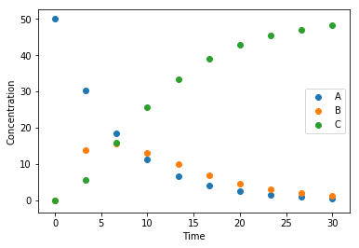
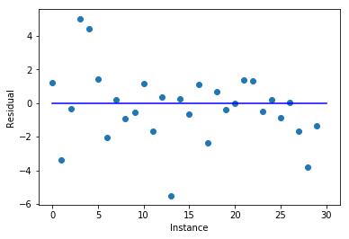
Statistical Philosophy of Models It’s All About Residuals
Observations
A statistical model is good if
Residuals have small magnitude
Residuals are i.i.d.
Residuals have no pattern
Ideally, residuals are normally distributed
Model
Residuals

Slide 6
Assessing Model Quality

Slide 7


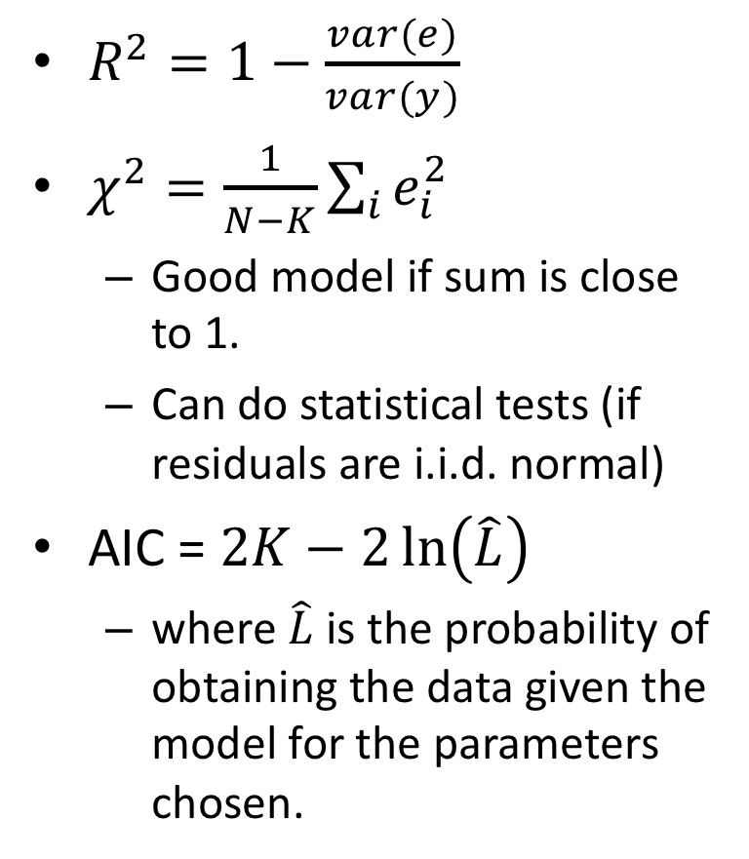

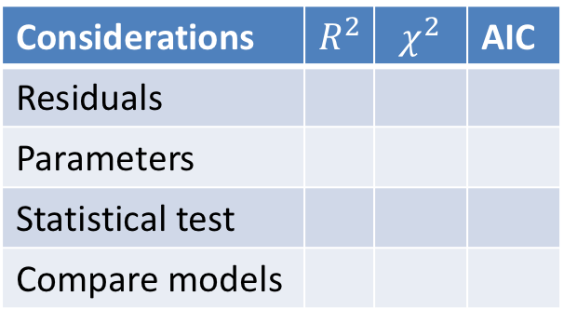
Metrics for Model Quality $y=f(x;θ)$; $e=y−\hat{y}$
$R^{2}=1−\frac{var(e)}{var(y)}$
$χ^{2}=\frac{1}{N−K}\sum_{i}{e_{i}^{2}}$
Good model if sum is close to 1.
Can do statistical tests (if residuals are i.i.d. normal)
AIC = $2K−2\ln\left(\hat{L}\right)$
where $\hat{L}$ is the probability of obtaining the data given the model for the parameters chosen.
Considerations | $$R^{2}$$ | $$χ^{2}$$ | AIC
Residuals
Parameters
Statistical test
Compare models

Slide 8




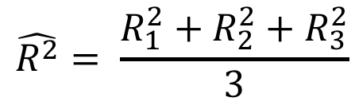


Cross Validation Summary
Divide full data set into N Folds
Data
Train 1
Test 1
{
$$R_{1}^{2}$$
Construct N training data sets and N test data sets
$${\hat{θ}}^{[1]}$$
Train 2
Test 2
{
$$R_{2}^{2}$$
$${\hat{θ}}^{[2]}$$
Obtain N parameter fits and model evaluations
Train 3
Test 3
{
$$R_{3}^{2}$$
$${\hat{θ}}^{[3]}$$
Report statistics of the evaluations
$$\hat{R^{2}}= \frac{R_{1}^{2}+R_{2}^{2}+R_{3}^{2}}{3}$$

Slide 9
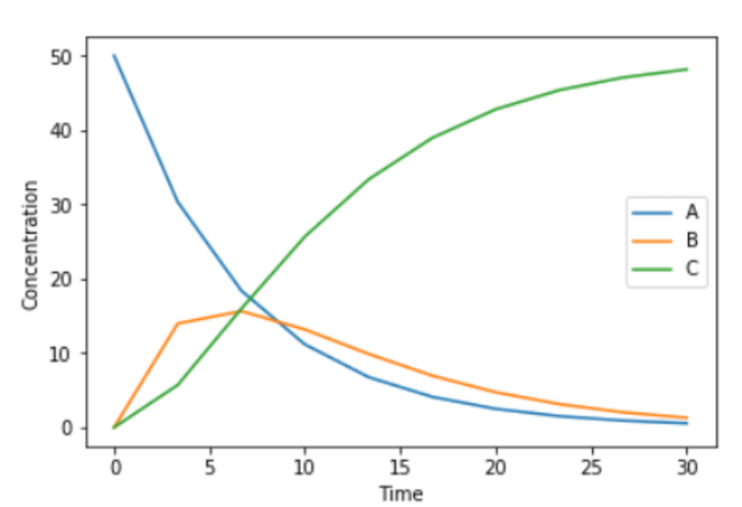
Choosing Folds Choose Wisely
X
Folds have very different functional characteristics
Folds have similar functional characteristics

Slide 10
Python Support for Cross Validation
import numpy as np
from sklearn.model_selection import train_test_split
from sklearn import datasets
from sklearn import svm
X, y = datasets.load_iris(return_X_y=True)
X_train, X_test, y_train, y_test = train_test_split(
X, y, test_size=0.4)
But be careful because folds are chosen randomly.

