Slide 1
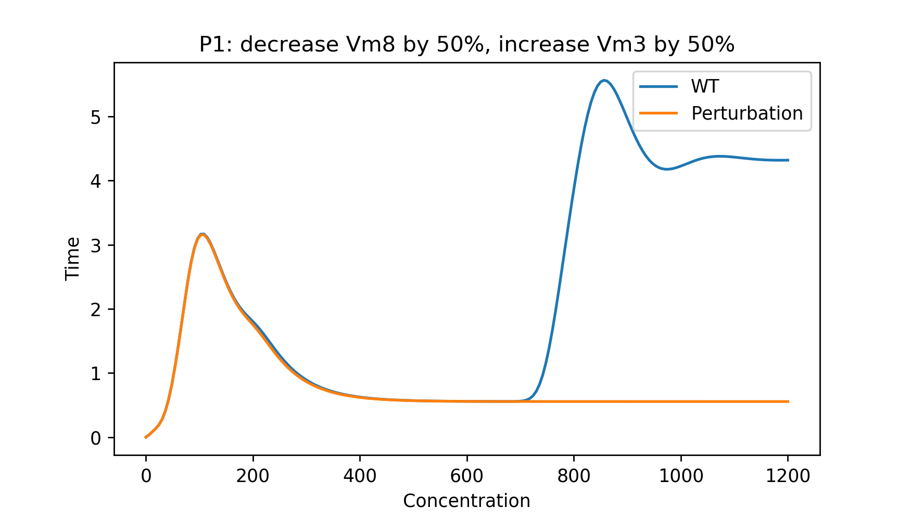
Stress Tests on P1

Slide 2
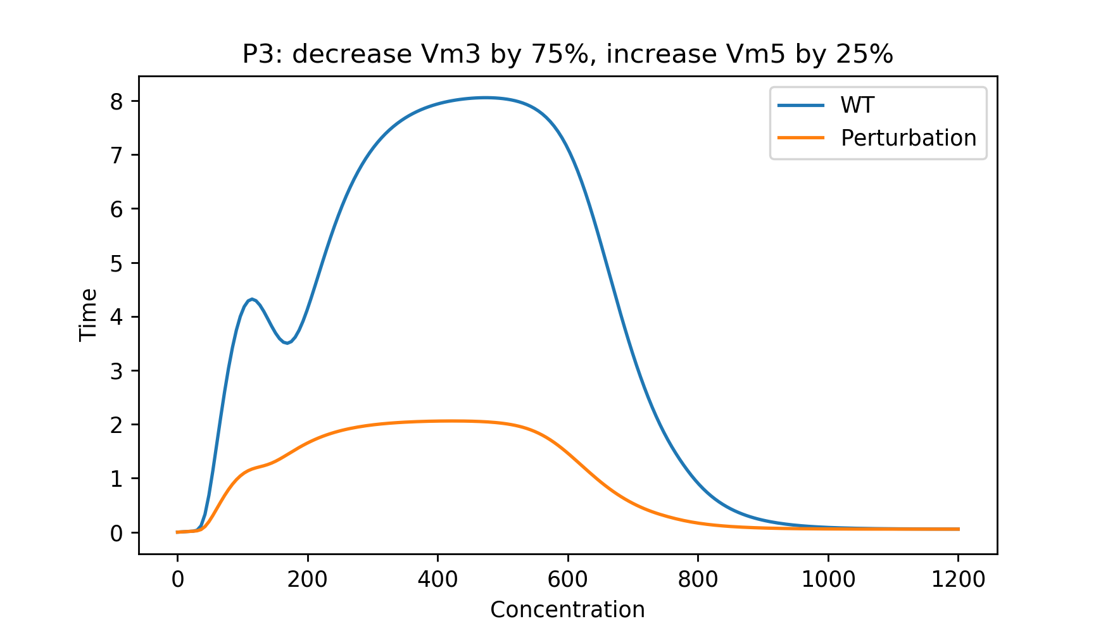
Stress Tests on P3

Slide 3
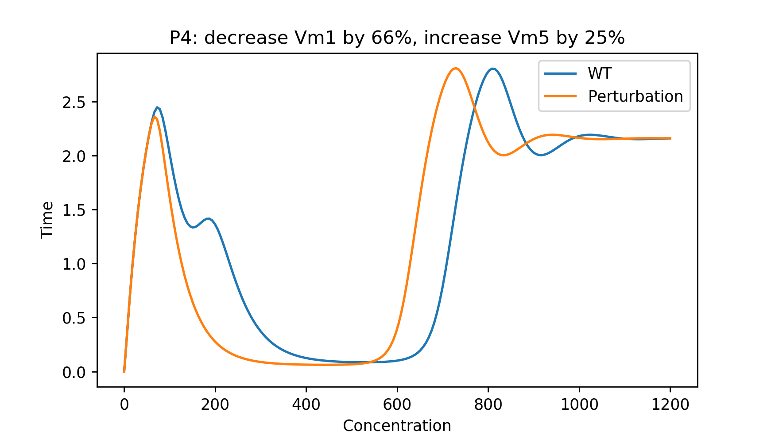
Stress Tests on P4

Slide 4
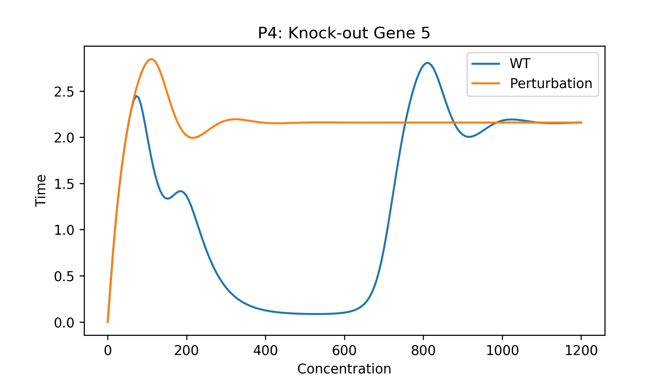
Stress Tests on P4

Slide 5
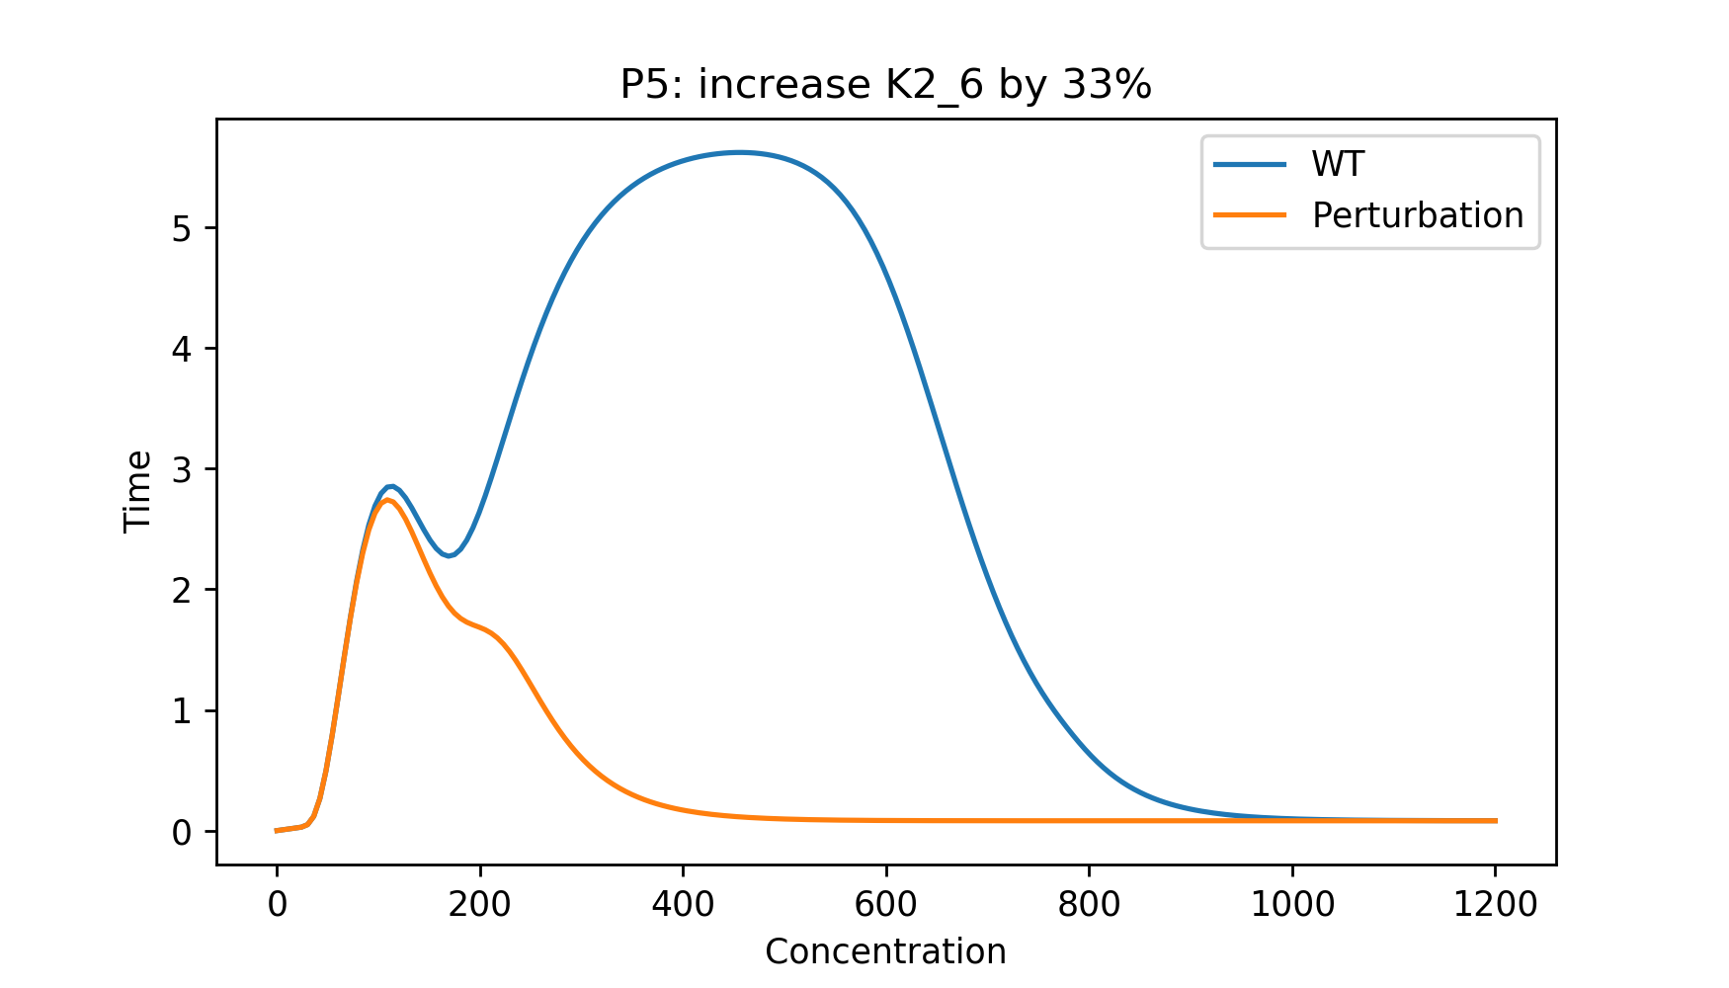
Stress Tests on P5

Slide 6
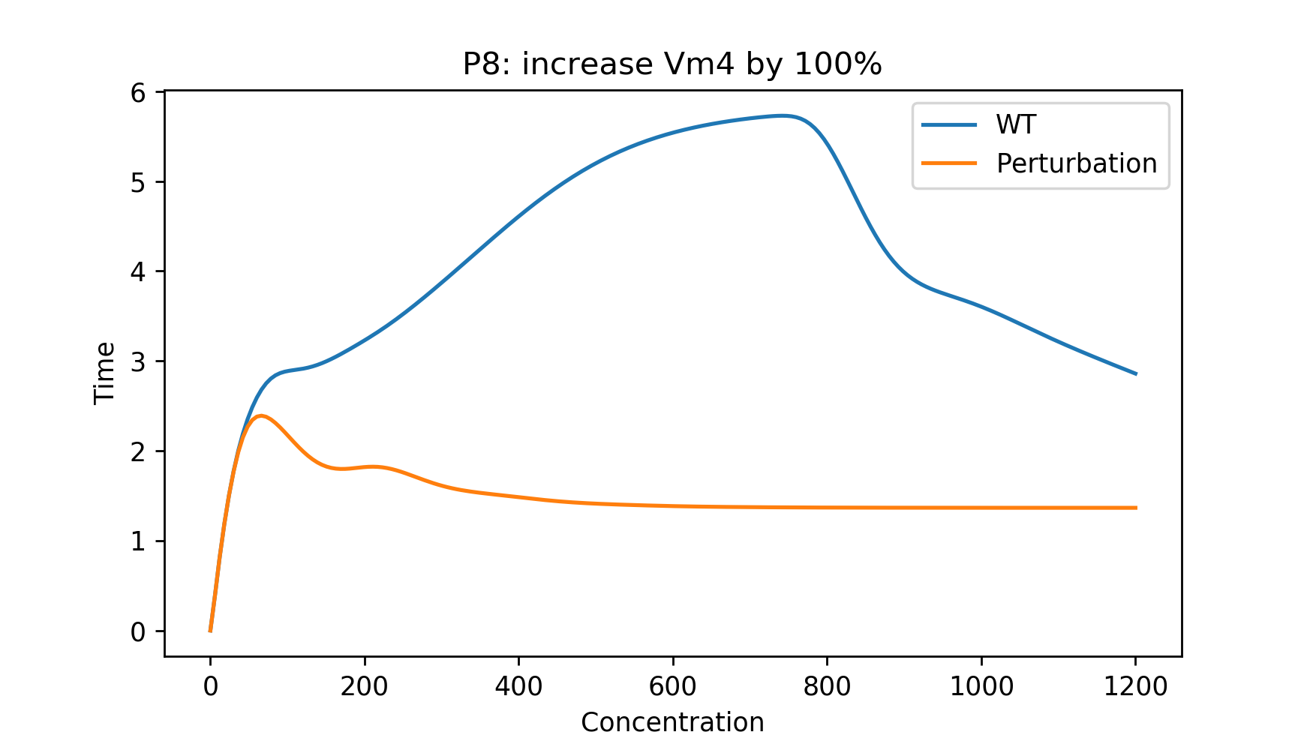
Stress Tests on P8

