Slide 1
BIOE 498 / BIOE 599: Computational Systems Biology for Medical Applications Lecture 5: Design of Experiments
Joseph L. Hellerstein*
Herbert Sauro**
*eScience Institute, Computer Science & Engineering
**BioEngineering

Slide 2
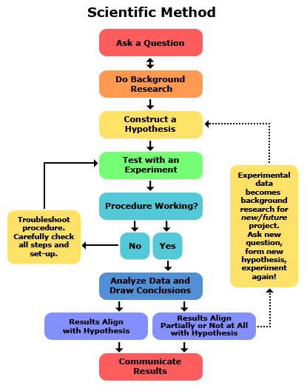
Design of experiments (DOE)

Slide 3
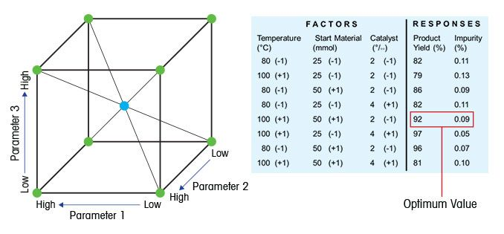
Key Concepts in DOE
Factor: Something changed in the experiment (e.g., parameter)
Level of factor: Value of a parameter
Response: Something measured
An experimental design consists of:
the system under study
the factors varied
the responses measured.
An experimental design is developed to address a research question.

Slide 4
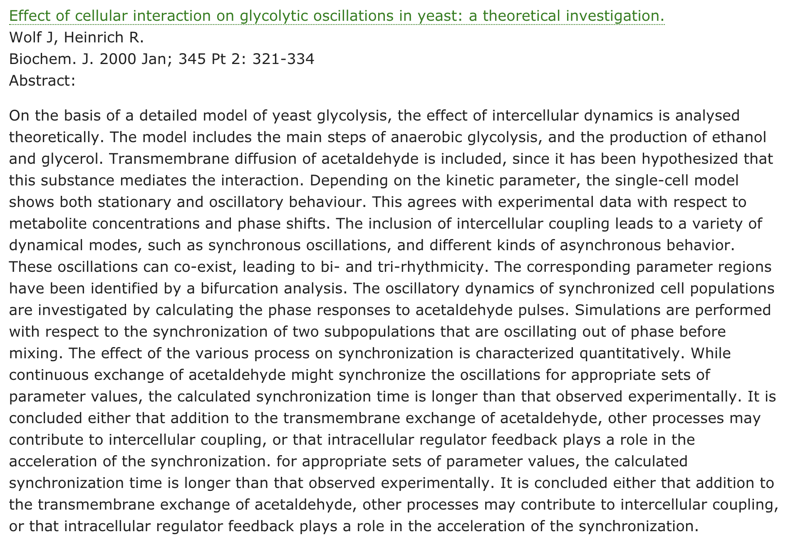
Research
Question
System
Studied
Factors
Responses

Slide 5
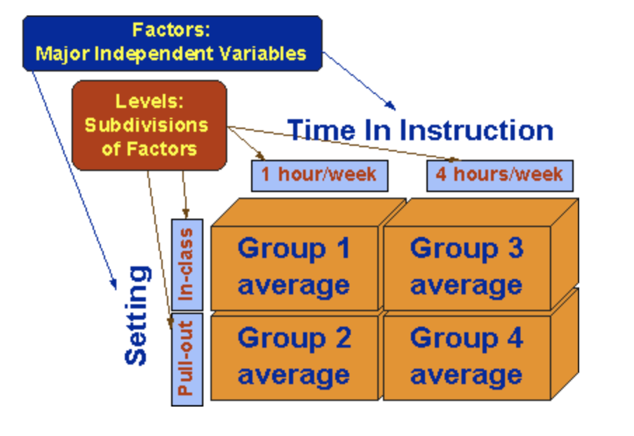
Factorial (All Factor) Design
Wolf Model: Factors = 16 parameters
#levels | #simulations | Time (1 sec/sim)
2 | ~10⁵ | ~day
4 | ~10⁹ | ~month
8 | ~10¹⁴ | ~1M year
Scaling dimensions
Compute time
Visualization complexity

Slide 6

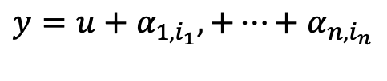


Single Factor Design
Wolf model: 16 parameters
#levels | #simulations
2 | 32
4 | 64
8 | 128
Implied model
$$y=u+α_{1,i_{1}},+⋯+α_{n,i_{n}}$$
$y$ = response
$u$ = baseline response (no change in factors)
$α_{k,i_{k}}$ = effect of factor k at level i_{k}
But what about interactions between factors?

Slide 7

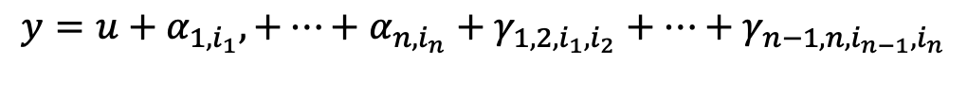



2 Factor Design
#simulations
# levels | 1 factor | 2 factor | All
2 | 32 | ~10³ | ~10⁵
4 | 64 | ~10⁴ | ~10⁹
8 | 128 | ~10⁵ | ~10¹⁴
$$y=u+α_{1,i_{1}},+⋯+α_{n,i_{n}}+γ_{1,2,i_{1},i_{2}}+⋯+γ_{n−1,n,i_{n−1},i_{n}}$$
{
{
$n$ terms
$\left(\begin{matrix}n \\ 2\end{matrix}\right)$ terms
$y$ = response
$u$ = baseline response (no change in factors)
$α_{k,i_{k}}$ = effect of factor k at level i_{k}
$γ_{k_{1},k_{2},i_{k_{1}},i_{k_{2}}}$ = effect of interaction of factors $k_{1},{ k}_{2}$ at levels${ i}_{k_{1}},i_{k_{2}}$

Slide 8
Reducing the Complexity of 2 Factor Designs
Focus on interaction between high impact factors
Strategic selection of the number of levels
Only explore more levels for those factors that have large impact
Notes:
More common to have 50 or so parameters.

