Slide 1
Computational Systems Biology for Medical Applications Modeling Fitting: Parameter Optimization Techniques
Joseph L. Hellerstein*
Herbert Sauro**
*eScience Institute, Computer Science & Engineering
**BioEngineering

Slide 2
Notes
Lab
Network structures, objective function, optimization algorithm
Probabilistically choose different species?
LMFIT only accepts one vector of residuals

Slide 3
Errata

Slide 4
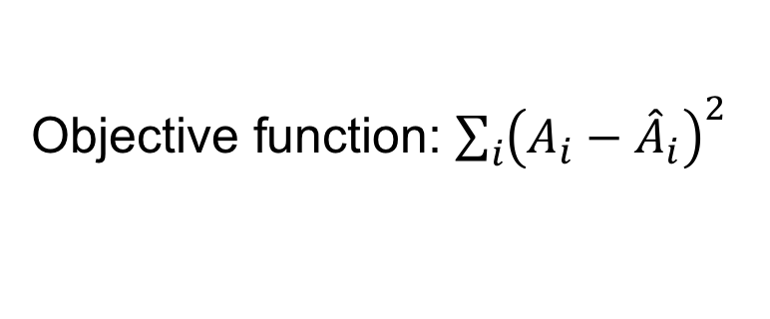
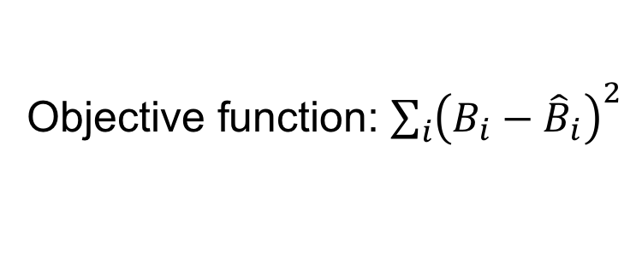

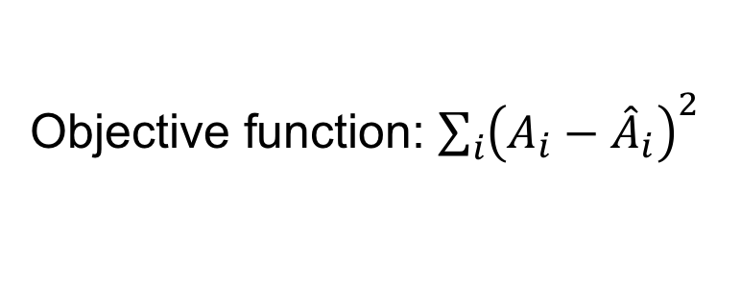


Correction to 2 Parameter Model
Choosing the right objective function
Model 1
$$A→B;k_{1}A$$
Objective function: ${\sum_{i}{\left(A_{i}−{\hat{A}}_{i}\right)}}^{2}$
Model 2
$$A→B;k_{1}A$$
Objective function: ${\sum_{i}{\left(A_{i}−{\hat{A}}_{i}\right)}}^{2}$
$$B→C;k_{2}B$$
Objective function: ${\sum_{i}{\left(B_{i}−{\hat{B}}_{i}\right)}}^{2}$
Why?

Slide 5
Review

Slide 6
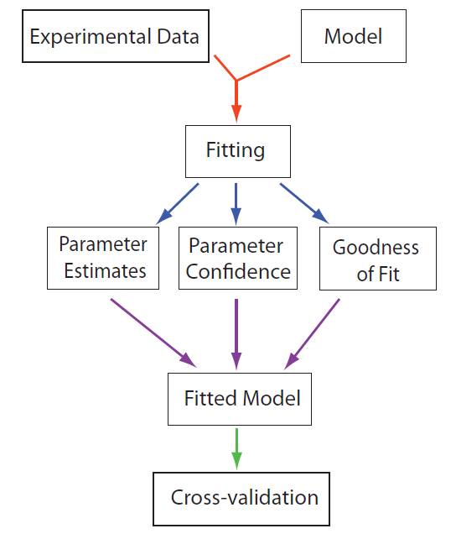
Model Fitting Work flow

Slide 7
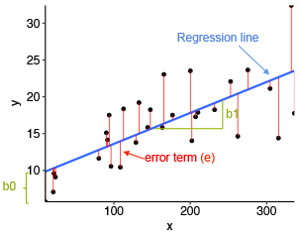




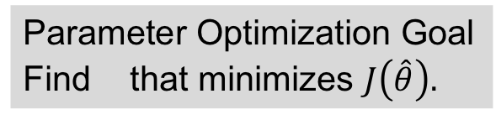
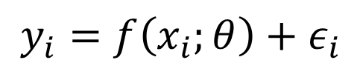

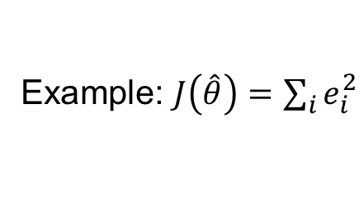


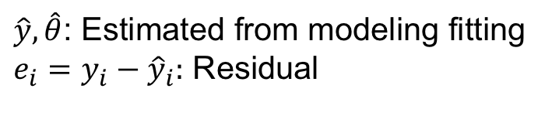
Parameter Optimization Summary
The Model
Ex: Linear Model
$$y_{i}=f\left(x_{i};θ\right)+ε_{i}$$
$$y_{i}=θ_{0}+θ_{1}x_{i}+ε_{i}$$
Observations
residuals
Model
$$e_{i}$$
Explanatory variables
Parameters
$$\hat{y}$$
predicted
Noise (random variable) – i.i.d.
$${\hat{θ}}_{1}$$
$${\hat{θ}}_{0}$$
Parameter Optimization Goal
Find that minimizes $J\left(\hat{θ}\right).$
$\hat{y}, \hat{θ}$: Estimated from modeling fitting
$e_{i}=y_{i}−{\hat{y}}_{i}:$ Residual
$$\hat{θ}$$
$J\left(\hat{θ}\right):$Non-zero measure of model quality
Example: $J\left(\hat{θ}\right)=\sum_{i}{e_{i}^{2}}$

Slide 8
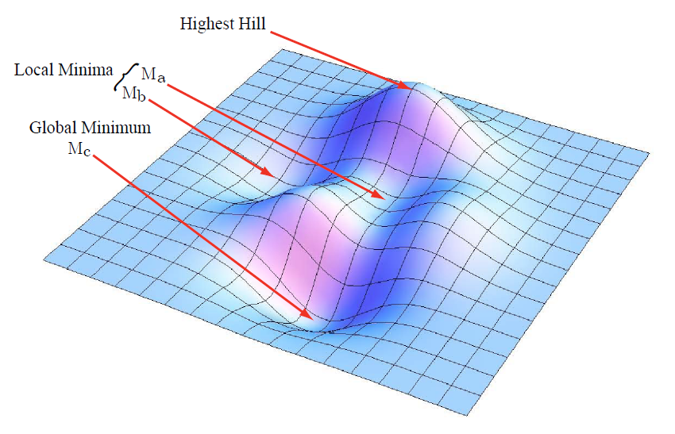



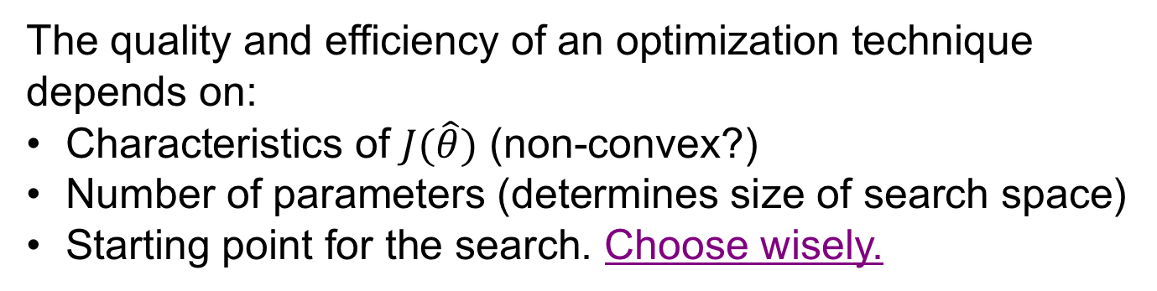
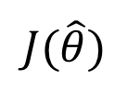
Parameter Optimization Minimize $J(\hat{θ})$
$$J(\hat{θ})$$
$${\hat{θ}}_{1}$$
$${\hat{θ}}_{0}$$
The quality and efficiency of an optimization technique
depends on:
Characteristics of $J(\hat{θ})$ (non-convex?)
Number of parameters (determines size of search space)
Starting point for the search. Choose wisely.
Notes:
Times in video: 0, 1:50, 2:20

Slide 9
Optimization Techniques

Slide 10
Optimization Techniques
Gradient decent
Gauss-Newton
Lavenberg-Marquardt
Simulated annealing
Differential evolution

Slide 11
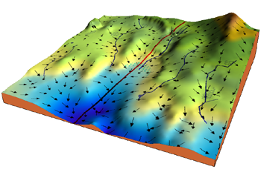
Gradient Descent
It’s the algorithm, that rivers and
streams use to get to the sea.
$$J(\hat{θ})$$
$${\hat{θ}}_{1}$$
$${\hat{θ}}_{0}$$

Slide 12
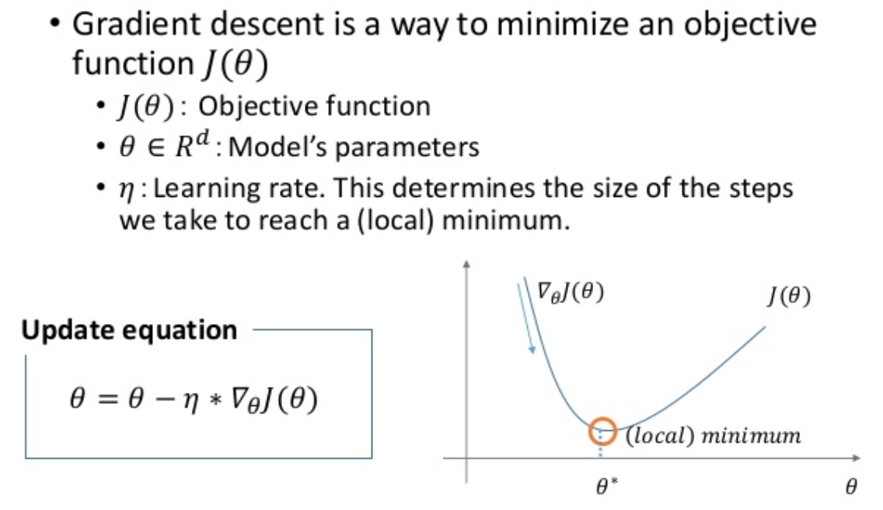

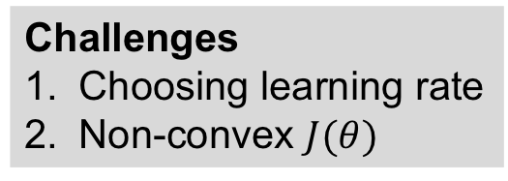
Gradient Descent In Brief
$$R^{M}$$
Challenges
Choosing learning rate
Non-convex $J(θ)$

Slide 13
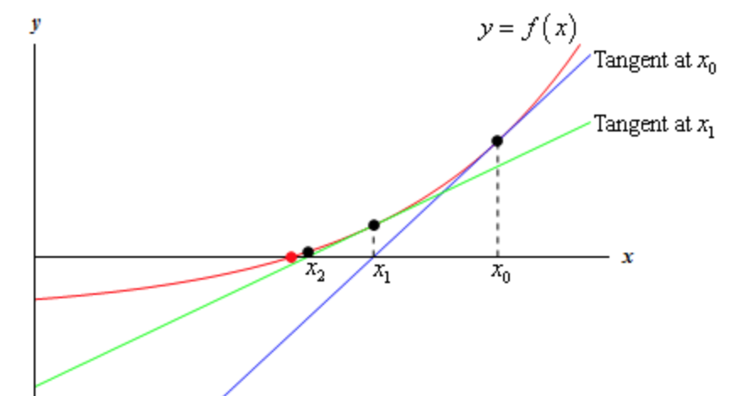


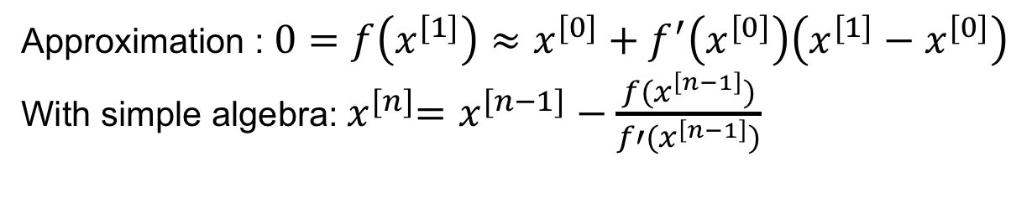



(Gauss) Newton
Extends Newton’s method for finding roots.
Newton’s method for finding roots, that is where f(x)=0.
Tangent at $x^{[0]}$
Tangent at $x^{[1]}$
$$x^{[2]}$$
$$x^{[1]}$$
$$x^{[0]}$$
Approximation : $0=f\left(x^{[1]}\right)≈x^{[0]}+f^{′}\left(x^{[0]}\right)\left(x^{[1]}−x^{[0]}\right)$
With simple algebra:${ x}^{[n]}=x^{[n−1]}−\frac{f(x^{\left[n−1\right]})}{f′(x^{\left[n−1\right]})}$

Slide 14
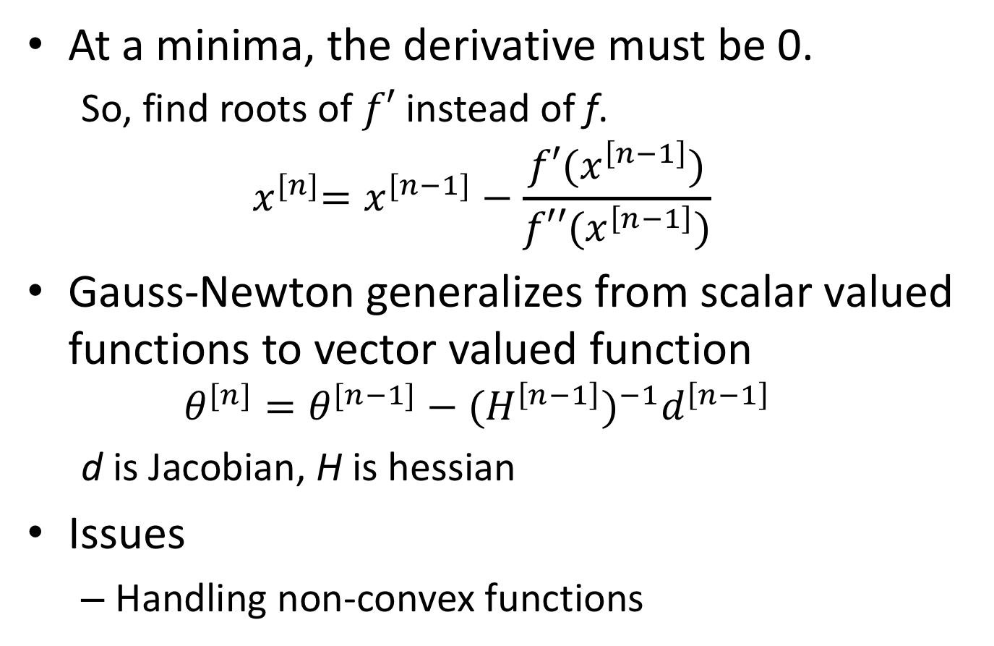
Gauss-Newton & Minima
At a minima, the derivative must be 0.
So, find roots of $f′$ instead of f.
$${ x}^{[n]}=x^{[n−1]}−\frac{f′(x^{\left[n−1\right]})}{f′′(x^{\left[n−1\right]})}$$
Gauss-Newton generalizes from scalar valued functions to vector valued function
$$θ^{[n]}=θ^{[n−1]}−{{(H}^{\left[n−1\right]})}^{−1}d^{\left[n−1\right]}$$
d is Jacobian, H is hessian
Issues
Handling non-convex functions

Slide 15
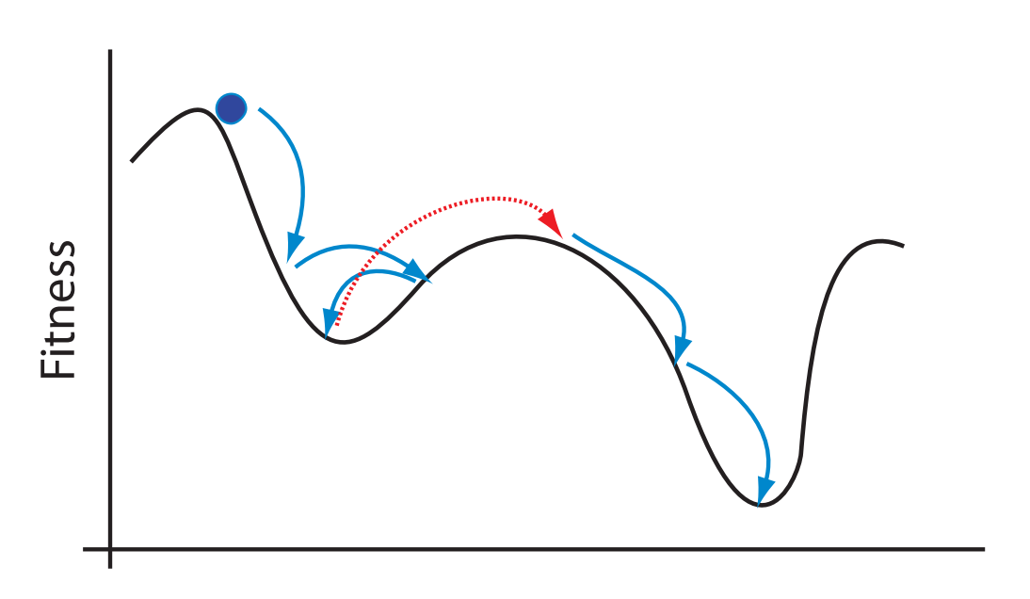
Simulated Annealing

