Slide 1


Extra Notes on Reactions Kinetics
In Collaboration with James Glazier, Bloomington

Slide 2
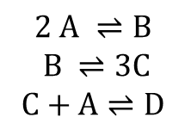

Chemical Reactions
All life depends on chemical reactions in which one or more chemical species react to form different chemical species
In chemical reactions, the substrates (usually written on the left hand side) are used up to produce products, with total mass and atomic species being conserved
The representation of chemical reactions will be fundamental to everything we do in this class (though we will find that the mathematics and computing we do to represent chemical reactions allows us to represent many other kinds of network dynamics as well
Chemical Reaction Formula
$$2 ADP ⇌ATP+AMP$$
$$2 A ⇌B$$
$$B ⇌3C$$
$$C+A⇌D$$
Chemical reaction networks conserve mass

Slide 3



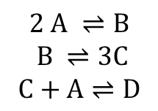
Chemical Reaction Networks
Chemical reaction networks are usually written either as lists of chemical reaction formulae or as network diagrams
Nodes represent molecular species (sometimes with separate nodes for particular forms or electron or other states) and the usual State variable is a number describing species amount or concentration
Links represent chemical transformations between substrate (input) and product (output) species.
Chemical reactions are usually represented with a variety of arrows which may be unidirectional, bidirectional and single or multiheaded. Links are always associated with a rate of action (though not always written)
Chemical Reaction Formula
$$2 ADP ⇌ATP+AMP$$
Chemical Reaction Network Diagram
Corresponding Chemical Reaction Formulae
$$2 A ⇌B$$
$$B ⇌3C$$
$$C+A⇌D$$
Chemical reaction networks conserve mass

Slide 4
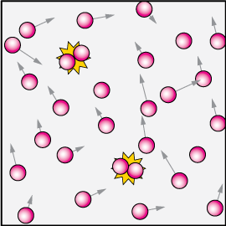
Modeling Chemical Reactions
To give you a quick taste of a chemical reaction network dynamic model, we will very quickly write down a chemical reaction, convert it to a mathematical form and solve it as a simulation using the Tellurium simulation environment, which allows you to define a simulation of a dynamic network model, numerically solve its time evolution and process and display these results
Don’t worry too much about the details, we will come back and review all these ideas in more depth soon
Chemical reactions occur when rapidly moving molecules collide with each other randomly

Slide 5
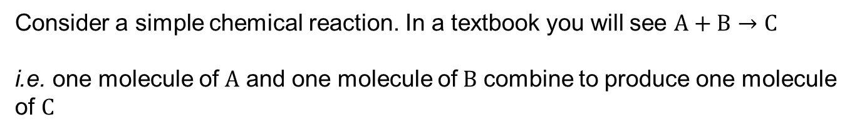
Describing Chemical Reactions
Consider a simple chemical reaction. In a textbook you will see $A+B→C$
i.e. one molecule of $A$ and one molecule of$B$ combine to produce one molecule of $C$
We want to know how the rate of production and amount of C depends on the amounts of A and B
To translate the textbook form into mathematical equations and computer simulations to answer this question, we go through a series of steps

Slide 6
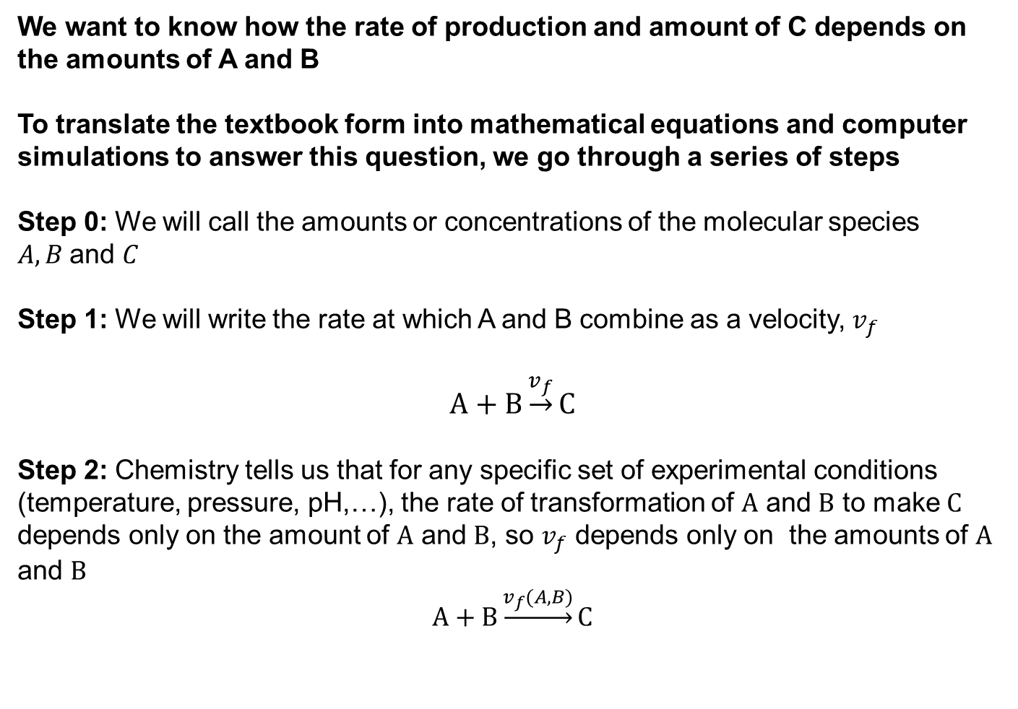
Describing Chemical Reactions
Consider a simple chemical reaction. In a textbook you will see $A+B→C$
We want to know how the rate of production and amount of C depends on the amounts of A and B
To translate the textbook form into mathematical equations and computer simulations to answer this question, we go through a series of steps
Step 0: We will call the amounts or concentrations of the molecular species $A, B$and $C$
Step 1: We will write the rate at which A and B combine as a velocity, $v_{f}$
$$A+B\underset{→}{v_{f}}C$$
Step 2: Chemistry tells us that for any specific set of experimental conditions (temperature, pressure, pH,…), the rate of transformation of $A$ and $B$ to make $C$ depends only on the amount of $A$ and $B$, so $v_{f}$ depends only on the amounts of $A$ and $B$
$$A+B\underset{→}{v_{f}(A,B)}C$$

Slide 7
Mathematics of Chemical Reactions—Ordinary Differential Equations (ODE) and Reaction Kinetics
$$A+B\underset{→}{v_{f}(A,B)}C$$
We want to know how the rate of production and amount of C depends on the amounts of A and B
To turn the diagram into a set of mathematical formulae, we have to make some assumptions:
The amounts of chemical species are large enough that we can consider molecular concentrations rather than discrete molecules (we will relax this assumption later)
The rate of change of the concentrations averages over enough molecules that the rate of change is deterministic and we can neglect that individual reactions between molecules happen randomly (we will relax this assumption later)
The concentration is uniform over the region we are considering (i.e. we neglect spatial variations in concentration). This hypothesis is known as a “stirred reactor”

Slide 8
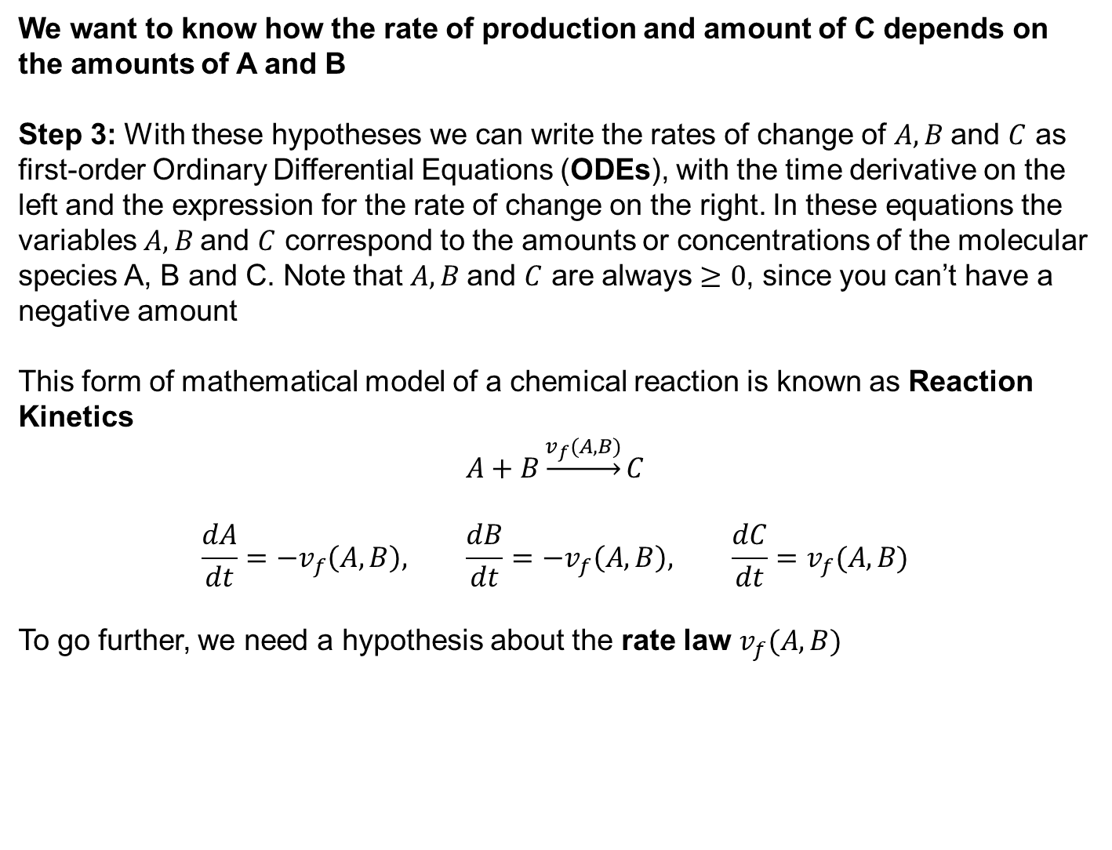
Mathematics of Chemical Reactions—Ordinary Differential Equations (ODE) and Reaction Kinetics
$$A+B\underset{→}{v_{f}(A,B)}C$$
We want to know how the rate of production and amount of C depends on the amounts of A and B
Step 3: With these hypotheses we can write the rates of change of $A, B$and $C$ as first-order Ordinary Differential Equations (ODEs), with the time derivative on the left and the expression for the rate of change on the right. In these equations the variables $A, B$and $C$ correspond to the amounts or concentrations of the molecular species A, B and C. Note that $A, B$and $C$ are always $≥0$, since you can’t have a negative amount
This form of mathematical model of a chemical reaction is known as Reaction Kinetics
$$A+B\underset{→}{v_{f}(A,B)}C$$
$$\frac{dA}{dt}=−v_{f}\left(A,B\right), \frac{dB}{dt}=−v_{f}\left(A,B\right), \frac{dC}{dt}=v_{f}(A,B)$$
To go further, we need a hypothesis about the rate law $v_{f}(A,B)$

Slide 9
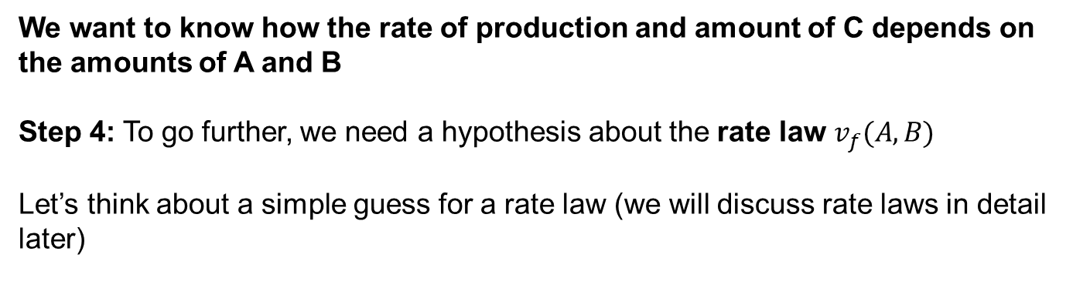
Rate Laws
$$A+B\underset{→}{v_{f}(A,B)}C, \frac{dA}{dt}=−v_{f}\left(A,B\right), \frac{dB}{dt}=−v_{f}\left(A,B\right), \frac{dC}{dt}=v_{f}(A,B)$$
We want to know how the rate of production and amount of C depends on the amounts of A and B
Step 4: To go further, we need a hypothesis about the rate law $v_{f}(A,B)$
Let’s think about a simple guess for a rate law (we will discuss rate laws in detail later)

Slide 10
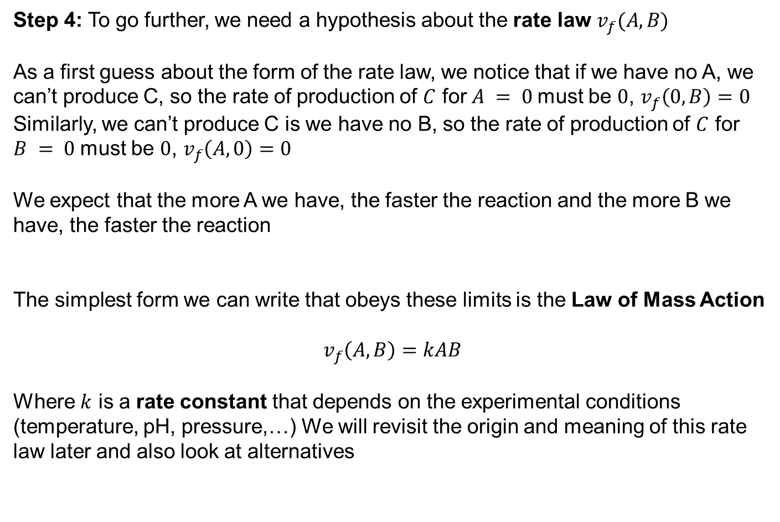
Rate Laws and Mass Action
$$A+B\underset{→}{v_{f}(A,B)}C, \frac{dA}{dt}=−v_{f}\left(A,B\right), \frac{dB}{dt}=−v_{f}\left(A,B\right), \frac{dC}{dt}=v_{f}(A,B)$$
Step 4: To go further, we need a hypothesis about the rate law $v_{f}(A,B)$
As a first guess about the form of the rate law, we notice that if we have no A, we can’t produce C, so the rate of production of $C$ for $A = 0$must be $0$, $v_{f}\left(0,B\right)=0$
Similarly, we can’t produce C is we have no B, so the rate of production of $C$ for $B = 0$must be $0$, $v_{f}\left(A,0\right)=0$
We expect that the more A we have, the faster the reaction and the more B we have, the faster the reaction
The simplest form we can write that obeys these limits is the Law of Mass Action
$$v_{f}\left(A,B\right)=kAB$$
Where $k$ is a rate constant that depends on the experimental conditions (temperature, pH, pressure,…) We will revisit the origin and meaning of this rate law later and also look at alternatives

Slide 11
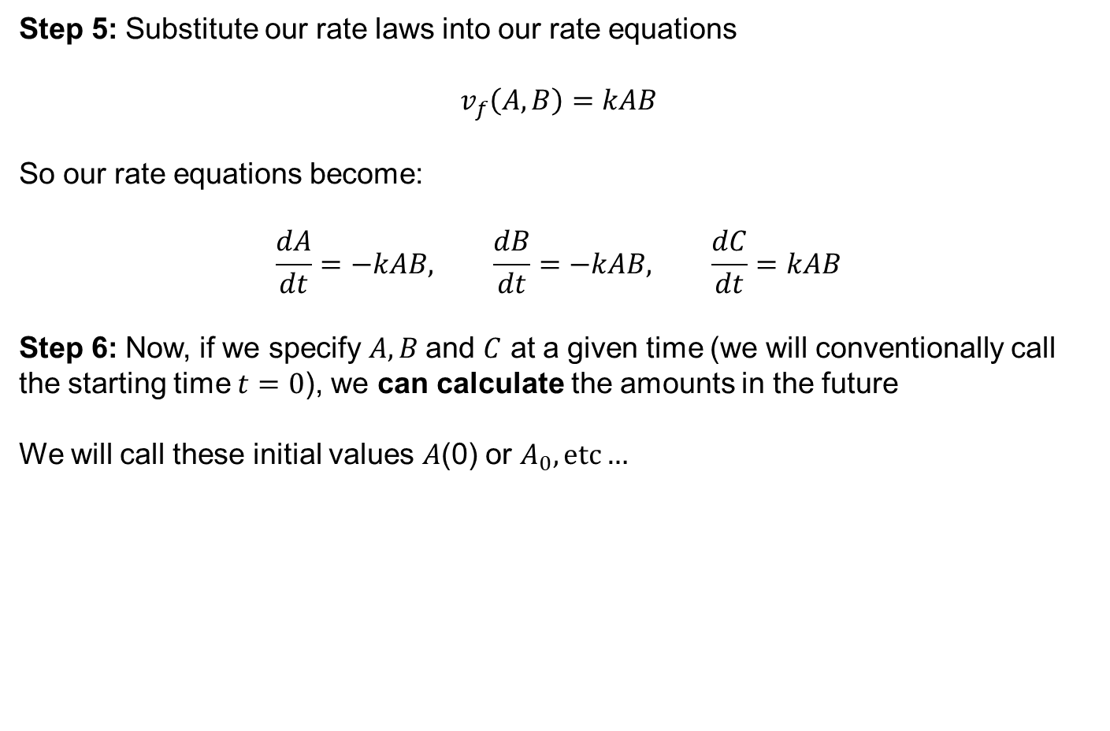
Reaction Kinetic Formalism
$$A+B\underset{→}{v_{f}(A,B)}C, \frac{dA}{dt}=−v_{f}\left(A,B\right), \frac{dB}{dt}=−v_{f}\left(A,B\right), \frac{dC}{dt}=v_{f}(A,B)$$
Step 5: Substitute our rate laws into our rate equations
$$v_{f}\left(A,B\right)=kAB$$
So our rate equations become:
$$\frac{dA}{dt}=−kAB, \frac{dB}{dt}=−kAB, \frac{dC}{dt}=kAB$$
Step 6: Now, if we specify $A, B$and $C$ at a given time (we will conventionally call the starting time $t=0$), we can calculate the amounts in the future
We will call these initial values $A$(0) or $A_{0}, etc…$

Slide 12
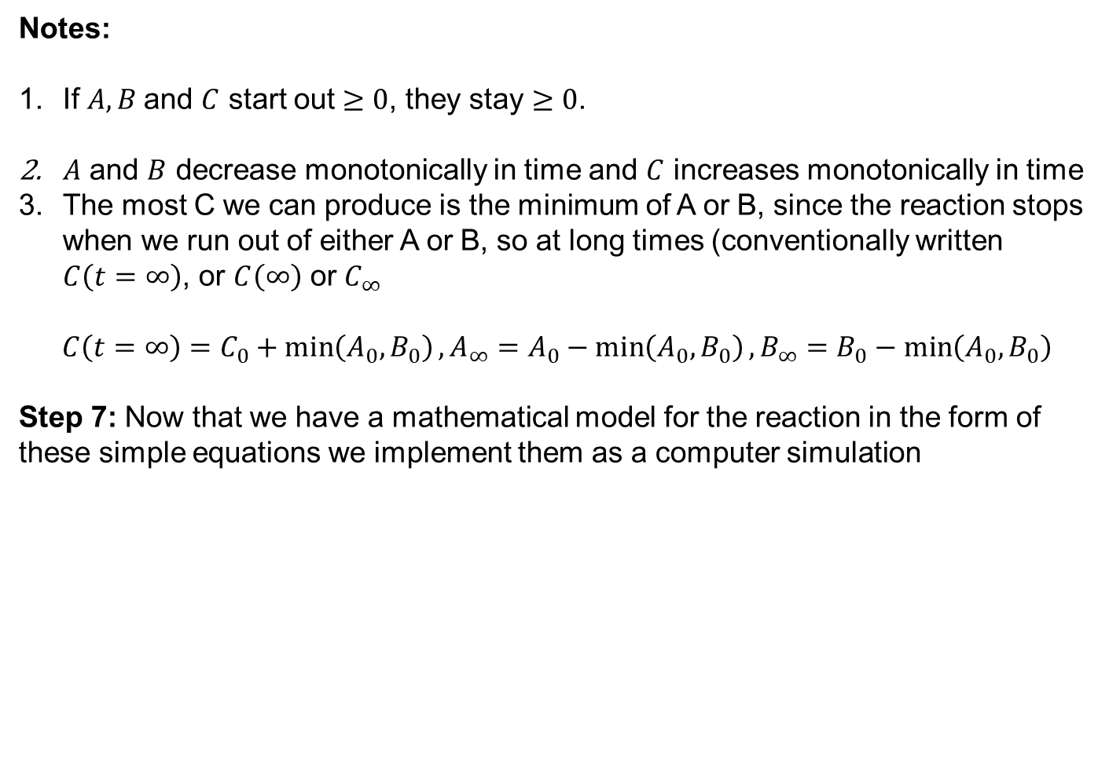
Reaction Kinetics Consequences
$$A+B\underset{→}{v_{f}(A,B)}C, \frac{dA}{dt}=−kAB, \frac{dB}{dt}=−kAB, \frac{dC}{dt}=kAB$$
Notes:
If $A, B$and $C$ start out $≥0$, they stay $≥0$.
$A$ and $B$ decrease monotonically in time and $C$ increases monotonically in time
The most C we can produce is the minimum of A or B, since the reaction stops when we run out of either A or B, so at long times (conventionally written $C\left(t=∞\right)$, or $C\left(∞\right)$ or $C_{∞}$
$$C\left(t=∞\right)=C_{0}+\min\left(A_{0}, B_{0}\right), A_{∞}=A_{0}−\min\left(A_{0}, B_{0}\right), B_{∞}=B_{0}−\min\left(A_{0}, B_{0}\right)$$
Step 7: Now that we have a mathematical model for the reaction in the form of these simple equations we implement them as a computer simulation

Slide 13
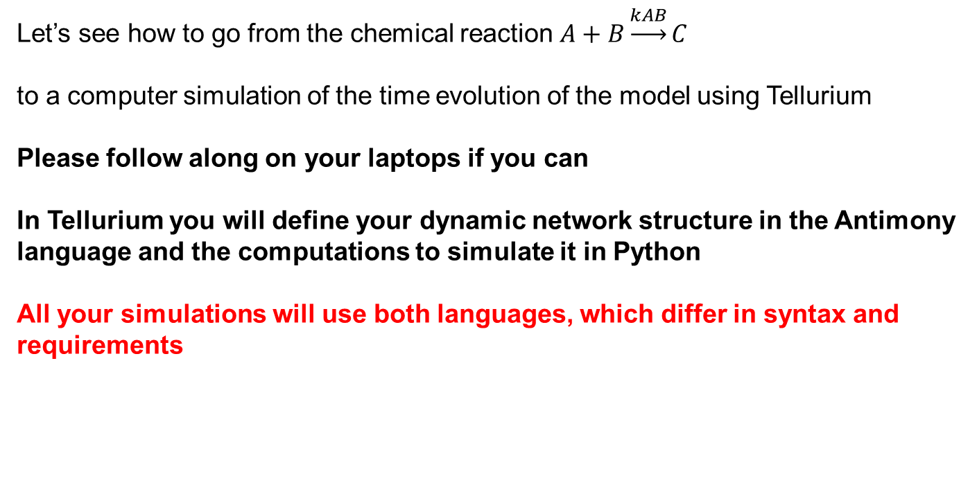
Implementing a Chemical Reaction Model as a Simulation in Tellurium
Let’s see how to go from the chemical reaction $A+B\underset{→}{kAB}C$
to a computer simulation of the time evolution of the model using Tellurium
Please follow along on your laptops if you can
In Tellurium you will define your dynamic network structure in the Antimony language and the computations to simulate it in Python
All your simulations will use both languages, which differ in syntax and requirements

