Slide 1
BIOE 498 / BIOE 599: Computational Systems Biology for Medical Applications Lab: Design of Experiments Revisited
Joseph L. Hellerstein*
Herbert Sauro**
*eScience Institute, Computer Science & Engineering
**BioEngineering

Slide 2
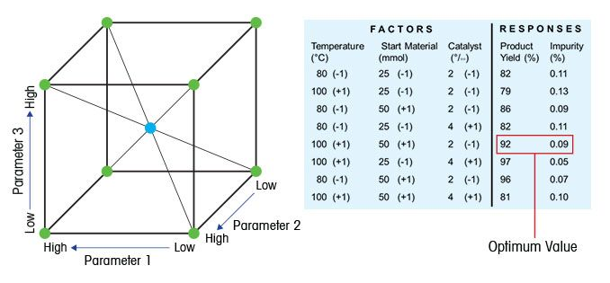
Key Concepts in DOE
Factor: Something changed in the experiment (e.g., parameter)
Level of factor: Value/setting of a factor
Response: Measured result of an experiment
An experimental design consists of:
experimental environment
factors and their levels
responses

Slide 3
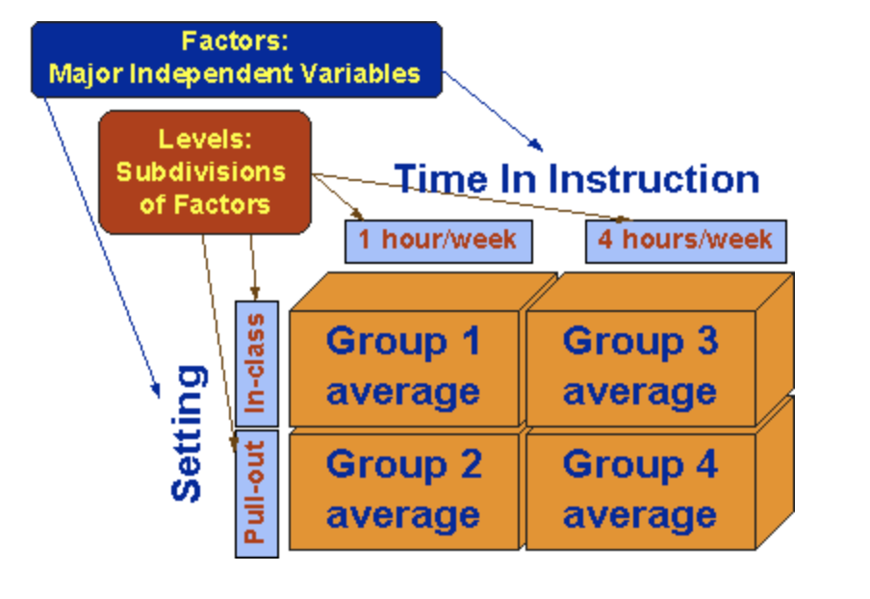
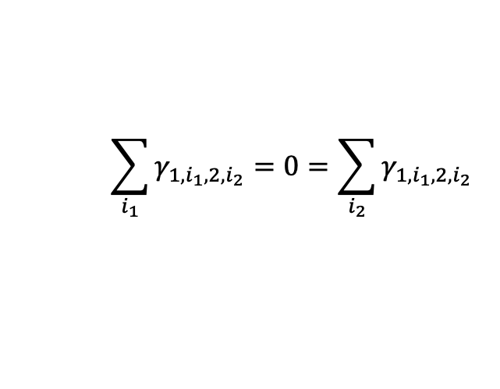
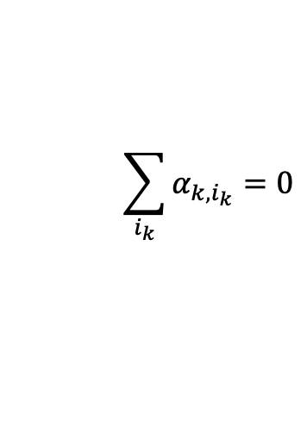







Experimental Design Basics
$$y_{1,i_{1},2,i_{2}}=μ+α_{1,i_{1}}+α_{2,i_{2}}+γ_{1,i_{1},2,i_{2}}$$
Factor 1
$μ$ is the baseline (given)
$α_{k, i_{k}}:$ Single factor effect (calculated)
Factor 2
$γ_{1,i_{1},2,i_{2}}$: Interaction effect (calculated)
Constraints
$$\sum_{i_{k}}{α_{k, i_{k}}=0}$$
$$\sum_{i_{1}}{γ_{1,i_{1},2,i_{2}}=0=\sum_{i_{2}}{γ_{1,i_{1},2,i_{2}}} }$$
$N=$ Total number of experiments
$k=$ index of factors. $k∈\{1,2\}$
$i_{k}=$ level of factor $k$. $i_{1}∈\left\{“inclass”, “pullout”\right\}, i_{2}∈\{“1 hour”, “4 hours”\}$
$y_{1,i_{1},2,i_{2}} =$ Measured value of response
Why decompose responses?
Provides a way to understand the effect of factors and levels.
Explicit understanding of assumptions of experiment.
Notes:
In practice,there are replications at the same level.

Slide 4


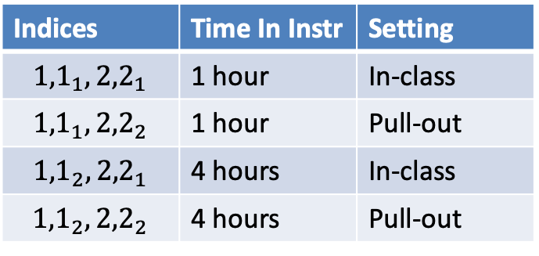
How Experiments, Levels are Indexed
$$y_{1,i_{1},2,i_{2}}=μ+α_{1,i_{1}}+α_{2,i_{2}}+γ_{1,i_{1},2,i_{2}}$$
Factor 1
Factor 1
Factor 2
Indices | Time In Instr | Setting
$${1,1}_{1},{2,2}_{1}$$ | 1 hour | In-class
$${1,1}_{1},{2,2}_{2}$$ | 1 hour | Pull-out
$${1,1}_{2},{2,2}_{1}$$ | 4 hours | In-class
$${1,1}_{2},{2,2}_{2}$$ | 4 hours | Pull-out
Factor 2
$N=$ Total number of experiments
$k$ – index of factors. $k∈\{1,2\}$
$i_{k}$ - level of factor $k$. $i_{1}∈\left\{“inclass”, “pullout”\right\}, i_{2}∈\{“1 hour”, “4 hours”\}$
Notes:
Alpha_1,1 = 2
Alpha_1, 2 = -2
Alpha_2,1 = 5
Alpha_2,2 = -5
Gamma_1,1,2,1 = 3; otherwise 0
Mu = 5

Slide 5
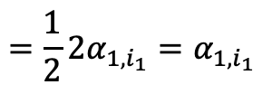

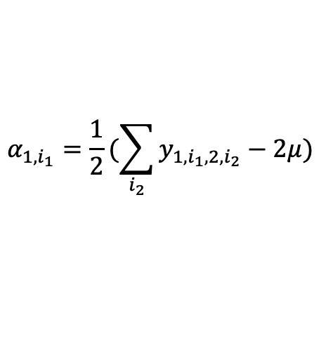
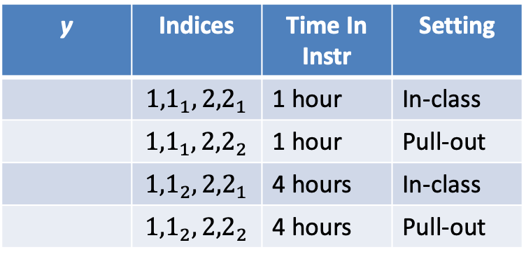

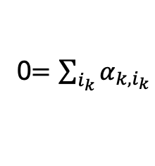
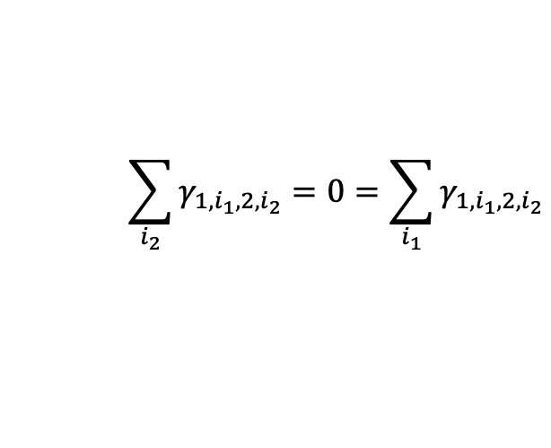


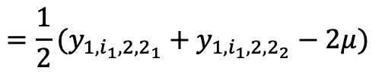

Calculating $α, γ$
$$y_{1,i_{1},2,i_{2}}=μ+α_{1,i_{1}}+α_{2,i_{2}}+γ_{1,i_{1},2,i_{2}}$$
Factor 1
y | Indices | Time In Instr | Setting
 | $${1,1}_{1},{2,2}_{1}$$ | 1 hour | In-class
 | $${1,1}_{1},{2,2}_{2}$$ | 1 hour | Pull-out
 | $${1,1}_{2},{2,2}_{1}$$ | 4 hours | In-class
 | $${1,1}_{2},{2,2}_{2}$$ | 4 hours | Pull-out
Factor 2
$y_{1,i_{1},2,i_{2}} =$ Measured response
$μ=$ baseline (given)
$$α_{1,i_{1}}=\frac{1}{2}(\sum_{i_{2}}{y_{1,i_{1},2,i_{2}}−2μ) }$$
0$=\sum_{i_{k}}{α_{k, i_{k}}}$
$$\sum_{i_{2}}{γ_{1,i_{1},2,i_{2}}=0}=\sum_{i_{1}}{γ_{1,i_{1},2,i_{2}}}$$
$$={\frac{1}{2}(y}_{1,i_{1},{2,2}_{1}}+y_{1,i_{1},{2,2}_{2}}−2μ)$$
$={\frac{1}{2}2(α}_{1,i_{1}}+γ_{1,i_{1},{2,1}_{2}}{+α}_{1,i_{1}}+γ_{1,i_{1},{2,2}_{2}}$)
$$={\frac{1}{2}2α}_{1,i_{1}}=α_{1,i_{1}}$$
$$γ_{1,i_{1},2,i_{2}}=y_{1,i_{1},2,i_{2}−μ−α_{1,i_{1}}−α_{2,i_{2}} }$$
Notes:
Alpha_1,1 = 2
Alpha_1, 2 = -2
Alpha_2,1 = 5
Alpha_2,2 = -5
Gamma_1,1,2,1 = 3; otherwise 0
Mu = 5

Slide 6

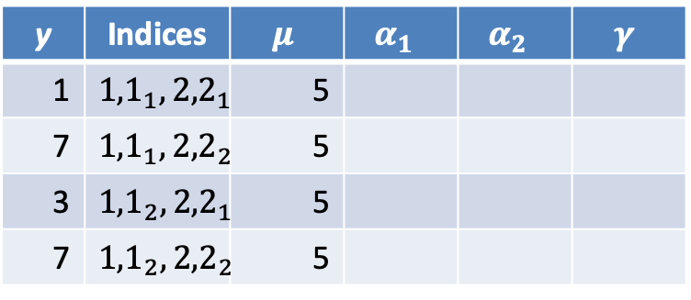
Complete the Table
y | Indices | $$μ$$ | $$α_{1 }$$ | $$α_{2 }$$ | $$γ$$
1 | $${1,1}_{1},{2,2}_{1}$$ | 5
7 | $${1,1}_{1},{2,2}_{2}$$ | 5
3 | $${1,1}_{2},{2,2}_{1}$$ | 5
7 | $${1,1}_{2},{2,2}_{2}$$ | 5
$$y_{1,i_{1},2,i_{2}}=μ+α_{1,i_{1}}+α_{2,i_{2}}+γ_{1,i_{1},2,i_{2}}$$
$$α_{1,i_{1}}=\frac{1}{2}(\sum_{i_{2}}{y_{1,i_{1},2,i_{2}}−2μ) }$$
$$={\frac{1}{2}(y}_{1,i_{1},{2,2}_{1}}+y_{1,i_{1},{2,2}_{2}}−2μ)$$
$={\frac{1}{2}2(α}_{1,i_{1}}+γ_{1,i_{1},{2,1}_{2}}{+α}_{1,i_{1}}+γ_{1,i_{1},{2,2}_{2}}$)
$$={\frac{1}{2}2α}_{1,i_{1}}=α_{1,i_{1}}$$
$$γ_{1,i_{1},2,i_{2}}=y_{1,i_{1},2,i_{2}−μ−α_{1,i_{1}}−α_{2,i_{2}} }$$

Slide 7
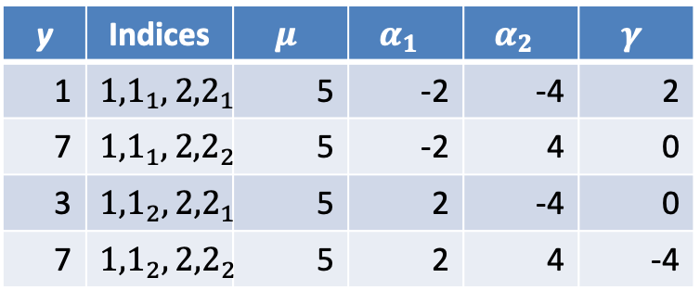
Complete the Table
y | Indices | $$μ$$ | $$α_{1 }$$ | $$α_{2 }$$ | $$γ$$
1 | $${1,1}_{1},{2,2}_{1}$$ | 5 | -2 | -4 | 2
7 | $${1,1}_{1},{2,2}_{2}$$ | 5 | -2 | 4 | 0
3 | $${1,1}_{2},{2,2}_{1}$$ | 5 | 2 | -4 | 0
7 | $${1,1}_{2},{2,2}_{2}$$ | 5 | 2 | 4 | -4

Slide 8
Issues
Unclear how interactions work and are calculated.

Slide 9
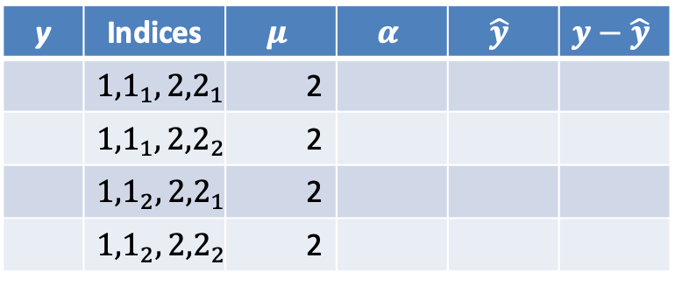
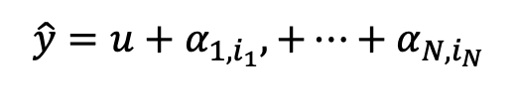


One Factor at a Time (OFT): Design
$$\hat{y}=u+α_{1,i_{1}},+⋯+α_{N,i_{N}}$$
Calculating $α$ for OFT:
$$α_{k,i_{k}}=y_{k,i_{k}}−μ$$
y | Indices | $$μ$$ | $$α$$ | $$\hat{y}$$ | $$y−\hat{y}$$
 | $${1,1}_{1},{2,2}_{1}$$ | 2
 | $${1,1}_{1},{2,2}_{2}$$ | 2
 | $${1,1}_{2},{2,2}_{1}$$ | 2
 | $${1,1}_{2},{2,2}_{2}$$ | 2

Slide 10

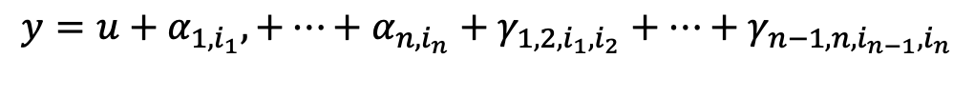




Two Factors in Combination (TFC) Design
#experiments (16 Factors)
# levels | OFT | TFC | Factorial
2 | 32 | ~10³ | ~10⁵
4 | 64 | ~10⁴ | ~10⁹
8 | 128 | ~10⁵ | ~10¹⁴
$$y=u+α_{1,i_{1}},+⋯+α_{n,i_{n}}+γ_{1,2,i_{1},i_{2}}+⋯+γ_{n−1,n,i_{n−1},i_{n}}$$
{
{
$n$ terms
$\left(\begin{matrix}n \\ 2\end{matrix}\right)$ terms
$y$ = response
$u$ = baseline response (no change in factors)
$α_{k,i_{k}}$ = effect of factor k at level i_{k}
$γ_{k_{1},k_{2},i_{k_{1}},i_{k_{2}}}$ = effect of interaction of factors $k_{1},{ k}_{2}$ at levels${ i}_{k_{1}},i_{k_{2}}$

Slide 11
Reducing the Complexity of TFC Designs
Focus on interaction between high impact factors
Strategic selection of the number of levels
Only explore more levels for those factors that have large impact
Notes:
More common to have 50 or so parameters.

Slide 12
Notes
Give more examples to clarify what is a factor, a level, a response.
Include cases where there are multiple responses.
Better illustrate and motivate the decomposition of response into different parts, including interactions.

