Slide 1
Computational Systems Biology for Medical Applications Lecture 10: Cross Validation Review and Software Engineering Basics for Modellers
Joseph L. Hellerstein*
Herbert Sauro**
*eScience Institute, Computer Science & Engineering
**BioEngineering

Slide 2
Downloads
Lecture_9* at http://shorturl.at/crOS2

Slide 3
TODO
Create cross_validation module in lecture 10
Construct bootstrap notebook
Exercises
Different models with different parameters for cross_validation module

Slide 4
The Layers of Modeling
Experimental
Data
Model
Bootstrapping
Cross Validation
Fitting
Parameter Estimates
Model Quality Metrics
Est.
Run
Model
Refined Parameter Estimates
Refined Model Quality Metrics
Parameter Confidence Intervals

Slide 5
Agenda
Review of cross validation (Jupyter notebook)
Bootstrapping steps
Bootstrapping details (Jupyter notebook)
Class exercises

Slide 6
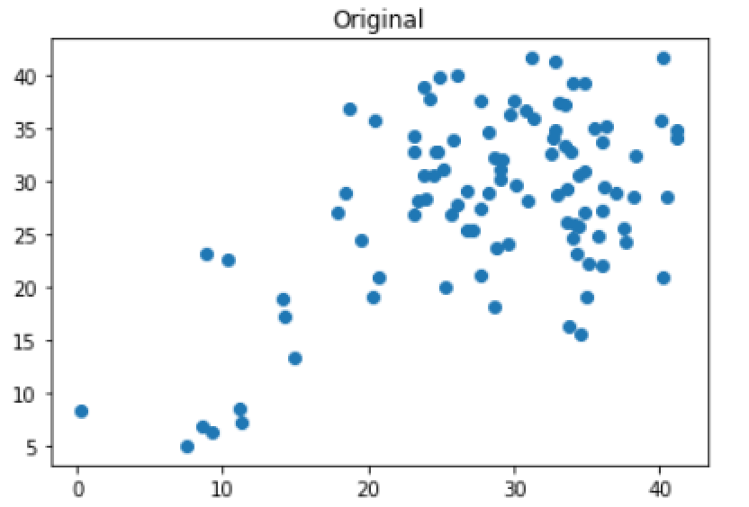
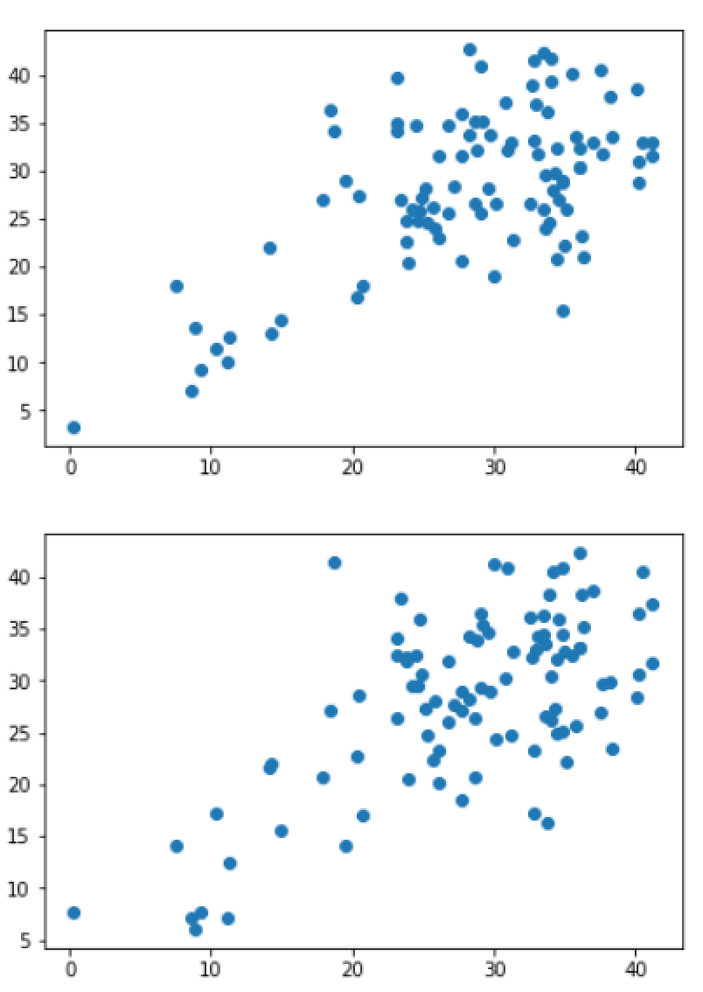
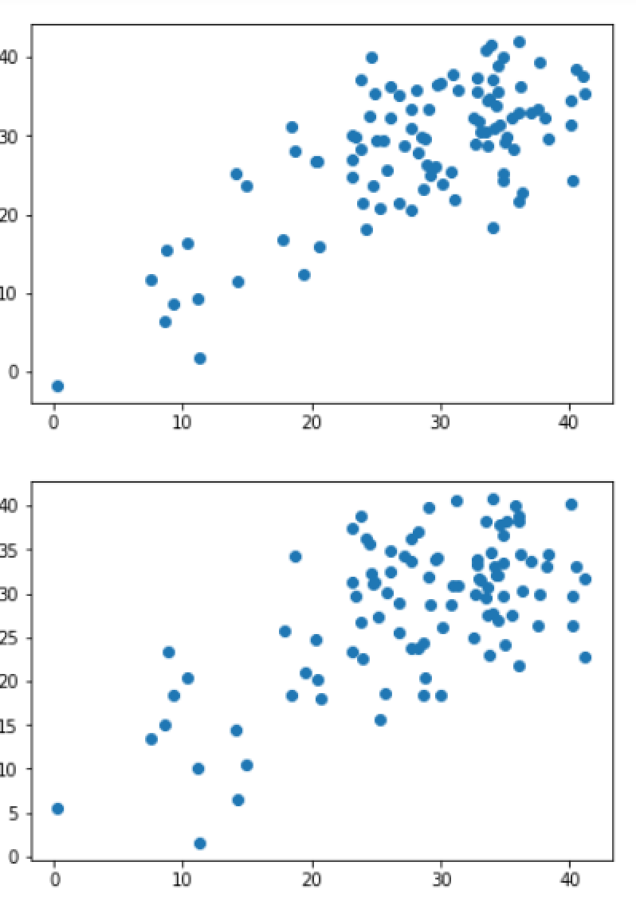
Synthetic Observations With Bootstrapping

Slide 7
Generating a Synthetic Response Data
def generateData(y_obs, y_fit):
"""
:param np.array y_obs
:param np.array y_fit
:return np.array: bootstrap data
"""
residuals = y_obs - y_fit
length = len(y_obs)
residuals = residuals.reshape(length)
samples = np.random.randint(0, length, length)
result = y_fit + residuals[samples]
result = result.reshape(length)
return result

Slide 8
Exercise

