Slide 1
Computational Systems Biology for Medical Applications Overview of Fitting Models to Data
Joseph L. Hellerstein*
Herbert Sauro**
*eScience Institute, Computer Science & Engineering
**BioEngineering

Slide 2
Agenda
Key concepts
Modeling fitting workflow
Parameter optimization
Computational framework

Slide 3
Key Concepts

Slide 4
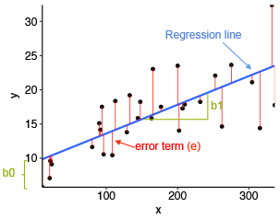
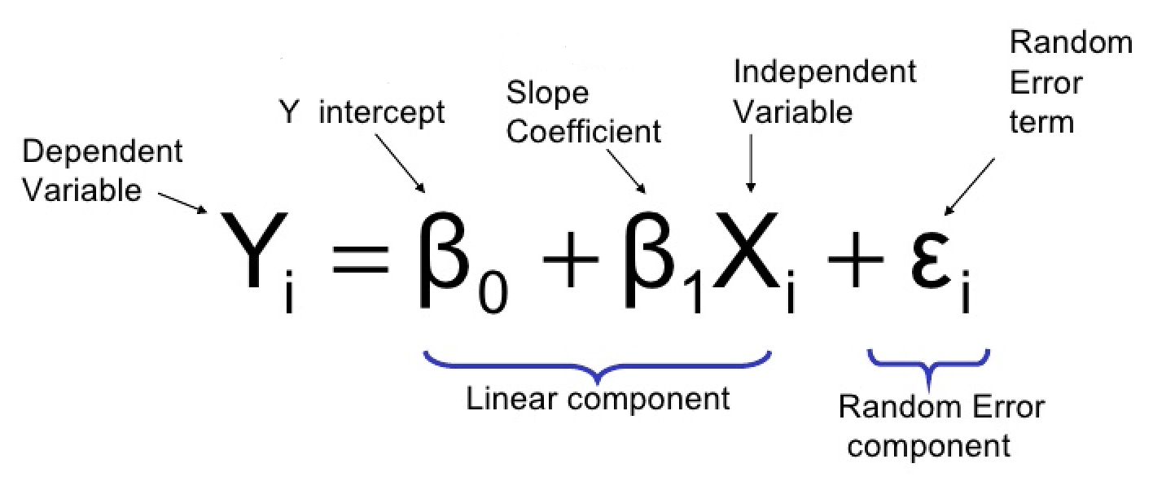
Linear Regression
You’re probably most familiar with this kind of fitting, linear regression
The Model
The Fit
The Fitted Parameters

Slide 5
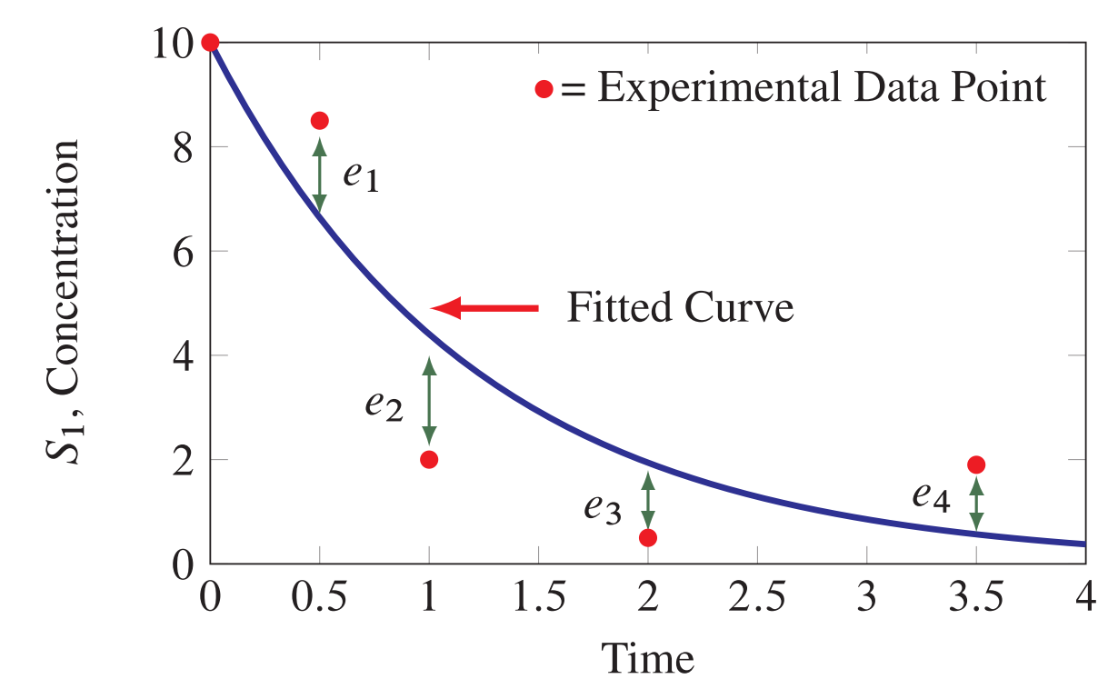
Residuals = Experimental - Fitted
Residual
Missing concepts
Model quality
Parameters

Slide 6
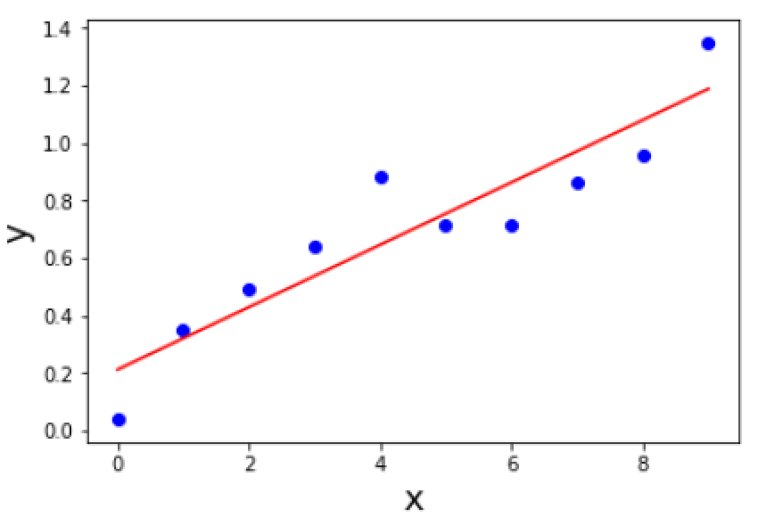
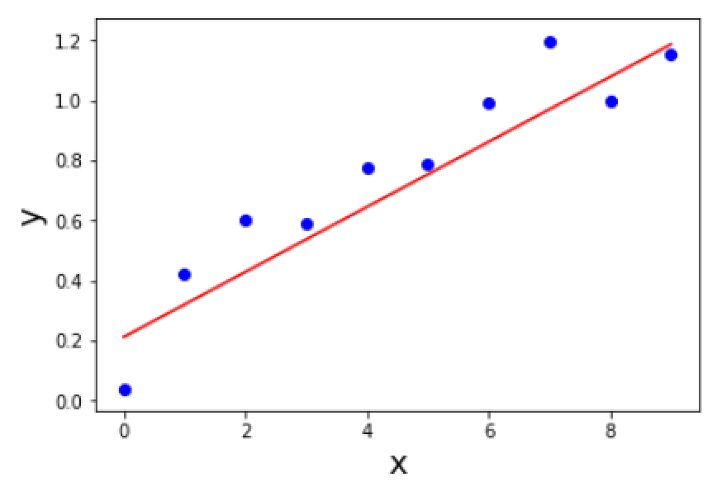
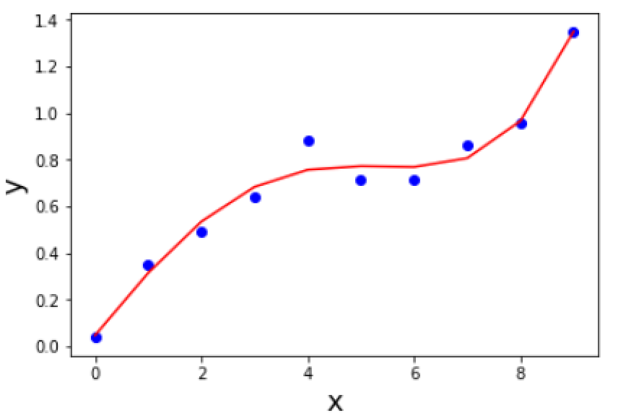
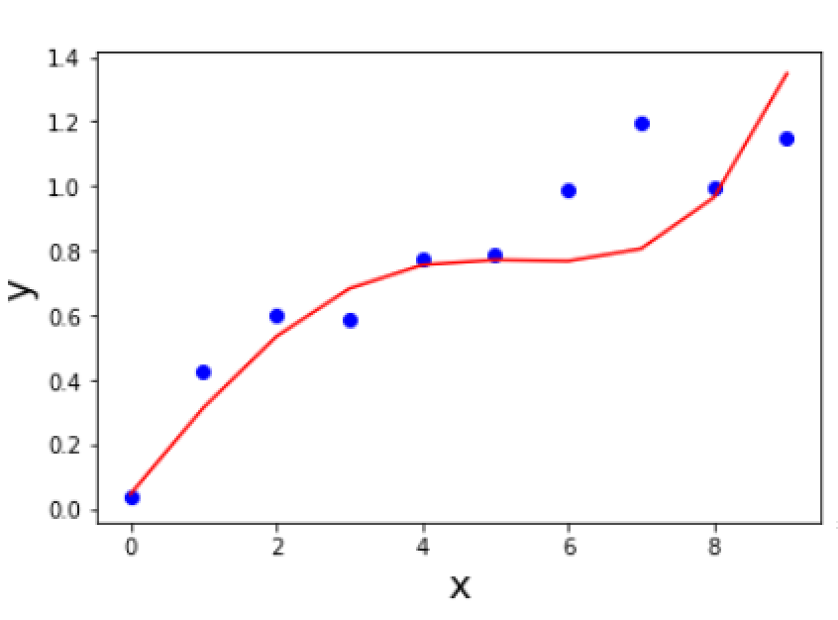


What is A Good Model?
Data 1
Data 2
$$y=ax+b$$
$$y=a_{1}x+a_{2}x^{2}+a_{3}x^{3}+a_{4}x^{4}+b$$
Fits measurement data
Simple (e.g., few parameters)
Generalizes to new measurement data

Slide 7
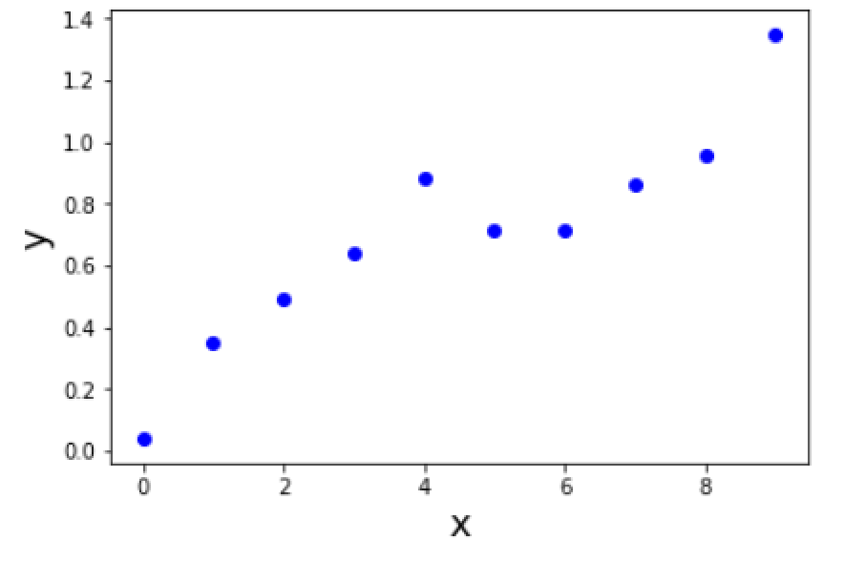


What is A Good Model?
Measured Data
$$y=ax+b$$
$$y=a_{1}x+a_{2}x^{2}+a_{3}x^{3}+a_{4}x^{4}+b$$

Slide 8
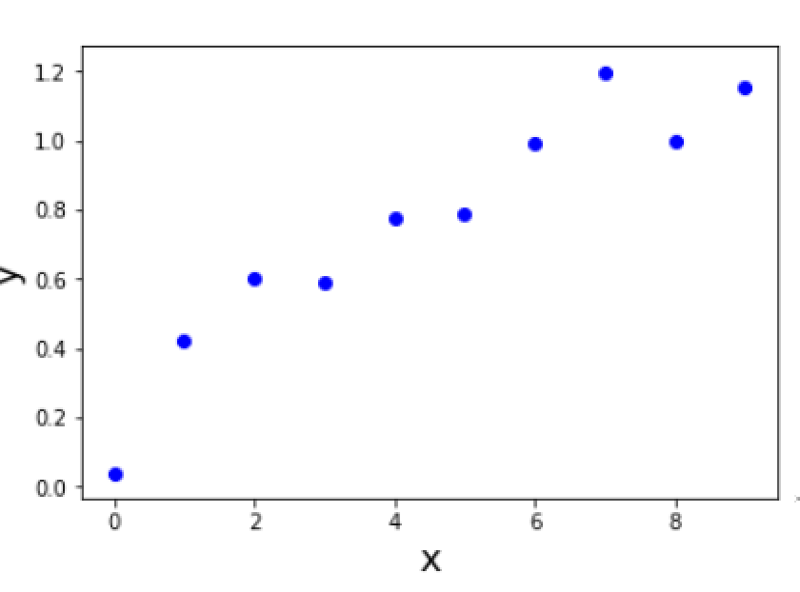
Generalizing Model to New Data
Data 2
Which is the better model now?

Slide 9
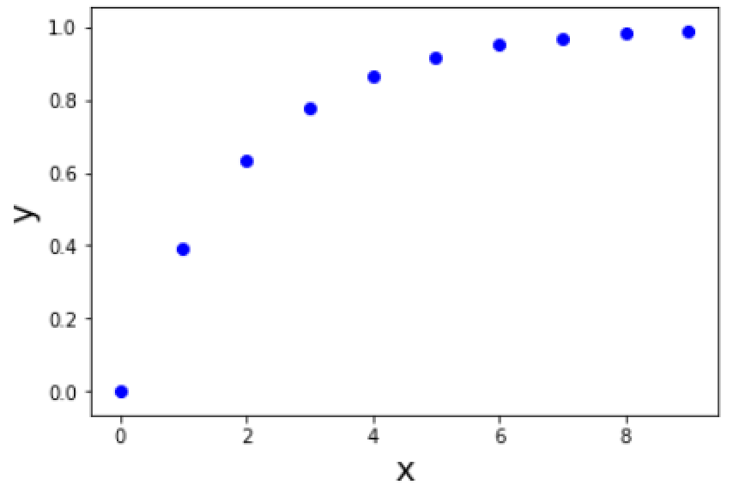
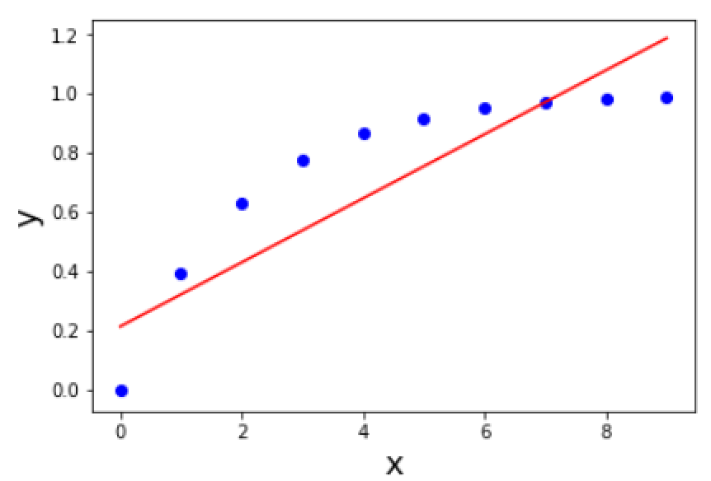
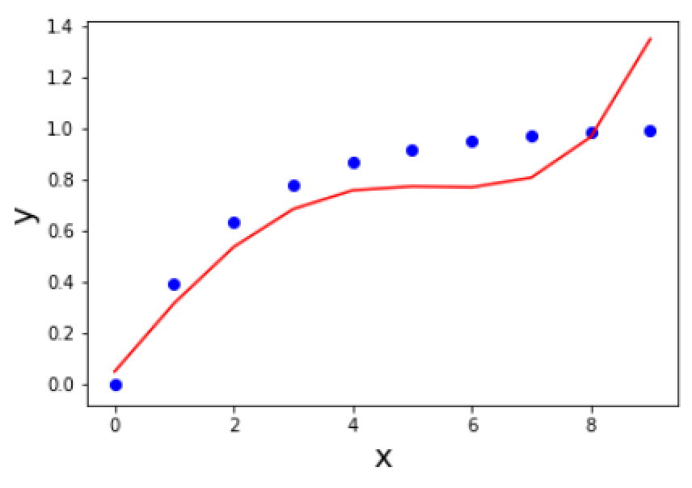
We Never Know if a Real World Model is Correct!
Data Without Measurement Errors

Slide 10
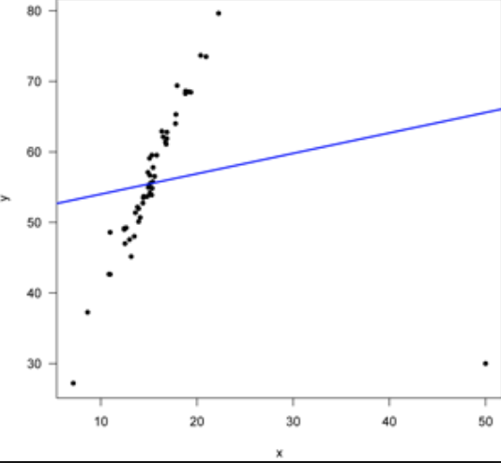
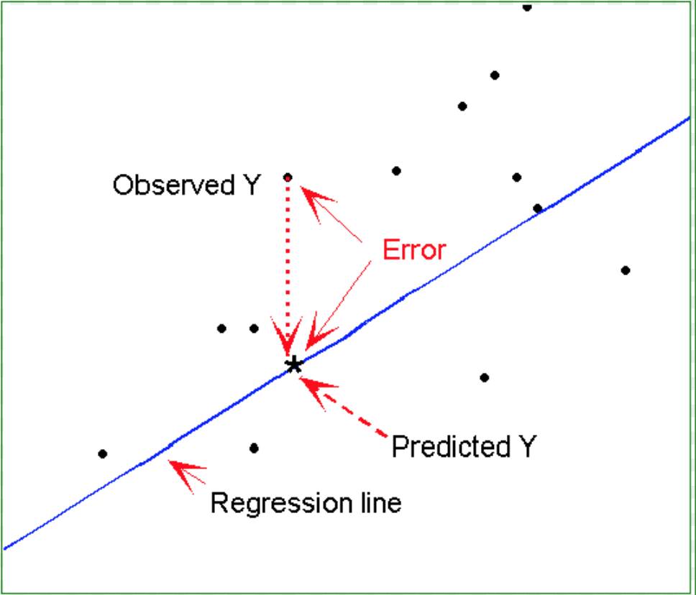
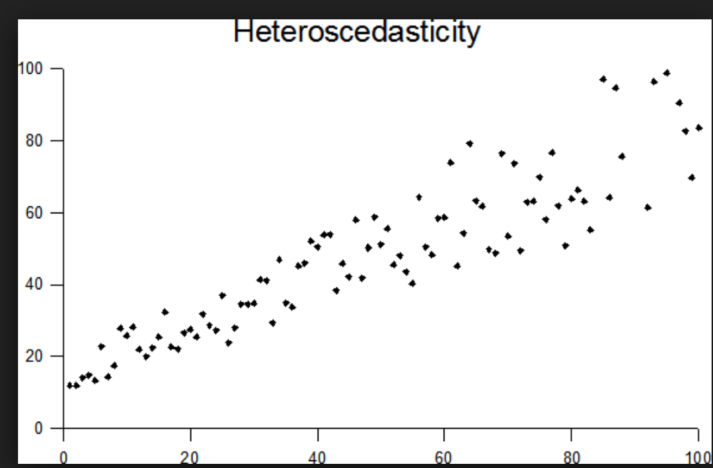
What Residuals Tell Us About Models
Likely Outlier
Functional Bias
Heteroschodasticity

Slide 11
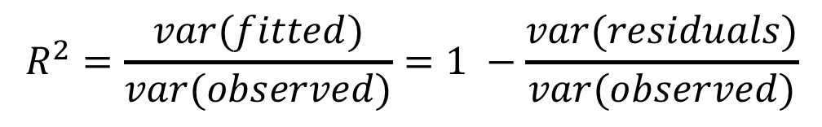



Quantifying Model Quality: $R^{2}$
$$R^{2}=\frac{var(fitted)}{var(observed)}=1 −\frac{var(residuals)}{var(observed)}$$
$$y=ax+b$$
$$y=a_{1}x+a_{2}x^{2}+a_{3}x^{3}+a_{4}x^{4}+b$$
0.85
0.97
Data 1
0.85
0.76
Data 2

Slide 12
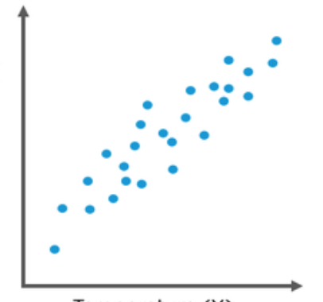
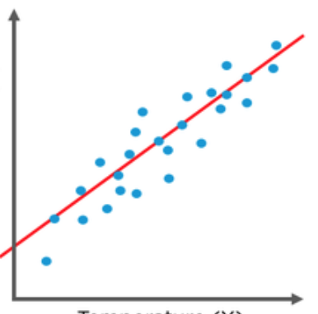
How Least Squares Fits a Line to Data
Line minimizes the sum of the squared residuals.

Slide 13
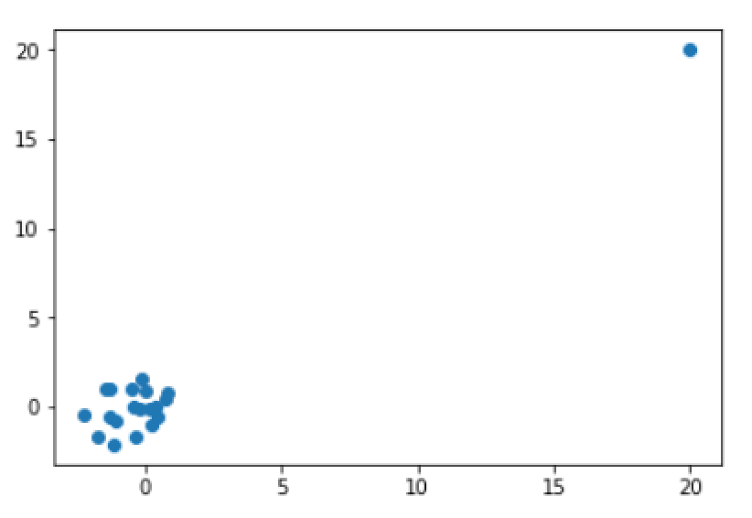
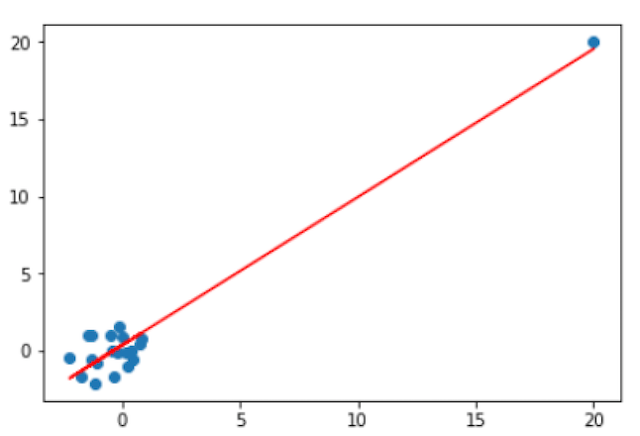

Limitations of Least Squares
What’s the least squares fit for these data?
But doesn’t give smallest squared residuals.
$$R^{2}=0.94$$
Maybe this?
Need outlier detection.

Slide 14
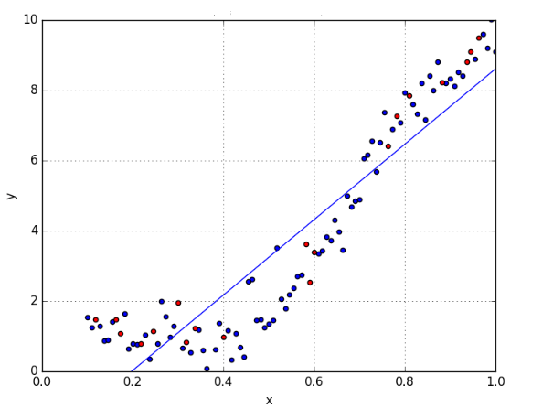
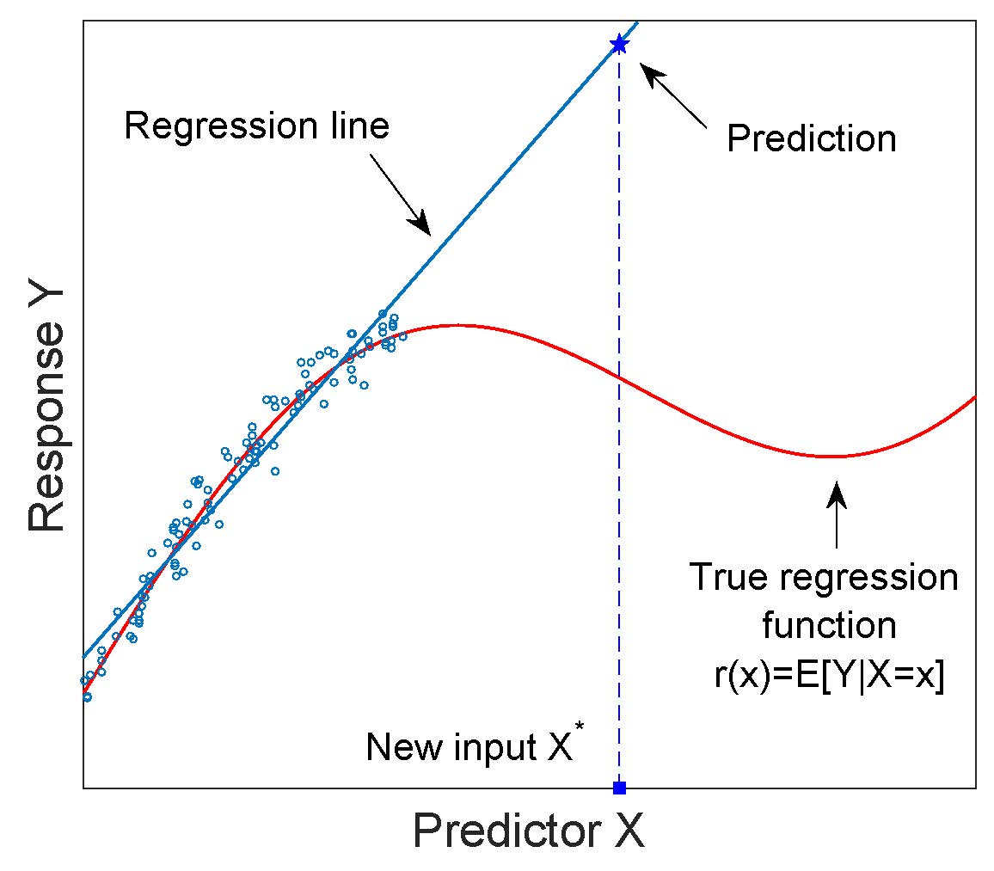
The various problems with fitting
A Bad Fit: Wrong Model
The Wrong Model!

Slide 15
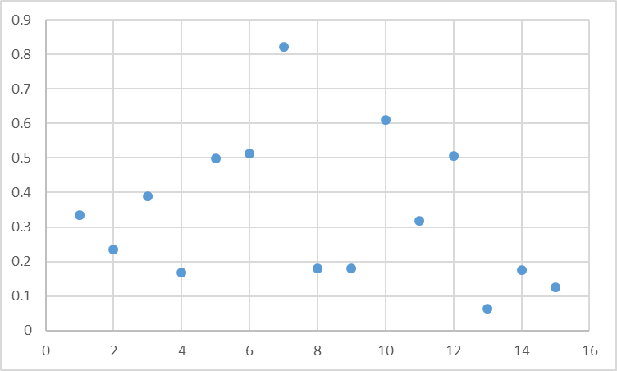
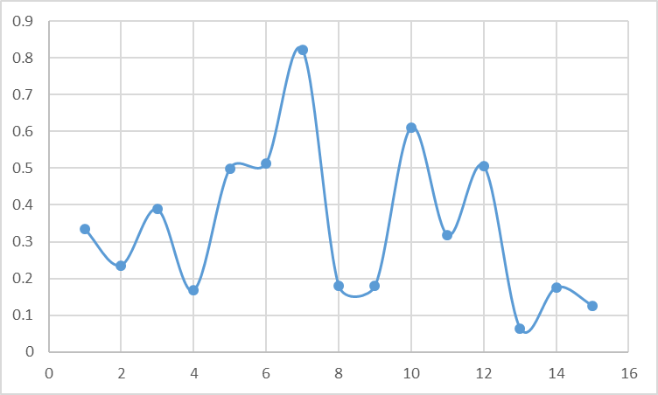
You’ve probably seen this: Someone is a bit too enthusiastic with Excel
Overfitting

Slide 16
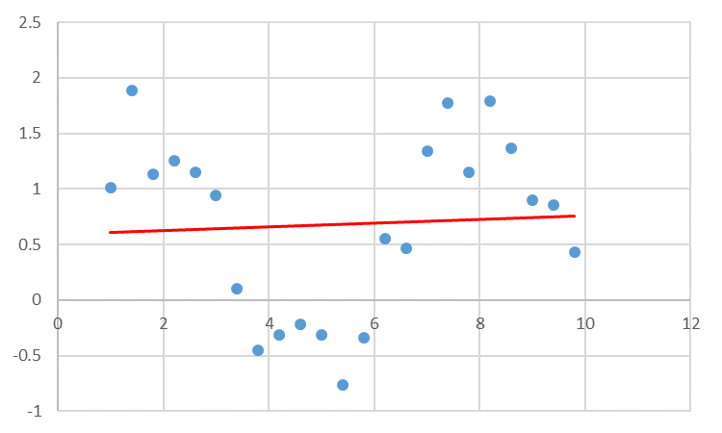
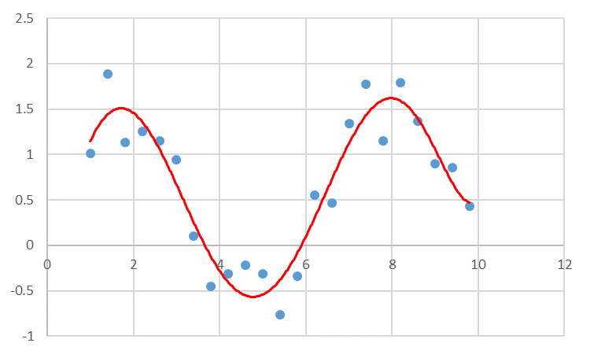
Under fitting
Under fitting
More Realistic

Slide 17
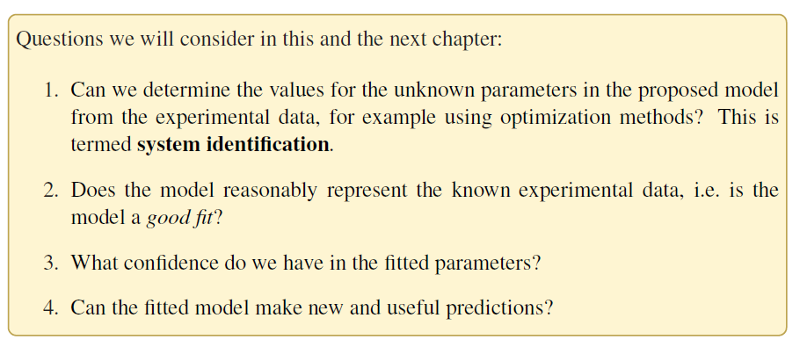
Types of Questions Asked when Fitting: Chapter 9

Slide 18
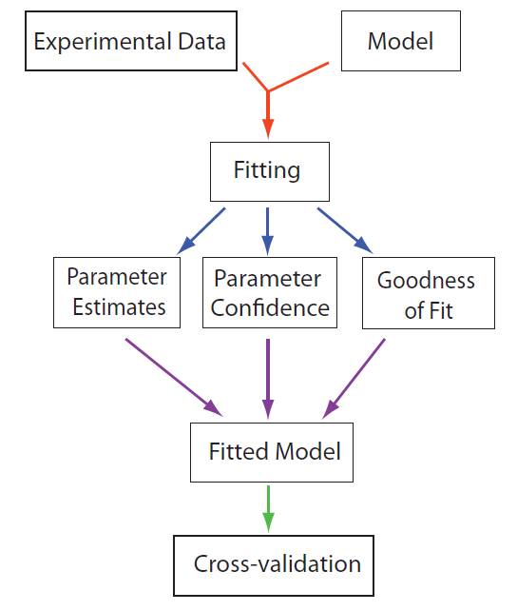
Model Fitting Work flow

Slide 19
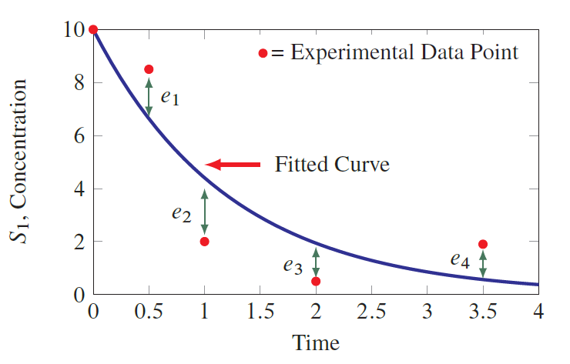
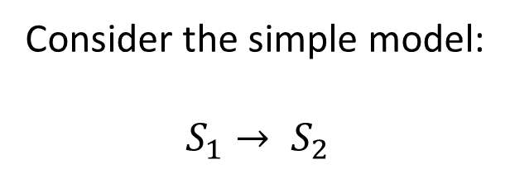

Fitting Models
Consider the simple model:
$$S_{1}→ S_{2}$$
$$e_{i}=residuals$$

Slide 20
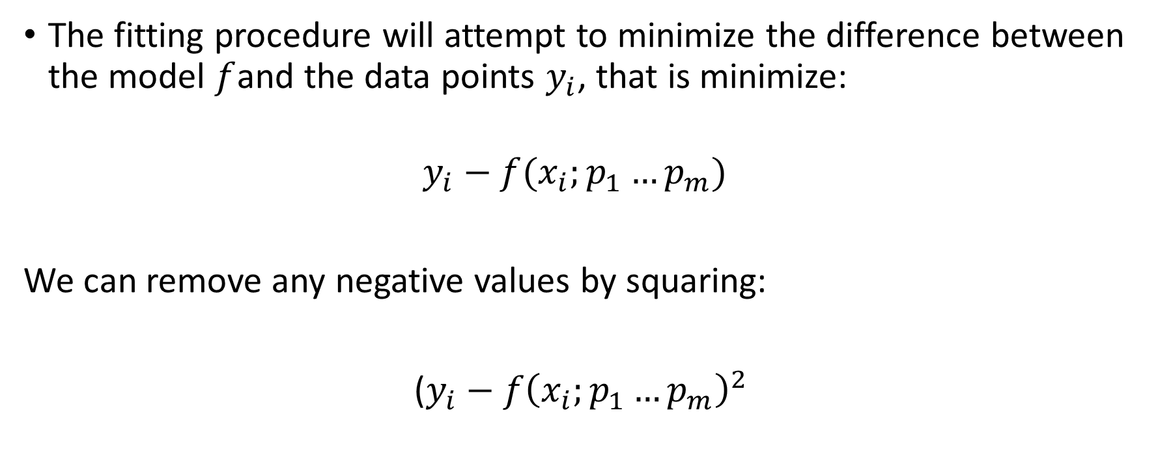
Fitting Models
The fitting procedure will attempt to minimize the difference between the model $f$and the data points $y_{i}$, that is minimize:
$$y_{i}−f(x_{i};p_{1}…p_{m})$$
We can remove any negative values by squaring:
($y_{i}−f{\left(x_{i};p_{1}…p_{m}\right)}^{2}$

Slide 21
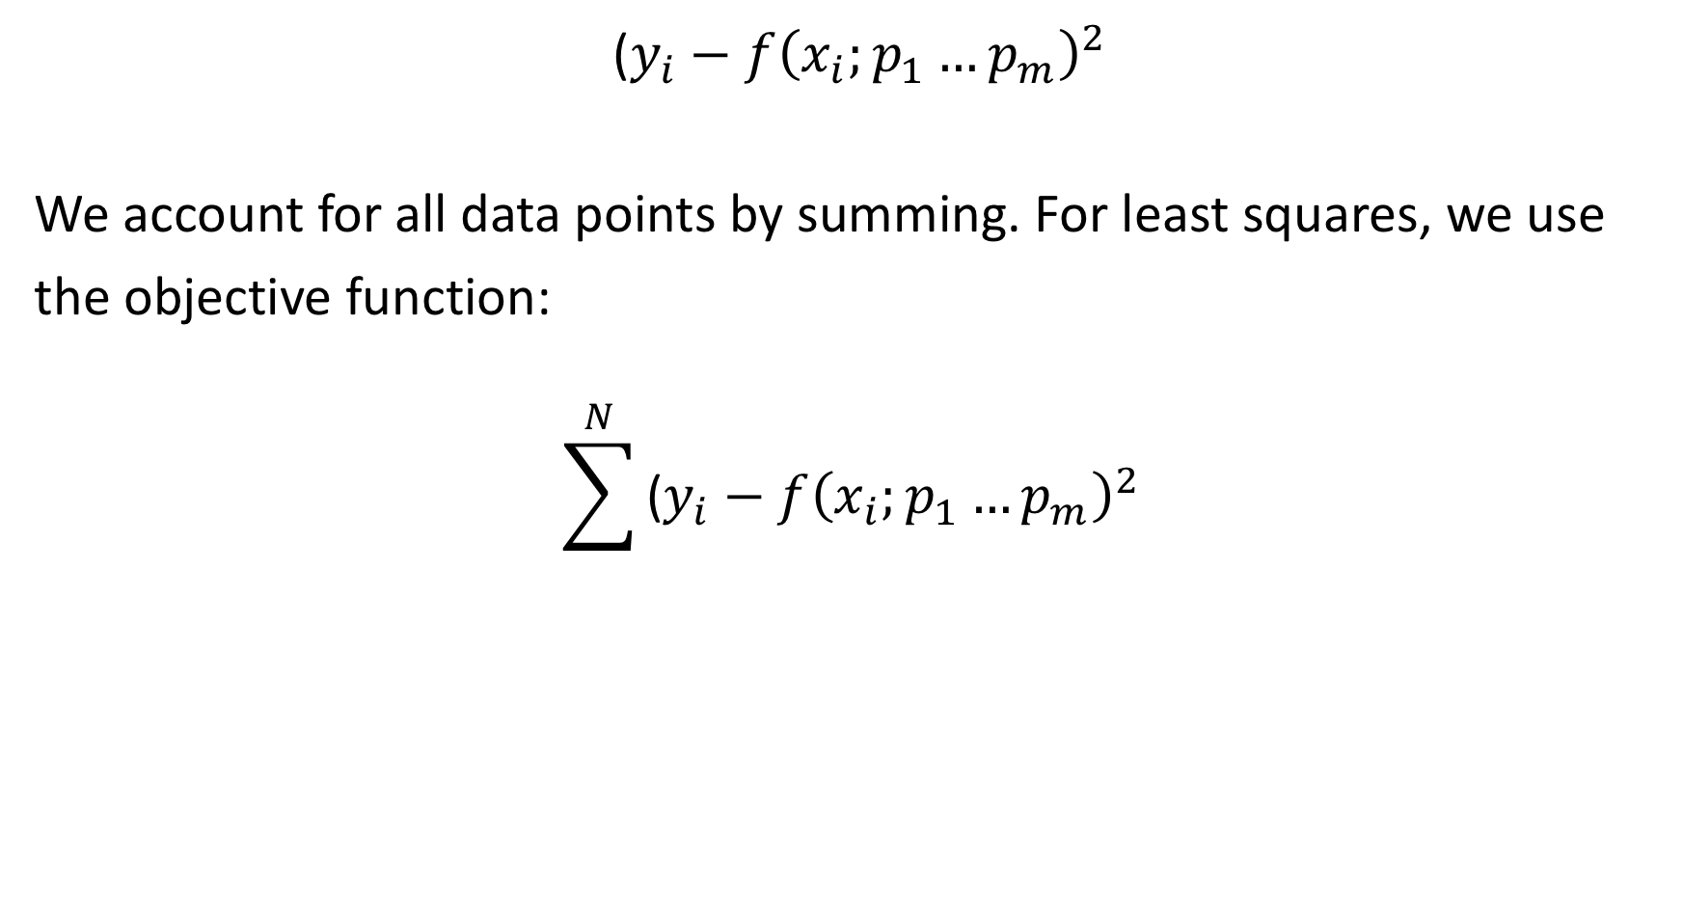
Fitting Models
($y_{i}−f{\left(x_{i};p_{1}…p_{m}\right)}^{2}$
We account for all data points by summing. For least squares, we use
the objective function:
$$\sum^{N}{\text{(}y_{i}−f{\left(x_{i};p_{1}…p_{m}\right)}^{2}}$$

Slide 22
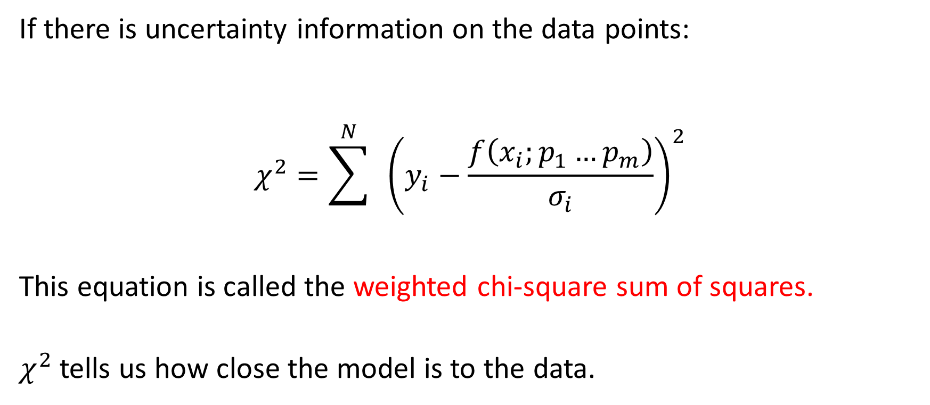
Chi-Square
If there is uncertainty information on the data points:
$$χ^{2}=\sum^{N}{ }{\left(y_{i}−\frac{f\left(x_{i};p_{1}…p_{m}\right)}{σ_{i}}\right)}^{2}$$
This equation is called the weighted chi-square sum of squares.
$χ^{2}$ tells us how close the model is to the data.

Slide 23
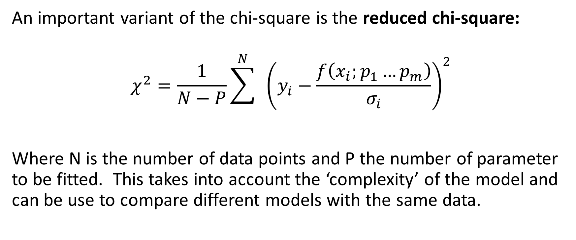
Chi-Square: The reduced Chi-Square
An important variant of the chi-square is the reduced chi-square:
$$χ^{2}=\frac{1}{N−P}\sum^{N}{ }{\left(y_{i}−\frac{f\left(x_{i};p_{1}…p_{m}\right)}{σ_{i}}\right)}^{2}$$
Where N is the number of data points and P the number of parameter to be fitted. This takes into account the ‘complexity’ of the model and can be use to compare different models with the same data.

Slide 24
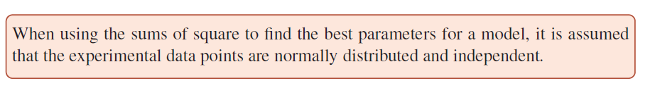
Assumptions

Slide 25
Parameter Optimization
The goal is to find parameter values that will reduce the objective function
to its lowest value.
This process is called Parameter Optimization
One way to find the parameter values minimize the
chi-square is to try all combinations.
This can work but it could take a long time*. So we don’t’ tend to do that.
* For small models this approach could be effective.

Slide 26
Parameter Optimization
Model
Experimental
Data
Run Model
Compare
No
Adjust Parameters
that improve the fit
Yes
Finished?

Slide 27
Parameter Optimization
Instead we use specialized search algorithms, called optimization algorithms.
These tend to be much faster but have their own little problems.

Slide 28
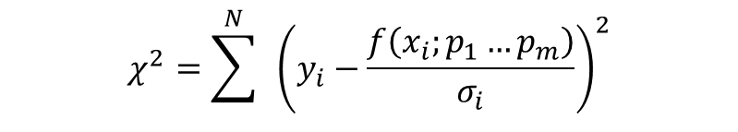
Search Surface
The chi-square function describes a surface (also called the fitness function) in
m dimensions:
For a two dimensional system can be visualized.
$$χ^{2}=\sum^{N}{ }{\left(y_{i}−\frac{f\left(x_{i};p_{1}…p_{m}\right)}{σ_{i}}\right)}^{2}$$

Slide 29
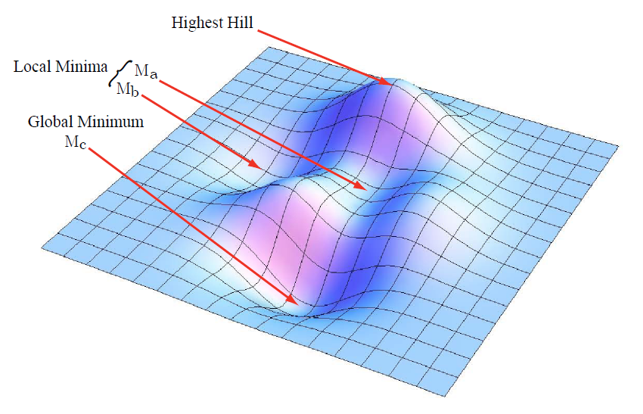
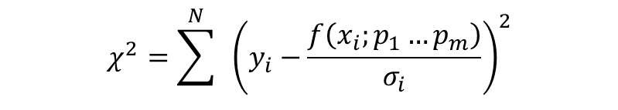
Parameter Optimization
$$χ^{2}=\sum^{N}{ }{\left(y_{i}−\frac{f\left(x_{i};p_{1}…p_{m}\right)}{σ_{i}}\right)}^{2}$$

Slide 30
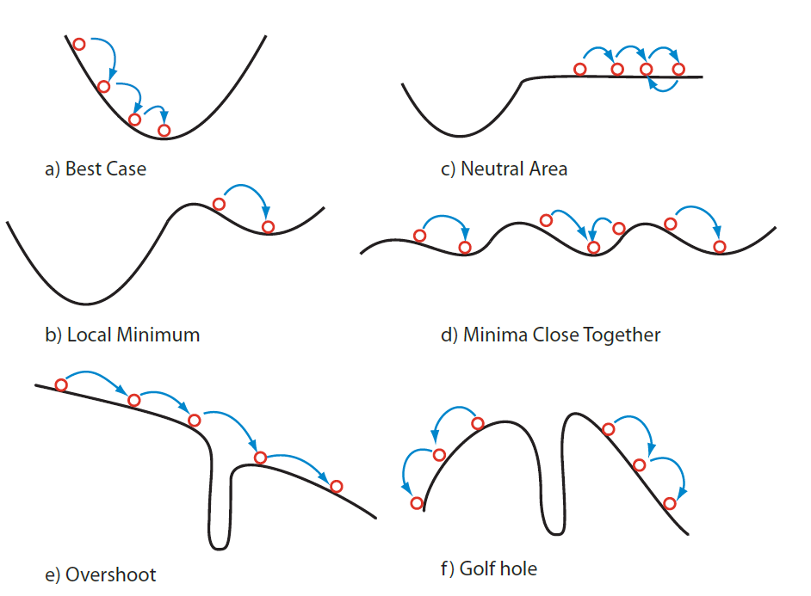
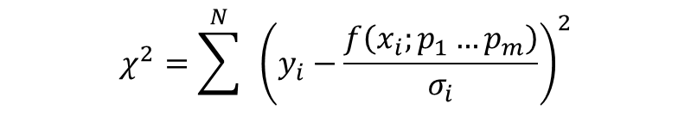
Problems encountered in different fitness landscapes
$$χ^{2}=\sum^{N}{ }{\left(y_{i}−\frac{f\left(x_{i};p_{1}…p_{m}\right)}{σ_{i}}\right)}^{2}$$

Slide 31
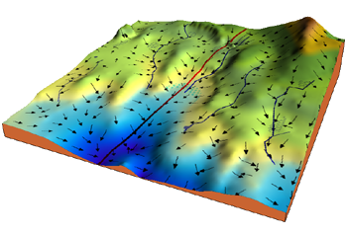
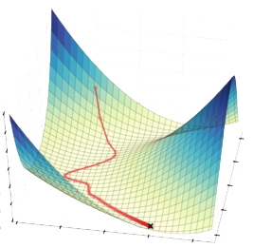
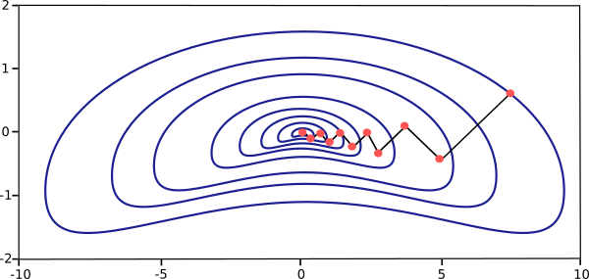
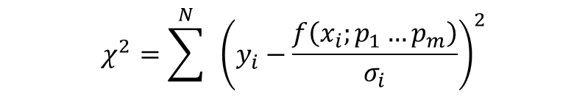
Gradient Descent
It’s the algorithm, that rivers and
streams use to get to the sea.
$$χ^{2}=\sum^{N}{ }{\left(y_{i}−\frac{f\left(x_{i};p_{1}…p_{m}\right)}{σ_{i}}\right)}^{2}$$

Slide 32
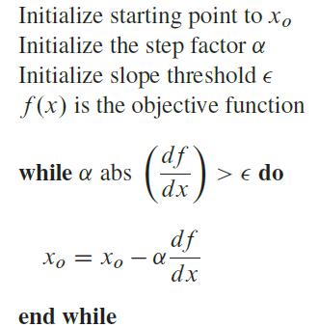
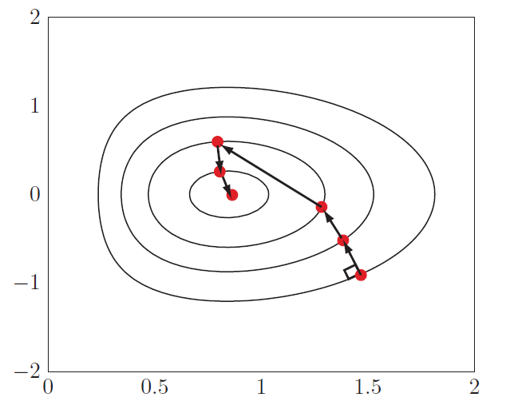

Gradient Descent
$$χ^{2}=\sum^{N}{ }{\left(y_{i}−\frac{f\left(x_{i};p_{1}…p_{m}\right)}{σ_{i}}\right)}^{2}$$
In gradient descent movement is perpendicular to the counter lines.
Major problem is judging how far to travel at each step. There is therefore
a tendency to either overshoot of take small steps and take tool long to get
the bottom of the fitness landscape.

Slide 33
Other Approaches
Gauss-Newton Method
This method relies on the assumption that we can approximate the surface near the minimum using a quadratic function in the parameters.
That is near the minimum we assume that the fitness landscape looks like a parabolic bowl.
The method is specifically designed for functions that are in the form of a sums of squares.

Slide 34
Other Approaches
Gauss-Newton Method
The method uses 2nd-order derivatives (gradient decent used 1st- order derivatives).
The 2nd-order derivatives are computed using an approximation which is only true near the minimum.
Near the minimum convergence is very fast and does not suffer from overshoot.

Slide 35
Levenberg-Marquardt
Gradient decent and Gauss-newton are rarely used on their own.
Gradient decent:
Fast when its far away from minimum
Converges slowly when close to the minimum
Gauss-Newton:
Inaccurate when its far away from the minimum
Converges rapidly and accurately near the minimum
Why not combine them? Get the best of all worlds, we just need to be carful has we transition from one method to the other.
At the start we’ll use Gradient decent, near the minimum we’ll use Gauss-Newton.

Slide 36
lmfit
Wrapper for many fitting algorithms
Usage
Define parameters present
Define python function that calculates residuals given parameter values
Construct the minimizer
Run the minimizer

Slide 37
Fitting Algorithms options for lmfit
’leastsq’: Levenberg-Marquardt (default)
’least_squares’: Least-Squares minimization, using Trust Region Reflective method
’differential_evolution’: differential evolution
’brute’: brute force method
’basinhopping’: basinhopping
’ampgo’: Adaptive Memory Programming for Global Optimization
’nelder’: Nelder-Mead
’lbfgsb’: L-BFGS-B
’powell’: Powell
’cg’: Conjugate-Gradient
’newton’: Newton-CG
’cobyla’: Cobyla
’bfgs’: BFGS
’tnc’: Truncated Newton
’trust-ncg’: Newton-CG trust-region
’trust-exact’: nearly exact trust-region (SciPy >= 1.0)
’trust-krylov’: Newton GLTR trust-region (SciPy >= 1.0)
’trust-constr’: trust-region for constrained optimization (SciPy >= 1.1)
’dogleg’: Dog-leg trust-region
’slsqp’: Sequential Linear Squares Programming
’emcee’: Maximum likelihood via Monte-Carlo Markov Chain
’shgo’: Simplicial Homology Global Optimization (SciPy >= 1.2)
’dual_annealing’: Dual Annealing optimization (SciPy >= 1.2)

Slide 38
Let’s do some parameter fitting!
Start with a very simple model: S1 -> S2 with v = k1*S1
The objective is to fit this model to some date in order to estimate k1
The first thing we need to do is create some ‘experimental data’

Slide 39
Let’s do some parameter fitting!
# We need lots of imports:
import tellurium as te
import numpy as np
import lmfit # Fitting lib
imort math
import random
import pylab as plt

Slide 40
Let’s do some parameter fitting!
# Here is the model
r = te.loada("""
A -> B; k1*A
A = 5;
k1 = 0.15
""")
timeToSimulate = 25
nDataPoints = 5

Slide 41
Let’s do some parameter fitting!
# Create the experimental data
m = r.simulate (0, timeToSimulate, nDataPoints)
# Create some 'experimental' data
x_data = m[:,0]
y_data = m[:,1]
for i in range (nDataPoints):
y_data[i] = y_data[i] + np.random.normal (0, 0.5) # standard deviation of noise
# Plot it to see what it looks like
plt.plot (x_data, y_data, marker='*', linestyle='None')
plt.show()

Slide 42
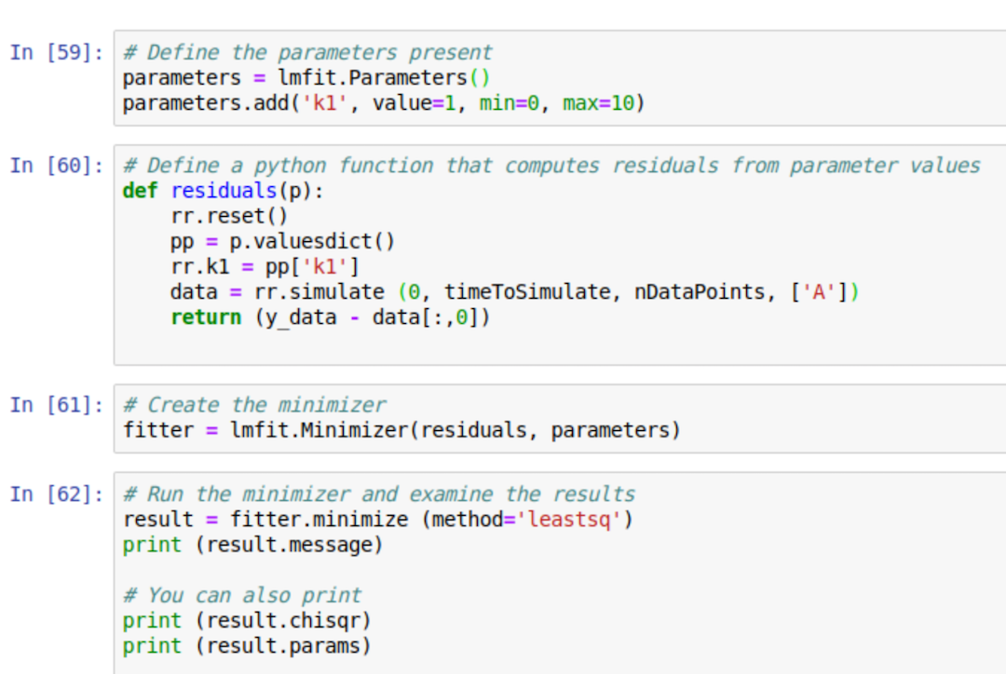
Python Codes for a lmfit

Slide 43
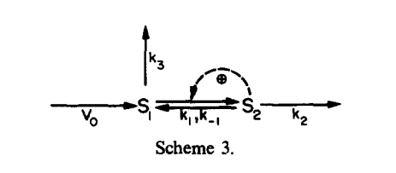
A more complicated model
r = te.loada("""
J1: -> S1; p0;
J2: S1 ->; S1;
J3: S1 -> S2; p1*S1*(1+p4*S2^4)
J4: S2 ->; S2*p6;
p0 = 7;
p1 = 1
p4 = 1
p6 = 4.96
""")
The model has:
a) Two variables
b) Four parameters
c) Four reactions
d) One positive feedback
From: Heinrich and Rapoport, 1977, Prog Biophys, Mole Biol, METABOLIC REGULATION AND MATHEMATICAL MODELS

Slide 44
A more complicated model
“Experimental Data”
Time, S1, S2
0.000000 1.000000 0.000000
0.204082 1.379486 0.204879
0.408163 2.565020 0.356814
0.612245 2.571992 0.480150
0.816327 2.320365 0.599705
1.020408 2.696351 0.637483
1.224490 3.112214 0.603181
1.428571 3.472407 0.843917
1.632653 3.351222 0.797151
1.836735 2.488234 0.828507
2.040816 2.418510 0.979342
2.244898 2.163064 1.024570
etc

Slide 45
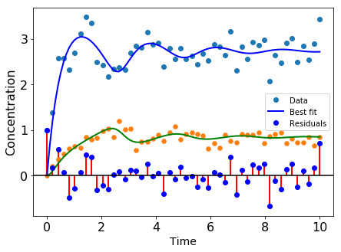
Using the same code as before but with additional parameters:
[[Variables]]
p0: 7.25513008 +/- 0.15932984 (2.20%) (True 7)
p1: 1.09435020 +/- 0.03194616 (2.92%) (True 1)
p4: 1.01152738 +/- 0.15490083 (15.31%) (True 1)
p6: 5.36118612 +/- 0.21478199 (4.01%) (True 4.96)

Slide 46
Optional Material

Slide 47
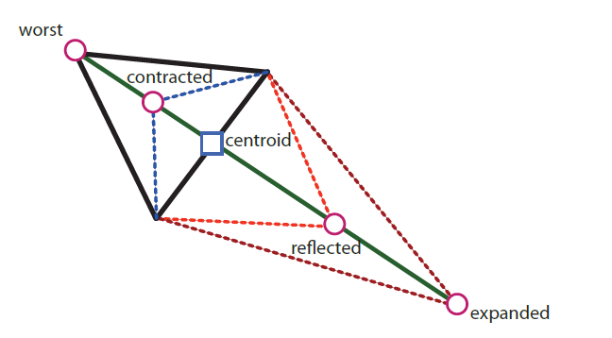
Other Optimizers for Large and more Difficult Problems
Simplex or Nelder and Mead
A simplex is a generalization of the notion of a triangle or tetrahedron to arbitrary dimensions.
The dimensions in this case are the number of parameters + 1.
For a system with two parameters the simplex is a triangle.
The objective function is evaluated at each vertex (each point of the triangle) and the vertices ranked from worst to best.

Slide 48

Other Optimizers for Large and more Difficult Problems
Simplex or Nelder and Mead
A single iteration involves:
1. The simplex reflects the worst point through the opposite face to a new point.
2. If the reflection results in a better point, i.e. lower error, it is further stretched in that direction (expansion).
3. If the reflection results in a worst point, abandon the reflection and contract the worst point towards the opposite face of the simplex.
4. If all the above fails, contract along all faces towards the best point.

Slide 49
Other Optimizers for Large and more Difficult Problems
Simplex or Nelder and Mead

Slide 50
Other Optimizers for Large and more Difficult Problems
Genetic or Evolutionary Algorithms – Many variants!
Simulated annealing
Various stochastic optimizers

Slide 51

Differential Evolution

Slide 52

Differential Evolution

Slide 53
Differential Evolution
To use differential evolution ins python, all you have to do is:
result = minimizer.minimize ('differential_evolution')

