Slide 1


Extra Tellurium Notes
In Collaboration with James Glazier, Bloomington

Slide 2
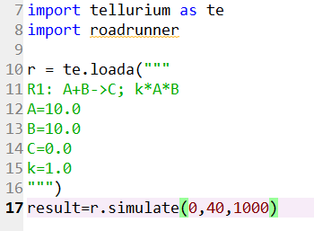
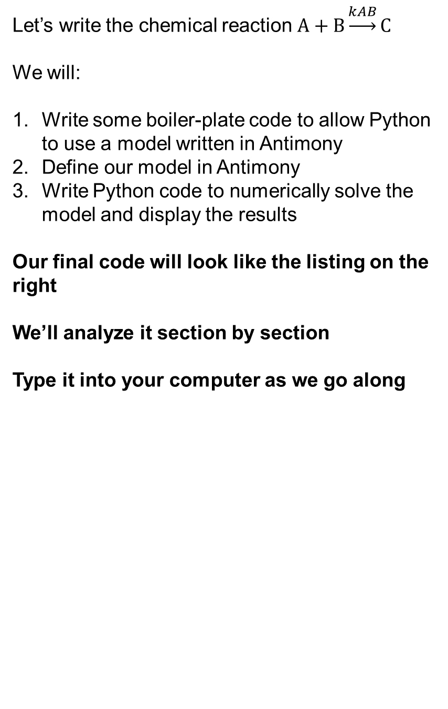
Writing and Solving a Simple Chemical Reaction in Tellurium
Let’s write the chemical reaction $A+B\underset{→}{kAB}C$
We will:
Write some boiler-plate code to allow Python to use a model written in Antimony
Define our model in Antimony
Write Python code to numerically solve the model and display the results
Our final code will look like the listing on the right
We’ll analyze it section by section
Type it into your computer as we go along
Note that all your simulations will have a mixture of these two languages

Slide 3
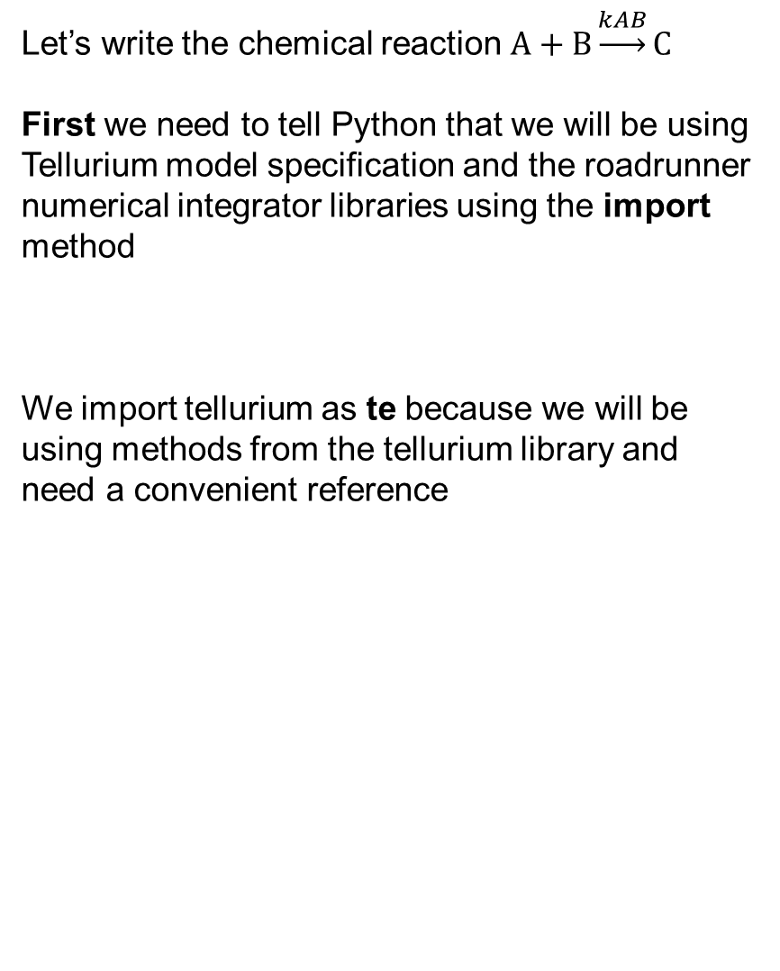
Loading Tellurium into Python
Let’s write the chemical reaction $A+B\underset{→}{kAB}C$
First we need to tell Python that we will be using Tellurium model specification and the roadrunner numerical integrator libraries using the import method
We import tellurium as te because we will be using methods from the tellurium library and need a convenient reference
Note that all your simulations will have a mixture of these two languages

Slide 4
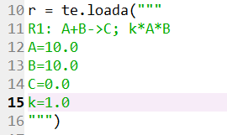

Loading an Antimony Model in Tellurium
Let’s write the chemical reaction $A+B\underset{→}{kAB}C$
Next, the Tellurium method te.loada()
Loads an Antimony-specified model character string as a simulation object and makes it available in Python via the object r
We could name the simulation object anything we liked (r1, model1,…)

Slide 5
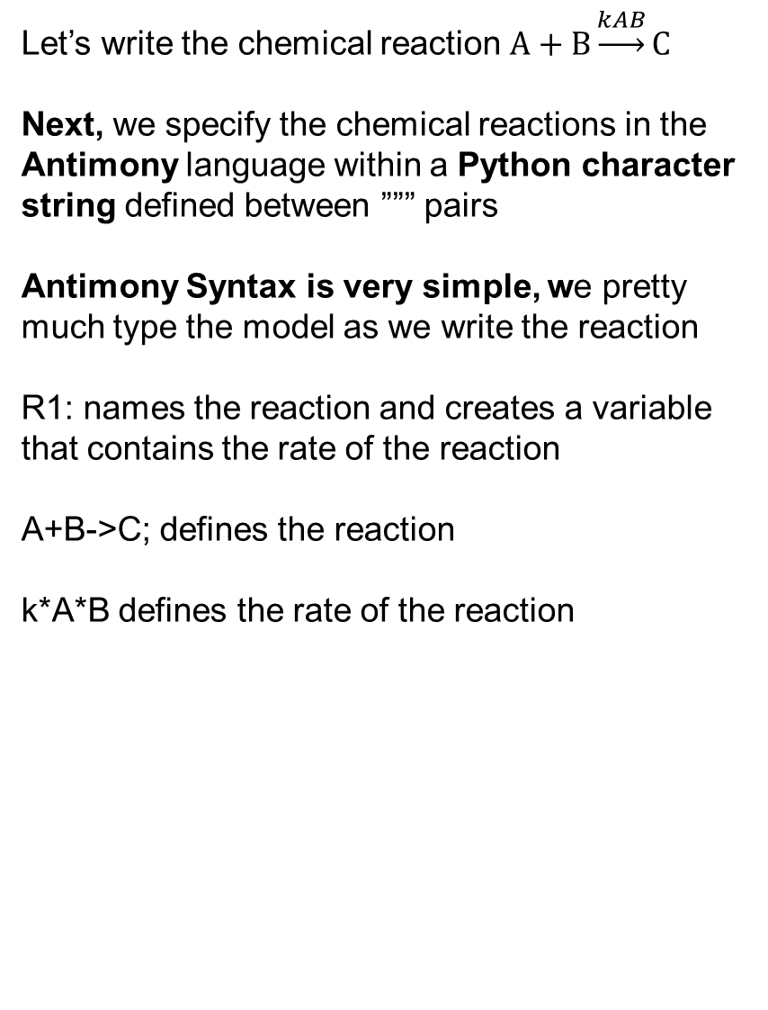
Defining a Chemical Reaction in Antimony
Let’s write the chemical reaction $A+B\underset{→}{kAB}C$
Next, we specify the chemical reactions in the Antimony language within a Python character string defined between ””” pairs
Antimony Syntax is very simple, we pretty much type the model as we write the reaction
R1: names the reaction and creates a variable that contains the rate of the reaction
A+B->C; defines the reaction
k*A*B defines the rate of the reaction

Slide 6
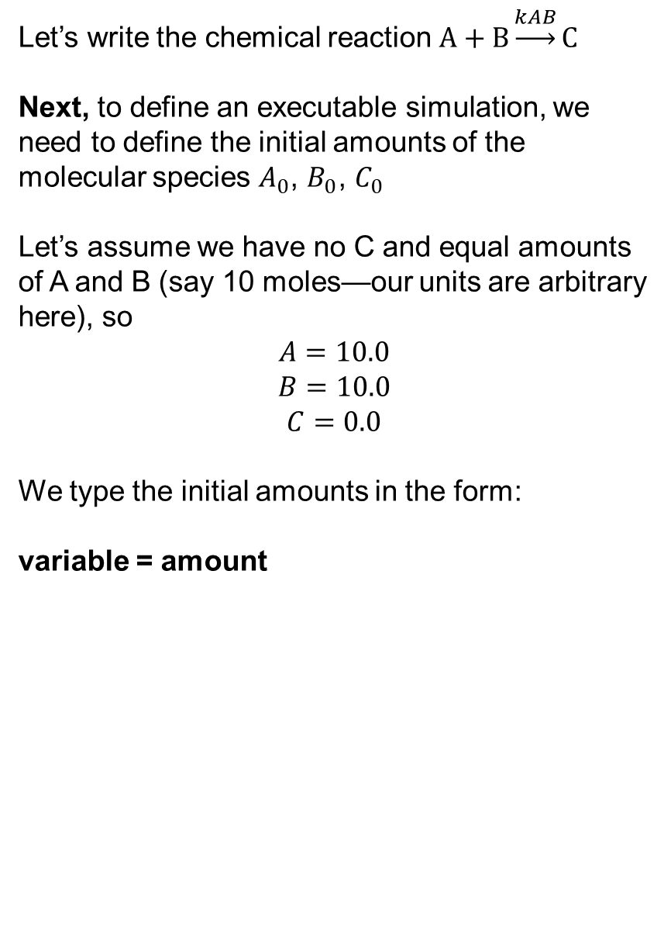
Setting Initial Conditions in Antimony
Let’s write the chemical reaction $A+B\underset{→}{kAB}C$
Next, to define an executable simulation, we need to define the initial amounts of the molecular species $A_{0}$, $B_{0}$, $C_{0}$
Let’s assume we have no C and equal amounts of A and B (say 10 moles—our units are arbitrary here), so
$$A=10.0$$
$$B=10.0$$
$$C=0.0$$
We type the initial amounts in the form:
variable = amount

Slide 7
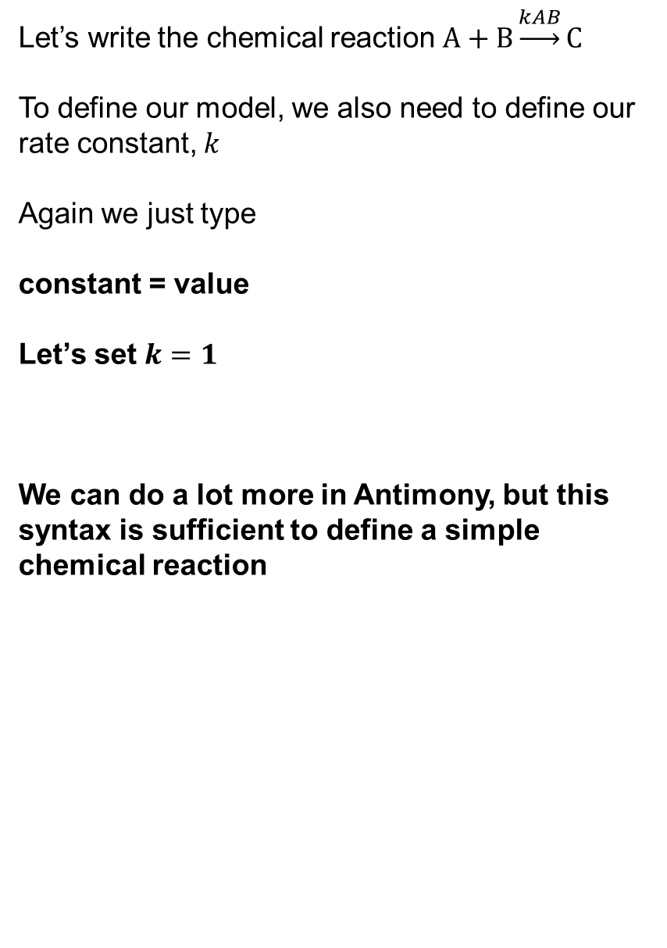
Defining Rate Constants in Antimony
Let’s write the chemical reaction $A+B\underset{→}{kAB}C$
To define our model, we also need to define our rate constant, $k$
Again we just type
constant = value
Let’s set $k=1$
We can do a lot more in Antimony, but this syntax is sufficient to define a simple chemical reaction

Slide 8
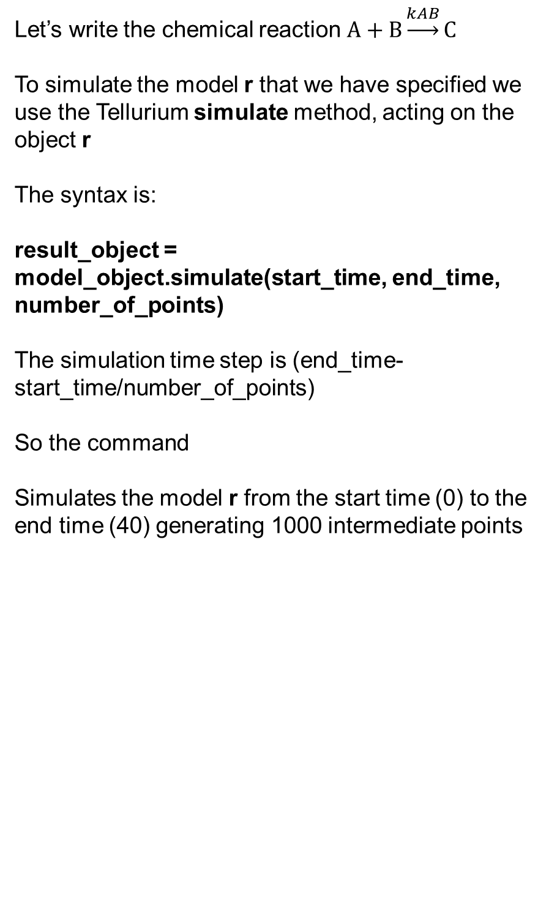
Defining a Simulation of an Antimony Model in Python
Let’s write the chemical reaction $A+B\underset{→}{kAB}C$
To simulate the model r that we have specified we use the Tellurium simulate method, acting on the object r
The syntax is:
result_object = model_object.simulate(start_time, end_time, number_of_points)
The simulation time step is (end_time-start_time/number_of_points)
So the command
Simulates the model r from the start time (0) to the end time (40) generating 1000 intermediate points

Slide 9
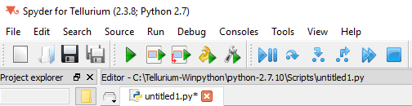

Running a Tellurium Simulation in Spyder2
Let’s simulate the chemical reaction $A+B\underset{→}{kAB}C$
To run the simulation hit the run button

Slide 10
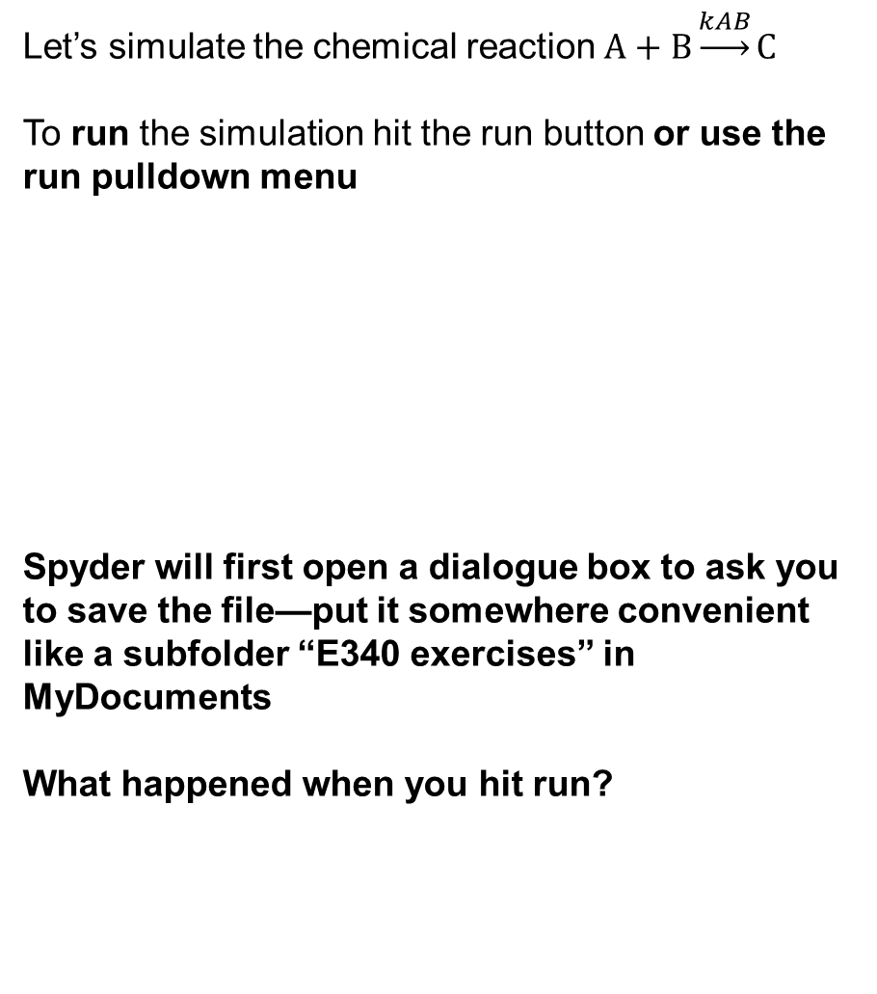
Running a Tellurium Simulation in Spyder2
Let’s simulate the chemical reaction $A+B\underset{→}{kAB}C$
To run the simulation hit the run button or use the run pulldown menu
Spyder will first open a dialogue box to ask you to save the file—put it somewhere convenient like a subfolder “E340 exercises” in MyDocuments
What happened when you hit run?

Slide 11
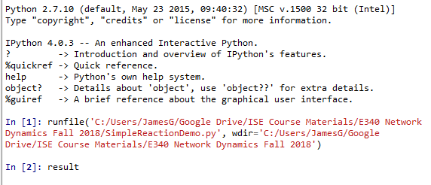
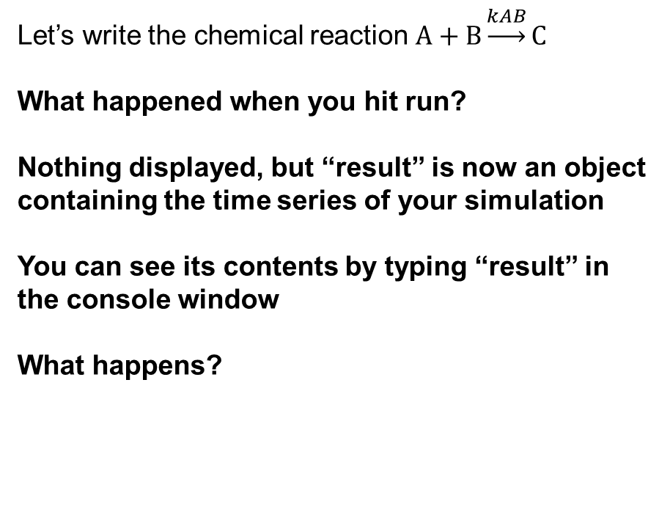
Running a Tellurium Simulation in Spyder2
Let’s write the chemical reaction $A+B\underset{→}{kAB}C$
What happened when you hit run?
Nothing displayed, but “result” is now an object containing the time series of your simulation
You can see its contents by typing “result” in the console window
What happens?

Slide 12
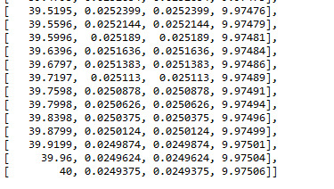
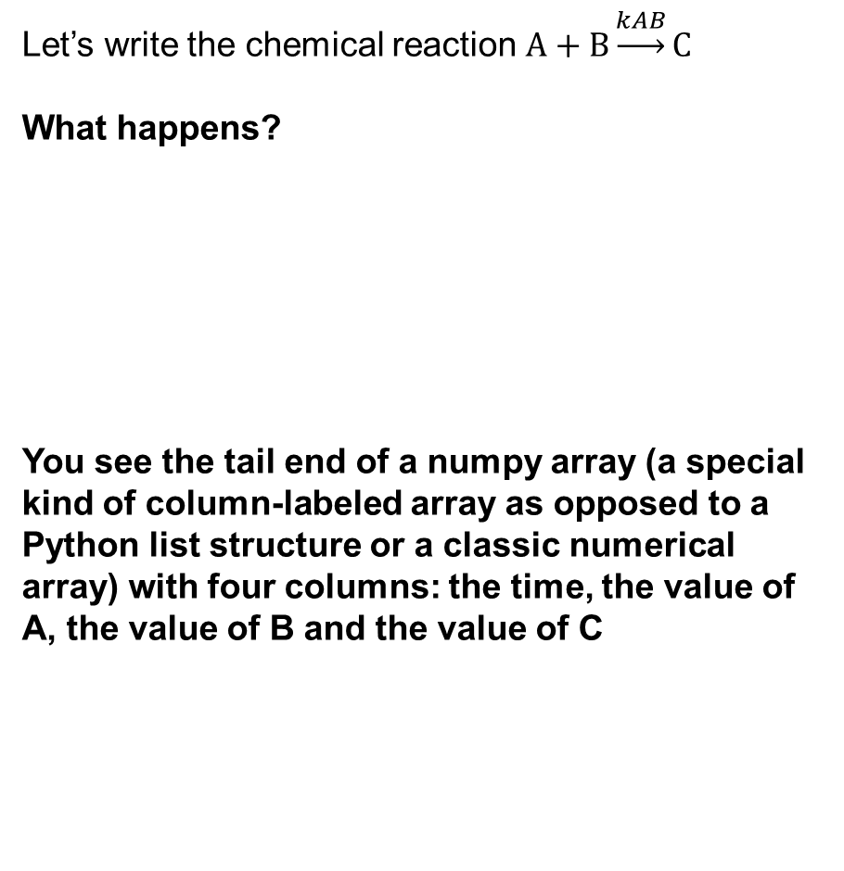
Viewing the Output of a Tellurium Simulation in Python
Let’s write the chemical reaction $A+B\underset{→}{kAB}C$
What happens?
You see the tail end of a numpy array (a special kind of column-labeled array as opposed to a Python list structure or a classic numerical array) with four columns: the time, the value of A, the value of B and the value of C

Slide 13
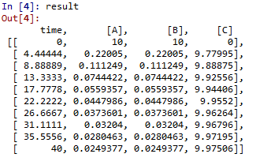
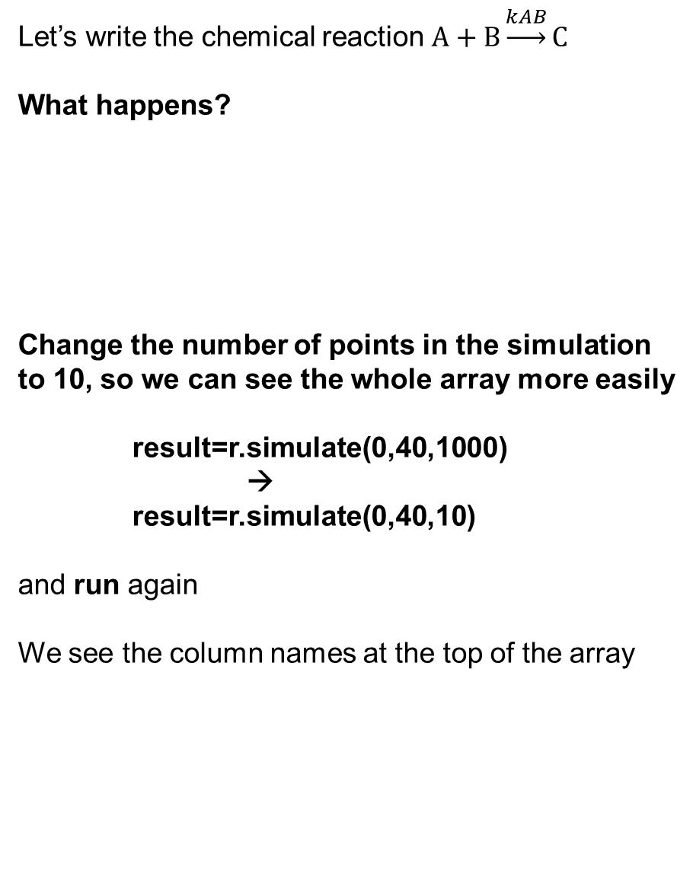
Viewing the Output of a Tellurium Simulation in Python
Let’s write the chemical reaction $A+B\underset{→}{kAB}C$
What happens?
Change the number of points in the simulation to 10, so we can see the whole array more easily
result=r.simulate(0,40,1000)
→
result=r.simulate(0,40,10)
and run again
We see the column names at the top of the array

Slide 14
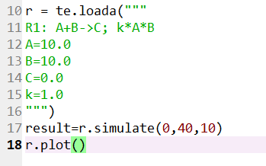

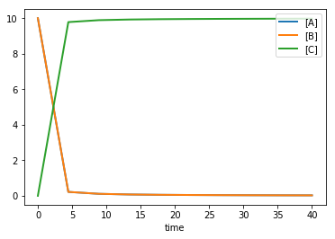
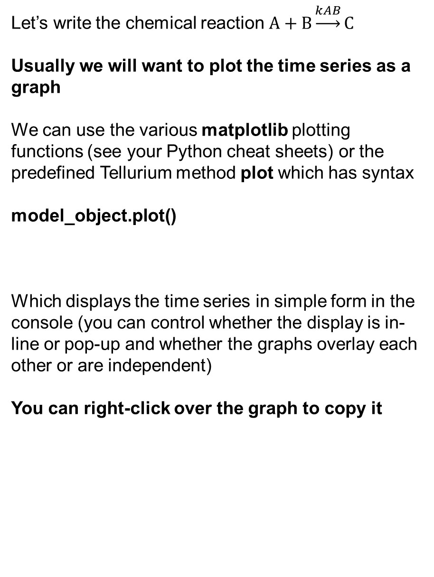
Plotting the Output of a Tellurium Simulation in Python
Let’s write the chemical reaction $A+B\underset{→}{kAB}C$
Usually we will want to plot the time series as a graph
We can use the various matplotlib plotting functions (see your Python cheat sheets) or the predefined Tellurium method plot which has syntax
model_object.plot()
Which displays the time series in simple form in the console (you can control whether the display is in-line or pop-up and whether the graphs overlay each other or are independent)
You can right-click over the graph to copy it
Concentration
Time

Slide 15
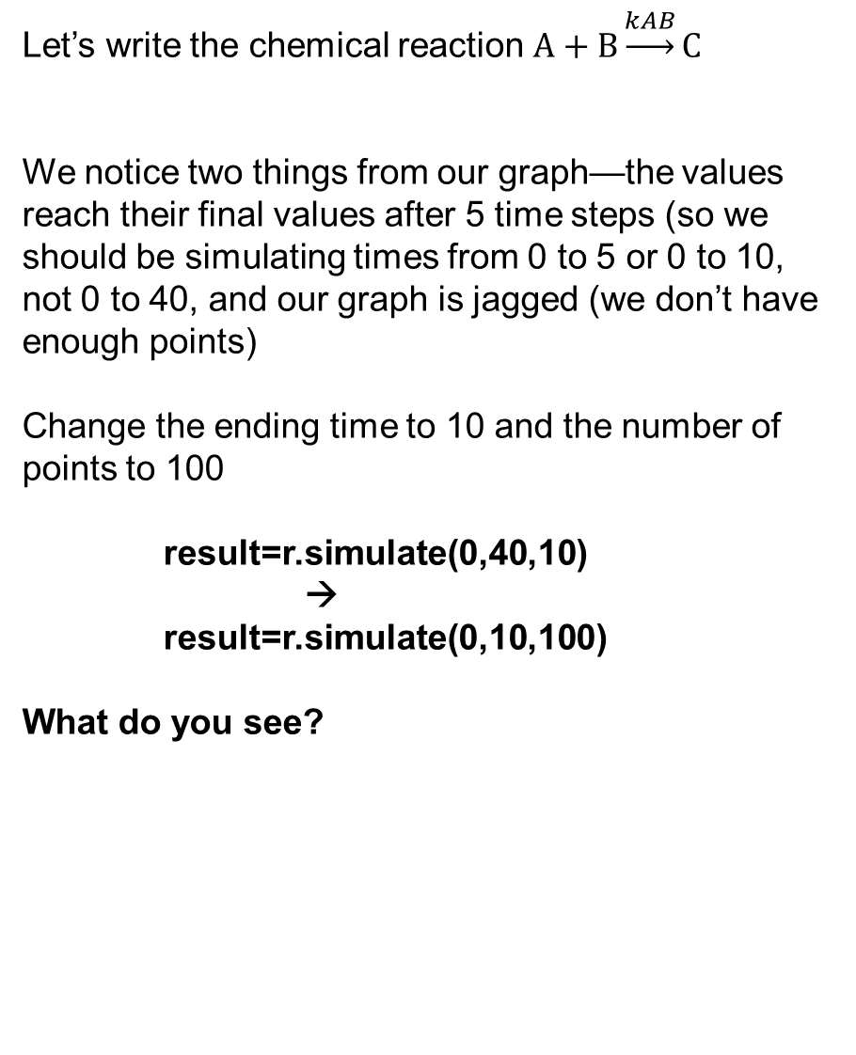
Selecting the Time Step and Duration of a Simulation
Let’s write the chemical reaction $A+B\underset{→}{kAB}C$
We notice two things from our graph—the values reach their final values after 5 time steps (so we should be simulating times from 0 to 5 or 0 to 10, not 0 to 40, and our graph is jagged (we don’t have enough points)
Change the ending time to 10 and the number of points to 100
result=r.simulate(0,40,10)
→
result=r.simulate(0,10,100)
What do you see?
Concentration
Time

Slide 16
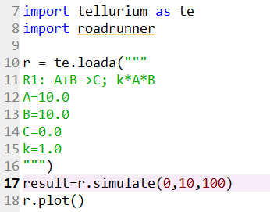
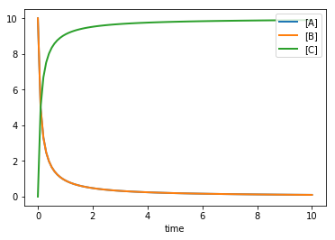

Selecting the Time Step and Duration of a Simulation
Let’s write the chemical reaction $A+B\underset{→}{kAB}C$
For result=r.simulate(0,10,100)
We can see the whole time-series of changes of concentration in our graph
Concentration
Time

