Slide 1
Computational Systems Biology for Medical Applications Lecture 9: Model Fitting-Dealing With Uncertainty
Joseph L. Hellerstein*
Herbert Sauro**
*eScience Institute, Computer Science & Engineering
**BioEngineering

Slide 2
Topics
Cross validation
Bootstrapping
AIC
Change in frame of reference from evaluating parameter optimization techniques to model evaluation

Slide 3
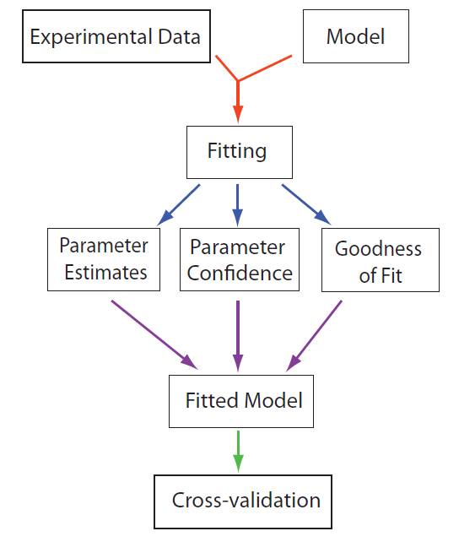
Model Fitting Work flow

Slide 4
Motivation

Slide 5
Cross Validation is an efficient way to quantify the quality of a model.

Slide 6



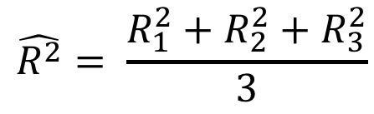
Cross Validation Summary
Divide full data set into N Folds
Data
Train 1
Test 1
$$R_{1}^{2}$$
Construct N training data sets and N test data sets
Train 2
Test 2
$$R_{2}^{2}$$
Obtain N evaluations of the model
Train 3
Test 3
$$R_{3}^{2}$$
Report statistics of the evaluations
$$\hat{R^{2}}= \frac{R_{1}^{2}+R_{2}^{2}+R_{3}^{2}}{3}$$

Slide 7
Python To Generate Indices of Train, Test Data
def foldGenerator(num_points, num_folds):
indices = range(num_points)
for remainder in range(num_folds):
test_indices = []
for idx in indices:
if idx % num_folds == remainder:
test_indices.append(idx)
train_indices = np.array(
list(set(indices).difference(test_indices)))
test_indices = np.array(test_indices)
yield train_indices, test_indices

Slide 8
Using the Fold Generator
generator = foldGenerator(10, 5)
for g in generator:
print(g)
(array([1, 2, 3, 4, 6, 7, 8, 9]), array([0, 5]))
(array([0, 2, 3, 4, 5, 7, 8, 9]), array([1, 6]))
(array([0, 1, 3, 4, 5, 6, 8, 9]), array([2, 7]))
(array([0, 1, 2, 4, 5, 6, 7, 9]), array([3, 8]))
(array([0, 1, 2, 3, 5, 6, 7, 8]), array([4, 9]))

Slide 9
Constructing the Regression Matrix
def buildMatrix(xv, order):
"""
:param array-of-float xv:
:return matrix:
"""
length = len(xv)
xv = xv.reshape(length)
constants = np.repeat(1, length)
constants = constants.reshape(length)
data = [constants]
for n in range(1, order+1):
data.append(xv*data[-1])
mat = np.matrix(data)
return mat.T

Slide 10
Doing the Regression
def regress(xv, yv, train, test, order=1):
"""
:param array-of-float xv: predictor values
:param array-of-float yv: response values
:param array-of-int train: indices of training data
:param array-of-int test: indices of test data
:param int order: Order of the polynomial regression
return float, array-float, array-float: R2, y_test, y_preds
"""
regr = linear_model.LinearRegression()
mat_train = buildMatrix(xv[train], order)
regr.fit(mat_train, yv[train])
mat_test = buildMatrix(XV[test], order)
y_pred = regr.predict(mat_test)
rsq = r2_score(YV[test], y_pred)
return rsq, yv[test], y_pred

Slide 11
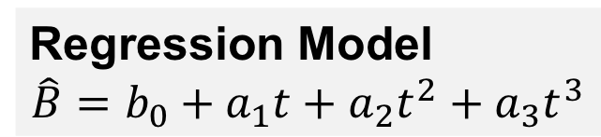
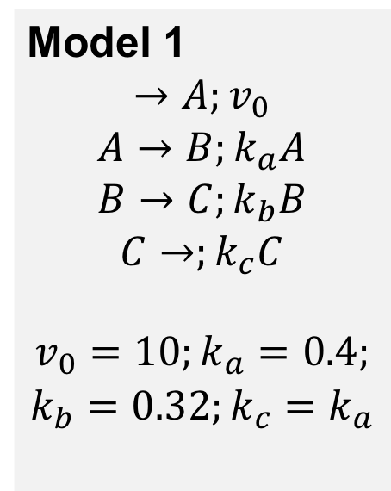
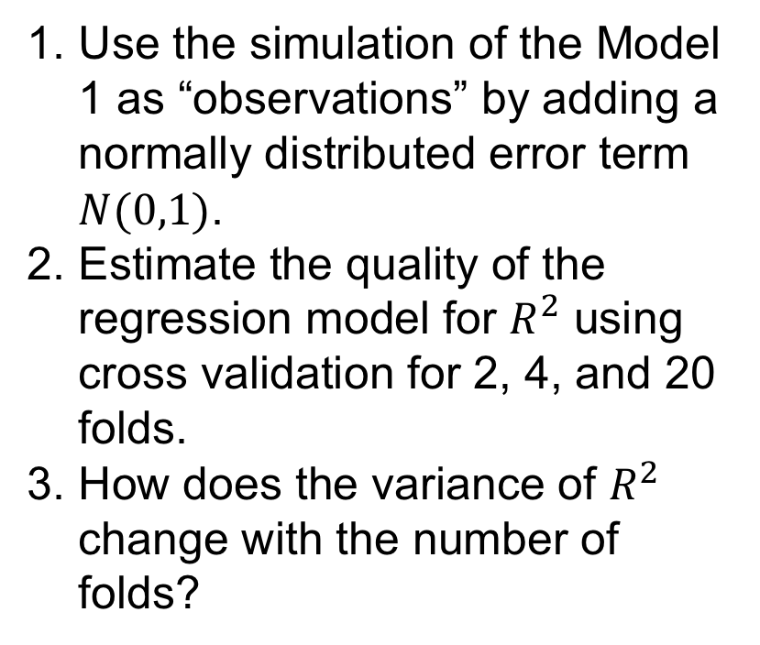
Exercise: Using Cross Validation
Model 1
$$→A;v_{0}$$
$$A→B;k_{a}A$$
$$B→C;k_{b}B$$
$$C→;k_{c}C$$
$$v_{0}=10;k_{a}=0.4;$$
$$k_{b}=0.32;k_{c}=k_{a}$$
Regression Model
$$\hat{B}=b_{0}+a_{1}t+a_{2}t^{2}+a_{3}t^{3}$$
Use the simulation of the Model 1 as “observations” by adding a normally distributed error term $N(0,1)$.
Estimate the quality of the regression model for $R^{2}$ using cross validation for 2, 4, and 20 folds.
How does the variance of $R^{2}$ change with the number of folds?

Slide 12
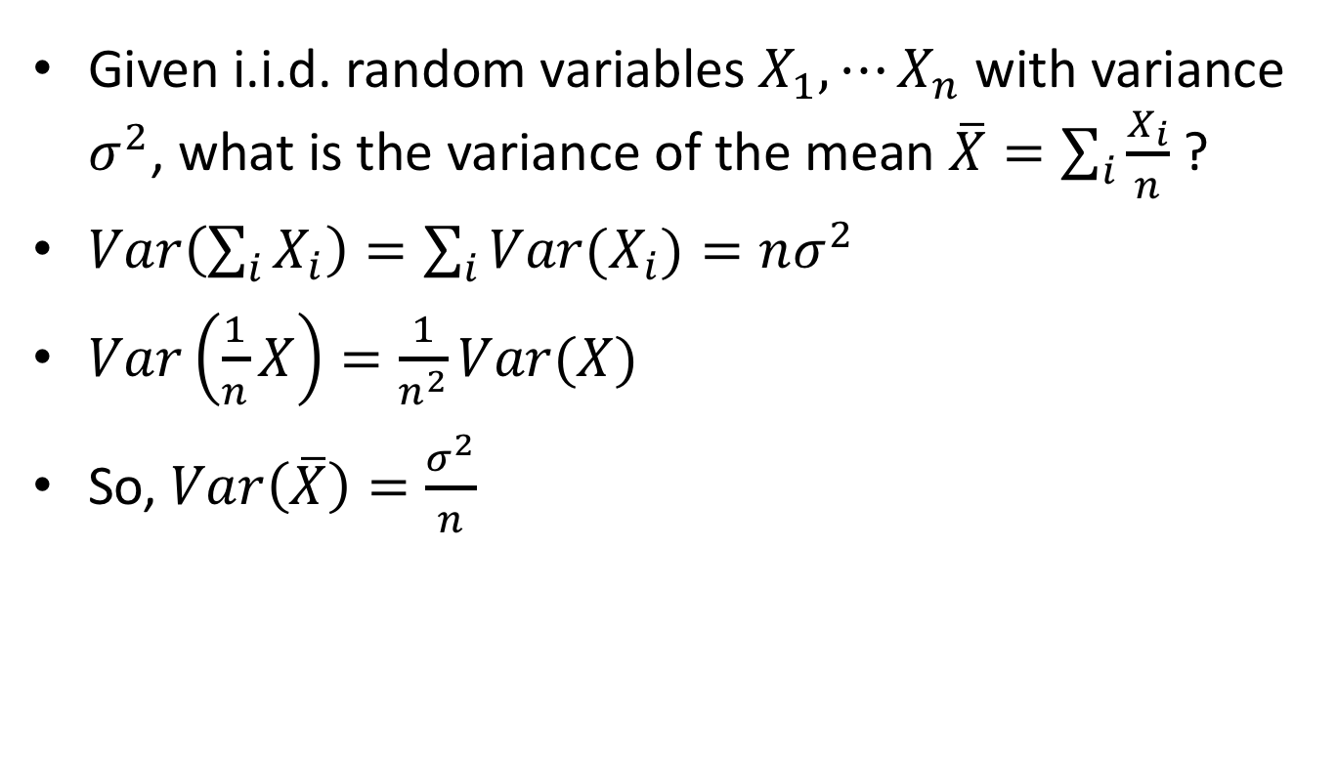
Calculating the Variance of a Mean Value
Given i.i.d. random variables $X_{1},⋯X_{n}$ with variance $σ^{2}$, what is the variance of the mean $\overline{X}=\sum_{i}{\frac{X_{i}}{n}}$ ?
$Var\left(\sum_{i}{X_{i}}\right)=\sum_{i}{Var(X_{i})}=nσ^{2}$
$Var\left(\frac{1}{n}X\right)=\frac{1}{n^{2}}Var(X)$
So, $Var\left(\overline{X}\right)=\frac{σ^{2}}{n}$

Slide 13
Bootstrapping is an efficient way to quantify the uncertainty of parameter estimates.

Slide 14
Bootstrapping Workflow
Fit model to data
Compute Residuals
Generate synthetic response data using the fitted model and randomly selected residuals.
Estimate model parameters for each synthetic data set.
Calculate parameter variances.

Slide 15
Generating a Synthetic Response Data
def generateData(y_obs, y_fit):
"""
:param np.array y_obs
:param np.array y_fit
:return np.array: bootstrap data
"""
residuals = y_obs - y_fit
length = len(y_obs)
residuals = residuals.reshape(length)
samples = np.random.randint(0, length, length)
result = y_fit + residuals[samples]
result = result.reshape(length)
return result

Slide 16
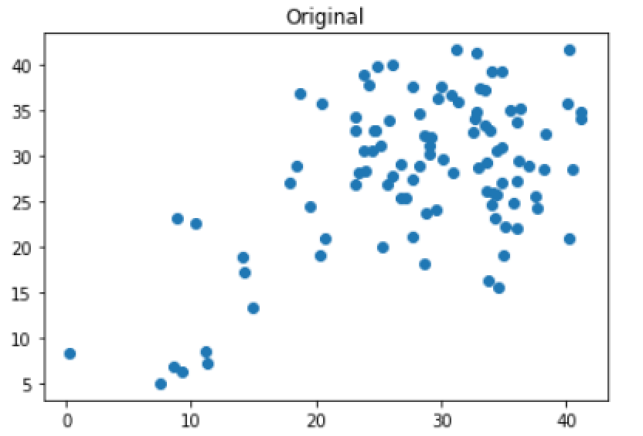
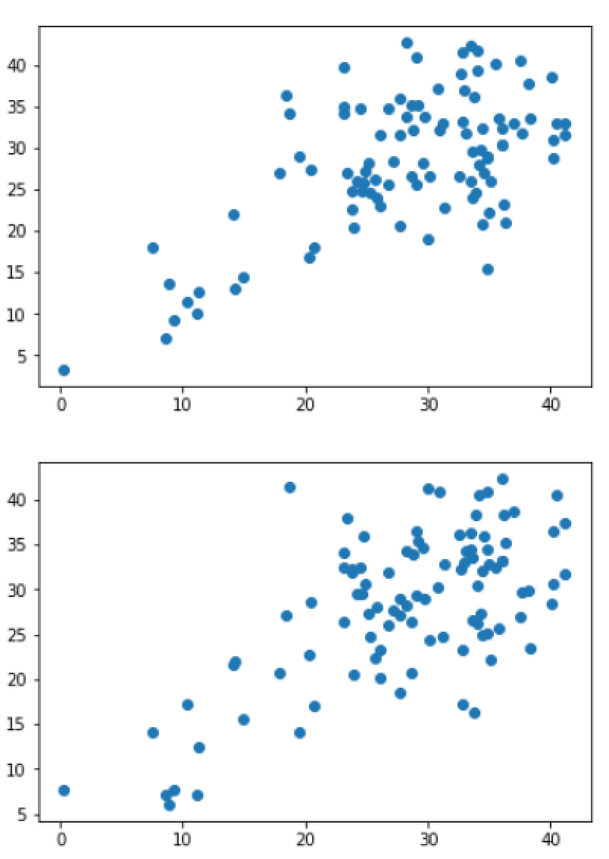
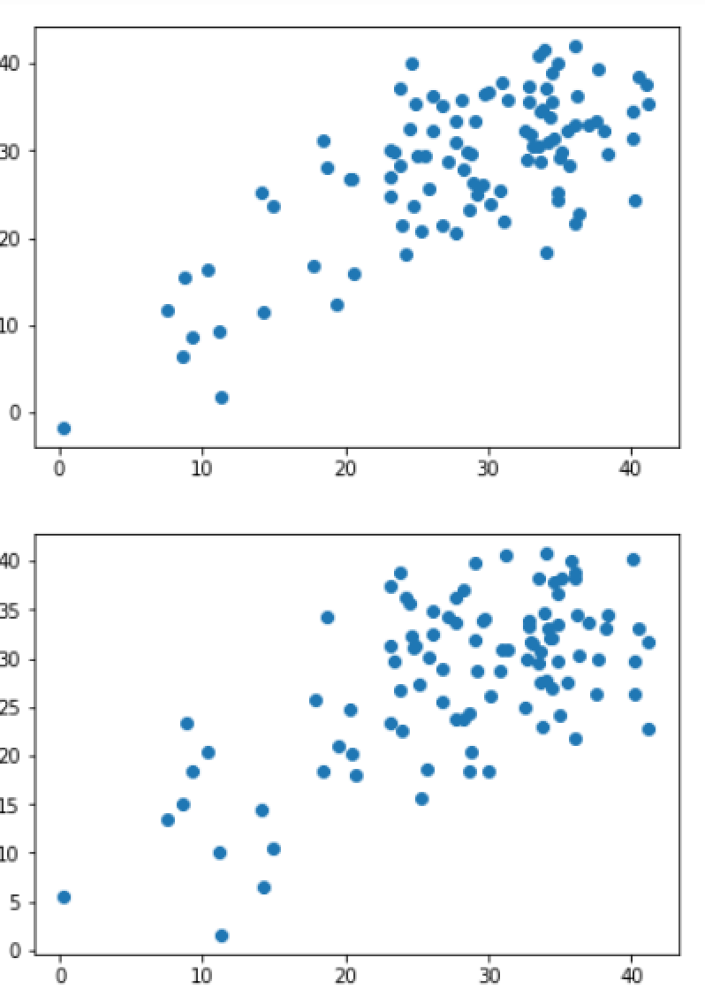
Examples of Synthetic Data

Slide 17
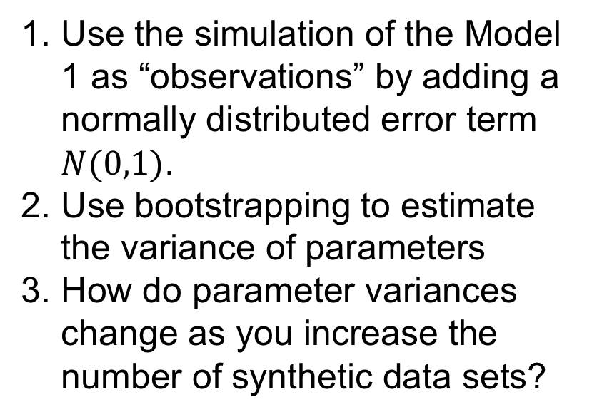
Exercise: Using Bootstrapping
Model 1
$$→A;v_{0}$$
$$A→B;k_{a}A$$
$$B→C;k_{b}B$$
$$C→;k_{c}C$$
$$v_{0}=10;k_{a}=0.4;$$
$$k_{b}=0.32;k_{c}=k_{a}$$
Regression Model
$$\hat{B}=b_{0}+a_{1}t+a_{2}t^{2}+a_{3}t^{3}$$
Use the simulation of the Model 1 as “observations” by adding a normally distributed error term $N(0,1)$.
Use bootstrapping to estimate the variance of parameters
How do parameter variances change as you increase the number of synthetic data sets?

